Slide 1
Foundation Studio
Submitted by Fiza Yasmeen
Submitted to Ma’am Usaila

Slide 2
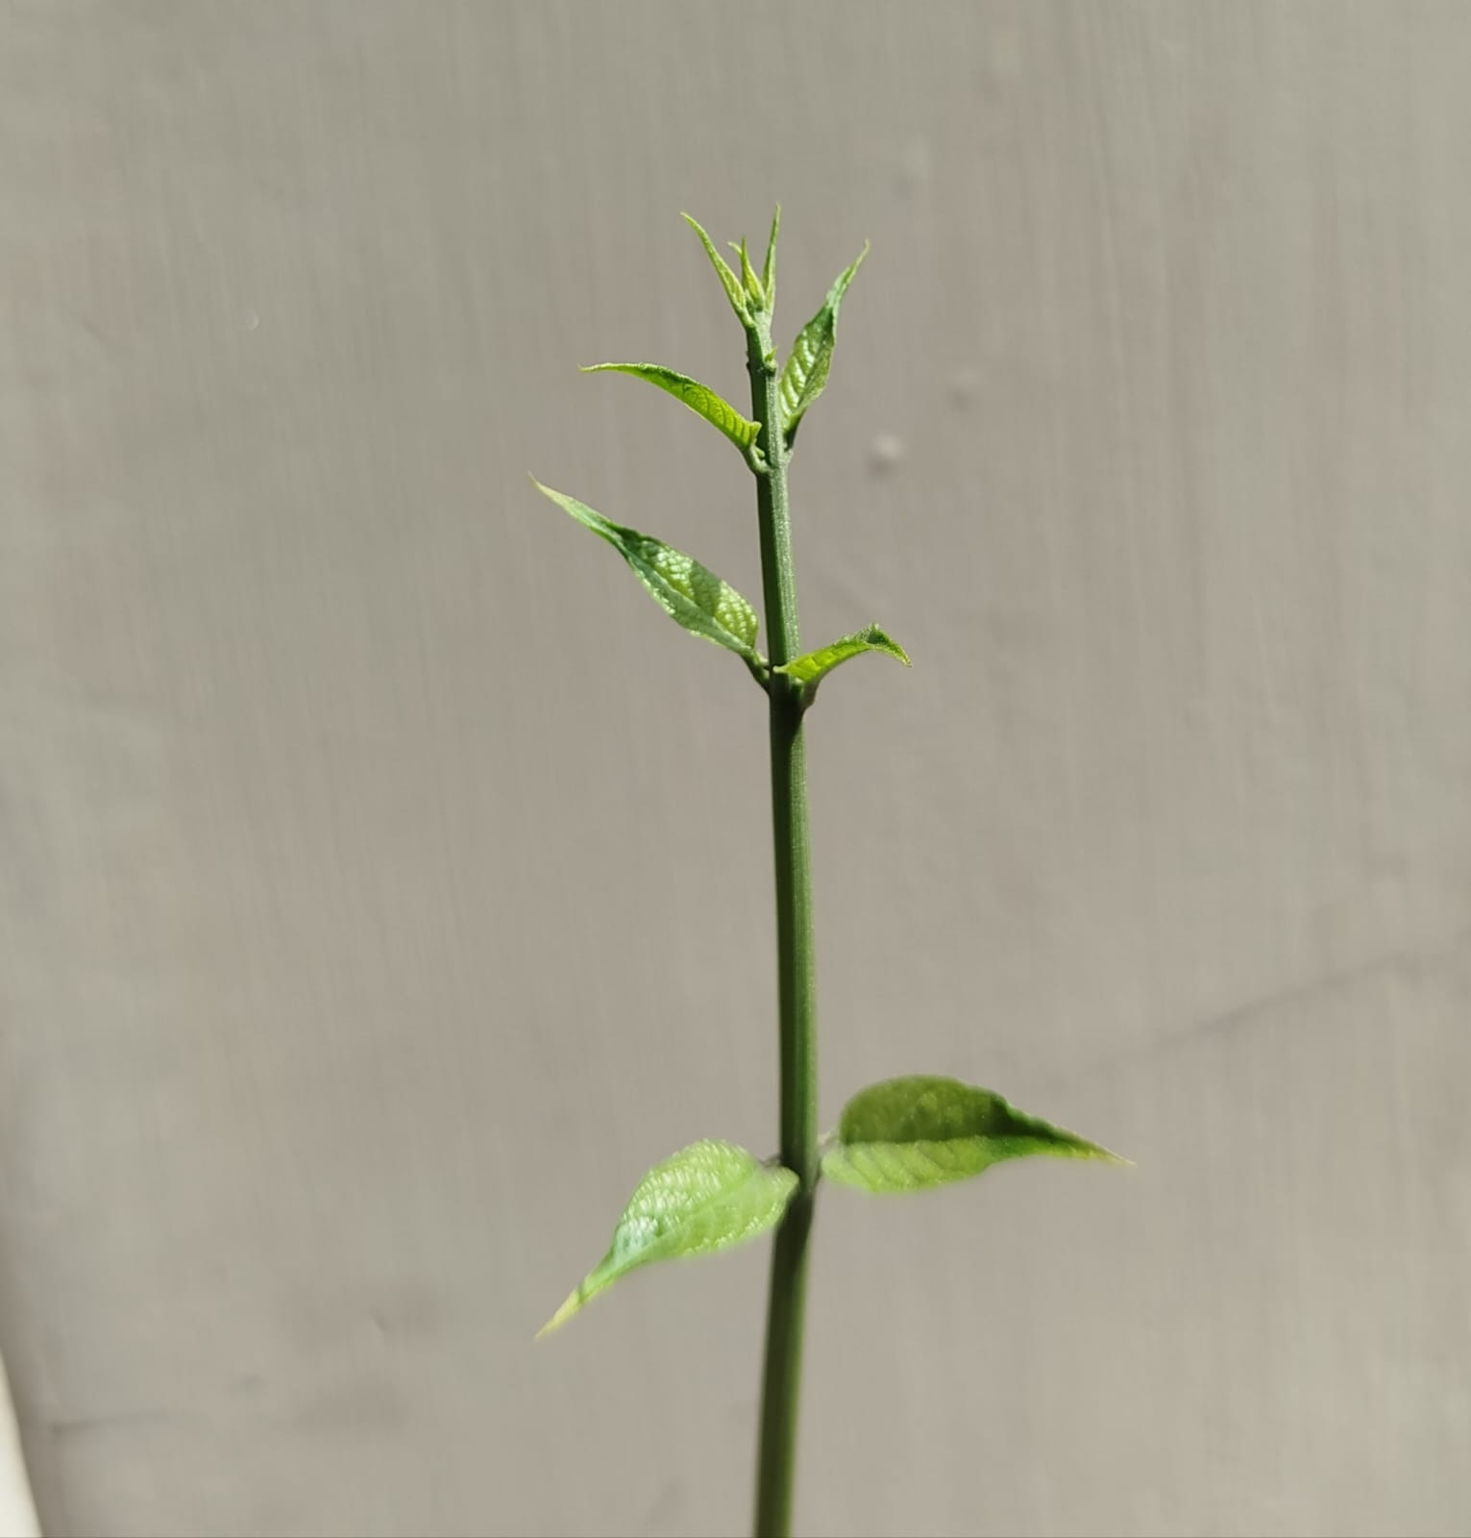
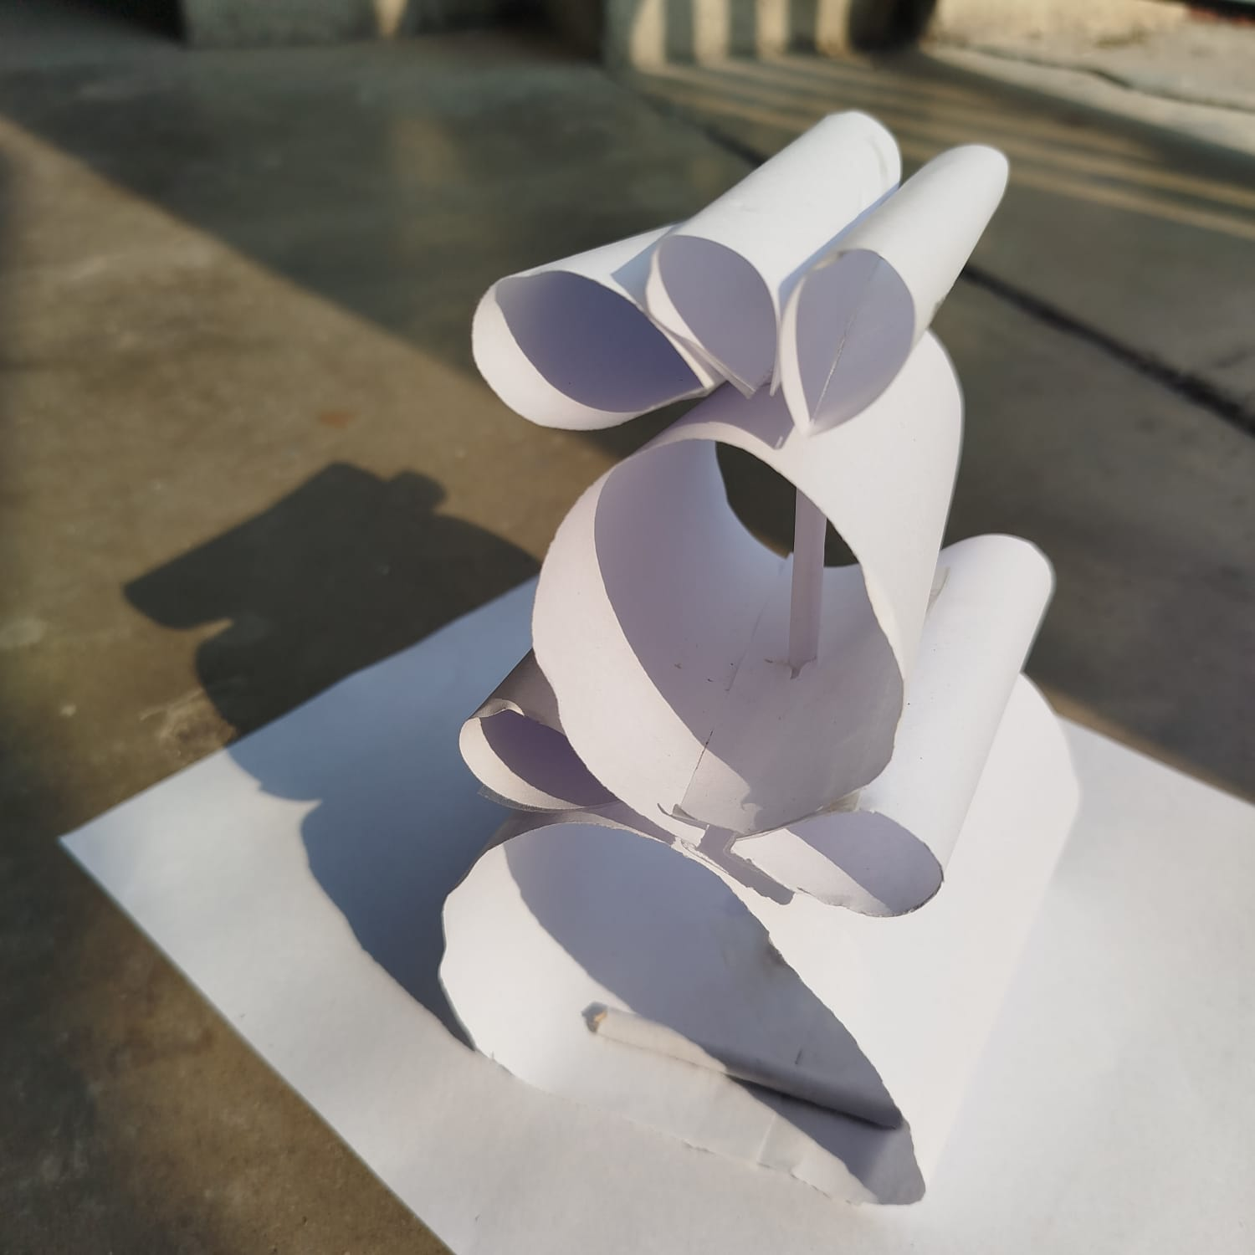
Project Transformation
Transformed an object into an architectural building
Imagined an object and turned it into an abstract building

