Slide 1

Descent’s Training
DESCENT
Learn, Share & Discuss

Slide 2
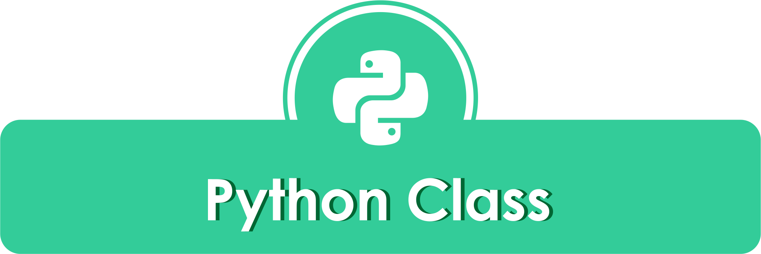



Let’s Discover the Treasure of Data #01
Mukhammad Kharis
Ari Rismansyah

Slide 3
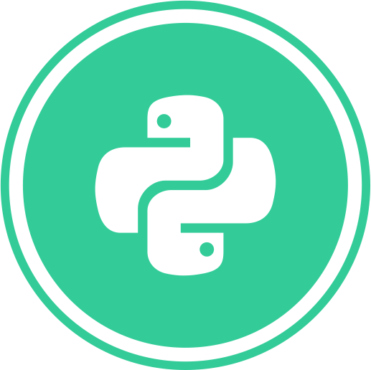
Let’s Discover the Treasure of Data #01
Python Programming
for Data Science
Introduction

Slide 4
Let’s Discover the Treasure of Data #01
print (“Hello World”)

Slide 5
Let’s Discover the Treasure of Data #01
Python is an open source, high-level programming language developed by Guido van Rossum in the late 1980s and presently administered by Python Software Foundation.

Slide 6
Let’s Discover the Treasure of Data #01
Why Python?
Python is an interpreted language
Python is an object-oriented language
Readability
Higher Productivity
Less Learning Time
Runs Across Different Platforms

Slide 7
Let’s Discover the Treasure of Data #01
Outline :
Installing Python & Packages
Interacting with Python
Python Syntax
Variables and Data Types
Basic Operator
Conditional Statements
Loops
User-defined Functions
Read Data (.csv or .xlsx)

Slide 8
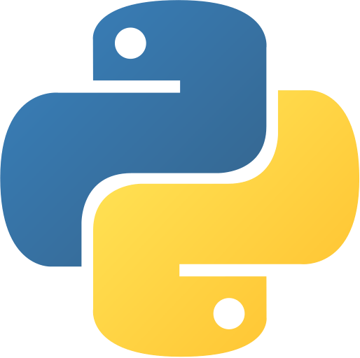


Let’s Discover the Treasure of Data #01
Installing
Python
Windows : https://www.python.org/downloads/
Mac-osx : https://www.python.org/downloads/mac-osx/
IDE
Anaconda : https://www.anaconda.com/
PyCharm : https://www.jetbrains.com/pycharm/

Slide 9
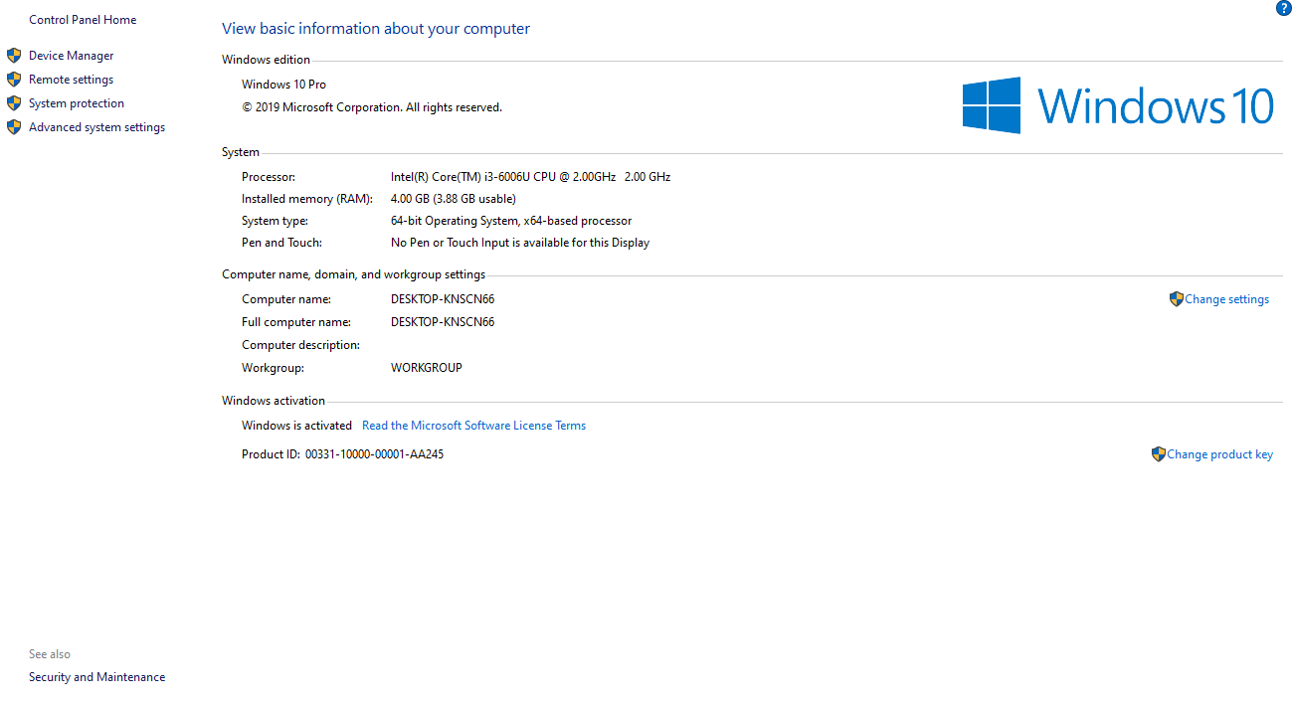
Let’s Discover the Treasure of Data #01
Checking Environment (Windows)
It’s recommended that you set up environment variables (in Windows)
Search PC then right click on “This PC” and click “Properties”
You will see basic information of your computer then click “Advanced System Settings”
The System Properties Window opens, then click “Environment Variables
Once Environment Variables opened, on “Path” click “Edit”
Check where the Anaconda Navigator is installed in your computer.

Slide 10
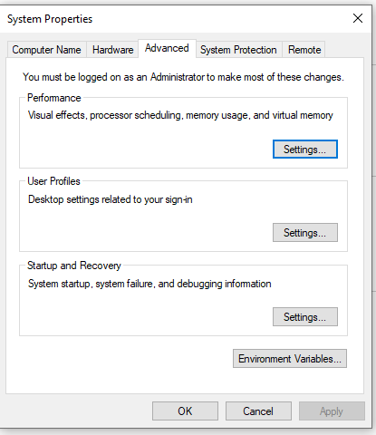
Let’s Discover the Treasure of Data #01
Checking Environment (Windows)
It’s recommended that you set up environment variables (in Windows)
Search PC then right click on “This PC” and click “Properties”
You will see basic information of your computer then click “Advanced System Settings”
The System Properties Window opens, then click “Environment Variables
Once Environment Variables opened, on “Path” click “Edit”
Check where the Anaconda Navigator is installed in your computer.

Slide 11
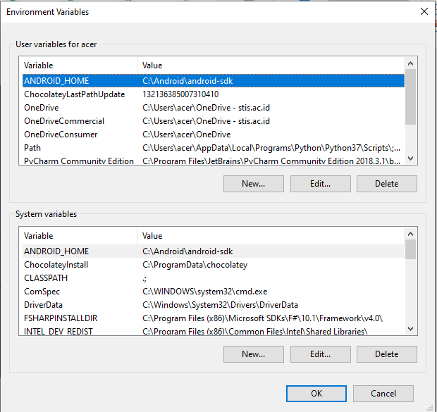
Let’s Discover the Treasure of Data #01
Checking Environment (Windows)
It’s recommended that you set up environment variables (in Windows)
Search PC then right click on “This PC” and click “Properties”
You will see basic information of your computer then click “Advanced System Settings”
The System Properties Window opens, then click “Environment Variables
Once Environment Variables opened, on “Path” click “Edit”
Check where the Anaconda Navigator is installed in your computer.

Slide 12
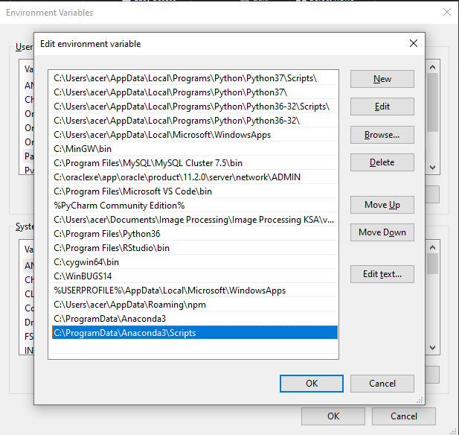
Let’s Discover the Treasure of Data #01
Checking Environment (Windows)
It’s recommended that you set up environment variables (in Windows)
Search PC then right click on “This PC” and click “Properties”
You will see basic information of your computer then click “Advanced System Settings”
The System Properties Window opens, then click “Environment Variables
Once Environment Variables opened, on “Path” click “Edit”
Check where the Anaconda Navigator is installed in your computer.

Slide 13


Let’s Discover the Treasure of Data #01
Find & Installing Packages
Find at :
PyPi : https://pypi.org/
Anaconda Cloud : https://anaconda.org/
Github
Installing use :
pip : pip install {package_name}
conda : conda install {package_name}
Anaconda Navigator

Slide 14
Let’s Discover the Treasure of Data #01
http://bit.ly/MateriPelatihan01

Slide 15
Let’s Discover the Treasure of Data #01
Required Packages
For Now :
Numpy
Pandas
Matplotlib
Seaborn
Scipy
Import packages :
import library_name as alias_name

Slide 16

Let’s Discover the Treasure of Data #01
Interacting With Python
Command Line :
Cmd or Terminal
Anaconda prompt
Jupyter :
Jupyter-notebook
Jupyter-lab

Slide 17
Let’s Discover the Treasure of Data #01
Python Syntax
Set of rules that defines how human users and the system should write and interpret a Python program.
Python keywords are reserved words in Python that should not be used as variable, constant, function name or identifier in your code.
RESERVED WORDS :
and, break, continue, del, else, exec, for, global, import, is , not, pass, raise, try, with, assert, class, def, elif, except, finally, from, if, in, lambda, or, print, return, while, yield

Slide 18
Let’s Discover the Treasure of Data #01
Python Syntax
Python Identifier :
A Python Identifier is a name given to a function, class, variable, module, or other objects that you’ll be using in your Python program.
Combination of uppercase letters, lowercase letters, underscores, and digits (0-9).
Special characters such as %, @, and $ are not allowed.
Should not begin with a number.
Case-sensitive
Cannot use Python keywords as identifiers.
Use underscores to separate multiple words

Slide 19
Let’s Discover the Treasure of Data #01
Python Syntax
Indentation :
A block of code can easily identified when you look at a Python program as they start on the same distance to the right.

Slide 20
Let’s Discover the Treasure of Data #01
Python Syntax
Comments :
starting the line with a hash (#) symbol.
Wrap multi-line comment with triple quotes (‘’’ comments‘’’)
Ctrl + /

Slide 21
Let’s Discover the Treasure of Data #01
Python Syntax
Variables :
A container that stores values that you can access or change.
A way of pointing to a memory location used by a program.
Just think of a name and declare it by assigning a value.

Slide 22
Let’s Discover the Treasure of Data #01
Data Types
Data Types :
String
Numeric e.g. (Int, Float, Octo, Hexa etc.)
Boolean (True & False)
Sequence Types (List, Tuples, range)
Dictionary
Binary Types (bytes, bytearray, memory view)

Slide 23
Let’s Discover the Treasure of Data #01
Data Types
Casting :
int(variable) - constructs an integer number from an integer literal, a float literal (by rounding down to the previous whole number), or a string literal (providing the string represents a whole number)
float(variable) - constructs a float number from an integer literal, a float literal or a string literal (providing the string represents a float or an integer)
str(variable) - constructs a string from a wide variety of data types, including strings, integer literals and float literals

Slide 24
Let’s Discover the Treasure of Data #01
String
Declare :
my_string = ‘ini adalah string’
Or
my_string = “ini adalah string”

Slide 25
Let’s Discover the Treasure of Data #01
String
Array of Char ? Indexing from 0
my_string = ‘ini adalah string’
my_string[0]
>> i

Slide 26
Let’s Discover the Treasure of Data #01
String
Concate : use (+)
my_string = “ini adalah string” + “ini tambahannya”

Slide 27
Let’s Discover the Treasure of Data #01
String
Getting the Size of Strings :
my_string = “ini adalah string”
len(my_string)

Slide 28
Let’s Discover the Treasure of Data #01
String
Slicing String:
You can create substrings with the slicing notation. You can do this by placing two indices (separated by a colon) within square brackets.
my_string = “ini adalah string”
my_string[0:2]
>> in
Indexing [0:2] -> 0 start inclusive & 2 end exclusive

Slide 29
Let’s Discover the Treasure of Data #01
String
Upper() and lower():
You can use the lower() function to print the string in lower case and upper() to print in upper case.
my_string1 = “ini adalah string”
print(my_string1.upper())
>> INI ADALAH STRING
my_string2 = “INI ADALAH STRING”
print(my_string2.lower())
>> ini adalah string

Slide 30
Let’s Discover the Treasure of Data #01
Numeric
Math operator:
+ Addition
- Subtraction
* Multiplication
/ Division
% Modulus
** Exponent
// Floor Division

Slide 31
Let’s Discover the Treasure of Data #01
Numeric
Comparison operator:
==
!=
<>
<
>
<=
>=

Slide 32
Let’s Discover the Treasure of Data #01
Boolean
Logical operator:
and Logical AND
or Logical OR
not Logical NOT

Slide 33
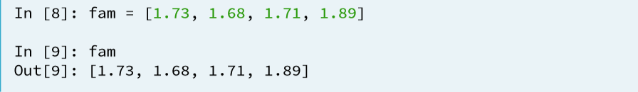
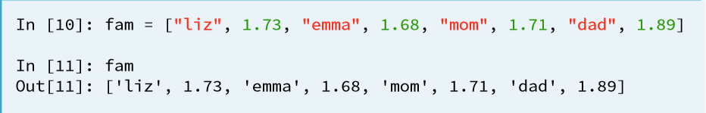
Let’s Discover the Treasure of Data #01
List
List :
A list is a data type that can be used to store any type and number of variables and information.

Slide 34
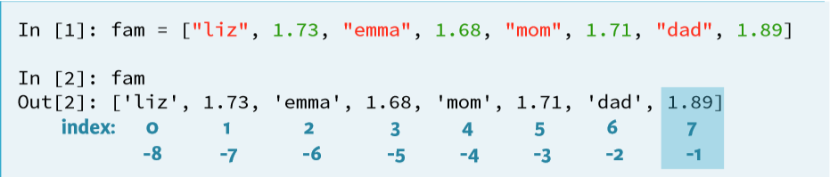
Let’s Discover the Treasure of Data #01
List
Subsetting List :
Zero based indexing

Slide 35
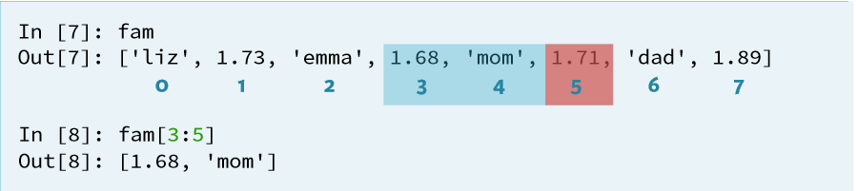
Let’s Discover the Treasure of Data #01
List
Slicing List :
[start : end] start inclusive, end exclusive

Slide 36
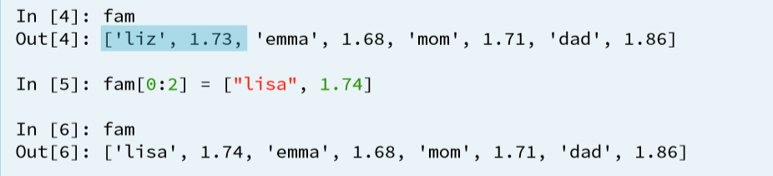
Let’s Discover the Treasure of Data #01
List
Manipulate List :
List mutable.

Slide 37
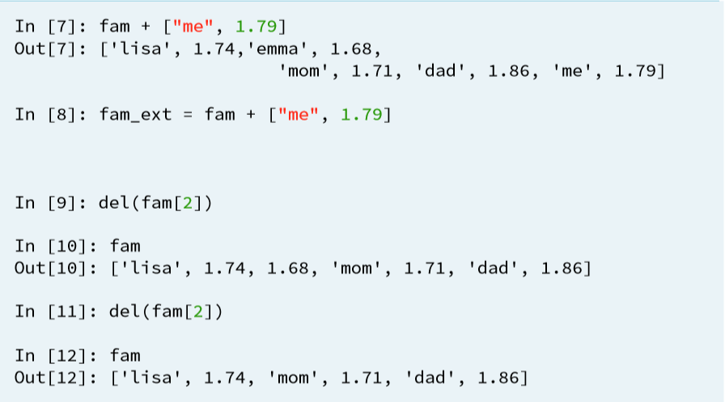
Let’s Discover the Treasure of Data #01
List
Adding & Remove :

Slide 38
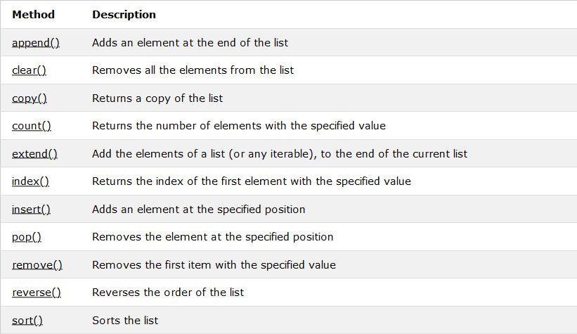
Let’s Discover the Treasure of Data #01
List
Methods :

Slide 39
Let’s Discover the Treasure of Data #01
Dictionary
Dictionary :
A dictionary is like a list but instead of looking up an index to access values, you’ll be using a unique key, which can be a number, string, or tuple.
Dictionary values can be anything but the keys must be an immutable data type.
A colon separates a key from its value and all are enclosed in curly braces. Here is the dictionary structure:

Slide 40
Let’s Discover the Treasure of Data #01
Dictionary
Dictionary :
d = {key_1 : a, key_2 : 2, key_3 : ab}

Slide 41
Let’s Discover the Treasure of Data #01
Tuples
Tuples :
Tuples are another kind of sequence that functions much like a list
They have elements which are indexed starting at 0
x = ('Glenn', 'Sally', 'Joseph')

Slide 42
Let’s Discover the Treasure of Data #01
Conditional Statements
Conditional Statements :
If, else, elif
Conditions :
Equals: a == b
Not Equals: a != b
Less than: a < b
Less than or equal to: a <= b
Greater than: a > b
Greater than or equal to: a >= b

Slide 43
Let’s Discover the Treasure of Data #01
Conditional Statements
If, else, elif :
if {condition}:
{command}
elif {condition}:
{command}
else:{command}
* {} diisi

Slide 44
Let’s Discover the Treasure of Data #01
Loops
Loops :
While (we can execute a set of statements as long as a condition is true)
For (iterating over a sequence)

Slide 45
Let’s Discover the Treasure of Data #01
Loops
While :
i = 1
while i < 6:
print(i)
i += 1

Slide 46
Let’s Discover the Treasure of Data #01
Loops
For :
fruits = ["apple", "banana", "cherry"]
for x in fruits:
print(x)

Slide 47
Let’s Discover the Treasure of Data #01
User-defined Functions
Function :
A function is a set of statements that perform a specific task, a common structuring element that allows you to use a piece of code repeatedly in different parts of a program.
The use of functions improve a program’s clarity and comprehensibility and makes programming more efficient by reducing code duplication and breaking down complex tasks into more manageable pieces.
Functions are also known as routines, subroutines, methods, procedures, or subprograms.
They can be passed as arguments, assigned to variables, or stored in collections.

Slide 48
Let’s Discover the Treasure of Data #01
User-defined Functions
Function :
def function_name(parameter_list):
function_body/statements

Slide 49
Let’s Discover the Treasure of Data #01
Read Data from File (.csv or .xlsx)
import pandas
data = pandas.read_csv( file_path, sep = separator)
data = pandas.read_excel( file_path)

Slide 50
Let’s Discover the Treasure of Data #01
Data Info
data.info()

Slide 51
Let’s Discover the Treasure of Data #01
Data Summary
data.describe()

