Slide 1
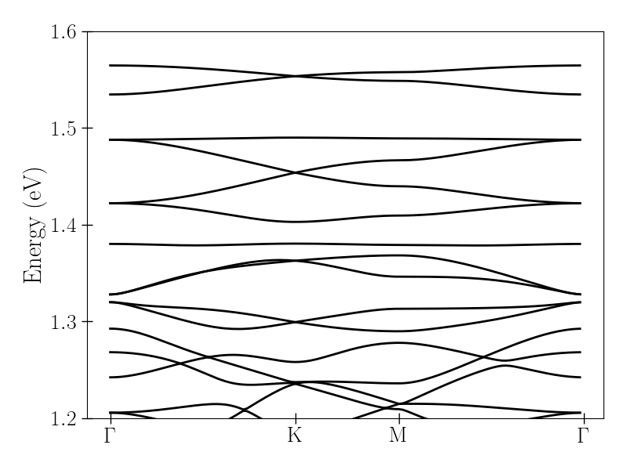
MoS2: sp2 hybridisation
S
$Ω=99meV$
p_{x},p_{y}

Slide 2
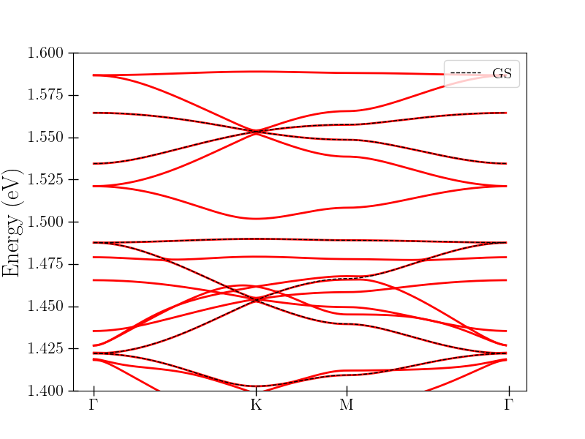
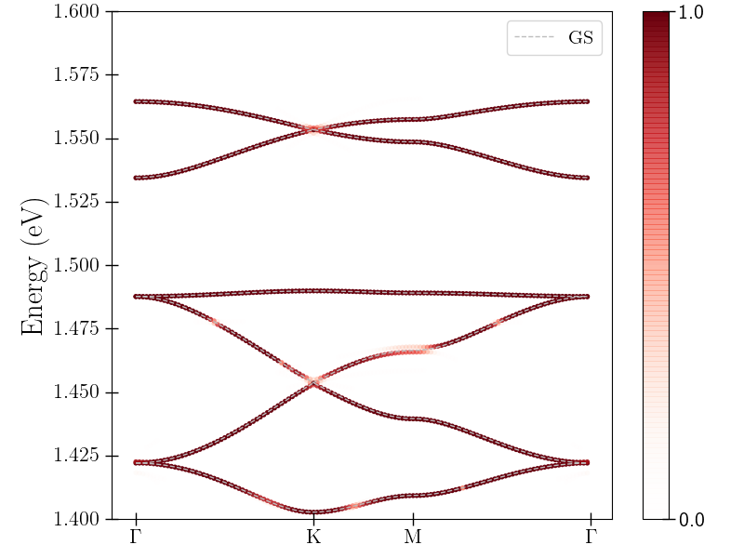
Floquet bandstructure
Circular, A=0.01 a₀⁻¹ (~4 MV/m),
$Ω=99meV$
Overlap with original bands

Slide 3
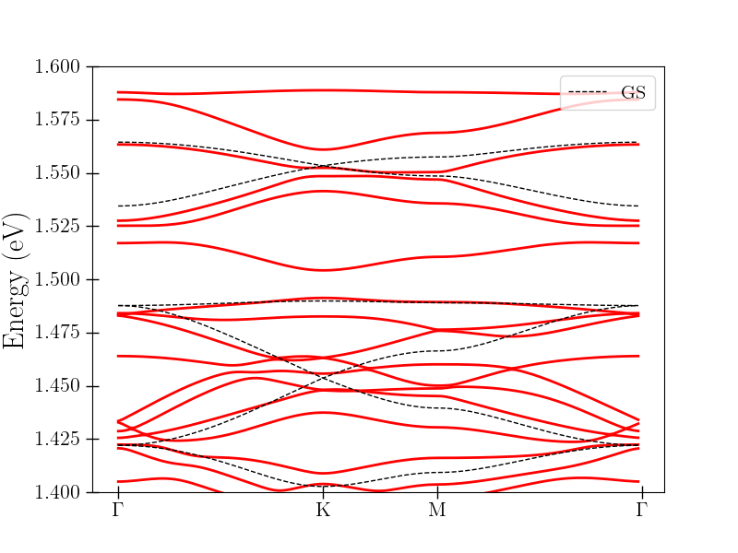
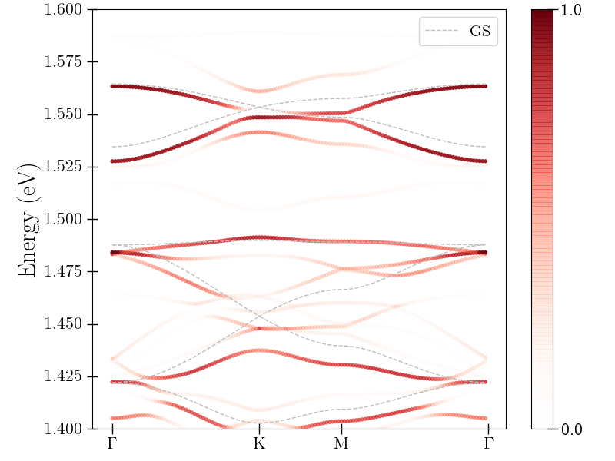
Floquet bandstructure
Circular, A=0.1 a₀⁻¹ (~40 MV/m),
$Ω=99meV$
Overlap with original bands

Slide 4
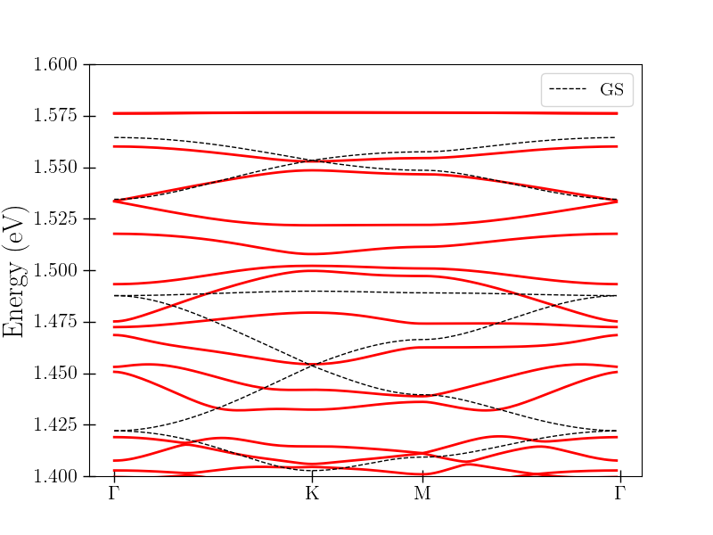
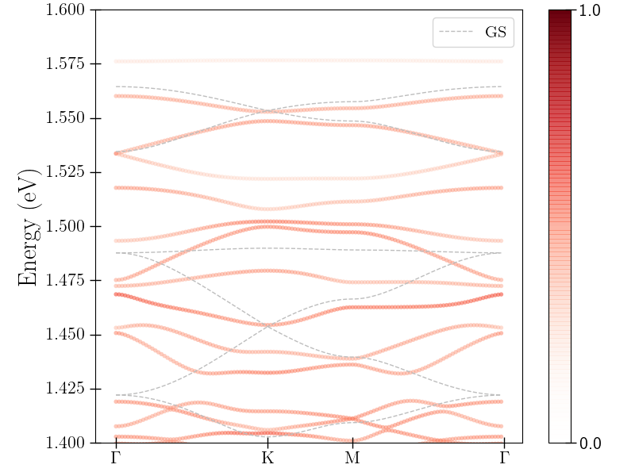
Floquet bandstructure
Circular, A=0.5 a₀⁻¹ (~200 MV/m),
$Ω=99meV$
Overlap with original bands

Slide 5
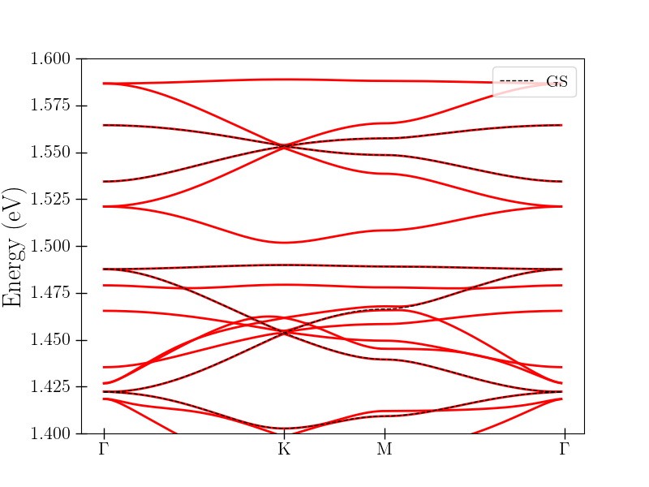
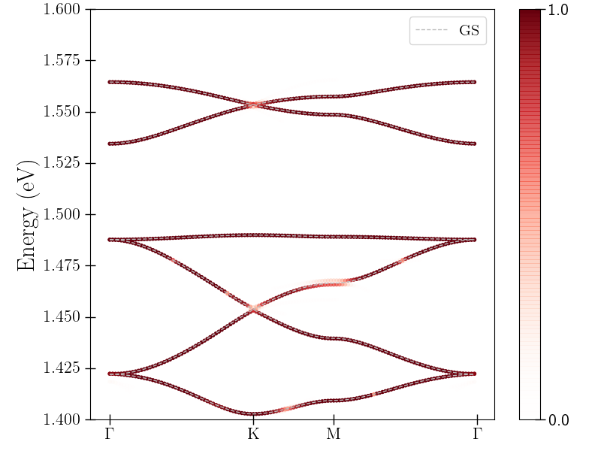
Floquet bandstructure
Linear (x=y), A=0.01 a₀⁻¹ (~4 MV/m),
$Ω=99meV$
Overlap with original bands

Slide 6
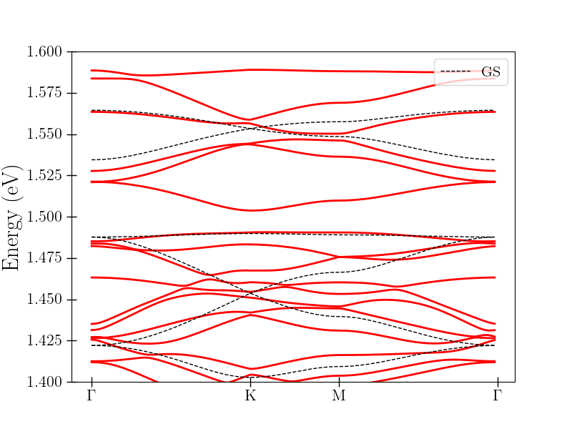
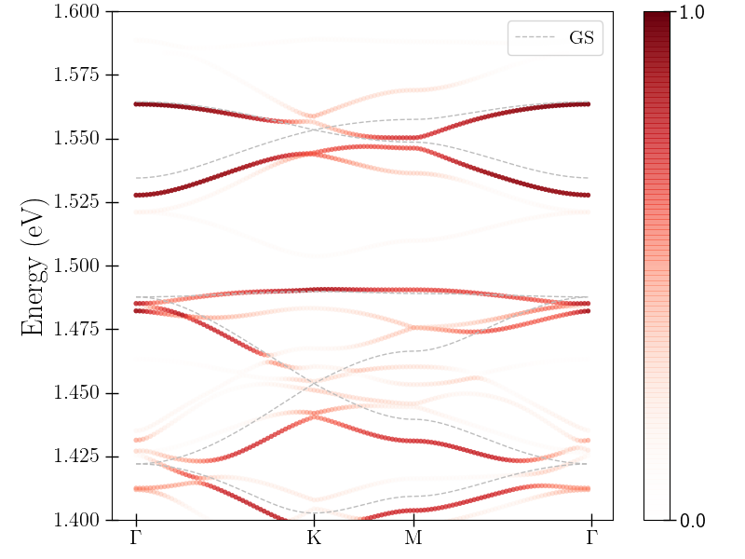
Floquet bandstructure
Linear (x=y), A=0.1 a₀⁻¹ (~40 MV/m),
$Ω=99meV$
Overlap with original bands

Slide 7
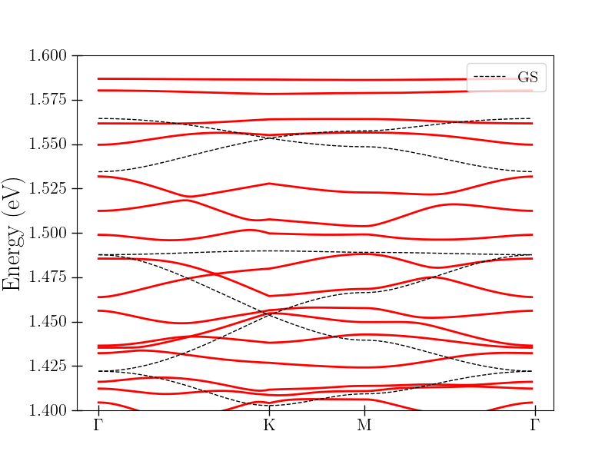
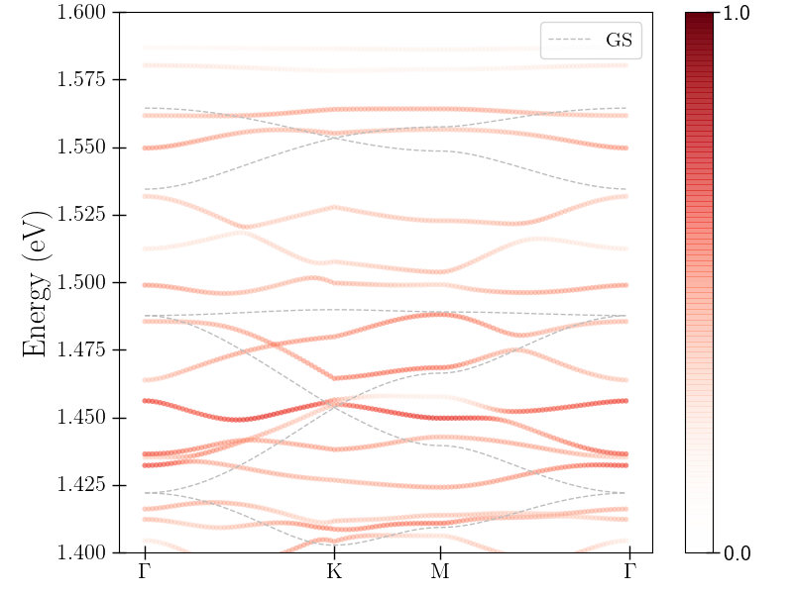
Floquet bandstructure
Linear (x=y), A=0.5 (~200 MV/m),
$Ω=99meV$
Overlap with original bands

