Slide 1
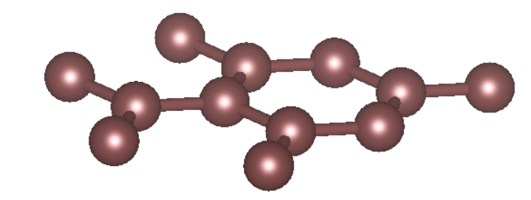
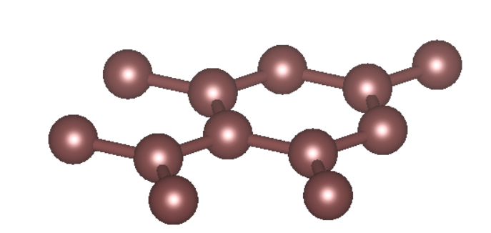

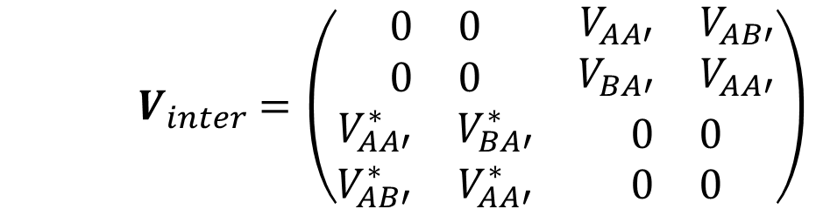


Moire (interlayer) potential of the twisted bilayer system:
$$H=H_{t}+H_{b}+V_{inter}$$
$$V_{AA′}$$
$$V_{AB′}$$
$V_{inter}$ $=\left(\begin{matrix}\begin{matrix}0 & 0 \\ 0 & 0\end{matrix} & \begin{matrix}V_{AA′} & V_{AB′} \\ V_{BA′} & V_{AA′}\end{matrix} \\ \begin{matrix}V_{AA′}^{∗} & V_{BA′}^{∗} \\ V_{AB′}^{∗} & V_{AA′}^{∗}\end{matrix} & \begin{matrix}0 & 0 \\ 0 & 0\end{matrix}\end{matrix}\right)$

Slide 2
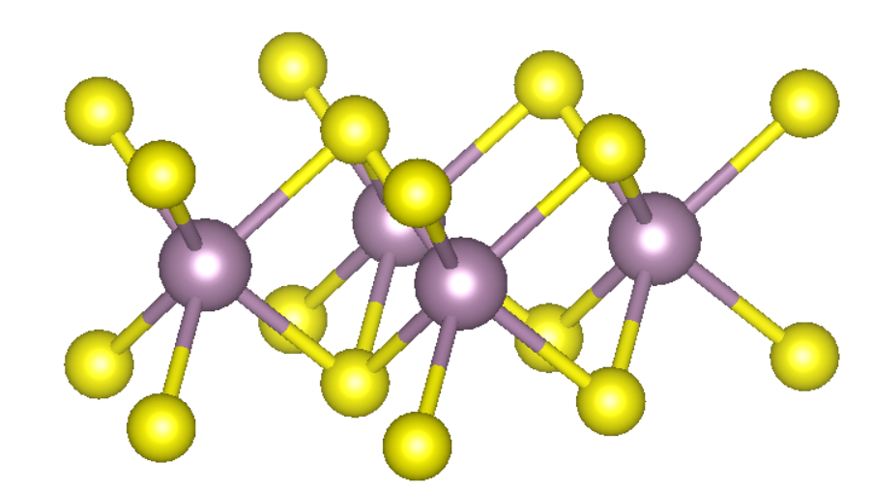
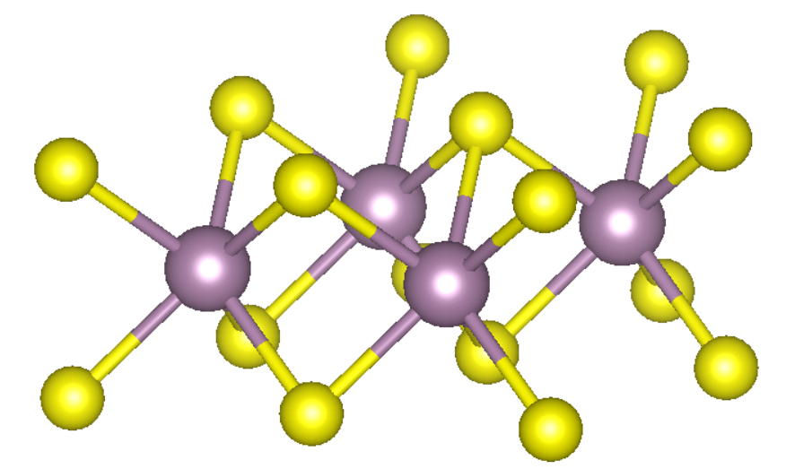


Moire (interlayer) potential of the twisted bilayer system:
$$H=H_{t}+H_{b}+V_{inter}$$
$V_{inter}$ $=\left(\begin{matrix}\begin{matrix}0 & 0 \\ 0 & 0\end{matrix} & \begin{matrix}V_{AA′} & V_{AB′} \\ V_{BA′} & V_{AA′}\end{matrix} \\ \begin{matrix}V_{AA′}^{∗} & V_{BA′}^{∗} \\ V_{AB′}^{∗} & V_{AA′}^{∗}\end{matrix} & \begin{matrix}0 & 0 \\ 0 & 0\end{matrix}\end{matrix}\right)$
$$V_{AA′}$$
$$V_{AB′}$$

Slide 3


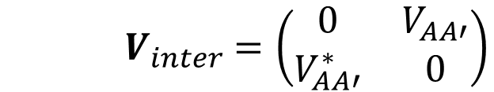



Moire (interlayer) potential of the twisted bilayer system:
$$H=H_{t}+H_{b}+V_{inter}$$
$V_{inter}$ $=\left(\begin{matrix}0 & V_{AA′} \\ V_{AA′}^{∗} & 0\end{matrix}\right)$
$$V_{AA′}$$
$$φ_{A}=φ_{A′}$$
$$H=H_{t}+V_{AA′}$$
$$H$$
$$φ_{A}=−φ_{A′}$$
$$H=H_{t}−V_{AA′}$$

Slide 4
Moire (interlayer) potential of the twisted bilayer system:
$$H=H_{t}+H_{b}+V_{inter}$$
$V_{inter}$ $=\left(\begin{matrix}0 & V_{AA′} \\ V_{AA′}^{∗} & 0\end{matrix}\right)$
$$V_{AA′}$$
$$φ_{A}=φ_{A′}$$
$$H=H_{t}+V_{AA′}$$
$$H$$
$$φ_{A}=−φ_{A′}$$
$$H=H_{t}−V_{AA′}$$

Slide 5
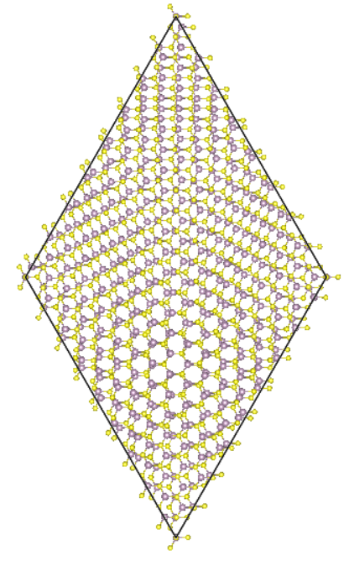
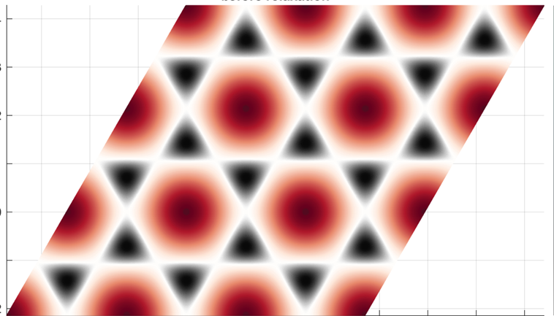
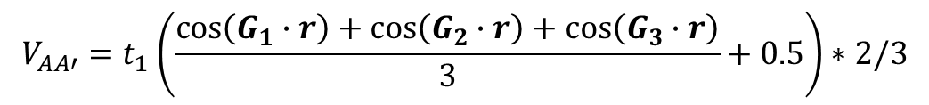
Moire (interlayer) potential of the twisted bilayer system:
G₁
G₃
G₂
$$V_{AA′}=t_{1}\left(\frac{cos\left(G_{1}∙r\right)+cos\left(G_{2}∙r\right)+cos\left(G_{3}∙r\right)}{3}+0.5\right)∗2/3$$

Slide 6
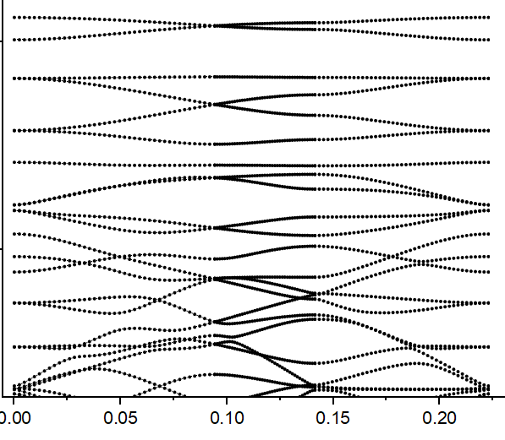
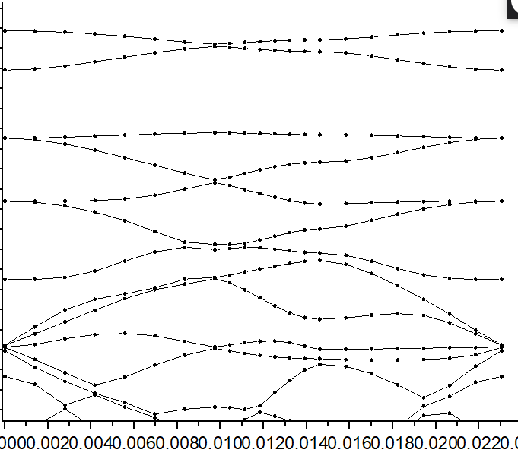
TB Lattice model with superlattice potential
DFT band structure at 2.65 degree

Slide 7
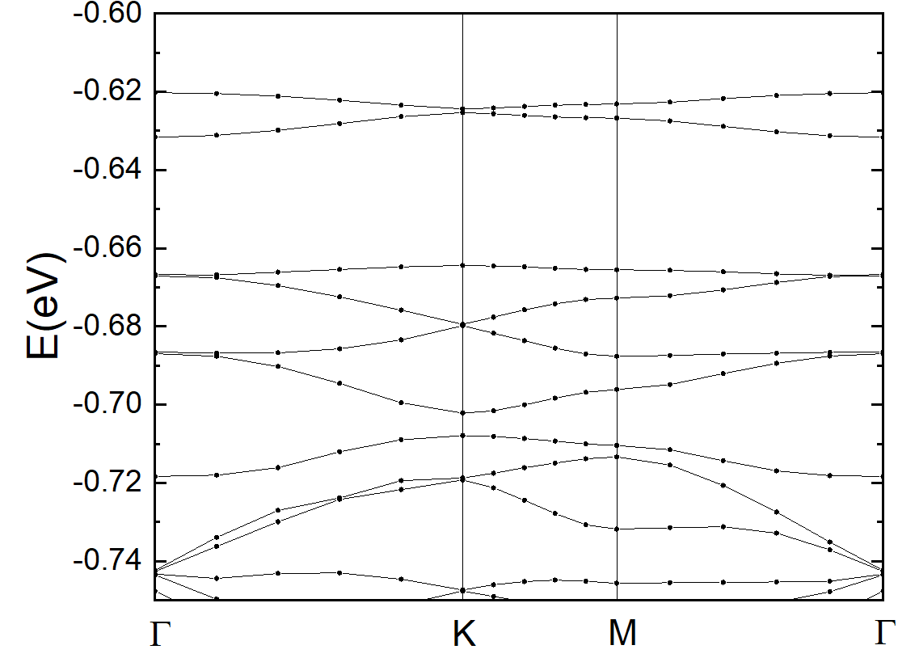
DFT band structure at 2.28 degree
S
p_{x},p_{y}
S
p_{x},p_{y}
sp²
Coupled/hybridized

Slide 8
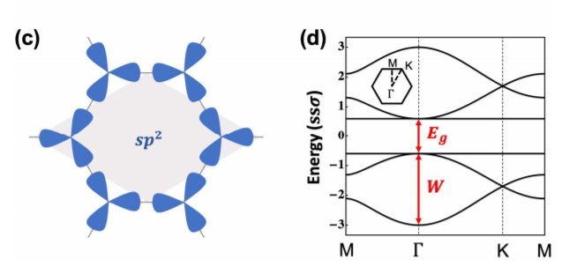
Floquet induced Sp2 kagome lattice
DFT band structure at 2.28 degree
S
p_{x},p_{y}
S
S
p_{x},p_{y}
sp²
Coupled/hybridized
p_{x},p_{y}

