Slide 1
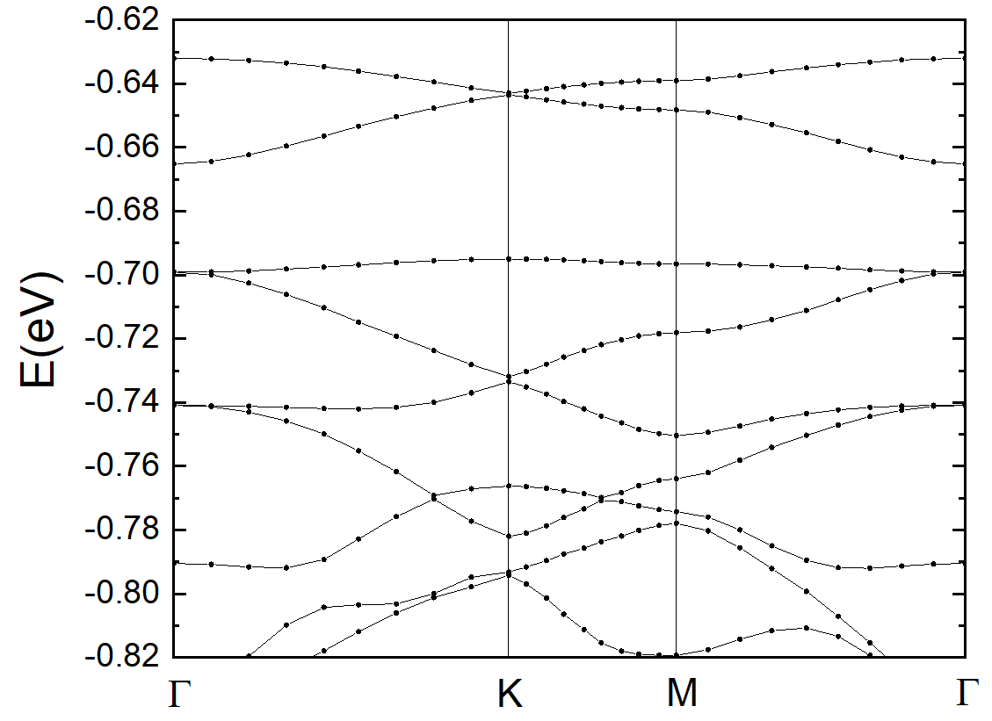
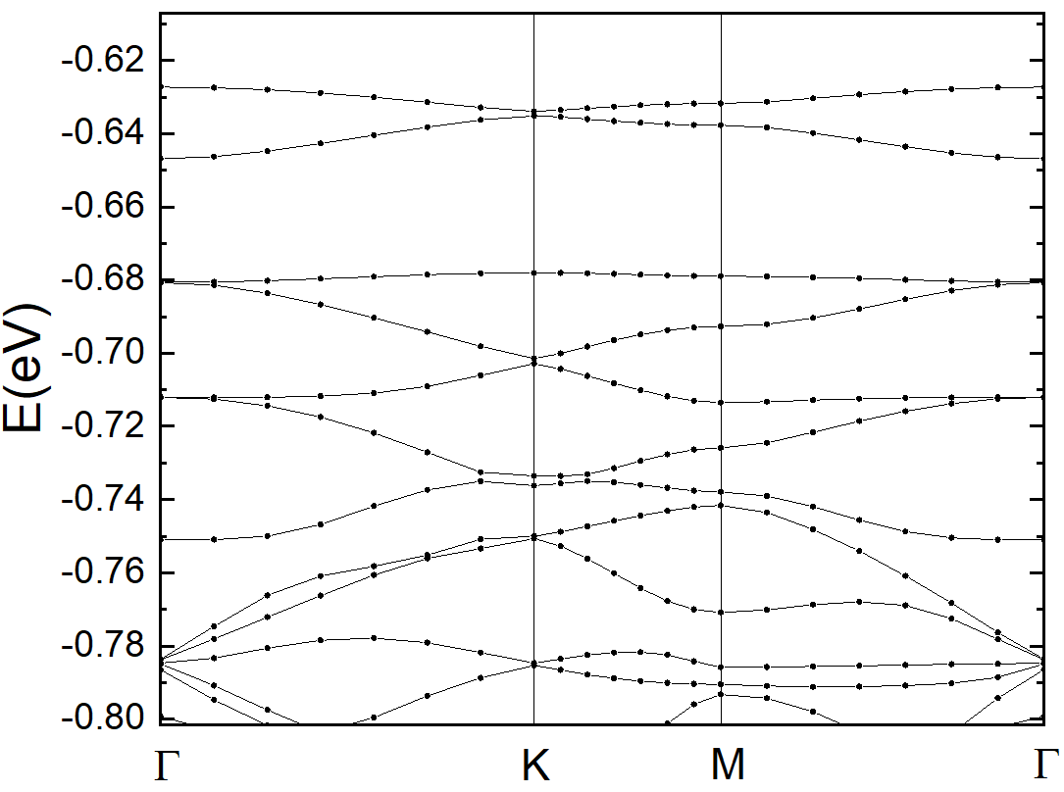
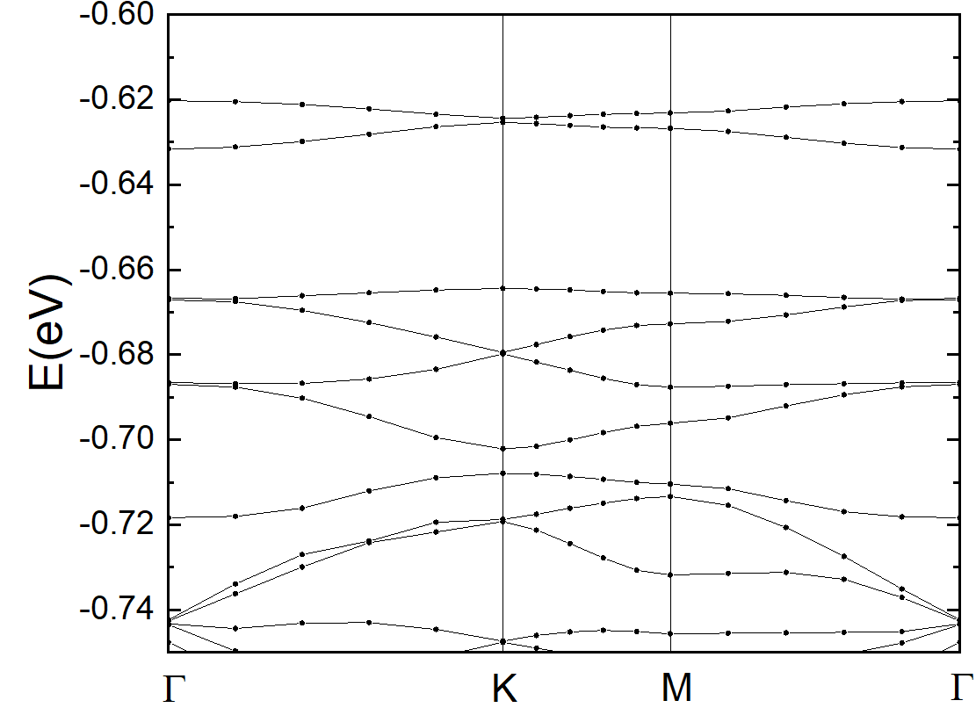
Twisted bilayer MoS2 DFT band structures
3.15°
2.65°
2.28°

Slide 2
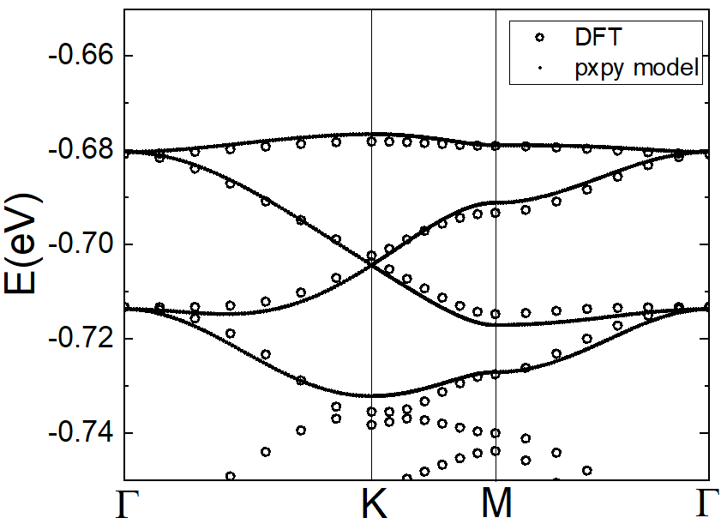
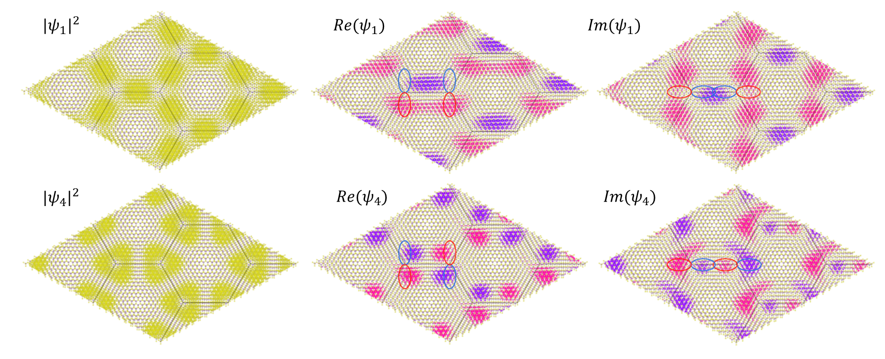
(a)
(b)
(a)DFT band structure of twisted MoS2 at 3.15 degree and the fitting with px-py graphene model, (b) Cartoon showing the px-py graphene model, (c)Module square, real and imaginary part of the wavefunctions from band 1 and 4 at the K point calculated with DFT. The wavefunctions are consistent with the expectation of the px-py graphene model (indicated with solid lines).
A
B
1
+
p_{x}
2
-
p_{y}
3
2.65°
4
(c)
+
-

Slide 3
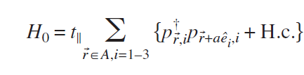


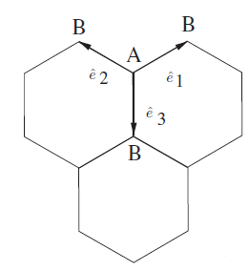

For the fitting, include two terms in the pxpy model:
Hopping parallel to bond direction
Hopping perpendicular to bond direction
Contribution form t|| and t_{ꓕ}, and include up to second nearest neighbor hopping:
The nearest neighbor hopping: t||=t₀; t_{ꓕ}=0.25t₀
The second nearest neighbor hopping: t’||=0.07t₀; t’_{ꓕ}=-0.04*t₀

