Slide 1
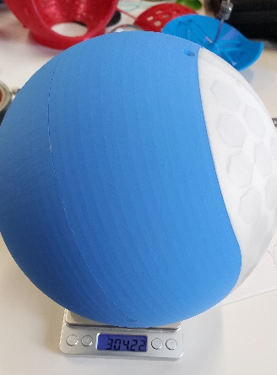
Assembly Guide Rigid Baseball Version
Material | PLA
Shell design | Baseball
Weight including suspension | 304g
Wall thickness | 3mm
Infill | 15%
Connection method | Screws

Slide 2
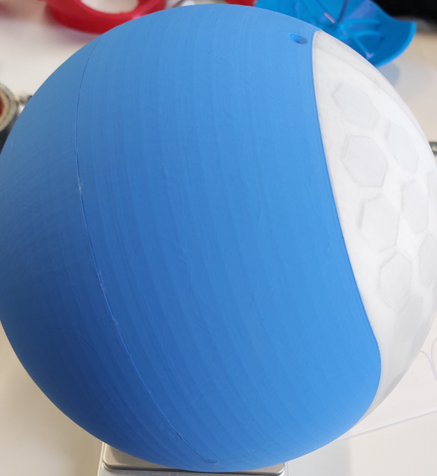
Improvements
Move location of the hole as indicated in the picture, to avoid splitting the two transparent shells. Same for the hole on the other side.
Add countermasses to the shell and print them with the shell

Slide 3
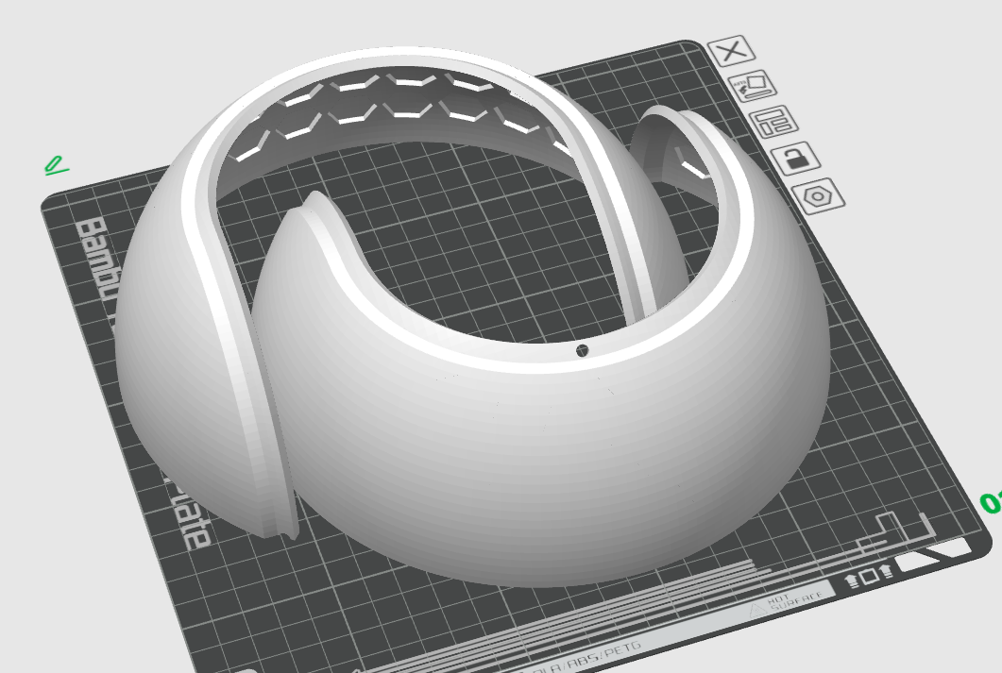
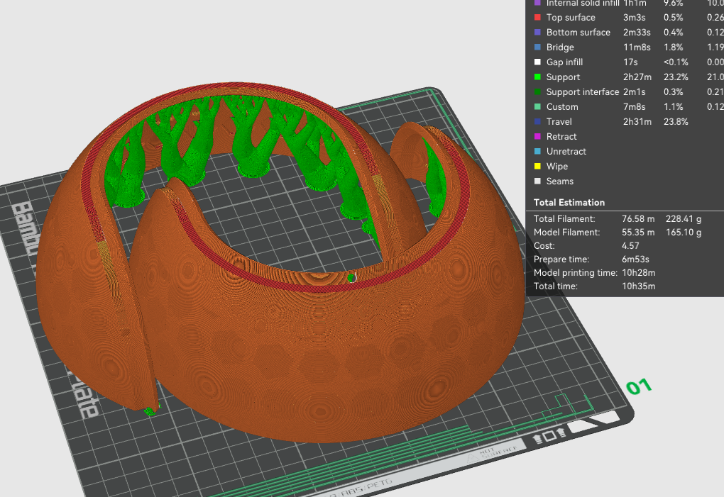
Printing the shell
Print settings
See print settings for PLA
Infill rate is 15%
Used tree support for best results with overhang
You can print two at the time

Slide 4
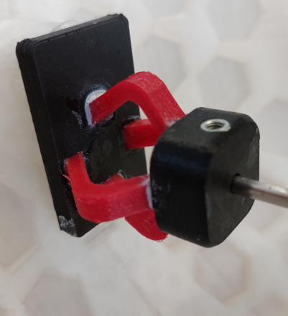
Printing the suspension
Print settings
Bending parts (red) out of TPU
Connection to shell and connection to axis out of PLA
See PLA and TPU print settings
Print bending parts on their sides for most strength
PLA
TPU

Slide 5
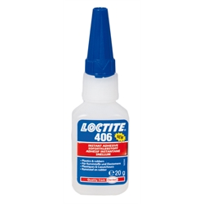
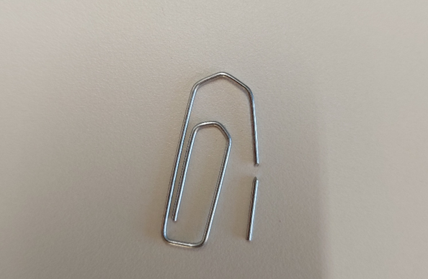
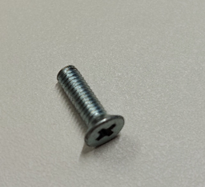
Assembly shell
M3 10mm (length including the head)
Loctite 406 instant glue
M3 Inserts
Put alignment pins in one half
Glue shells together
Melt inserts in bottom shell

Slide 6
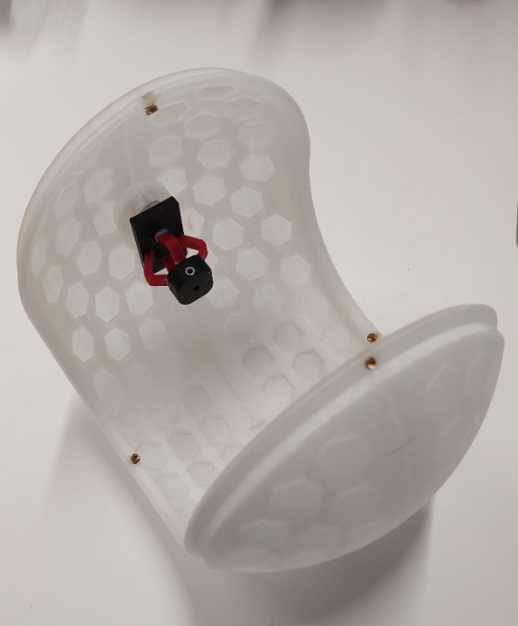
Assembly suspension
Glue in bending parts with instant glue or flexible glue
Make sure to have the insert part facing upwards like in the picture. Otherwise fixating the axis is harder
Glue the whole suspension in the shell with the hot glue gun
This allows you to take it out if needed, but stays in place for general use

