Slide 1
Zombies!
By: Charles Carlson
Dustin Dodson
Mike Moss

Slide 2
How We Got Started
Zombie survival game.
Horde mode style play.
Arcade attributes.
Challenging game play.
Didn’t want to make graphics or sounds.
Spawning system.
Later on port to DS.
All trademarks belong to their rightful owners.

Slide 3
Libraries
Spritelib – Graphics
Soil – Reads image files.
OpenGL – Draws things on screen.
irrKlang - Sound

Slide 4
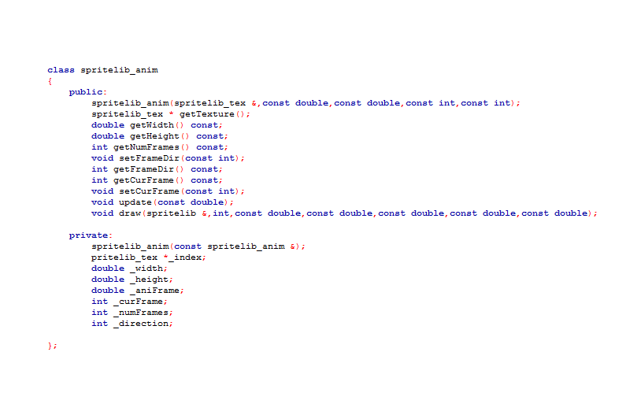
Spritelib Additions
Animations

Slide 5
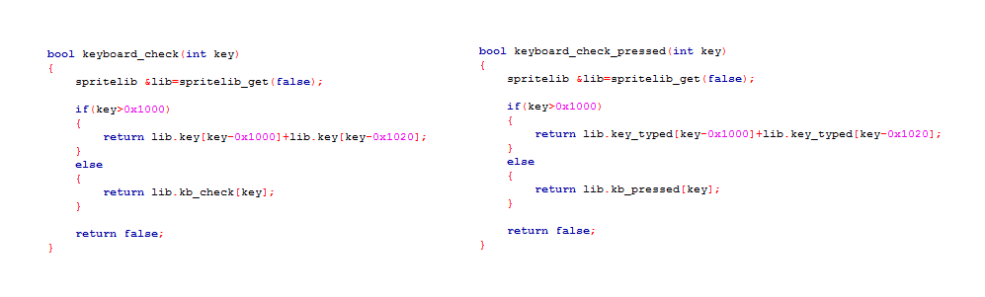
Spritelib Additions
Inputs

Slide 6
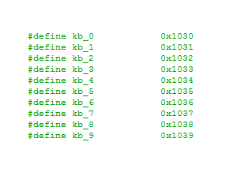
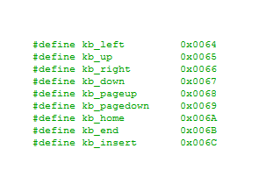
Spritelib Additions
Inputs Continued

Slide 7
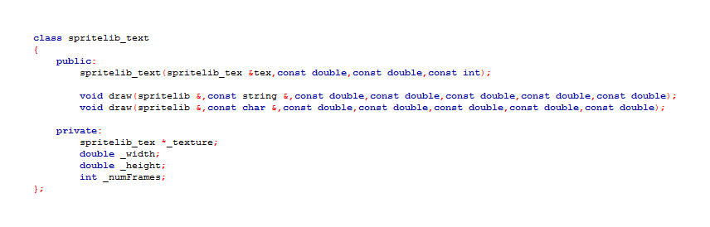
Spritelib Additions
Text

Slide 8
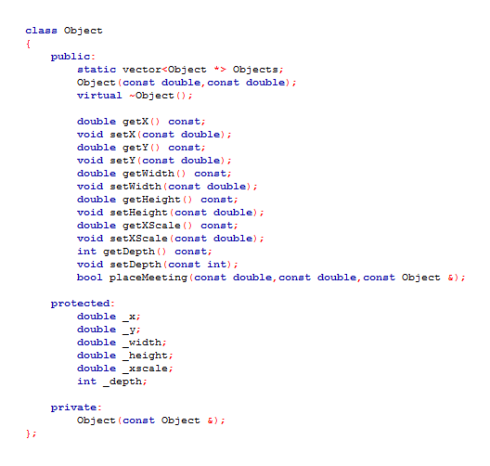
Object Structure

Slide 9
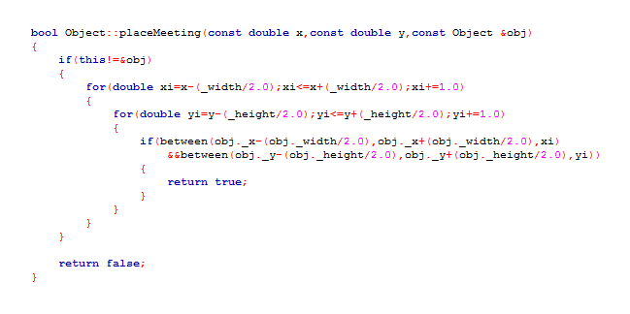
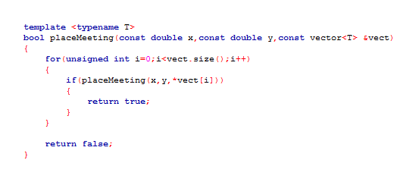
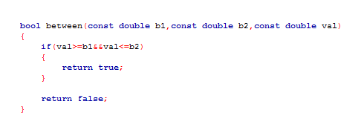
Object Functions

Slide 10
Object Children
Player
Zombie
Barricade
Effect
Pickup
Each had their own static vector.

Slide 11
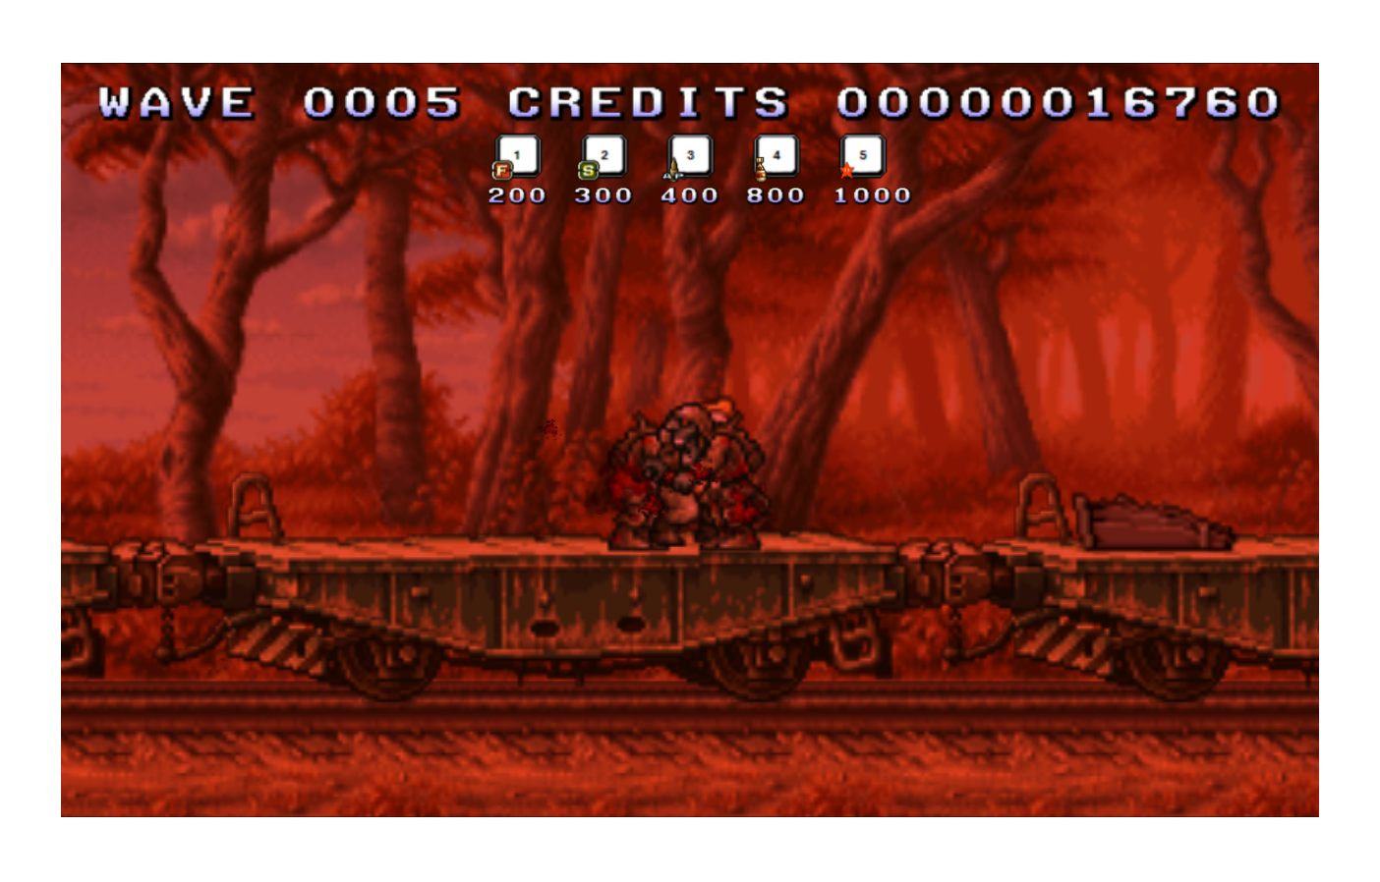
Challenges
Red Flashing Screen

Slide 12
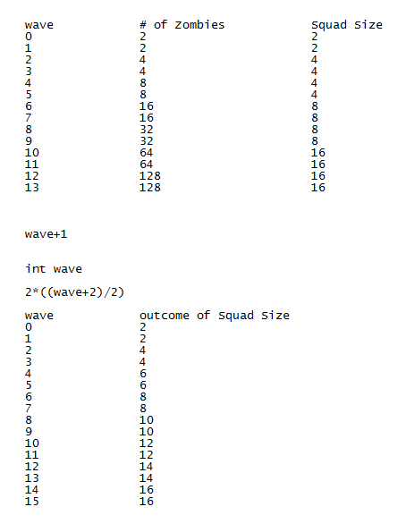
Challenges
Spawn Rates

Slide 13



Challenges
Sprite Alignment

Slide 14

Challenges
Run Speed on Different Computers

Slide 15
Bugs and Other Problems
Corrupted/Incorrectly Formatted Sprite Files
Corrupted Sound Files
Repeated Variable Names
SVN Issues
Deleting Libraries
File Renaming

Slide 16
Things We Wanted But Didn’t Get Done
Archive System
3D Sound

Slide 17
Questions?

Slide 18
The End

