Slide 1
Test-driven development
Problems that it solves

Slide 2
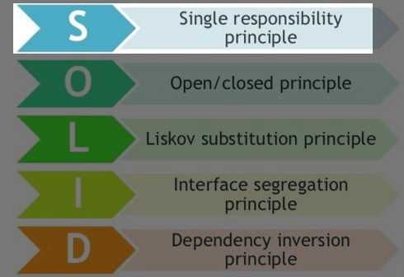
Single-responsibility
Easy concept
Hard to understand for junior developers.
More experienced developers would say its intuitive.
- doesn’t help to understand.
- abstract answer.

Slide 3
The Mockery (anti-pattern)
Doesn’t do anything.
Indicates that code architecture should be reconsidered.
Highly-coupled.
- inflexible.
- hard to change.
- fragile.

Slide 4
The Giant (anti-pattern)

Slide 5
Syncer method

Slide 6
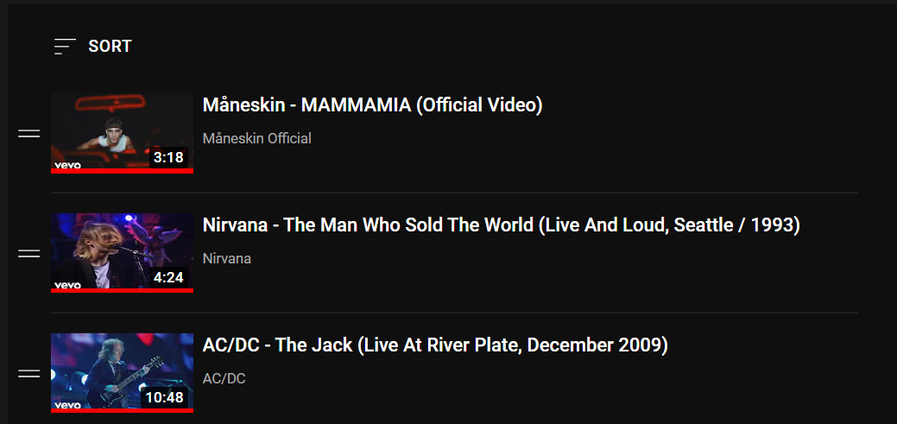
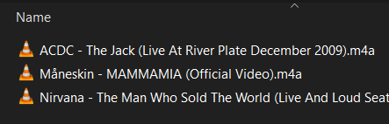
Download playlist -> local folder

Slide 7
Remove playlist -> local folder

Slide 8
Remove local folder -> playlist

Slide 9
The Giant (anti-pattern)
Unit tests should “document” the code.
Hard to know which Assert broke the test method.
Highly-coupled.
- inflexible.
- hard to change.
- fragile.

Slide 10
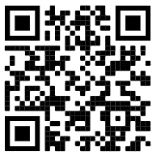
Thanks for listening !
If you would like to check out the code seen in presentation:
https://github.com/Fjalee/Testing_LW2

Slide 11
References
https://www.yegor256.com/2018/12/11/unit-testing-anti-patterns.html
https://www.youtube.com/watch?v=UWtEVKVPBQ0
https://stackoverflow.com/questions/7075375/is-mockery-a-tdd-anti-pattern
https://medium.com/ibm-garage/solid-design-principles-makes-test-driven-development-faster-and-easier-35c9eec22ff1
https://www.youtube.com/watch?v=llaUBH5oayw

