Slide 1
Log4Shell – CVE-2021-44228

Slide 2
Overview
Publicly disclosed December 9th, 2021
Exploit leverages flaw in the Java Naming and Directory Interface (JDNI).
Can be combined with a referral service to point vulnerable software to attacker controlled servers and payloads.

Slide 3
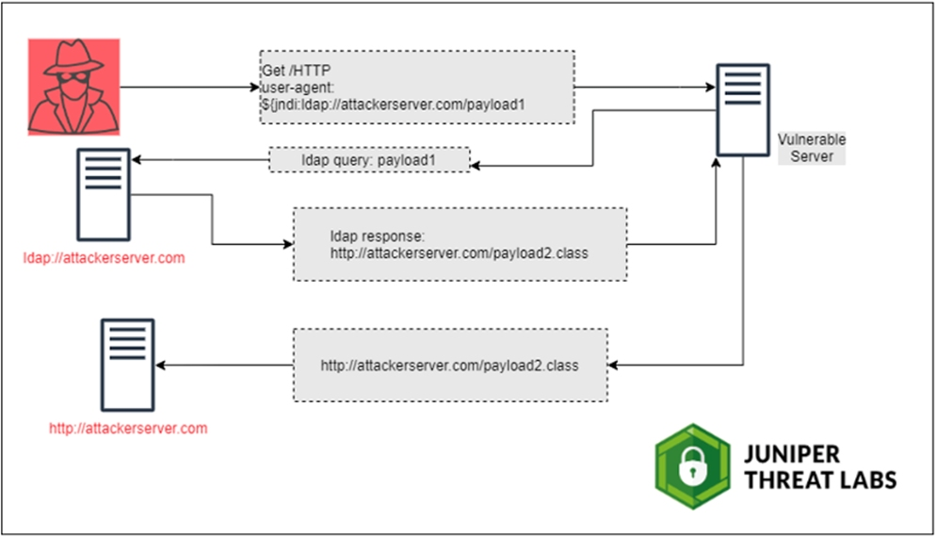

Slide 4

DEMO TIME!

Slide 5
Software / References
https://github.com/mbechler/marshalsec
https://www.lunasec.io/docs/blog/log4j-zero-day/#how-the-exploit-works

