Slide 1
Quality control system for laptop manufacturing.
<p> Emil Hovhannisyan </p>

Slide 2
TABLE OF CONTENTS.
01
02
03
04
05
06
Introduction
Code Overview
Laptop Structure and Functions
Main Function and User Interaction
Quality Assessment and Data Handling
Conclusion and Q&A

Slide 3
Introduction
01
<p> This presentation introduces a practical Quality Control System for Laptop Manufacturing. It explores a codebase managing and evaluating laptops based on specific criteria. We'll cover functions for adding, displaying, assessing quality, deleting, and saving laptop details, aiming to understand its practical use in manufacturing.</p>

Slide 4
User Interaction Menu
<p> Elephants and storms. </p>
The output menu of the code presents users with various options for interacting with the Quality Control System for Laptop Manufacturing.

Slide 5
Innovation is not about saying yes to everything. It's about saying NO to all but the most crucial features.
Steve Jobs

Slide 6
Code Overview
02
<p> This section covers the functions and structure of the code, detailing how it manages laptop data within the Quality Control System for Laptop Manufacturing.</p>

Slide 7
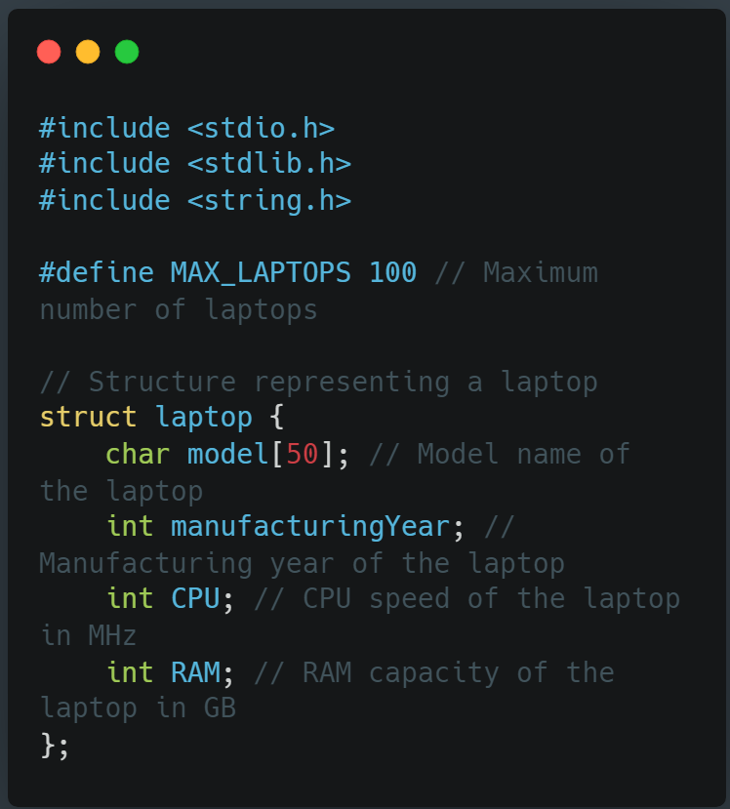
Structure and Data Representation in Code
This code snippet defines a Structure and Data Representation in Code and necessary header files to manage laptop information. It establishes a 'struct laptop' to store details such as model name, manufacturing year, CPU speed, and RAM capacity. This forms the foundational structure for handling laptop data within the system.

Slide 8
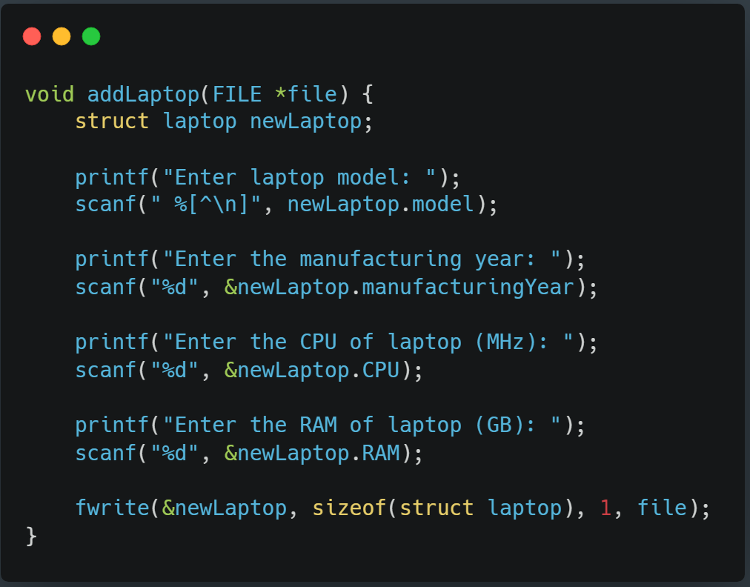
Function to Add a Laptop
This function enables the user to input laptop details, including model, manufacturing year, CPU speed, and RAM capacity. The information entered by the user is stored in a 'struct laptop' instance and then written to a file using 'fwrite.' This function serves to add new laptops to the system.

Slide 9
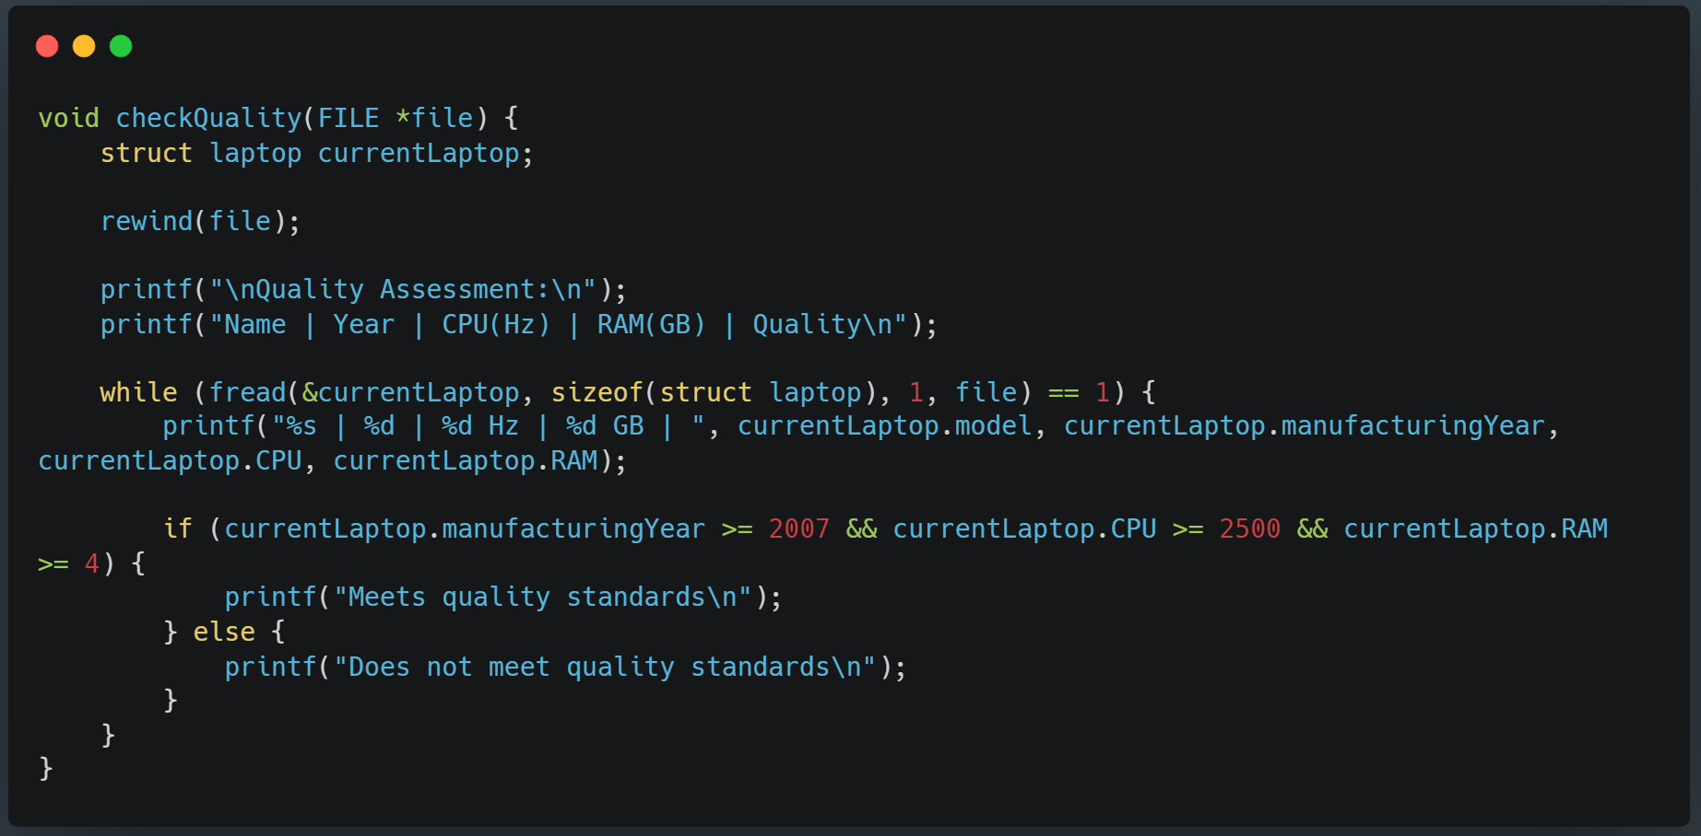
Quality Assessment Function
This code segment illustrates the 'checkQuality' function, responsible for assessing the quality of laptops within the system by examining their manufacturing year, CPU speed, and RAM capacity against established criteria.

Slide 10
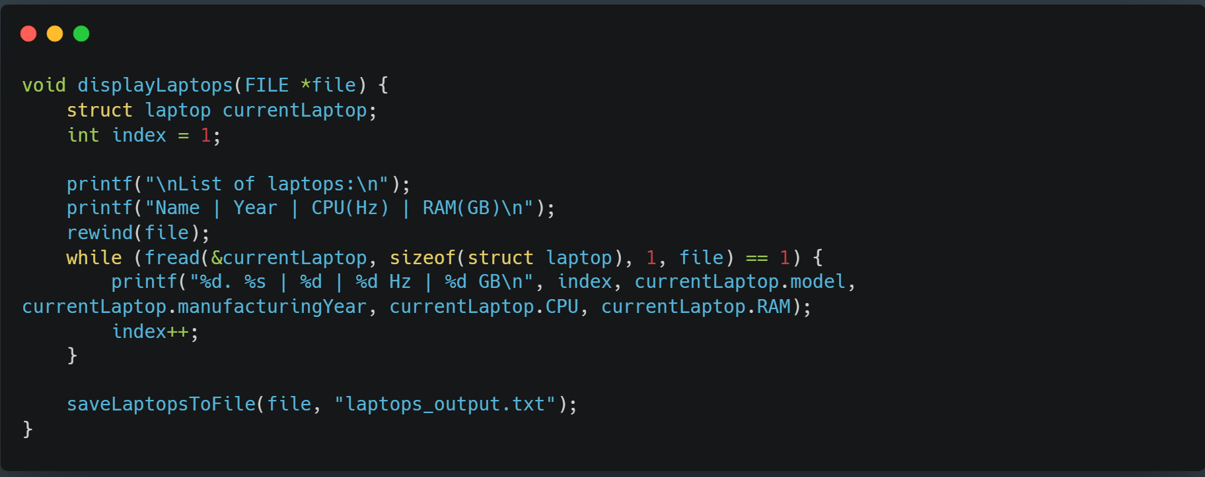
Display Function
The 'displayLaptops' function presents a list of available laptops to the user. It retrieves laptop details from the file and prints them in a formatted manner, including model names, manufacturing years, CPU speeds, and RAM capacities. This function provides users with a comprehensive view of the laptops stored within the system.

Slide 11
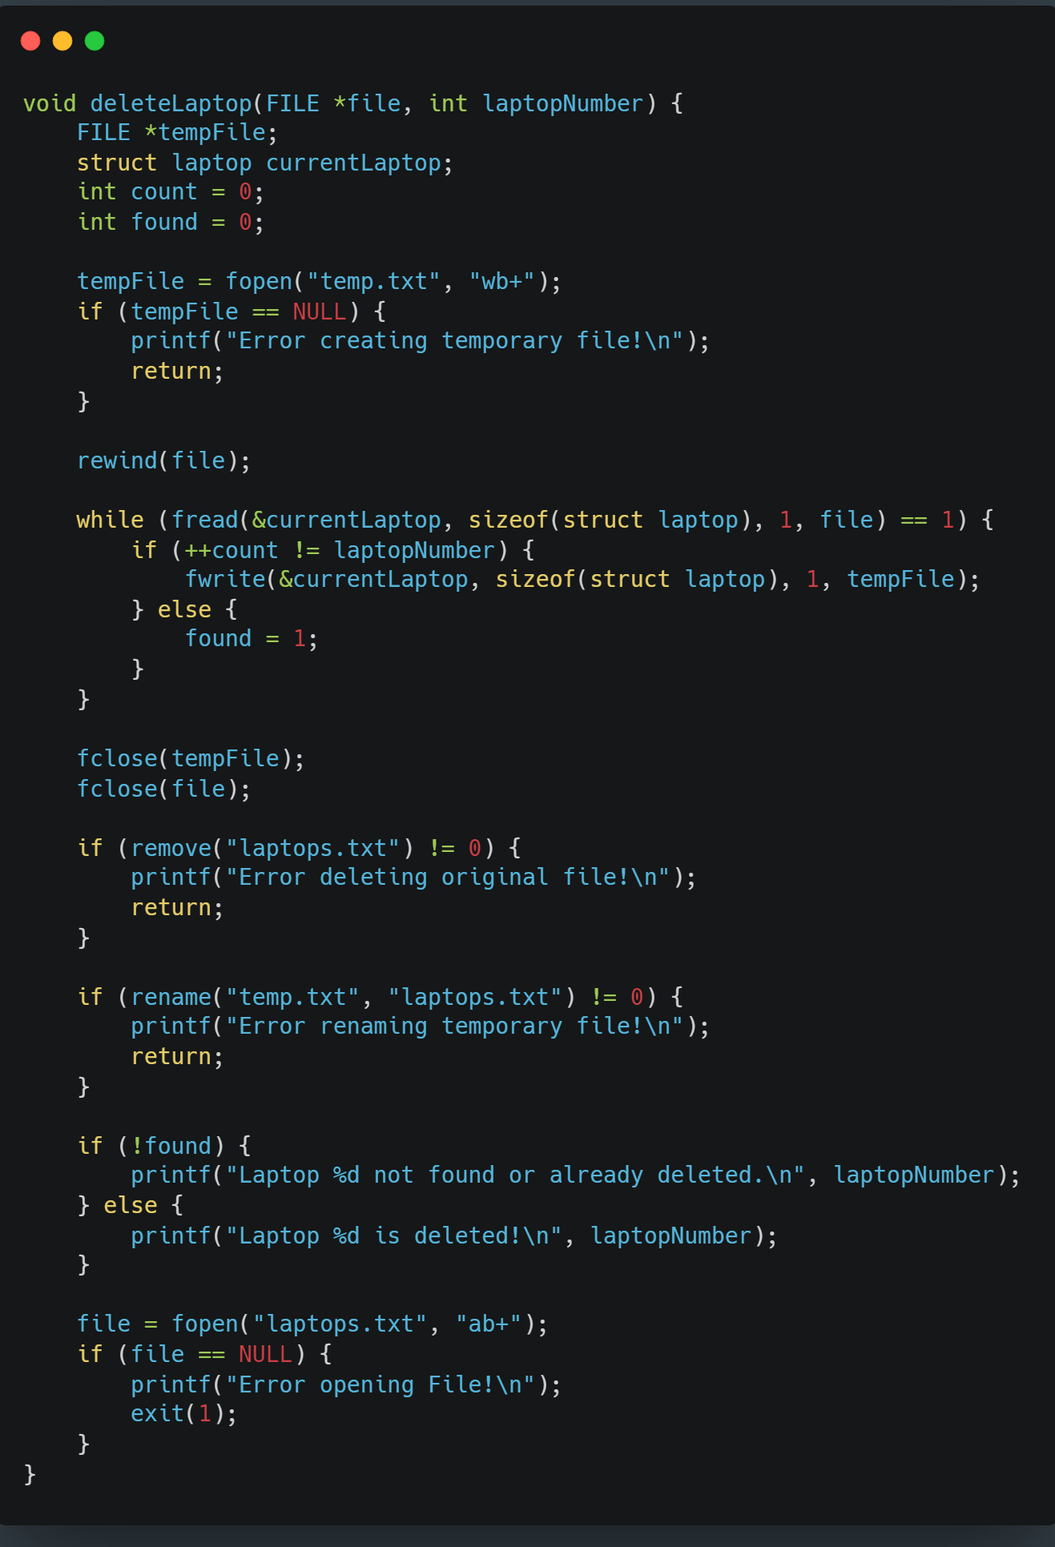
Laptop Deletion Function:
The 'deleteLaptop' function allows users to remove specific laptops from the system. It iterates through the file, locates the targeted laptop by its index, and deletes it by rewriting the file without including the selected laptop's information. This function offers a means to manage and remove unwanted or obsolete laptops from the system.

Slide 12
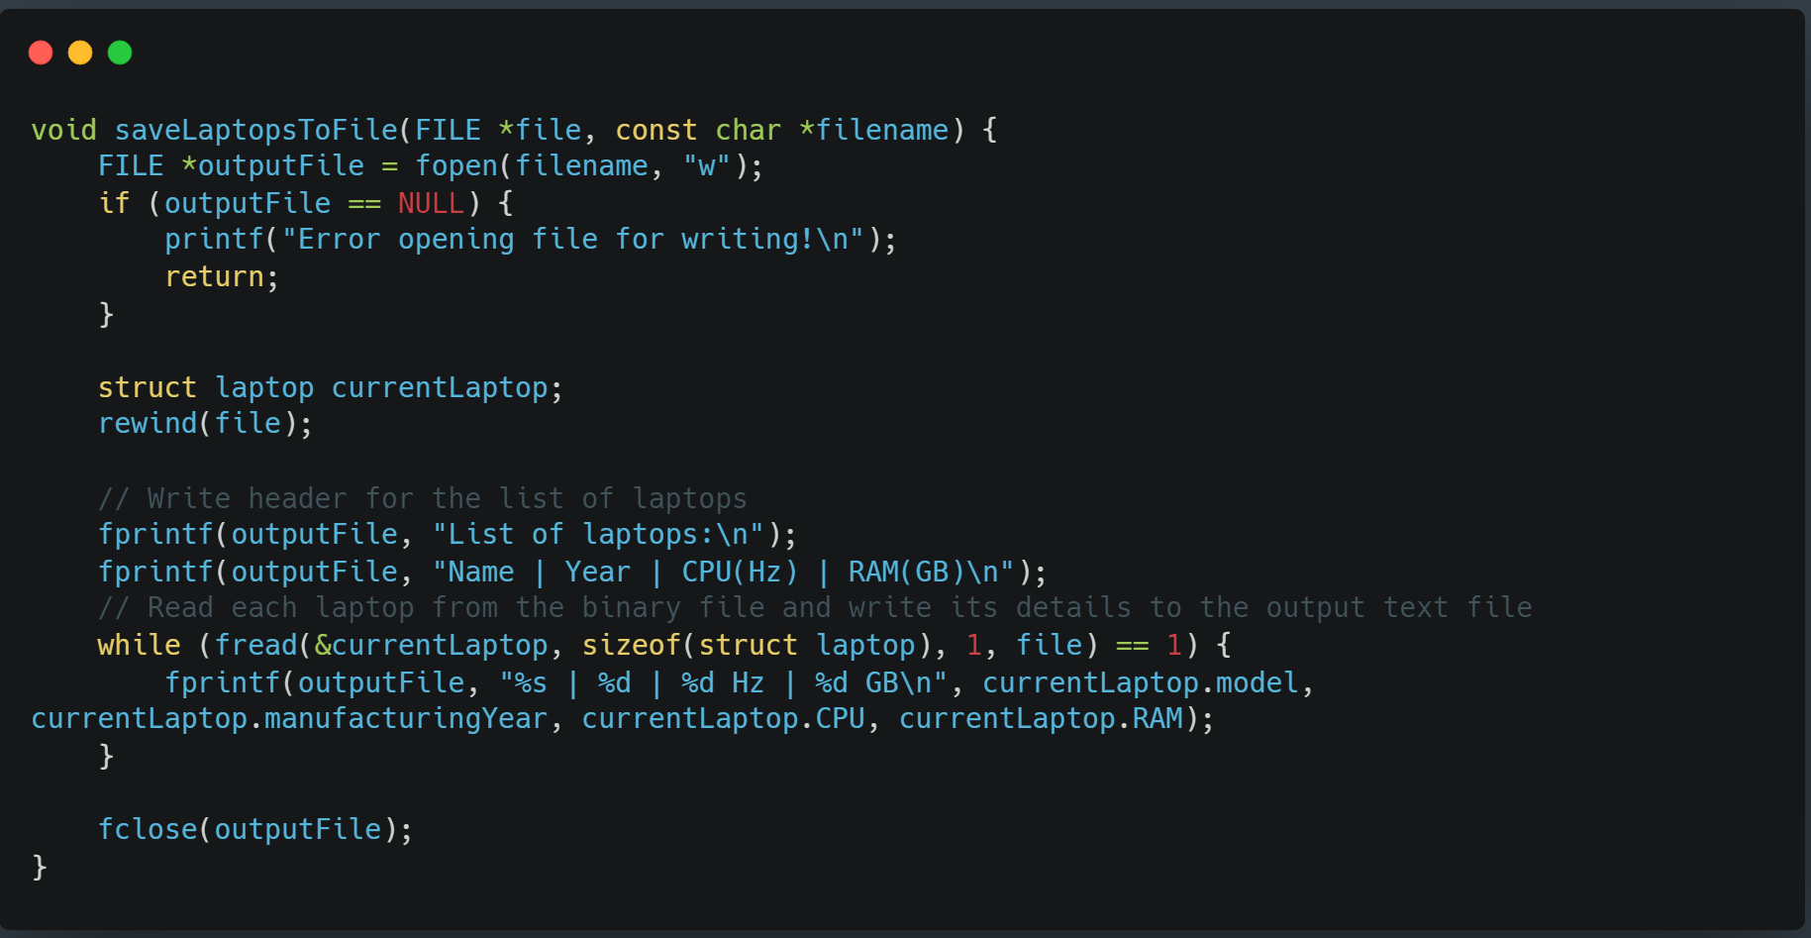
Laptop Data Saving Function
This code excerpt illustrates the 'saveLaptopsToFile' function, responsible for collecting laptop details from the system and storing them in a designated text file. It enables users to maintain a record of laptop information, enhancing data persistence and external accessibility.

Slide 13
Laptop Structure and Functions
Operational Functions
Structuring Data
User-Centric Design
03
Functions drive user interaction, data management, and persistence.
Struct ‘laptop’ organizes key attributes, ensuring coherent data storage.
Designed for seamless user interaction and laptop management.

Slide 14
Main Function and User Interaction
04
Main Function: User Interaction Control
The 'main' function acts as the central control hub, orchestrating user interaction within the Quality Control System for Laptop Manufacturing. It presents users with a menu of options, allowing them to choose various functionalities such as adding laptops, displaying existing ones, assessing quality, deleting specific entries, saving data, and exiting the program. This function's structured design ensures seamless navigation and utilization of the system's core features, offering users a clear pathway to manage and evaluate laptops within the system.

Slide 15
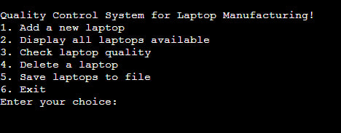
Main Function and User Interaction
04
Users can choose these options to perform specific tasks, such as adding new laptops, viewing existing ones, assessing their quality, managing the list by deletion, saving data, or exiting the program.

Slide 16
Quality Assessment & Data Handling
05
Data Storage Formats: Binary & Text Files
This section encompasses the process of quality assessment and data handling within the system. The user-inputted laptop information undergoes conversion into binary files and text files. The binary file stores data in a machine-readable format, efficiently organizing and preserving laptop details within the system's memory. On the other hand, the text file serves as a human-readable record, enabling external accessibility and facilitating data backup or sharing. This approach ensures data integrity, efficiency in storage, and user convenience by offering multiple formats for data representation and usage.

Slide 17
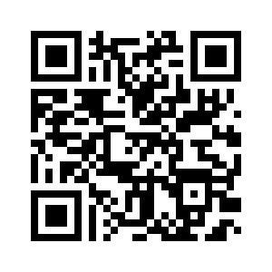
THANK YOU!
I22.Hovhannisyan.Emil@etud.ufar.am
Github: FjolnirTheWiseOne
Do you have any questions?

