Slide 1

ALTO Performance Metrics draft-ietf-alto-performance-metrics-20->28
Qin Wu
Y. Richard Yang
Young Lee
D. Dhody
Sabine Randriamasy
Luis Miguel Contreras Murillo
March 23, 2022
IETF 113, Virtual Meeting

Slide 2
Status
Updates between IETF 112 and IETF 113 (v20 -> v28)
Diff: https://tools.ietf.org/rfcdiff?url1=https://www.ietf.org/archive/id/draft-ietf-alto-performance-metrics-20.txt&url2=https://www.ietf.org/archive/id/draft-ietf-alto-performance-metrics-28.txt
Address IESG reviews
Provide structures and organizations
Specify clear grammar and requirements
Give as much info as possible on derivations, conditions
Update references (e.g., avoid downref)
Update examples, including check json grammar, ipv6 example
Have ballots but there are large updates which can benefit from one more round of reviews

Slide 3
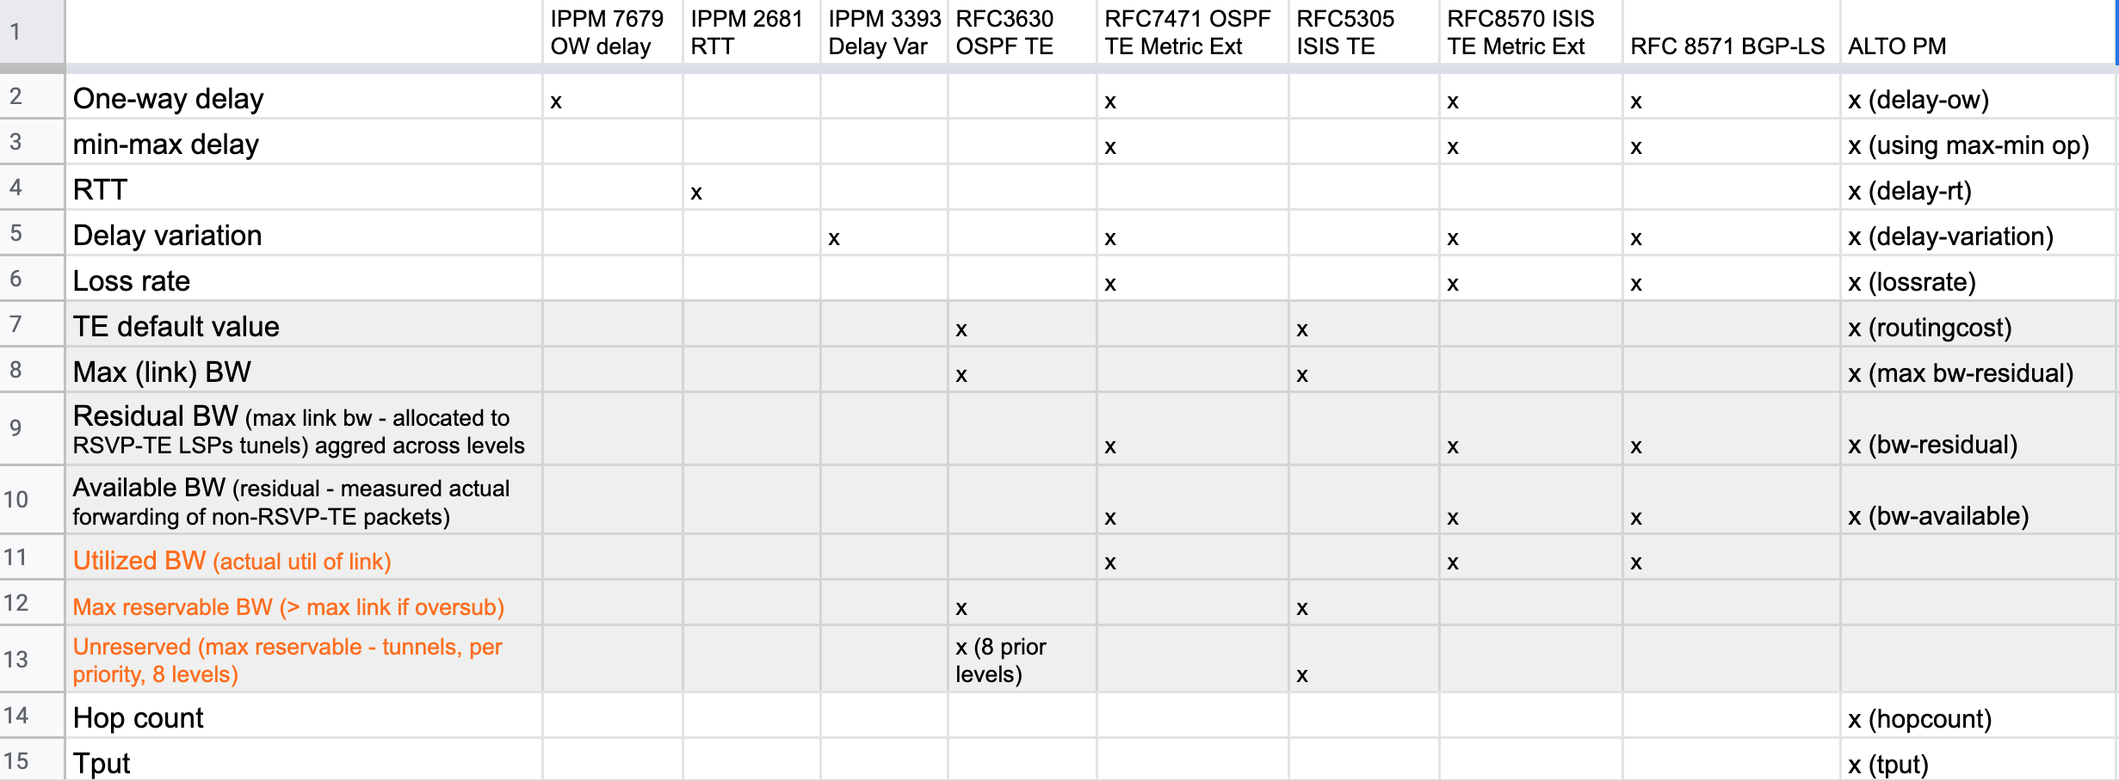
Main Update: Structure
Clarify that ALTO performance metrics are systematically derived from routing metrics (e.g., OSPF/ISIS/GBP-LS routing TE metrics are main source of ALTO performance metrics)
Notes:
Table see link: https://docs.google.com/spreadsheets/d/13COBUEDNlA_Fb8abg7nRTNq4pvClTq7EPg5Ef3-_bpM/edit?usp=sharing

Slide 4
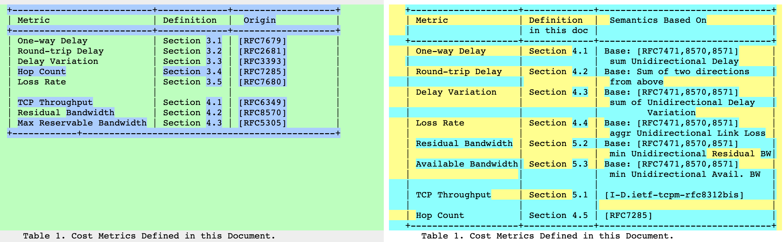
Main Update: Structure

Slide 5
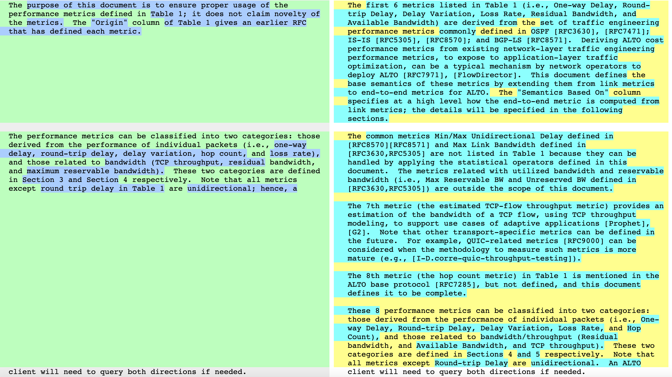
Main Update: Structure

Slide 6
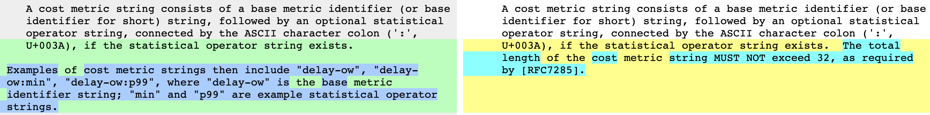
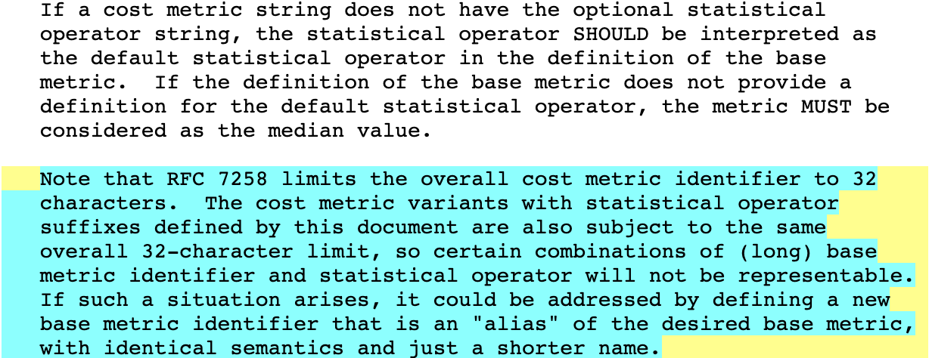
Update: Grammar and Requirements

Slide 7
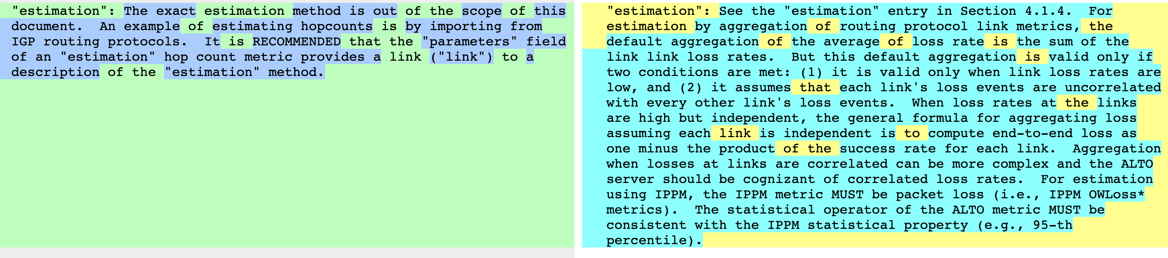
Update: Conditions and Derivations

Slide 8
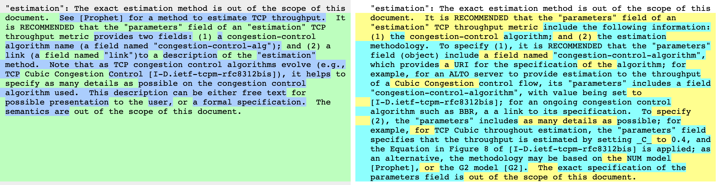
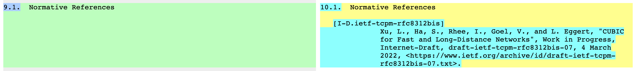
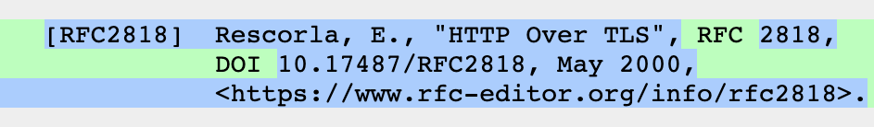
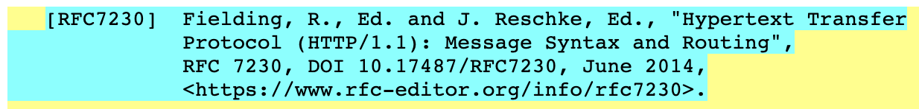
Update: References

Slide 9
Need WG Decision
Take advantage of new round of review to add (back) metrics
bw-utilized (added in -21 (Sec. 4.4), removed in -23), bw-reservable, bw-reservable-level-[0-7]) => fully compatible w/ routing TE metrics set
Notes:
https://datatracker.ietf.org/doc/draft-ietf-alto-performance-metrics/21/

