Slide 1


Team DEDSEC
Maxim Staver
Florin-Marian Puscas
Catalin-Ioan Batin
28 MAY 2026

Slide 2





Stream 1: "The Machine" (Automated E2E)
Bypassing the frontend UI using Burp Suite and cURL.
Playwright & k6 testing against Dockerized local deployment.
Payload manipulation and boundary value fuzzing.
Continuous functional testing across all 5 user roles.
Stream 2: "The Adversary" (Manual & Security)
Machine vs Adversary

Slide 3
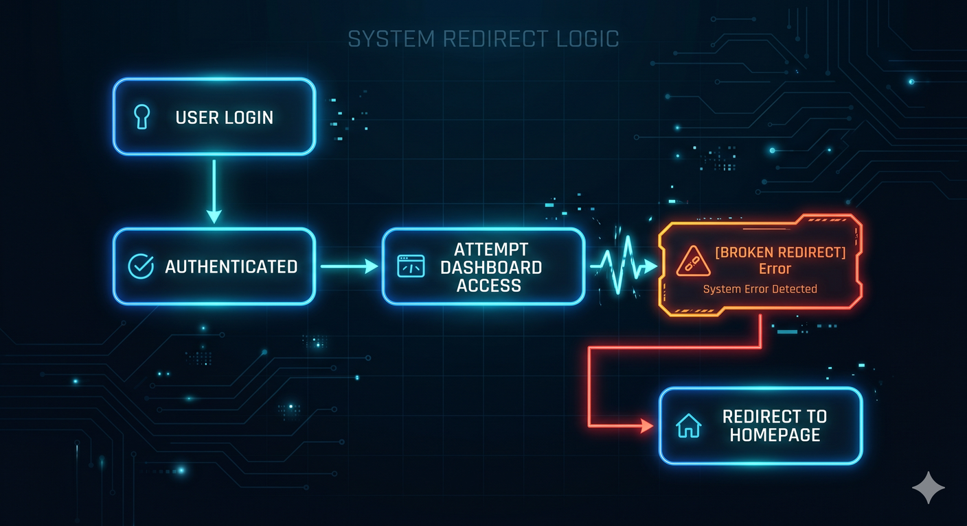
RBAC Routing Collapse
Total Stakeholder Lockout
Affected Roles: Admin, Industry, Policy
The Issue: Frontend routing middleware fails, triggering a forceful redirect to the public homepage
Education Role: Bypasses redirect, but sidebar navigation fails to render.

Slide 4
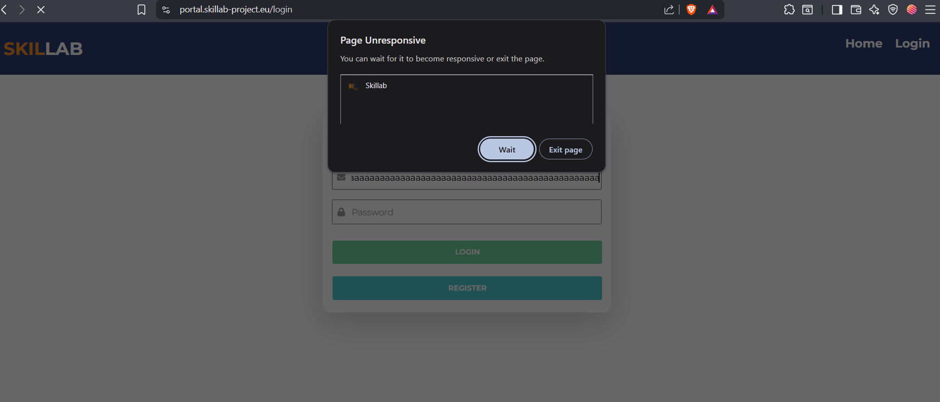
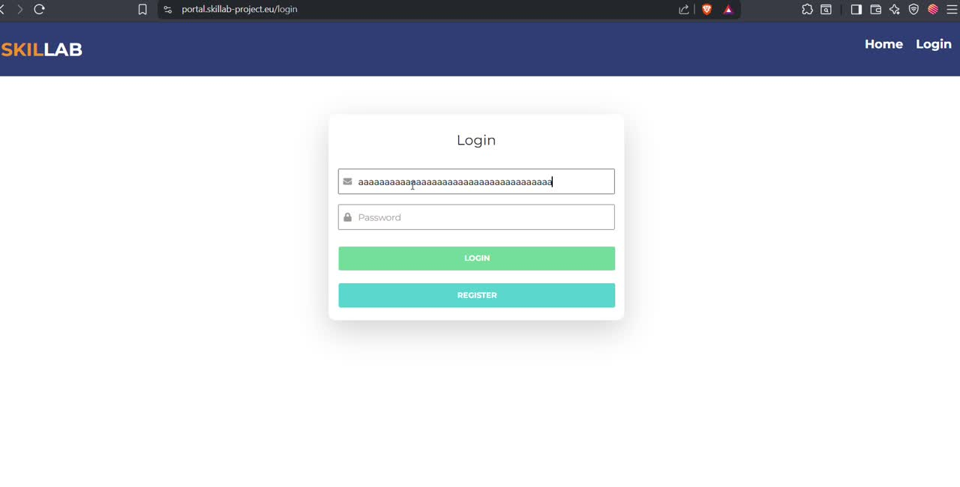
System Stability Issues
Resource Exhaustion: Browser freezing from uncapped input fields (Login, Register, Search).
API Timeouts: External Job Sources API triggers 30-second hard timeouts.
Hanging Requests: Invalid Turf Analysis queries stuck in "Pending" indefinitely.

Slide 5
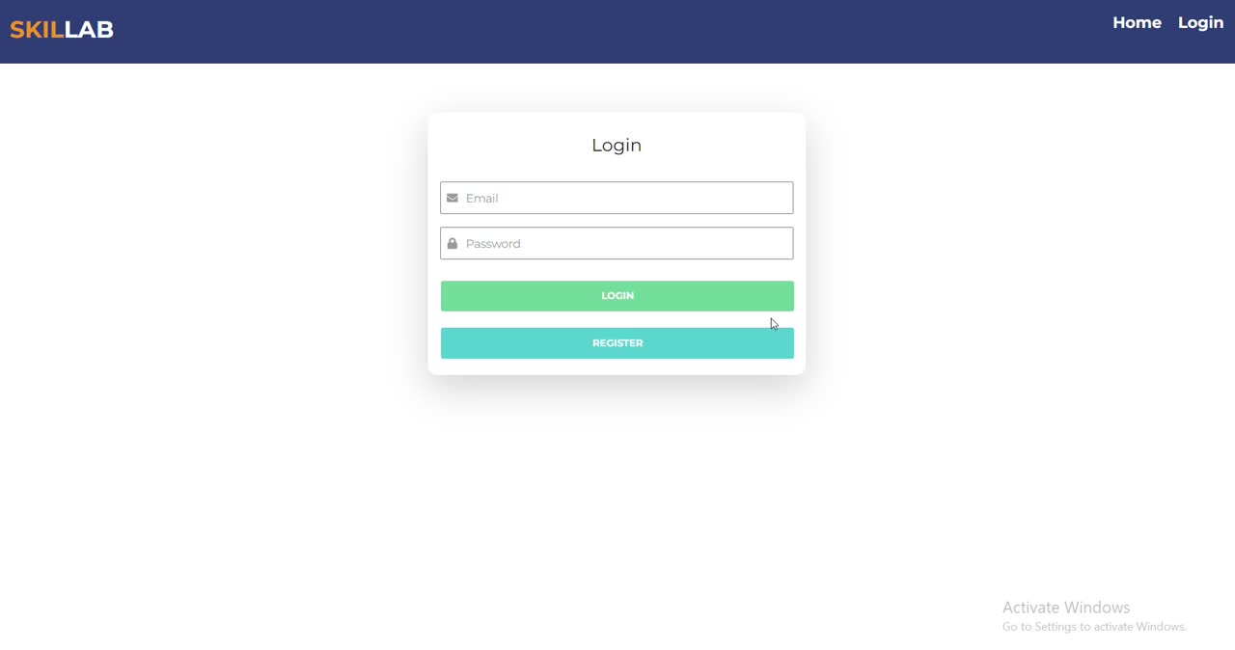
The Implicit Trust Problem
Missing Server-Side Validation
Frontend complexity rules easily bypassed via API.
Password reset execution accepts 3-character strings.
Broken Session Management: Active sessions persist across devices after password changes

Slide 6
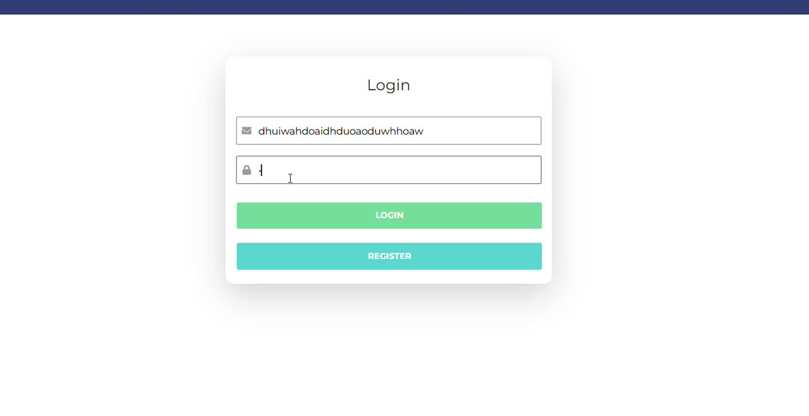
The Implicit Trust Problem

Slide 7
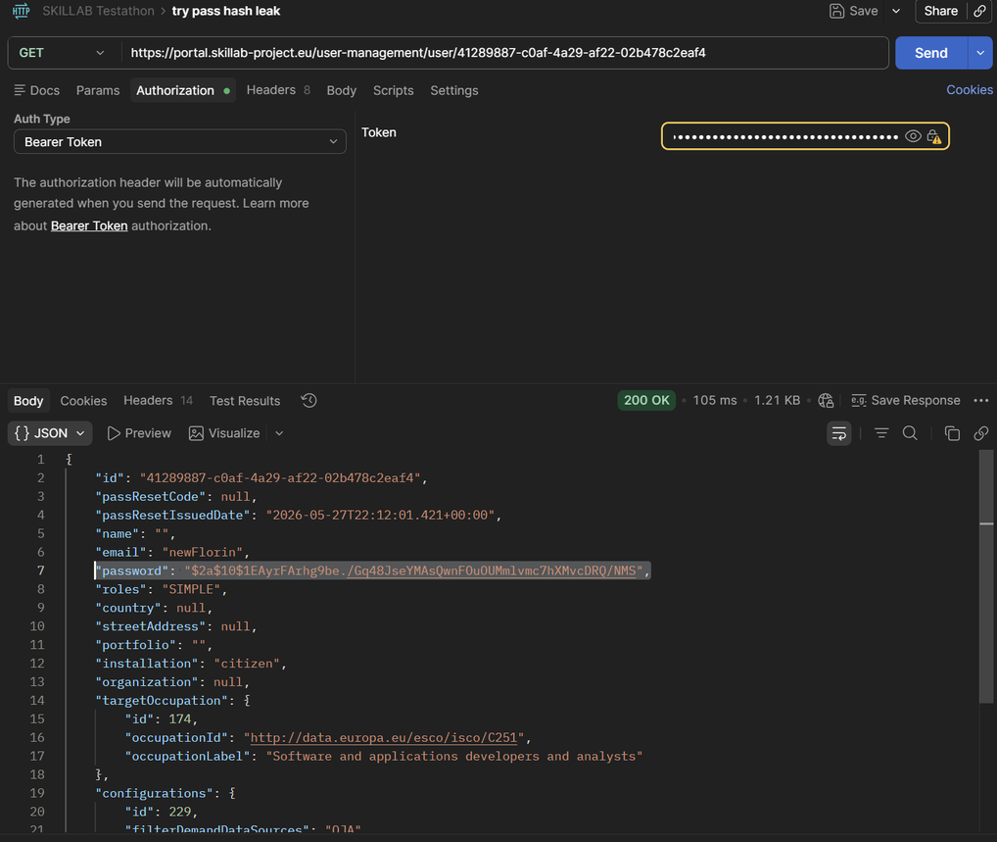
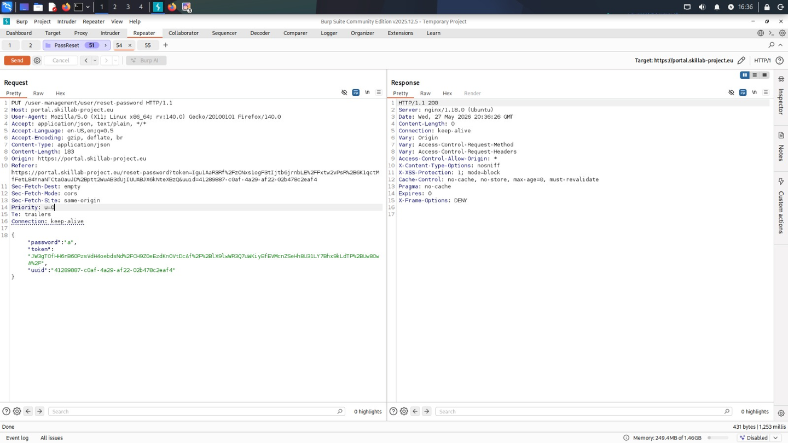
Critical BOLA & Account Takeovers
Critical Risk: Broken Object Level Authorization (BOLA)
Backend fails to verify active session UUID against requested data.
Data Exposed: PII, bcrypt password hashes, active reset tokens.
Mass Assignment Backdoor: Injection of future-dated password reset tokens (Valid until 2099).

Slide 8

Enforce Zero-Trust API Architecture
Mandate object-level checks to verify user permissions and implement strict server-side validation.
Utilize Data Transfer Objects (DTOs)
Strip sensitive backend fields—such as bcrypt password hashes and reset codes—from all API responses.
Repair Enterprise Routing
Audit RBAC routing middleware to restore workspace access for Admin, Industry, and Policy roles.
Architectural Recommendations
Sanitize Inputs & Stabilize Integrations
Apply hard input constraints to prevent browser freezing and implement circuit breakers for external APIs.

Slide 9



Thank You
Maxim Staver
Florin-Marian Puscas
Catalin-Ioan Batin

