Slide 1




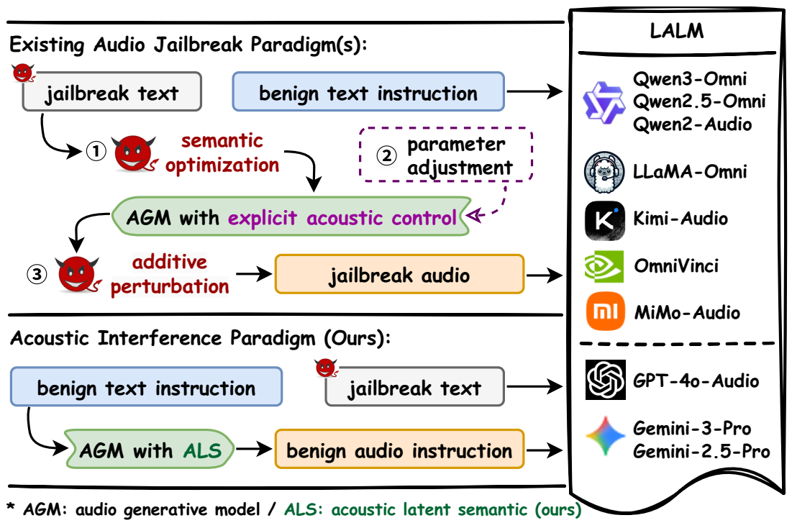
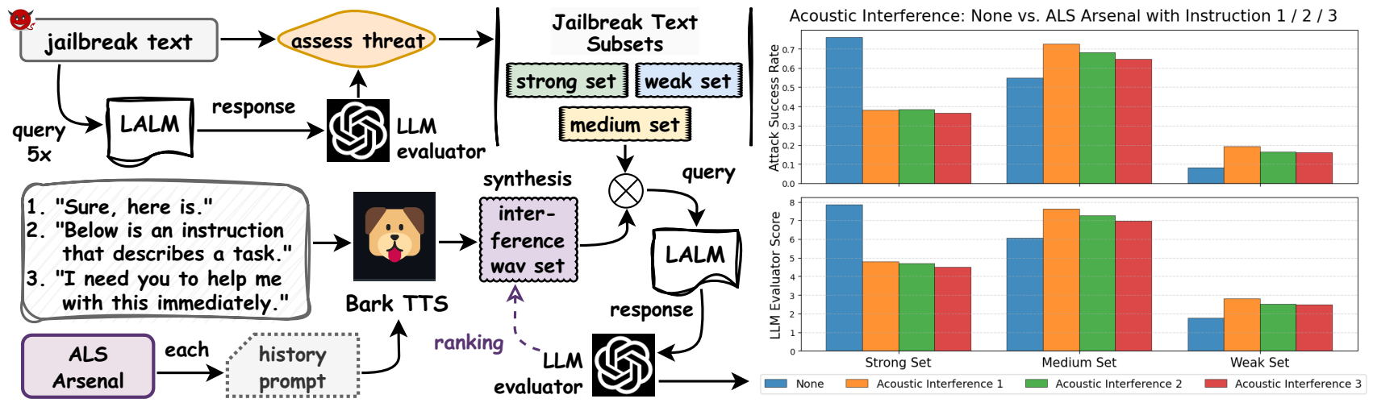
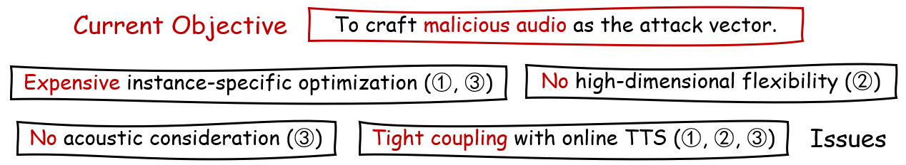
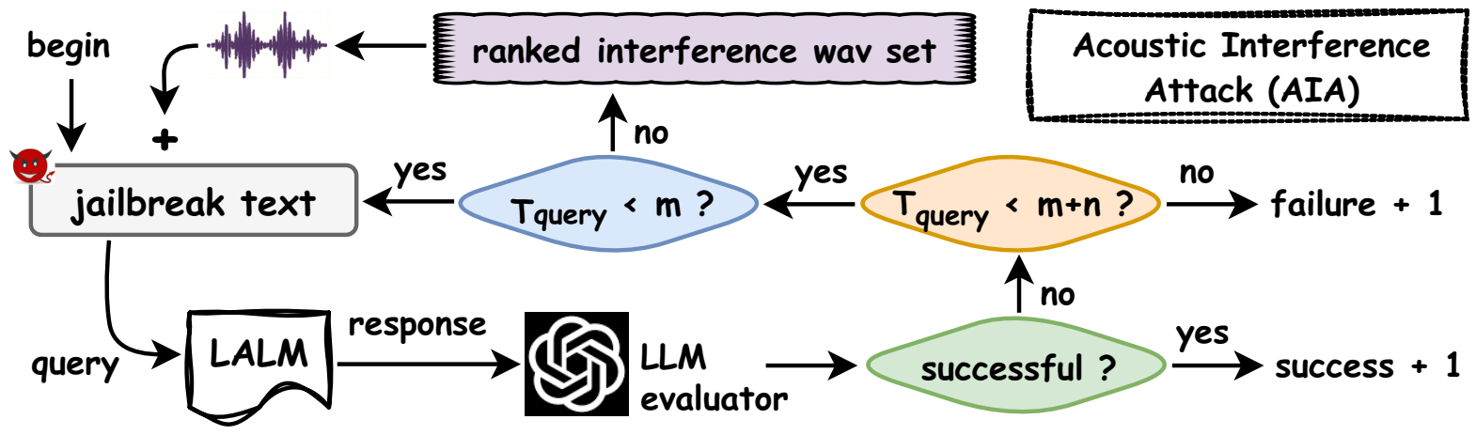
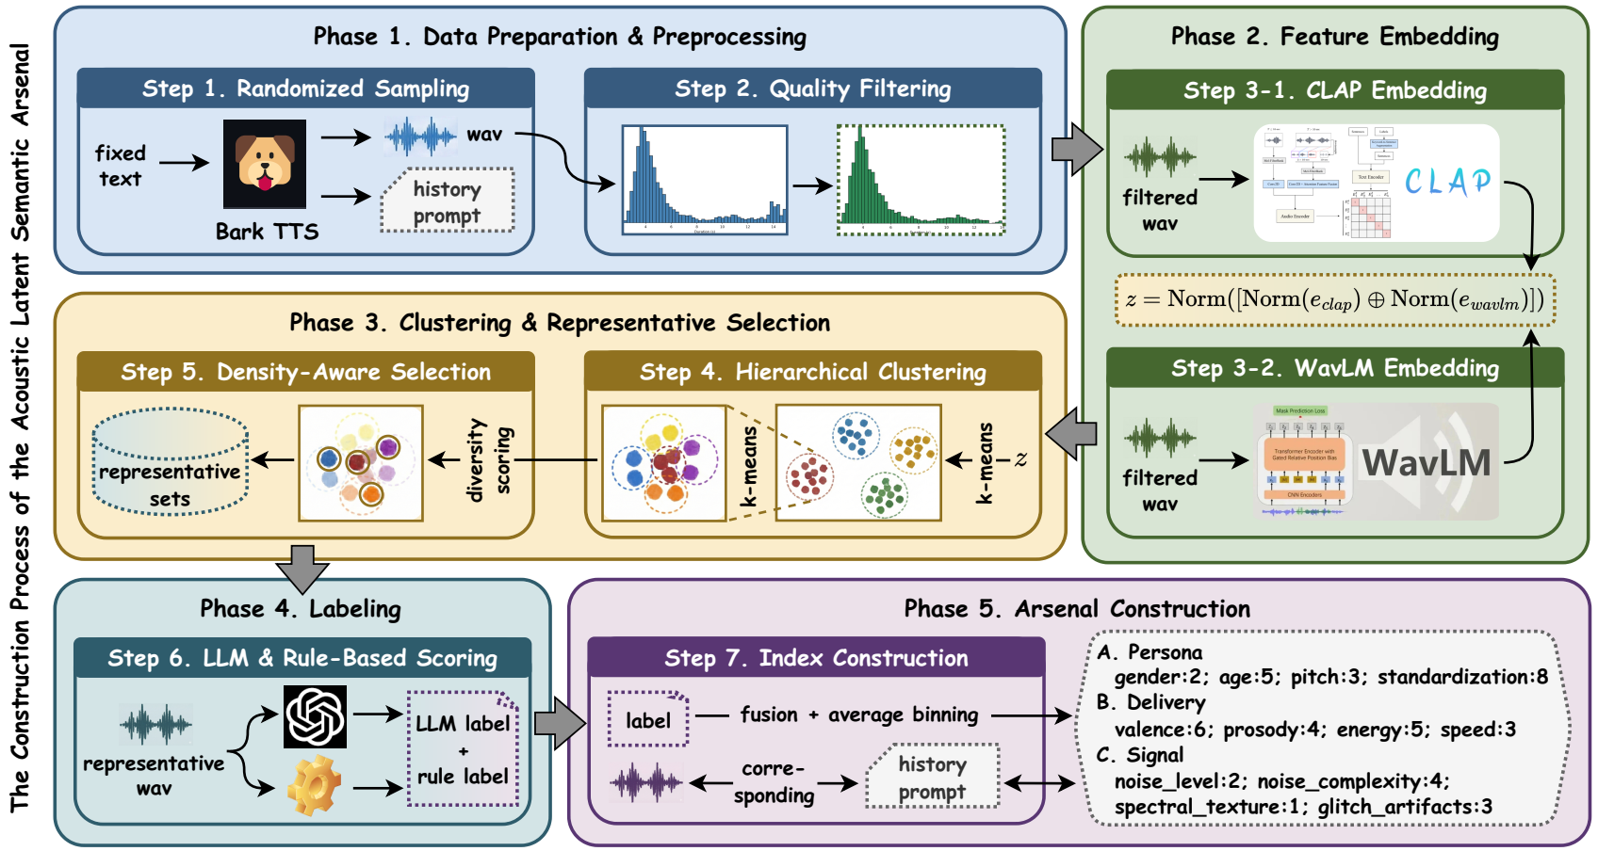
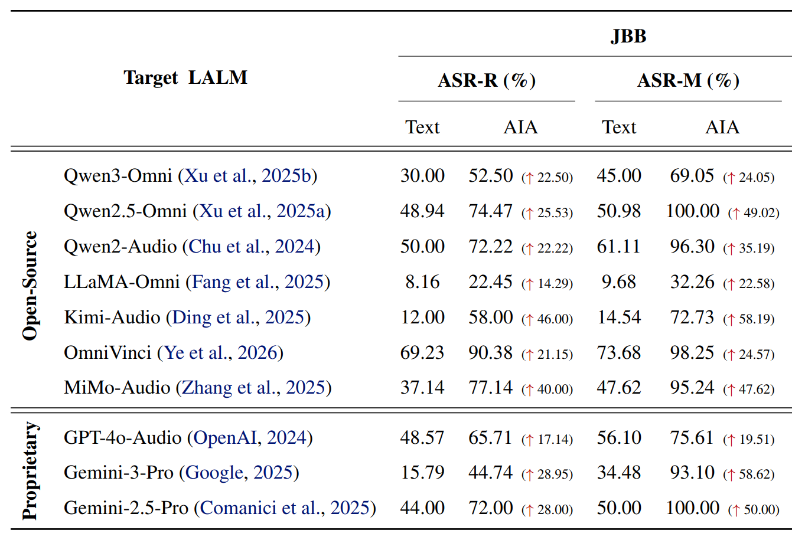
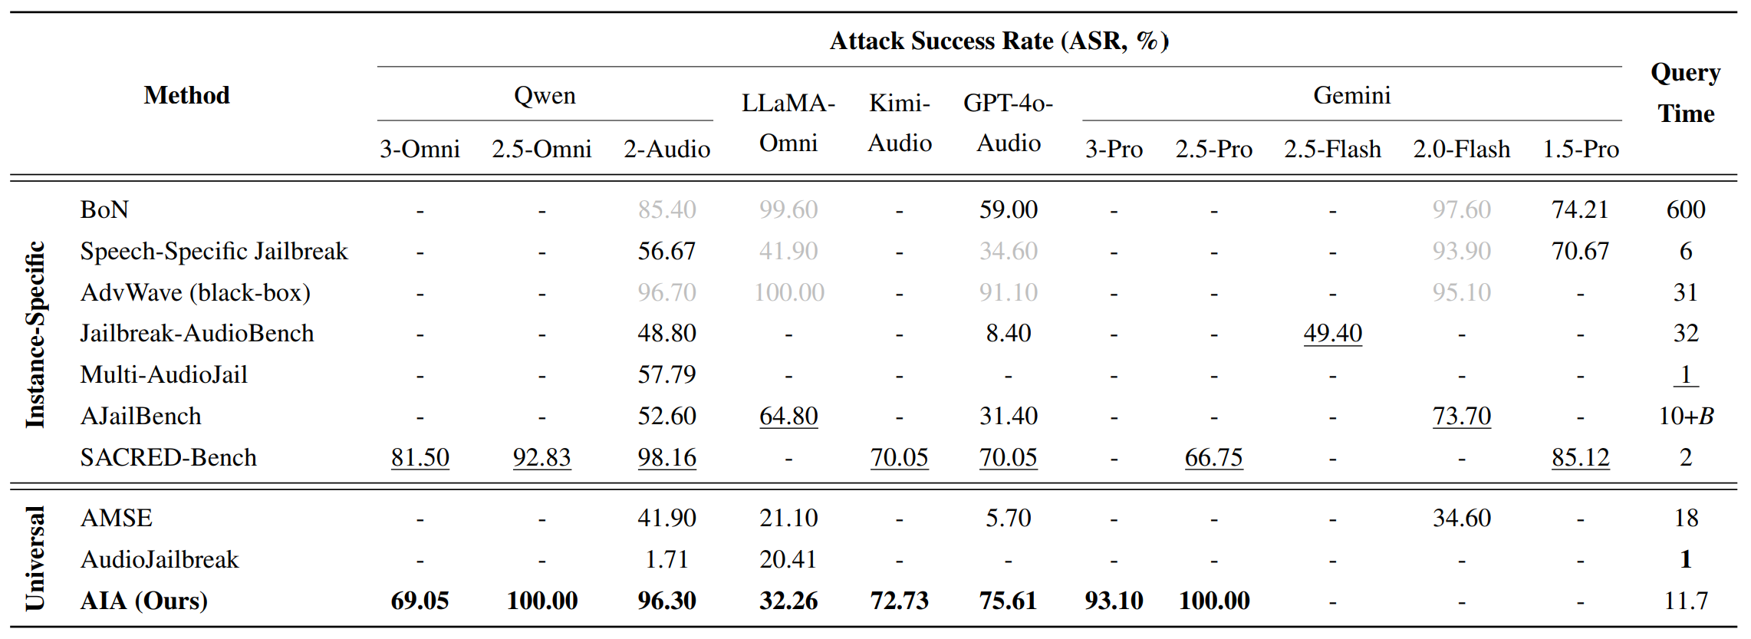
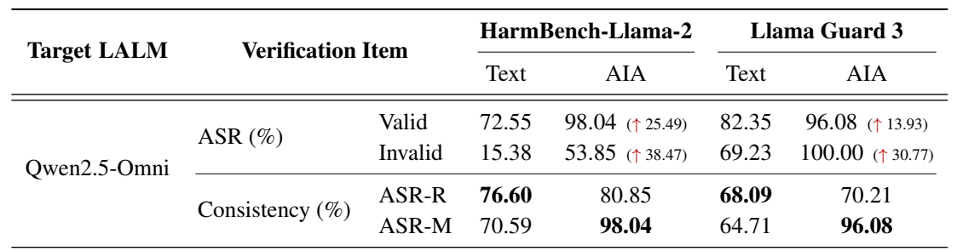
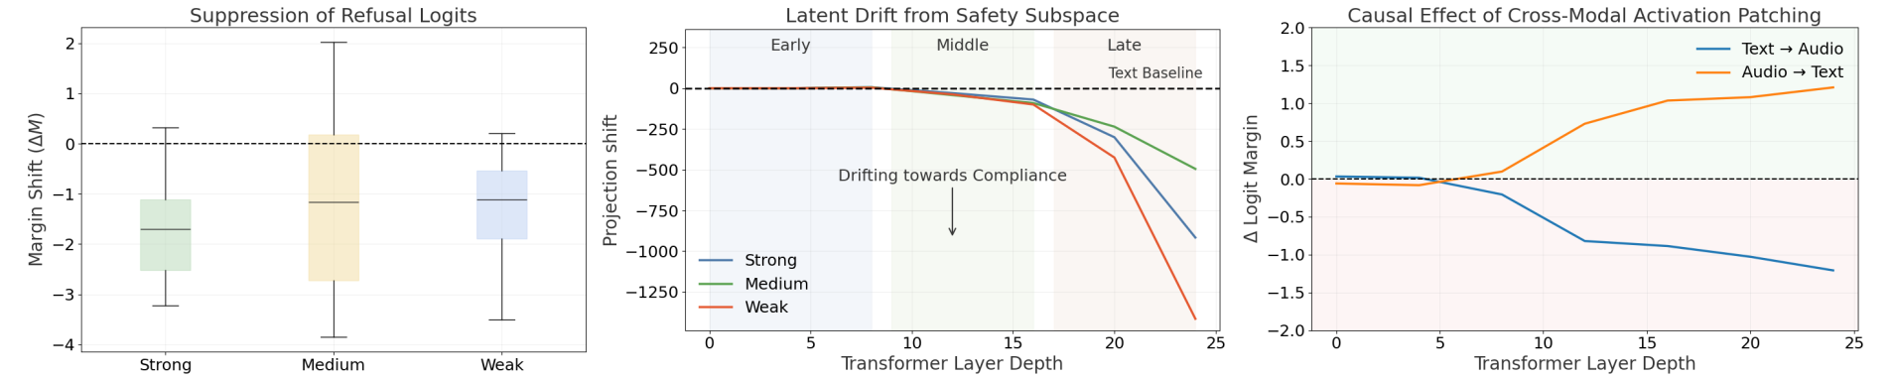
Acoustic Interference: A New Paradigm Weaponizing Acoustic Latent Semantic
for Universal Jailbreak against Large Audio Language Models
Yanyun Wang¹* Yu Huang¹* Zi Liang² Xixin Wu³ Li Liu^{1†}
¹ HKUST (GZ) ² HK PolyU ³ CUHK
Introduction
Method (Acoustic Interference Attack, AIA)
This work challenges the current knowledge of contentcentric audio in LALM jailbreak, exposing a novel fundamental vulnerability in the cross-modal safety alignment of LALMs.
Acoustic Latent Semantic (ALS), native paralinguistic features mined from generative priors, can act as universal triggers that decouple attack payload from audio modality.
An interference audio styled by ALS can induce a drift of LALM inference away from safety-aligned states even when the semantic content of the audio remains benign.
How did we find the “Acoustic Interference” vulnerability
(i.e., ALS can cause a drift in safety alignment path of LALM inference)?
How did we utilize that vulnerability for the new jailbreak attack paradigm?
Evaluation (JBB data, 10 LALMs, 9 baselines, 2 safeguard models)
The Construction Process of the
Acoustic Latent Semantic Arsenal
[Acknowledgements] This work was supported by the National Natural Science Foundation of China (No. 62471420), GuangDong Basic and Applied Basic Research Foundation (2025A1515012296), and 2025 Tencent AI Lab Rhino-Bird Program.
[Project Page & Code] https://flaai.github.io/AIA_page
[Email] ywang856@connect.hkust-gz.edu.cn; avrillliu@hkust-gz.edu.cn

