Slide 1

Historical Background to the Book of Jeremiah
By Phil Leage

Slide 2
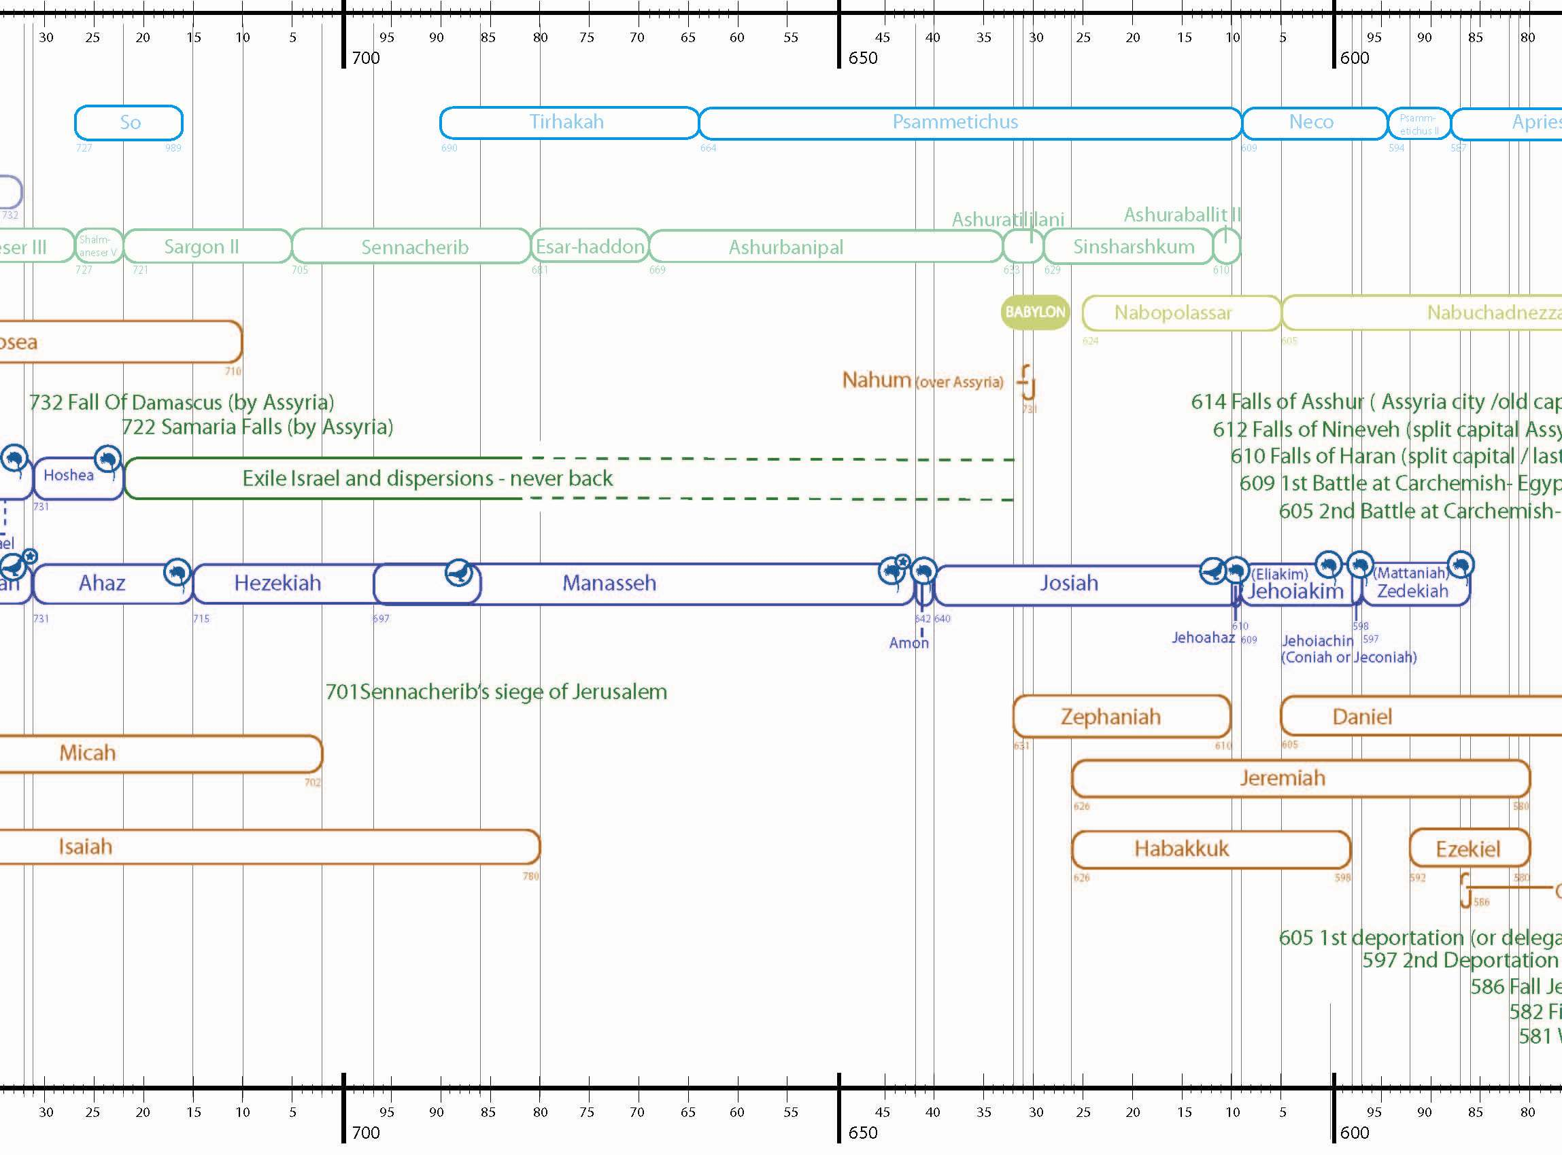

Slide 3
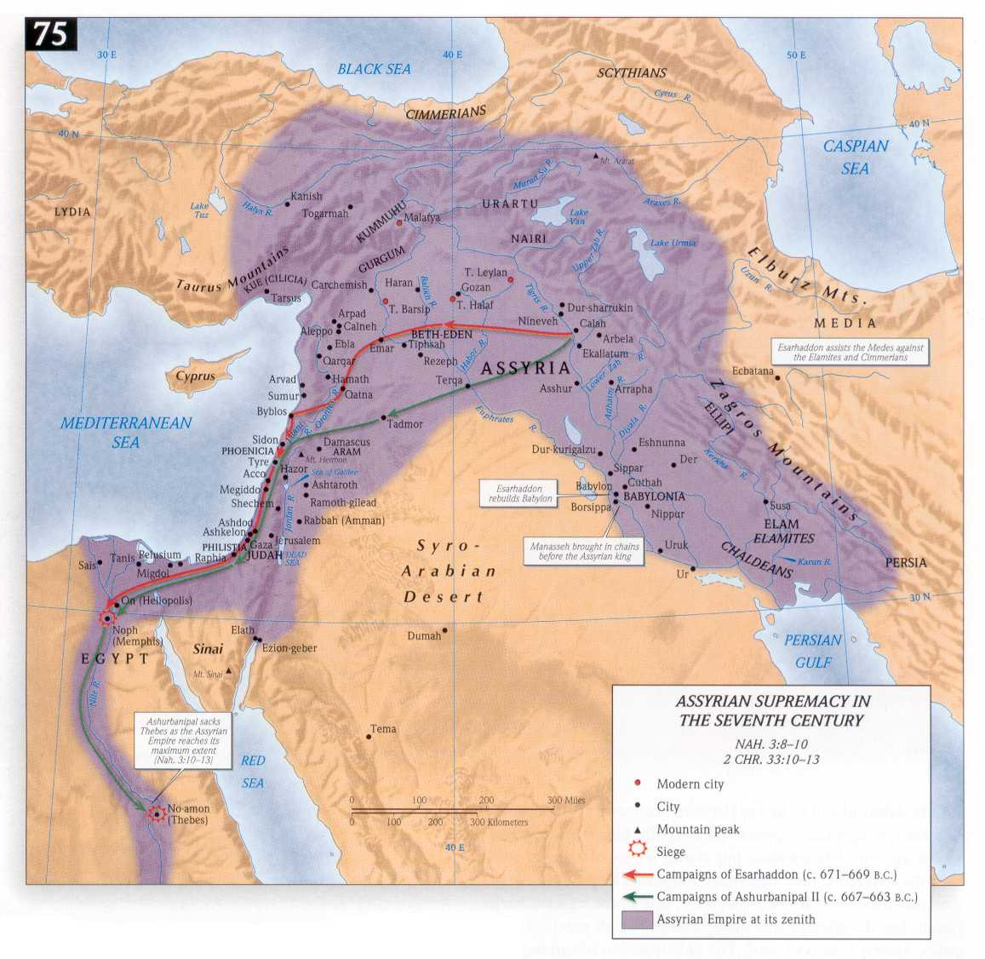

Slide 4
Historical Background to the Book of Jeremiah
This period is described in 2 Kg 21-25 and 2 Chr 33-36
Great political and religious crisis:-
Collapse of Assyria
Rise of Babylon
Decline of Egypt
Extinction of Judah

Slide 5
686 BC Manasseh Assumed Sole Kingship
Manasseh was the most evil king
He submitted to the yoke of Assyria
Esarhaddon and Ashurbanipal

Slide 6
686 BC Manasseh Assumed Sole Kingship
Shamash-shum-ukim rallied support from vassals
Manasseh was drawn into this

Slide 7
648 BC Josiah Was Born

Slide 8
642 BC Amon Succeeded Manasseh As King
Back to the extreme idolatry

Slide 9
640 BC Josiah Becomes King (Aged 8)
Ruled for 31 years

Slide 10
633/2 BC Josiah Begins to Seek God
8th year of reign
He was 16 years old

Slide 11
628 BC Josiah Renounces Idolatry
12th year of his reign
Purges the land of idols
He was 20 years old
This was before he had read the book of the law

Slide 12
627 BC Jeremiah Called by God
13th year of the reign of Josiah

Slide 13
626 BC Death of Ashurbanipal
Last great king of Assyria
Period of independence for Judah
Babylon independent
Nabopolassar becomes threat to Assyria
Egypt growing stronger under Psammetichus I

Slide 14
622/1 BC Discovery of Book of Law
King Josiah repents
Reformation begins
Passover celebrated
Josiah’s 18th year of reign

Slide 15
622/1 BC Discovery of Book of Law
Josiah was 26 years old
10 years after seeking God
6 years after the purge began

Slide 16
What Was Found?
‘The book of the law given through Moses’
2Chron 34:14
‘The book of the covenant’ 2Chron 34:30
‘The book of the law in the house of the Lord’
2Kg 22:8
‘All the words of the book’ 2Kings 22:16
‘All the curses written in the book read before the king’ 2Chron 34:24
The book of Deuteronomy?

Slide 17
Josiah’s Response to Reading the Law #1
2 Chron 34-35
Tore his clothes
His heart was penitent
He humbled himself
He wept before the Lord

Slide 18
Josiah’s Response to Reading the Law #2
He commanded a public reading
He renewed the covenant
Made the people join in
Continued to cleans the land
This was when Bethel was cleansed:
2King’s 23:15ff cf 1Kings 13:2
He kept the Passover

Slide 19
What Was the Result of the Reform?
There was no lasting change
There was outward reformation
No inward transformation in the people

Slide 20
617 BC Attacks by Babylon and Medes on Assyrian Cities

Slide 21
612 BC Nineveh ‑ Capital of Assyria Falls
The remnant of Assyria is allied to Egypt

Slide 22
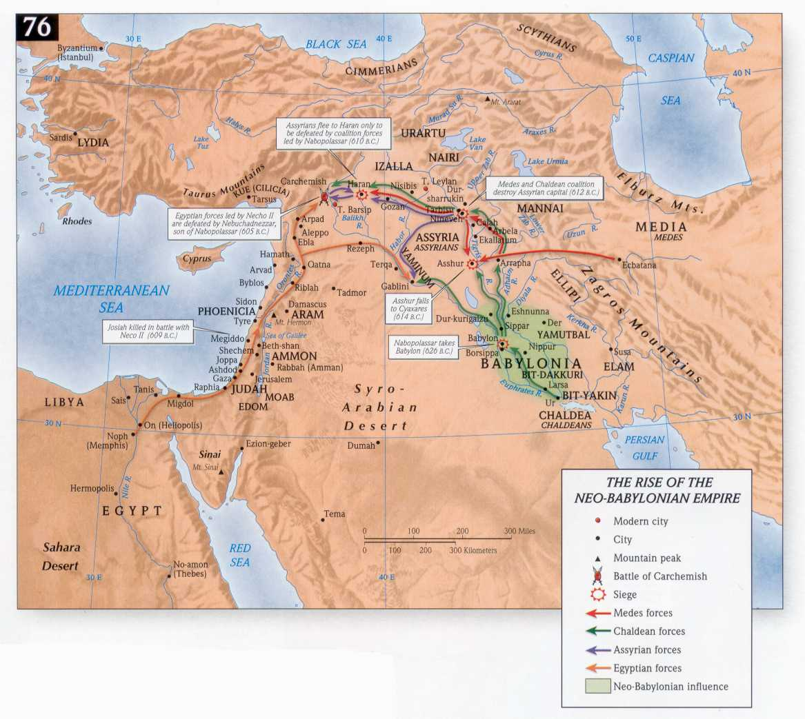

Slide 23
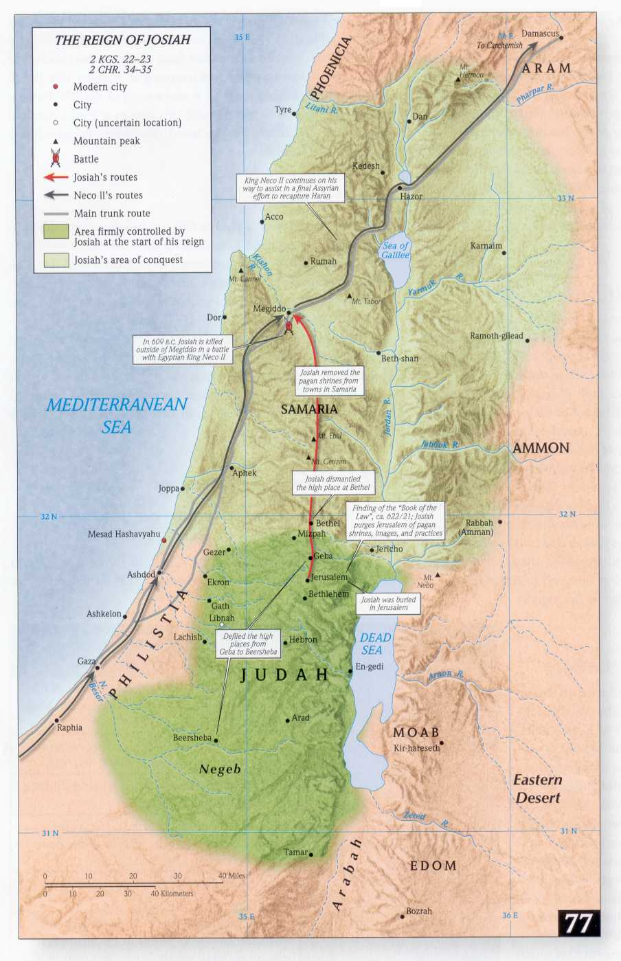
609 BC Necho and Egyptian Army March North
Josiah intercepts army at Megiddo and is killed
Judah looses independence
Judah becomes a vassal of Egypt

Slide 24
609 BC Necho and Egyptian Army March North
Necho deposes Jehoahaz
Jehoiakim is placed on the throne
Collapse of reforms

Slide 25
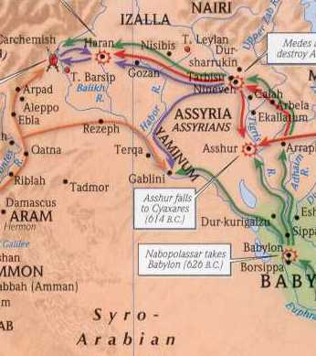
605/4 BC Battle of Carchemish
Egypt beaten by Babylon
Babylon becomes main power
Small deportation (including Daniel)

Slide 26
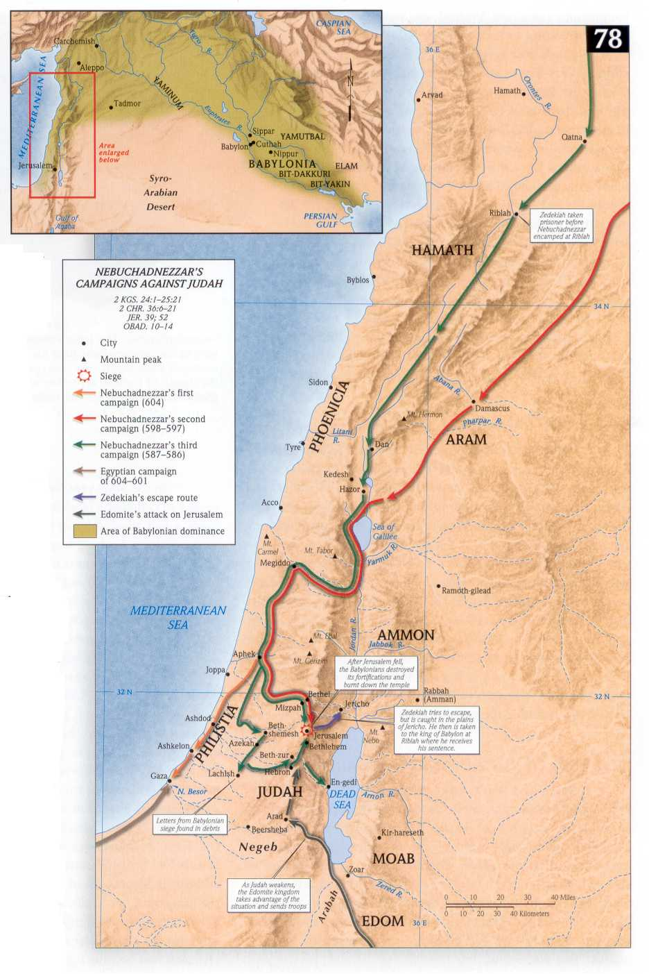
605/4 BC Battle of Carchemish
Nebuchadnezzar attacks Philistine cities
A fast is proclaimed
Judah becomes a vassal of Babylon

Slide 27
601 BC Nebuchadnezzar Attacks Egypt
Meets resistance and retreats

Slide 28
598/7 BC Judah Rejects Babylon Suzerainty #1
Makes alliance with Egypt
Babylon sends in the army again
2-month siege of Jerusalem
Jehoiakim dies (possibly assassinated)

Slide 29
598/7 BC Judah Rejects Babylon Suzerainty #2
Jehoiachin deported to Babylon
Major deportation including Ezekiel
Two communities now
Exiles: Hope for the future - good figs
Zedekiah becomes king

Slide 30
594/3 BC Uprising in Babylon
Hope for fall of Babylon
Edom, Ammon, Moab, Tyre and Sidon plan rebellion
Try to persuade Zedekiah to join them Jer 27:2

Slide 31
588 BC Judah Invaded by Babylon
Jerusalem is sieged for 18 months
Brief lull in the siege
Egypt comes to help
Babylon sent forces to Egypt relieving Jerusalem
Slaves freed and retaken Jer 34:8ff

Slide 32
587 BC Jeremiah Is Imprisoned

Slide 33
586 BC Babylonian Army Breaks Into Jerusalem #1
Prisoners taken to Riblah
Zedekiah's sons killed
Zedekiah blinded and taken to exile
Most people are deported

Slide 34
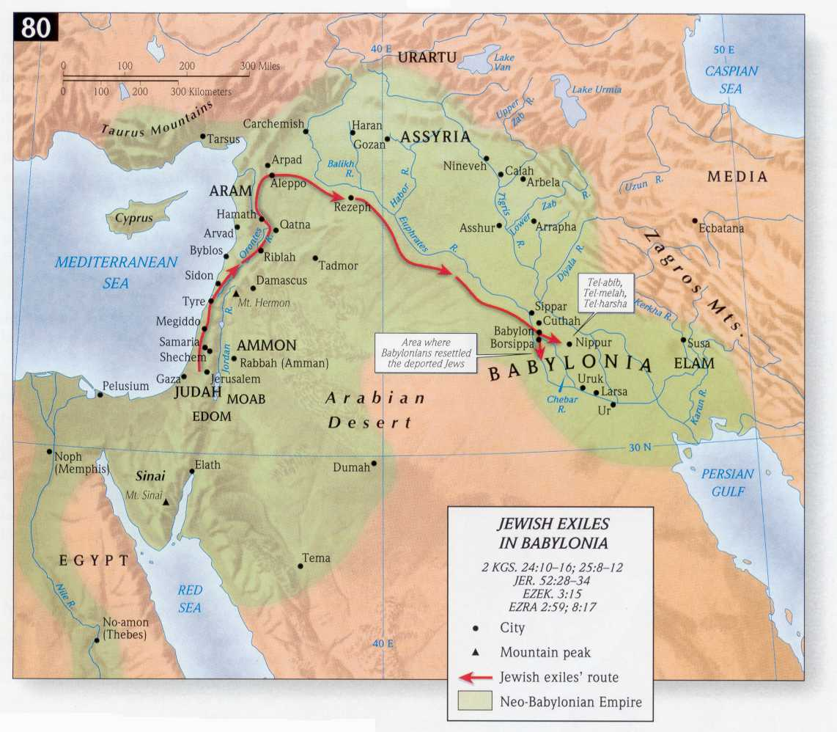

Slide 35
586 BC Babylonian Army Breaks Into Jerusalem #2
The city plundered and burned
Objects of worship taken from temple
The temple destroyed
Including the ark of the covenant?

Slide 36
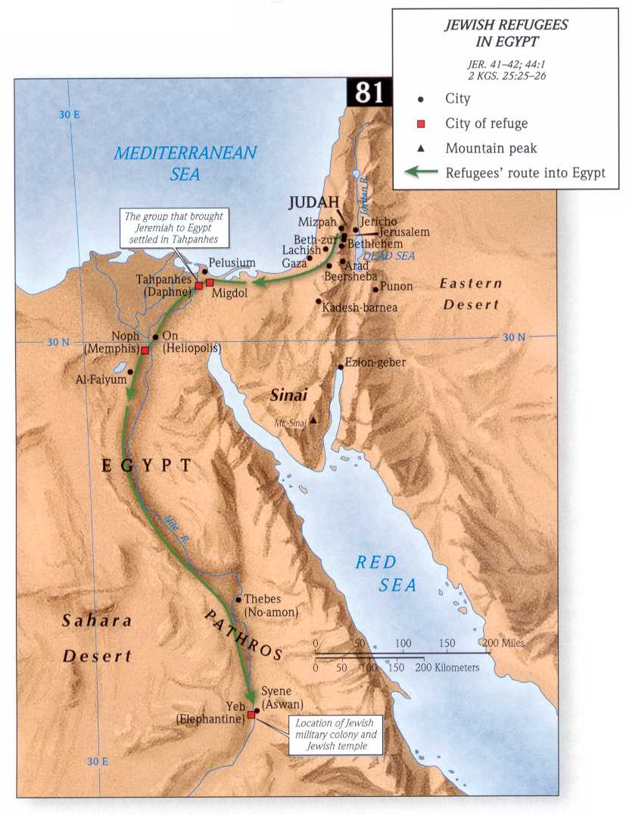
586 BC Continued
Gedaliah made governor
3 months later Gedaliah is murdered
Jews flee to Egypt

Slide 37
582 BC Final Deportation of the Poorest of Poor

