Slide 1
Computer Network Security
TE - IT
Lecture -15
17/08/2022
Session: 11:00 - 12:00 PM
Prof. Stella J
Department of Information Technology
Xavier Institute of Engineering

Slide 2
Module-2
Kerberos
Digital Certificate

Slide 3
Kerberos
Kerberos is a protocol for authenticating service requests between trusted hosts across an untrusted network, such as the internet. Kerberos support is built in to all major computer operating systems, including Microsoft Windows, Apple macOS, FreeBSD and Linux.

Slide 4
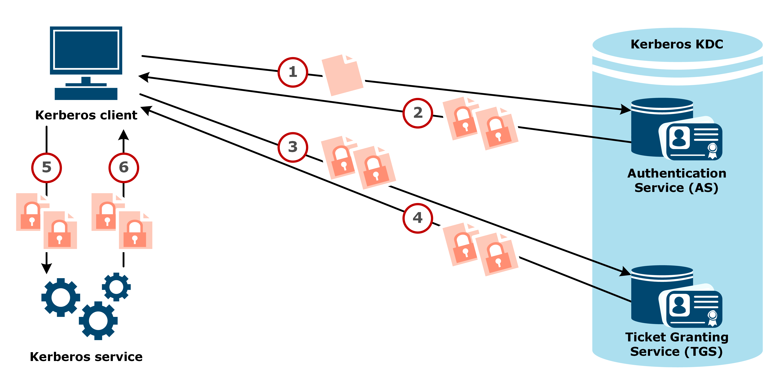
Kerberos Service request

Slide 5
Kerberos Services:
Authentication server request. To start the Kerberos client authentication process, the initiating client sends an authentication request to the Kerberos KDC authentication server. The initial authentication request is sent as plaintext because no sensitive information is included in the request. The authentication server verifies that the client is in the KDC database and retrieves the initiating client's private key.
C --> AS = ID_{C} || ID _{TGS} || Timestamp
Authentication server response. If the initiating client's username isn't found in the KDC database, the client cannot be authenticated, and the authentication process stops. Otherwise, the authentication server sends the client a TGT and a session key.
AS --> C = E[K_{C,TGS}|| ID _{TGS} || TICKET _{TGS}],
TICKET TGS = E[ID_{C} || AD_{C}||TS||K_{C,TGS}]

Slide 6
Kerberos Services:
Service ticket request. Once authenticated by the authentication server, the client asks for a service ticket from the TGS. This request must be accompanied by the TGT sent by the KDC authentication server.
C --> TGS = ID_{V} ||TICKET _{TGS}||AUTHENTICATION
AUTHENTICATION = ID_{C}||AD_{C}||TS
Service ticket response. If the TGS can authenticate the client, it sends credentials and a ticket to access the requested service. This transmission is encrypted with a session key specific to the user and service being accessed. This proof of identity is used to access the requested "Kerberized" service. That service validates the original request and then confirms its identity to the requesting system.
TGS --> C = TICKET _{V}|| ID_{C}, TICKET _{V} = E[K_{V}(K_{C,V}||ID_{C}||ID_{V}||TS)]

Slide 7
Kerberos Services:
Application server request. The client sends a request to access the application server. This request includes the service ticket received in step 4. If the application server can authenticate this request, the client can access the server.
C --> V = TICKET || AUTHENTICATION
ID_{C}||AD_{C}||ID_{V}||TS
Application server response. In cases where the client requests the application server to authenticate itself, this response is required. The client has already authenticated itself, and the application server response includes Kerberos authentication of the server.
V --> C = E[K_{C,V}(TS)]

Slide 8
Public Key Infrastructure (PKI):
1. It is a standard for digital Certificate
2. It is related to Assymetric key Cryptography
3. It includes message integrity, digital signature and Encryption services
4. To enable all these services digital certificate is required

Slide 9
Digital Certificate:
It is Standrdized by PKI
It is a small file on computer electronic device
file extension is .cer
It establishes the relation between a user and the public key

Slide 10
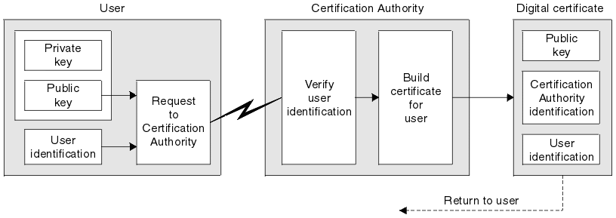
Digital Certificate X.509

Slide 11
X.509 Parameters
Serial Number
Algorithm and Parameters
Issuer Name
Validity From and TO
Subject Name
Subject Public Key Info
Issuer unique Identity
Subject unique Identity
Extensions
Signature
X.509 V1
X.509 V2
X.509 V3

Slide 12
THANK YOU

