Slide 1
Lecture 24
Network Management Security
26/09/2022

Slide 2
Outline
Basic Concepts of SNMP
SNMPv1 Community Facility
SNMPv3

Slide 3
Basic Concepts of SNMP
An integrated collection of tools for network monitoring and control.
Single operator interface
Minimal amount of separate equipment. Software and network communications capability built into the existing equipment
SNMP key elements:
Management station
Managament agent
Management information base
Network Management protocol
Get, Set and Notify

Slide 4
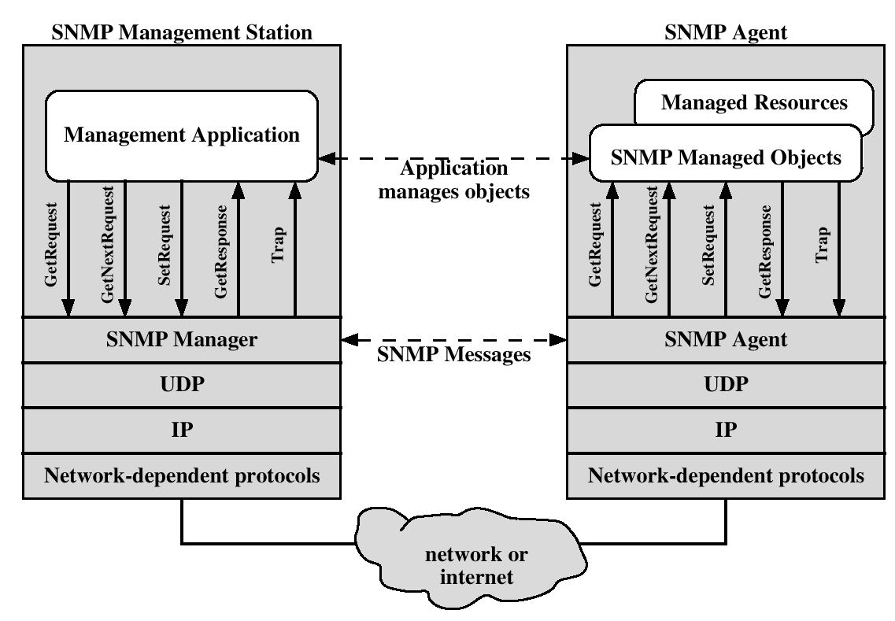
Protocol context of SNMP

Slide 5
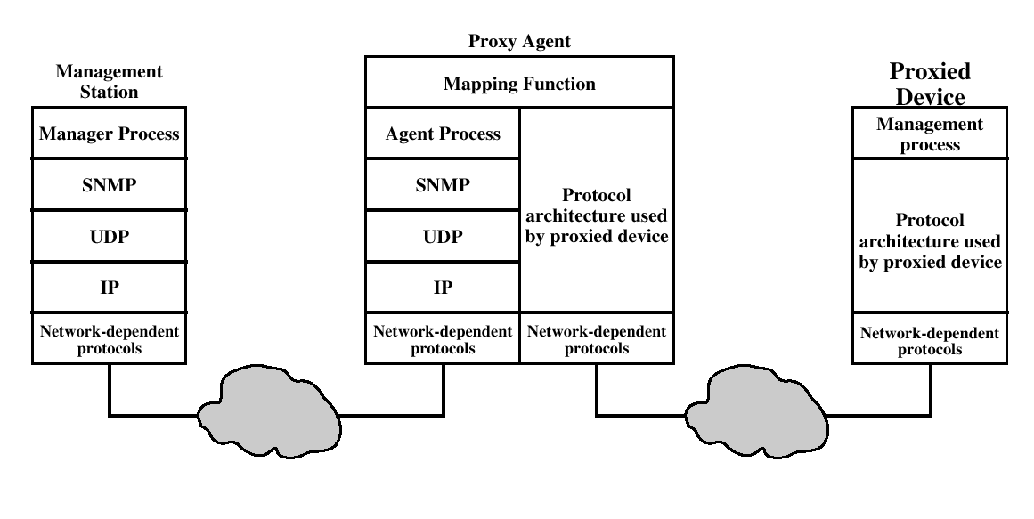
Proxy Configuration

Slide 6
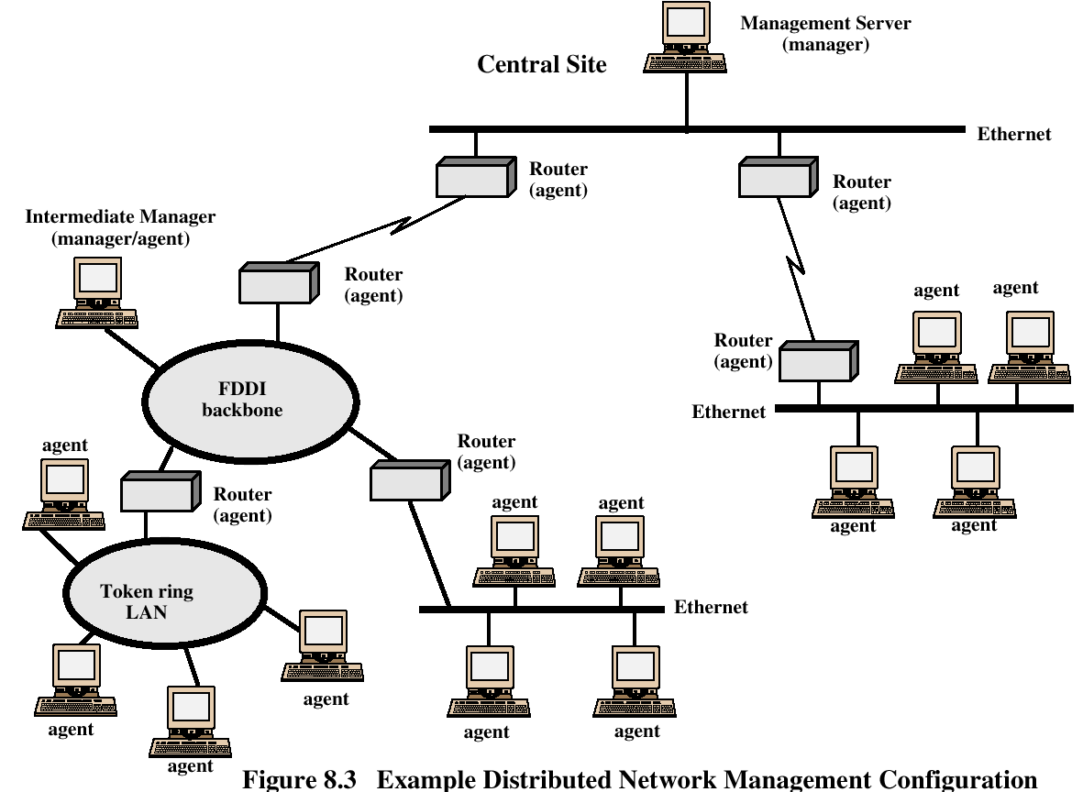

Slide 7
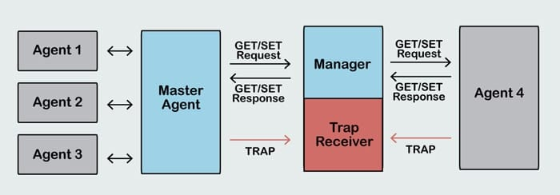
SNMP Messages

Slide 8
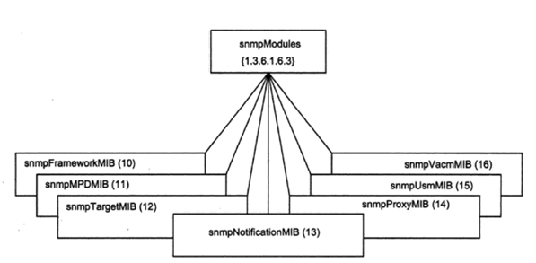
Seven MIB Groups

Slide 9
Seven MIB Groups
There are three groups defined under snmpModules for applications. They are snmpTargetMIB (node 12), snmpNotificationMIB (node 13), and snmpProxyMIB (node 14).
iv) The first two are used for notification generator. The snmpTargetMIB defines MIB objects, which are used to remotely configure the parameters used by a remote SNMP entity. There are two tables in that MIB, which are of specific interest for us

Slide 10
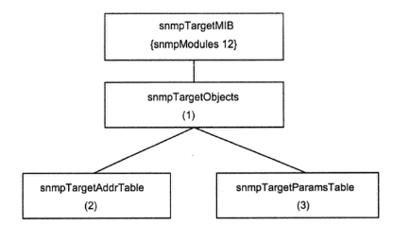
Seven MIB Groups

Slide 11
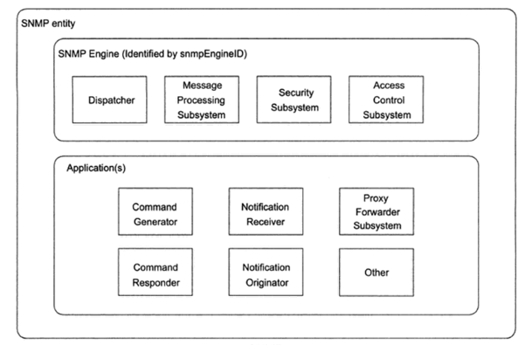
SNMP Entity

Slide 12
Dispatcher:
It is used to send and receive messages. It tries to determine the version of each received messages (v1,v2,v3) and if the version is supported, hands the message off to the message processing system.
The Dispatcher also sends SNMP Messages to other entities

Slide 13
Message Processing subsystem:
The message processing subsystem prepares messages to be sent and extracts data from received messages.
It can contain multiple message processing modules.

Slide 14
Security Subsystem:
It provides authentication and privacy services.
Authentication uses either community strings(SNMP v1 and v2) or V3 user based authentication.
User based authentication uses MD5 or SHA algorithms to authenticate users without sending a password in the clear text
Privacy services uses DES or AES for encryption

Slide 15
Access Control Subsystem:
It is responsible for controlling access to MIB objects. You can control what objects a user can access as well what operations she is allowed to perform on those objects.

Slide 16
SNMP Entity
It generates get, getnext, getbulk and set requests and processes the responses
It can issue queriesand set requests against entities on routers, switches, unix host etc

Slide 17
SNMP Entity
It responds to get, getnext, getbulk and set requests. This application is implemented by an entity such as cisco router or unix host.
for V1 and V2 it is implemented by SNMP Agent

Slide 18
SNMP Entity
It generates SNMP traps and notifications. The application is implemented by an entity such as a router or Unix hosts.

Slide 19
SNMP Entity
It receives the traps and inform messages. It is implemented by NMS

Slide 20
SNMP Entity
It facilitates message passing between entities

Slide 21
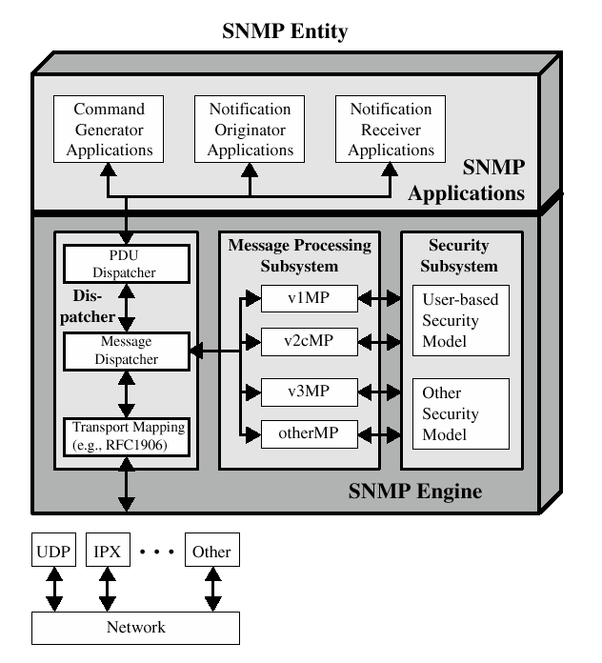
Traditional SNMP Manager

Slide 22
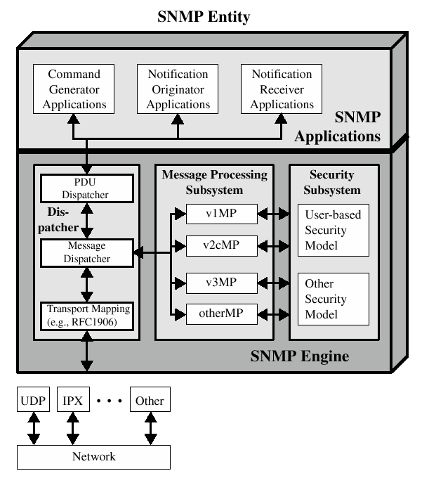
Traditional SNMP Agent

Slide 23
SNMP v1 and v2
Trap – an unsolicited message (reporting an alarm condition)
SNMPv1 is ”connectionless” since it utilizes UDP (rather than TCP) as the transport layer protocol.
SNMPv2 allows the use of TCP for ”reliable, connection-oriented” service.

Slide 24
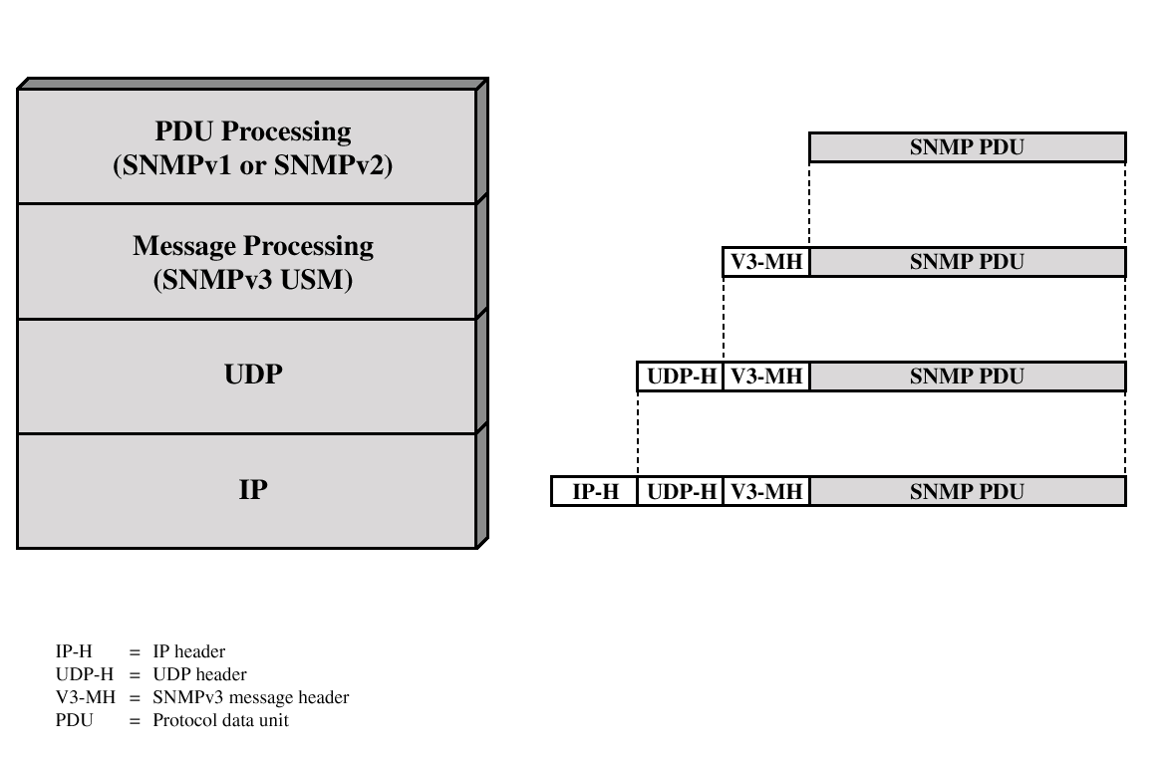
SNMPv3
SNMPv3 defines a security capability to be used in conjunction with SNMPv1 or v2

Slide 25
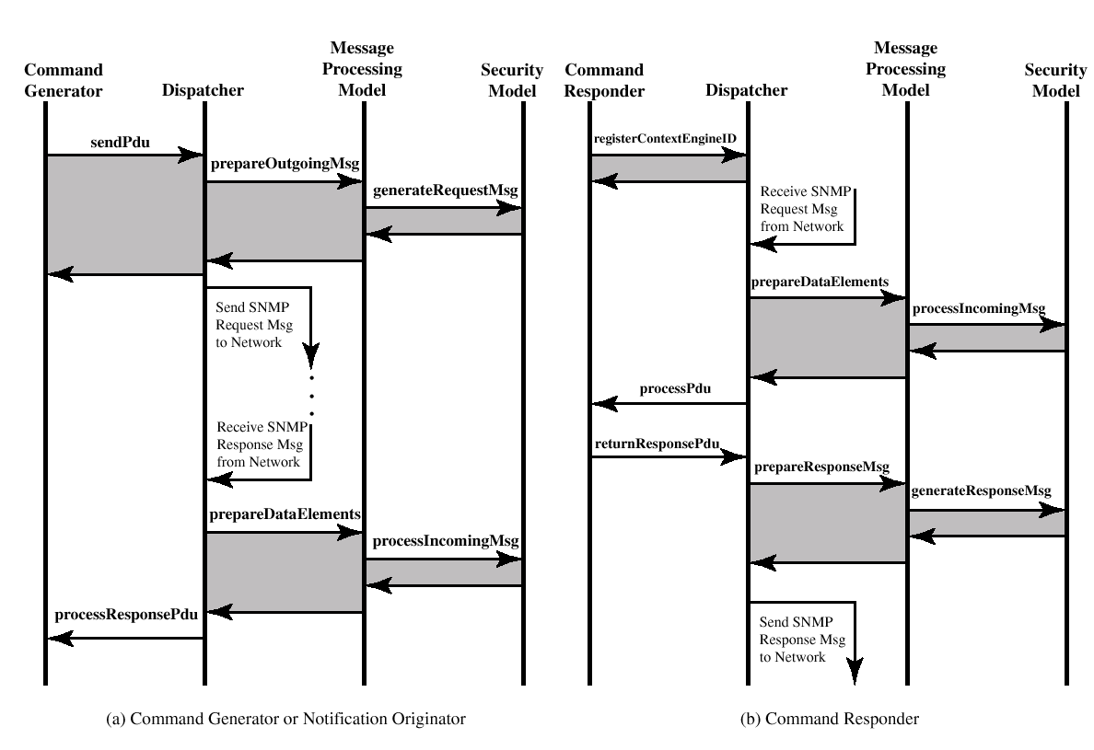
SNMPv3 Flow

Slide 26
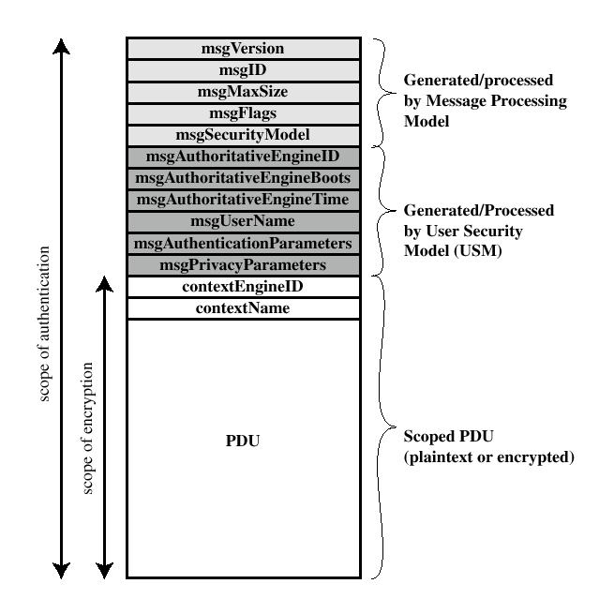
SNMP3 Message Format with USM

Slide 27
User Security Model (USM)
Designed to secure against:
Modification of information
Masquerade
Message stream modification
Disclosure
Not intended to secure against:
Denial of Service (DoS attack)
Traffic analysis

Slide 28
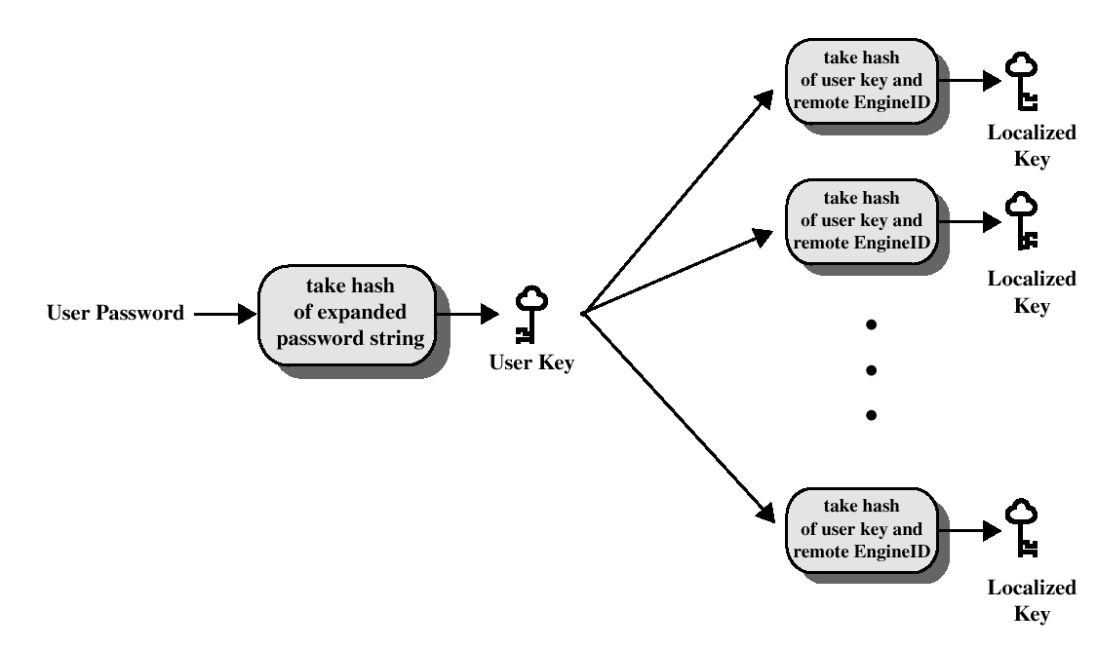
Key Localization Process

Slide 29
View-Based Access Control Model (VACM)
VACM has two characteristics:
Determines wheter access to a managed object should be allowed.
Make use of an MIB that:
Defines the access control policy for this agent.
Makes it possible for remote configuration to be used.

Slide 30
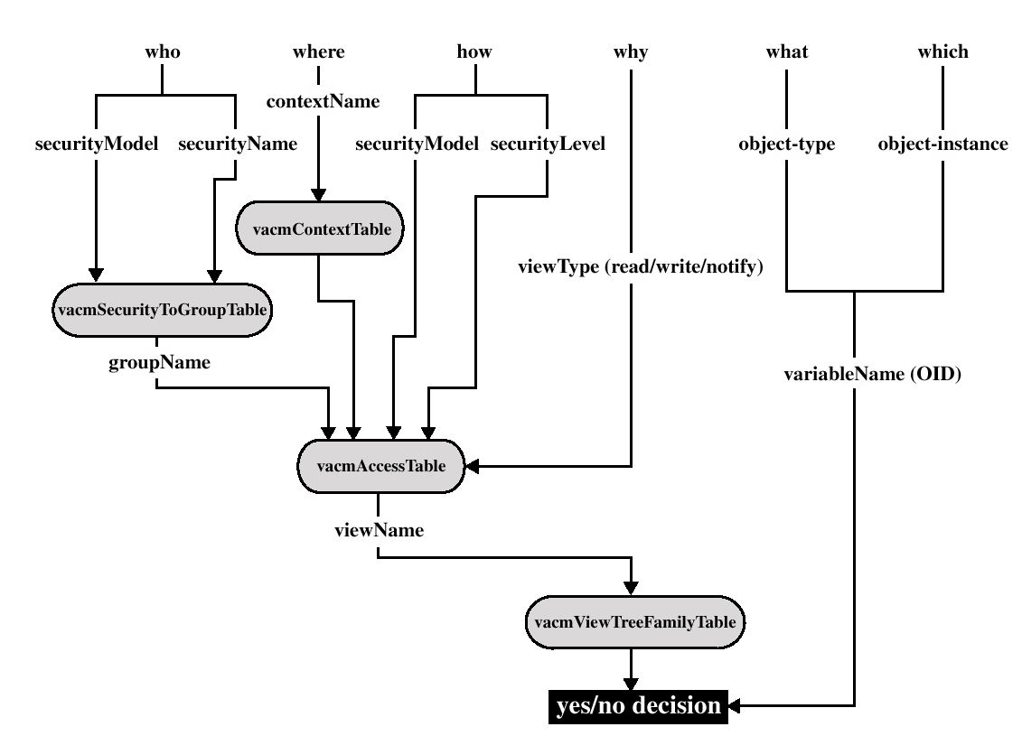
Access control decision

