Slide 1
Computer Network Security
TE - IT
Lecture -28
03/10/2022
Session: 12:00 - 1:00 PM
Prof. Stella J
Department of Information Technology
Xavier Institute of Engineering

Slide 2
Outline
Firewall
Types of Firewall
Types of Network Architecture and Problems
Limitation of Firewall

Slide 3
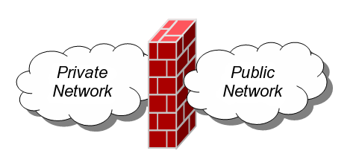
Firewall
A firewall is an integrated collection of security measures designed to prevent unauthorized electronic access to a networked computer system.
A network firewall is similar to firewalls in building construction, because in both cases they are intended to isolate one "network" or "compartment" from another.

Slide 4
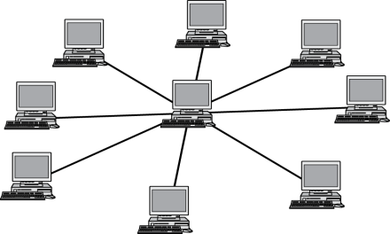
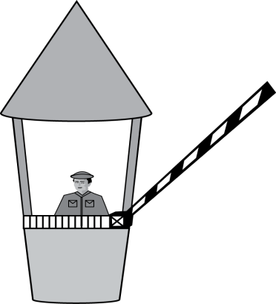
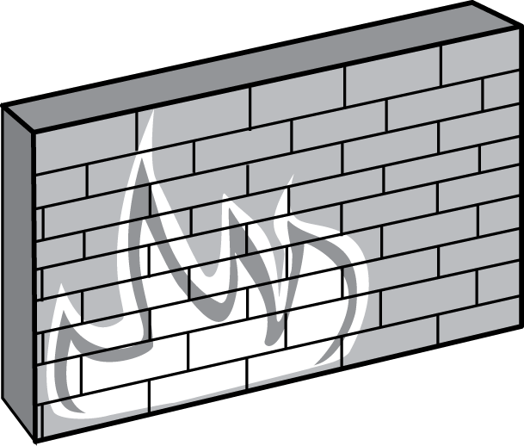


Firewall Policies
To protect private networks and individual machines from the dangers of the greater Internet, a firewall can be employed to filter incoming or outgoing traffic based on a predefined set of rules called firewall policies.
Trusted internal network
Firewall policies
Untrusted
Internet
Firewall

Slide 5
Policy Actions
Packets flowing through a firewall can have one of three outcomes:
Accepted: permitted through the firewall
Dropped: not allowed through with no indication of failure
Rejected: not allowed through, accompanied by an attempt to inform the source that the packet was rejected
Policies used by the firewall to handle packets are based on several properties of the packets being inspected, including the protocol used, such as:
TCP or UDP
the source and destination IP addresses
the source and destination ports
the application-level payload of the packet (e.g., whether it contains a virus).

Slide 6
BlackLists and WhiteLists
Two fundamental approaches to creating firewall policies (or rulesets)
Blacklist approach (default-allow)
All packets are allowed through except those that fit the rules defined specifically in a blacklist.
Pros: flexible in ensuring that service to the internal network is not disrupted by the firewall
Cons: unexpected forms of malicious traffic could go through
Whitelist approach (default-deny)
Packets are dropped or rejected unless they are specifically allowed by the firewall
Pros: A safer approach to defining a firewall ruleset
Cons: must consider all possible legitimate traffic in rulesets

Slide 7
Firewall Types
packet filters (stateless)
If a packet matches the packet filter's set of rules, the packet filter will drop or accept it
"stateful" filters
it maintains records of all connections passing through it and can determine if a packet is either the start of a new connection, a part of an existing connection, or is an invalid packet.
application layer
It works like a proxy it can “understand” certain applications and protocols.
It may inspect the contents of the traffic, blocking what it views as inappropriate content (i.e. websites, viruses, vulnerabilities, ...)

Slide 8

Stateless Firewall:
A stateless firewall doesn’t maintain any remembered context (or “state”) with respect to the packets it is processing. Instead, it treats each packet attempting to travel through it in isolation without considering packets that it has processed previously.
SYN
Seq = x
Port=80
Client
SYN-ACK
Seq = y
Ack = x + 1
ACK
Seq = x + 1
Ack = y + 1
Trusted internal
network
Server
Firewall
Allow outbound SYN packets, destination port=80
Allow inbound SYN-ACK packets, source port=80

Slide 9


Stateless Restrictions:
Stateless firewalls may have to be fairly restrictive in order to prevent most
attacks.
Client
SYN
Seq = y
Port=80
Attacker
(blocked)
Trusted internal
network
Firewall
Allow outbound SYN packets, destination port=80
Drop inbound SYN packets,
Allow inbound SYN-ACK packets, source port=80

Slide 10
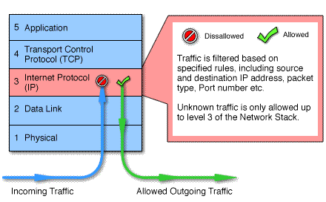
Packet Firewall:
Work at the network level of the OSI model
Each packet is compared to a set of criteria before it is forwarded
Packet filtering firewalls is low cost and low impact on network performance

Slide 11
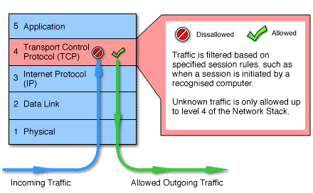
Circuit Firewall:
Circuit level gateways work at the session layer of the OSI model, or the TCP layer of TCP/IP
Monitor TCP handshaking between packets to determine whether a requested session is legitimate.

Slide 12
Statefull Firewall
Stateful firewalls can tell when packets are part of legitimate sessions originating within a trusted network.
Stateful firewalls maintain tables containing information on each active connection, including the IP addresses, ports, and sequence numbers of packets.
Using these tables, stateful firewalls can allow only inbound TCP packets that are in response to a connection initiated from within the internal network.

Slide 13
Statefull Firewall:
76.120.54.101
SYN
Seq = x
Port=80
Server
128.34.78.55
Client
SYN-ACK
Seq = y
Ack = x + 1
ACK
Seq = x + 1
Ack = y + 1
Trusted internal
network
(blocked)
SYN-ACK
Seq = y
Port=80
Attacker
Allow outbound TCP sessions,
destination port=80
Firewall
Established TCP session: (128.34.78.55, 76.120.54.101)
Firewall state table

Slide 14
Statelfull Firewall:
TCP-based connections are easy to check
TCP SYN packet
UDP-based traffic is not so clear
There is no UDP connection set up
Treat a UDP session starts when a legitimate UDP packet is allowed through the firewall (such as from inside to outside)
Session is defined by (source IP, source port, dest IP, dest port)

Slide 15
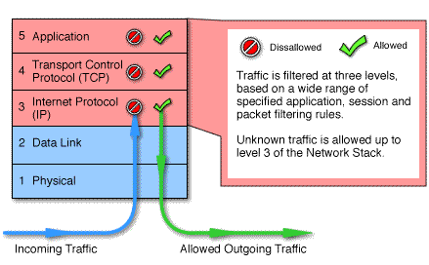
StateFull Multilayer:
Stateful multilayer inspection firewalls combine the aspects of the other three types of firewalls
They filter packets at the network layer, determine whether session packets are legitimate and evaluate contents of packets at the application layer

Slide 16
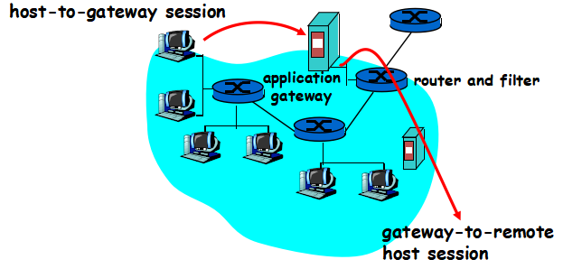
Application-level Firewall:
Filters packets on application data as well as on IP/TCP/UDP fields.
Example: allow select internal users to telnet outside.
1. Require all telnet users to telnet through gateway.
2. For authorized users, gateway sets up telnet connection to dest host. Gateway relays data between 2 connections
3. Router filter blocks all telnet connections not originating from gateway.
Example: block user access to know facebook websites
Check if the Web URL is in a “black-list”

Slide 17
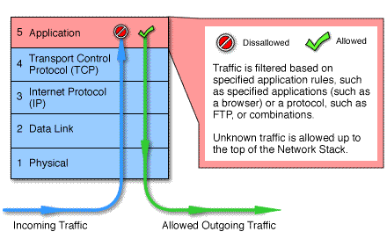
Application-level Firewall:
Application level gateways, also called proxies, are similar to circuit-level gateways except that they are application specific
Gateway that is configured to be a web proxy will not allow any ftp, gopher, telnet or other traffic through

Slide 18
Firewalls on Windows and Linux:
On Linux, Iptables is used to provide firewall function
http://en.wikipedia.org/wiki/Iptables\
On Windows, use “control panel”→ “Windows Firewall”

Slide 19

Getting Inside an Trusted Network
Passive Evasion - The victim “phones home” to the attacker
1. Phishing/spearphishing
2. Malicious website/drive-by infection
3. “Sneakernet” infection
4. Social Engineering
Indirect Evasion – Traffic appears to be authentic
1. Stolen remote access credentials
2. VPN piggyback
3. Session hijacking
4. Address spoofing (for i

Slide 20
Getting Inside an Trusted Network
Active Evasion
1. Attack exposed services (Web, E-mail)
2. Attack firewall vulnerabilites
3. Exploit weak ruleset/poor configuration
4. “Trick” or subvert the firewall logic with protocol manipulation
(AET)
5. Find out-of-band channels (wireless, modems, satellite links)
6. Get physical access to firewall or other infrastructure

Slide 21
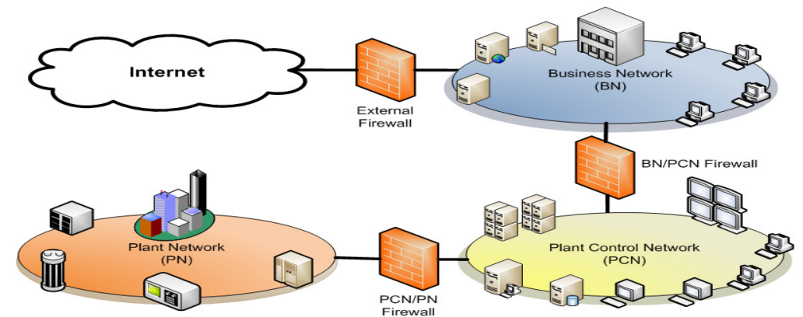
Type of Network Architecture
Business network acts as backbone
• Firewall between business network (BN) and plant
control network (PCN)
• Firewall between PCN and plant network (PN) may or
may not be in place
Problems:
• BN/PCN Firewall is configured to partially or
completely trust BN
• PCN/PN Firewall is
configured to partially or completely trust PCN

Slide 22
Limitation:
Firewall technology is not one way (non-deterministic, not
application-fluent)
•Firewalls can be bypassed in many ways
•Firewalls have their own vulnerabilities
•Effective Security Programs must do the following:
-Prevent
-Detect
-Delay
-Deny
-Deter
-Respond
-Recover
• Firewalls cannot do all of these things alone

Slide 23
THANK YOU

