Slide 1
Beaver Botanica.
The OSU Plant Map.
Adison Daggett, Kathryn Butler, Luke Scovel, William Brennan, Anshu Avinash, Finlay Curtiss, Jake Thompson

Slide 2
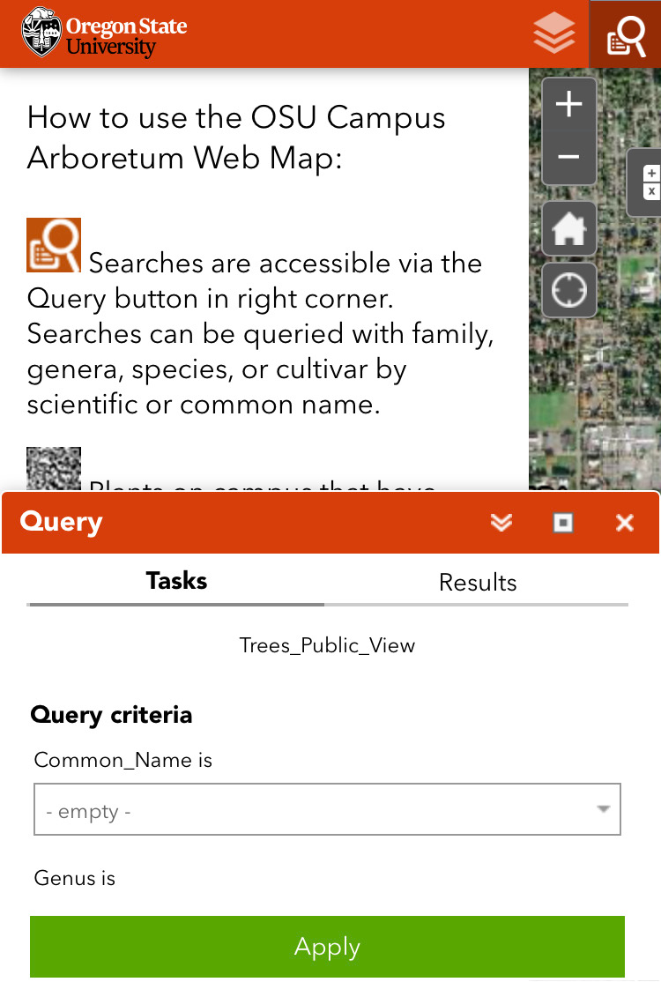
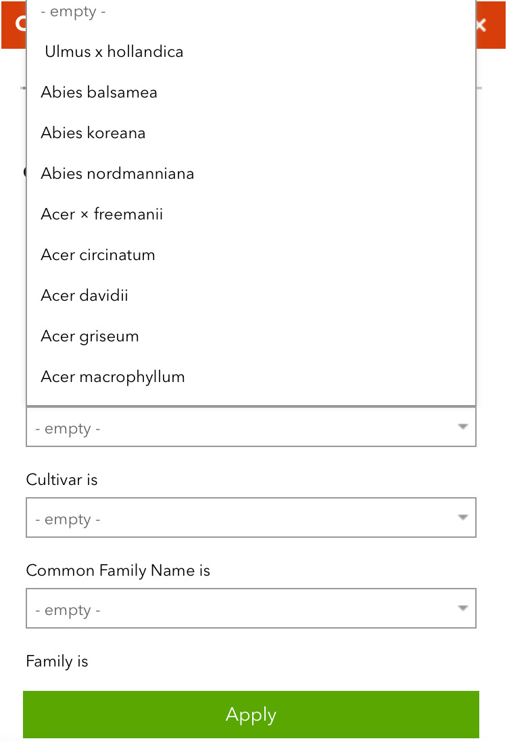
Problem
Broad Software
Limited Time
Poor Design
Current botanical software covers a wide location and does not show the locations of individual plants for a specific area.
Outside of classes and clubs, it is hard to learn about native flora. Botany students may wish to investigate flora on their own time, but will not know where to find specific plants.
Current softwares require the user to know the scientific name of the plant they wish to record and are not built for mobile devices.
Notes:
Problem 1: Most software is too broad! We want to be able to see all the plants in a specific location, the OSU Corvallis campus.
Problem 2: This is especially a problem for students like us, who really only have the chance to take Computer Science classes, so we miss out on learning about other topics. I wouldn’t know where to start if I wanted to start learning more about the plants on campus.
Problem 3: The current software that exists requires knowledge of plants that many users would likely not have. This is a website for trees at OSU, which has a lot of search criteria, but they all look a bit like this:
Also, this software isn’t made for mobile devices, which is the best type of device to use if you’re trying to navigate to figure out the tree in front of you. Here’s what it looks like when I open it on my phone:

Slide 3
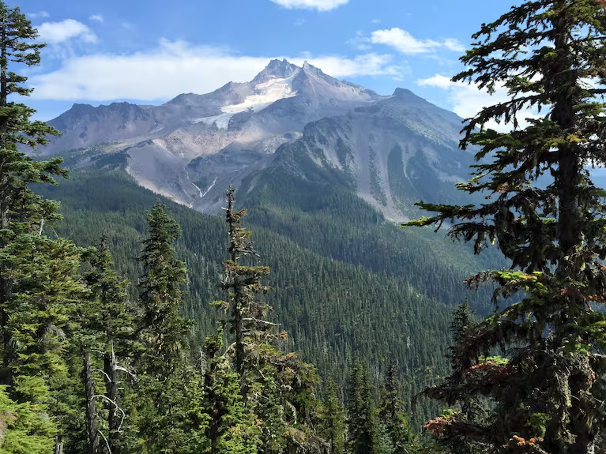
Solution
To help students better learn and identify OSU’s local flora, we want to create an interactive plant map. It will solve the problems mentioned by being specific to OSU, easily accessible, and intuitively designed.
Notes:
Our proposed solution the the aforementioned problems is to create our own interactive map with the locations of individual plants on the OSU Corvallis campus. We are going to implement an intuitive and simple design built for mobile devices to allow for easy access.

Slide 4

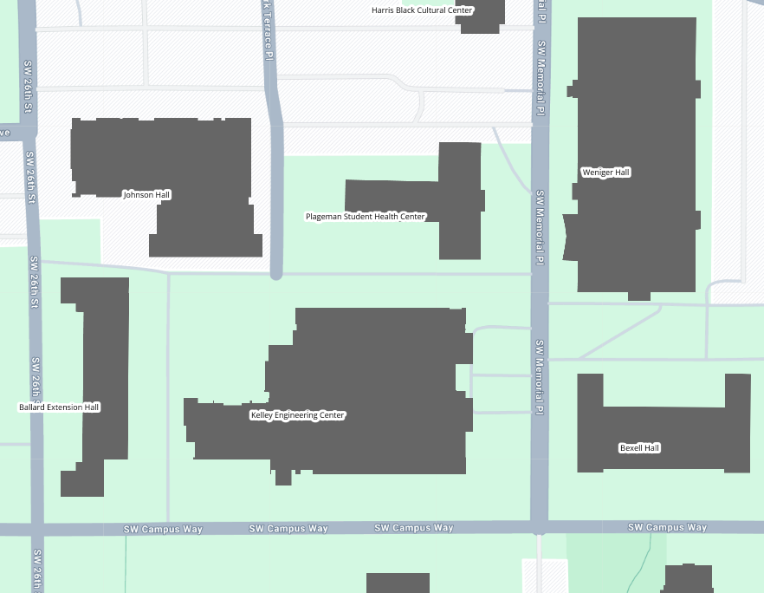
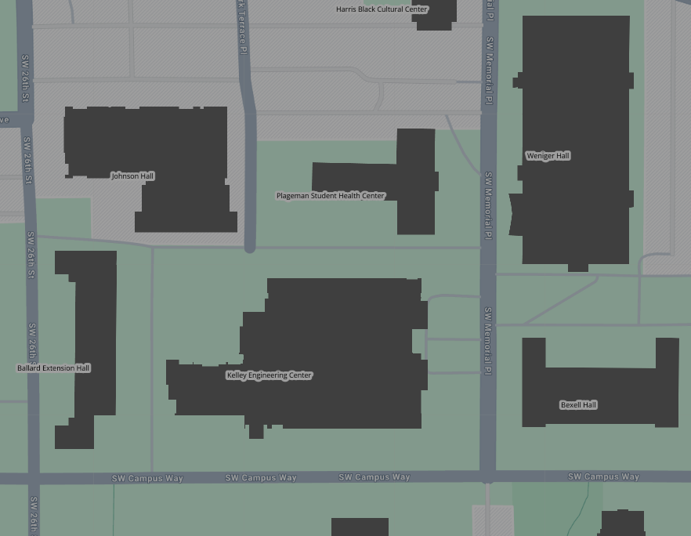
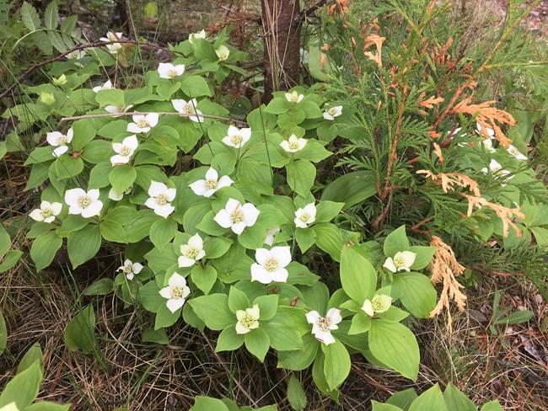
Features
Home
Search
Add Plant
Name of Plant
Scientific Name
Details about the plant type
Comprehensive, easy to understand search
User post interaction features, such as liking and commenting on entries
Informative plant descriptions
Admin/voting verification system to ensure the plants have the right information
Info about the specific plant the user clicked on.
Notes:
Search: The search feature should make sense to new users and those without a lot of experience with botany or plants.
Social Features: Social features can help create a sense of community, allowing users to connect over plants and share things they learn or photos they have taken of the plants on campus.
Descriptions: Descriptions and facts on entries help users learn more about plants they see every day.
Post verification: By implementing a verification system, we can protect our database from being accidentally or maliciously edited. Keeping information about plants and their locations accurate means our users will trust the software and it can be a source of helpful data.

