Slide 1
Beaver Botanica. OSU’s Plant Map.
Adison Daggett, Kathryn Butler, Luke Scovel, William Brennan, Anshu Avinash, Finlay Curtiss, Jake Thompson

Slide 2
The Problem with Current Software
Broad Scope
Poor Design
Limited Time
Current botanical software covers a wide location and does not show the locations of individual plants for a specific area.
Current softwares require the user to know the complicated scientific name of the plant they wish to record and are not built for mobile devices.
Outside of classes and clubs, it is hard to learn about native flora.
Students may wish to investigate flora on their own time, but do not have the resources.

Slide 3
The Solution - Beaver Botanica
A community built and driven platform to help students learn to identify plants across campus
Students can learn from other students and provide feedback and fun facts about their observations
A fun, community oriented way to learn about the flora that occupies our campus

Slide 4
Requirements
Nonfunctional
Expandable
Safe and Accurate
Accessible
Functional
Add and edit a plant entry
Like and comment
Verifying plant entry
Search and view map

Slide 5
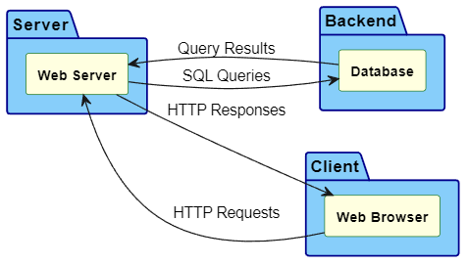
Software Architecture - System
Server: Node.js connected to a self-hosted database server
Framework: Express.js to provide a simple API
These libraries are both open-source and widely used
Client-Server Architecture

Slide 6
Software Architecture - Frontend
HTML: HTML provides an easy way of developing a website from scratch and is the language we all have experience in.
CSS: Like HTML, CSS is easy to use and everyone on the team knows how to use it.
JavaScript: Javascript is what everyone knows and is a very adaptable language.
React.js: An incredibly usable library that can even be used in mobile development

Slide 7
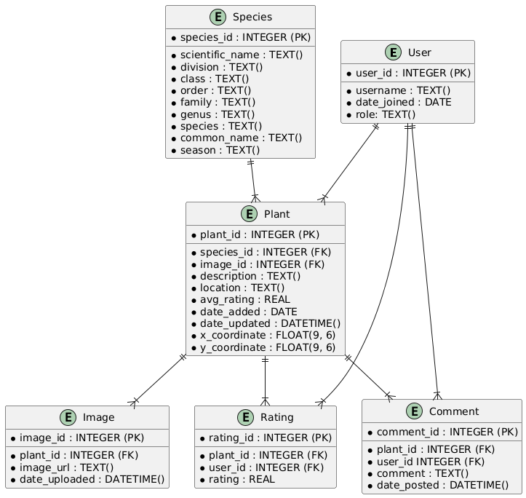
Software Architecture - Backend
Database: MySQL managed with MySQL Workbench. Stores plant information, user data, comments, and ratings
Design and Schema

Slide 8
Algorithms
Add a Plant Instance
Add a Species
Update either
Delete plant (system staff only), users can flag it.
Login
Add new User
Add/Edit/delete Comments. Staff delete. Users report.
Get Directions (send coordinates to Google maps)
Filtering/searching

Slide 9

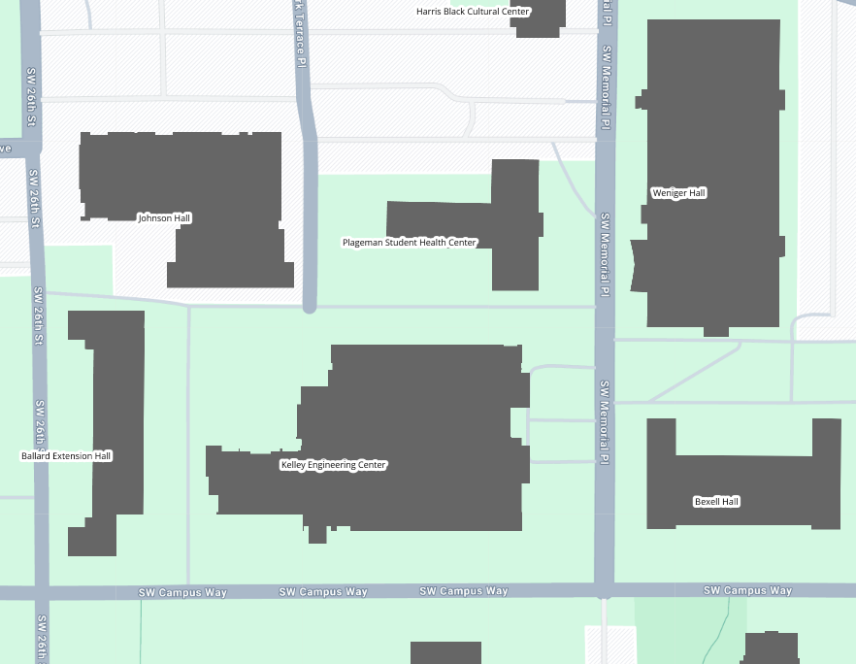
UI Design
Home
Search
Add Plant
Design goals
Intuitive and accessible
User-driven and scalable
Mobile Friendly
Key UI Components
Interactive map
Upload plant image
Search and filter system

Slide 10
Testing Our Solution
User Experience
Performance
Reliability
We will have students and faculty (with little to no botany experience) test the mobile website to see if they find it accessible and enjoyable.
We will ensure the website loads quickly and the map updates are smooth.
We will test the platform in real-world conditions around OSU’s campus.
We will compare user-submitted plant identifications to verified sources to improve identification reliability and accuracy.

Slide 11
Testing Our Solution
Dataset We Will Use
OSU Department of Horticulture
We can source data from our botany department resources.
Crowdsourced Campus Data
Users will contribute their own identifications and observations.
Metrics We Will Consider
Identification Accuracy
We will compare user plant submissions to verified sources.
Fun Factor and Usability
We will gather feedback on user engagement and perceived accessibility of our platform.

Slide 12
Thank you!
The Problem
The Solution
The Tests
The Outcome
1
2
Most plant identification apps are complex and not beginner-friendly.
Beaver Botanica makes plant learning fun and accessible for students.
3
4
We will track user engagement, feedback, and plant submissions.
Exploring campus plant life will make learning botany more engaging.

Slide 13
Thank you!

