Slide 1
计算机学院课程
计算机组成
从晶体管到运算
高小鹏
北京航空航天大学计算机学院
系统结构研究所

Slide 2
提纲
内容主要取材：CS61C的17讲、18讲
http://inst.eecs.berkeley.edu/~cs61c/su12
晶体管
门电路
运算

Slide 3
提纲
内容主要取材：CS61C的17讲、18讲
http://inst.eecs.berkeley.edu/~cs61c/su12
晶体管
门电路
运算

Slide 4
Design Hierarchy
system
datapath
control
code registers
state registers
combinational logic
multiplexer
comparator
register
logic
switching networks

Slide 5
Switches (1/2)
The basic element of physical implementations
Convention: if input is a “1,” the switch is asserted
A
Z
Open switch if A is “0” (unasserted)
and turn OFF light bulb (Z)
A
Z
Close switch if A is “1” (asserted) and turn ON light bulb (Z)
In this example, Z ≡ A.

Slide 6
Switches (2/2)
Can compose switches into more complex ones (Boolean functions)
Arrows show action upon assertion (1 = close)
A
B
AND:
“1”
Z ≡ A and B
A
OR:
“1”
Z ≡ A or B
B

Slide 7
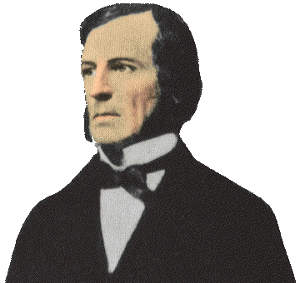
Historical Note
1938年香农在MIT获得电气工程硕士学位，硕士论文题目是《A Symbolic Analysis of Relay and Switching Circuits》（继电器与开关电路的符号分析）。当时他已经注意到电话交换电路与布尔代数之间的类似性，即把布尔代数的“真”与“假”和电路系统的“开”与“关”对应起来，并用1和0表示。于是他用布尔代数分析并优化开关电路，这就奠定了数字电路的理论基础。哈佛大学的Howard Gardner教授说，“这可能是本世纪最重要、最著名的一篇硕士论文。”
Early computer designers built ad hoc circuits from switches
Began to notice common patterns in their work: ANDs, ORs, …
Master’s thesis (by Claude Shannon) made link between work and 19th Century Mathematician George Boole
Called it “Boolean” in his honor
Could apply math to give theory to hardware design, minimization, …

Slide 8
Transistors
High voltage (V_{dd}) represents 1, or true
Low voltage (0 volts or Ground) represents 0, or false
Let threshold voltage (V_{th}) decide if a 0 or a 1
If switches control whether voltages can propagate through a circuit, can build a computer
Our switches: CMOS transistors

Slide 9
CMOS Transistor Networks
Modern digital systems designed in CMOS
MOS: Metal-Oxide on Semiconductor
C for complementary: use pairs of normally-open and normally-closed switches
Used to be called COS-MOS for complementary-symmetry -MOS
CMOS transistors act as voltage-controlled switches
Similar, though easier to work with, than relay switches from earlier era (Porter computer)
Use energy primarily when switching
Notes:
Wikipedia: The phrase "metal–oxide–semiconductor" is a reference to the physical structure of certain field-effect transistors, having a metal gate electrode placed on top of an oxide insulator, which in turn is on top of a semiconductor material.
CMOS circuits use a combination of p-type and n-type metal–oxide–semiconductor field-effect transistors (MOSFETs)

Slide 10
CMOS Transistors
Gate
Source
Drain
Three terminals: source, gate, and drain
Switch action: if voltage on gate terminal is (some amount) higher/lower than source terminal then conducting path established between drain and source terminals (switch is closed)
Note circle symbol to indicate “NOT” or “complement”
Gate
Gate
Source
Drain
Source
Drain
n-channel transitor open when voltage at Gate is low closes when:
voltage(Gate) > voltage (Threshold)
(High resistance when gate voltage Low,
Low resistance when gate voltage High)
p-channel transistor closed when voltage at Gate is low opens when:
voltage(Gate) > voltage (Threshold)
(Low resistance when gate voltage Low,
High resistance when gate voltage High)
Notes:
From wikipedia:
The field-effect transistor (FET) relies on an electric field to control the shape and hence the conductivity of a channel of one type of charge carrier in a semiconductor material.
The most commonly used FET is the MOSFET. The CMOS (complementary-symmetry metal oxide semiconductor) process technology is the basis for modern digital integrated circuits. This process technology uses an arrangement where the (usually "enhancement-mode") p-channel MOSFET and n-channel MOSFET are connected in series such that when one is on, the other is off.
CMOS circuits are constructed in such a way that all PMOS transistors must have either an input from the voltage source or from another PMOS transistor. Similarly, all NMOS transistors must have either an input from ground or from another NMOS transistor. The composition of a PMOS transistor creates low resistance between its source and drain contacts when a low gate voltage is applied and high resistance when a high gate voltage is applied.
On the other hand, the composition of an NMOS transistor creates high resistance between source and drain when a low gate voltage is applied and low resistance when a high gate voltage is applied.

Slide 11
CMOS circuit rules
Don’t pass weak values => Use Complementary Pairs
N-type transistors pass weak 1’s (V_{dd} - V_{th})
N-type transistors pass strong 0’s (ground)
Use N-type transistors only to pass 0’s (N for negative)
Converse for P-type transistors: Pass weak 0s, strong 1s
Pass weak 0’s (V_{th}), strong 1’s (V_{dd})
Use P-type transistors only to pass 1’s (P for positive)
Use pairs of N-type and P-type to get strong values
Never leave a wire undriven
Make sure there’s always a path to V_{dd} or gnd
Never create a path from V_{dd} to gnd (ground)
Notes:
Wikipedia: CMOS accomplishes current reduction by complementing every nMOSFET with a pMOSFET and connecting both gates and both drains together. A high voltage on the gates will cause the nMOSFET to conduct and the pMOSFET not to conduct while a low voltage on the gates causes the reverse. This arrangement greatly reduces power consumption and heat generation. However, during the switching time both MOSFETs conduct briefly as the gate voltage goes from one state to another. This induces a brief spike in power consumption and becomes a serious issue at high frequencies.

Slide 12
MOS Networks
p-channel transistor closed when voltage at Gate is low opens when:
voltage(Gate) > voltage (Threshold)
X
what is the relationship between x and y?
3v
x
y
Y
0 volts
(gnd)
0v
3 volts
(Vdd)
n-channel transitor open when voltage at Gate is low closes when:
voltage(Gate) > voltage (Threshold)
Called an invertor or not gate
Notes:
X = 0 implies top switch is closed, so 3V sent Y
X = 0 implies bottom switch is open, so nothing sent to Y
X = 3v implies Top switch is open, so nothing sent to Y
X = 3v implies Bottom switch is closed, so 0V sent Y
Wikipedia:
The image shows what happens when an input is connected to both a PMOS transistor (top of diagram) and an NMOS transistor (bottom of diagram). When the voltage of input X is low, the NMOS transistor's channel is in a high resistance state. This limits the current that can flow from Y to ground.
The PMOS transistor's channel is in a low resistance state and much more current can flow from the supply to the output. Because the resistance between the supply voltage and Y is low, the voltage drop between the supply voltage and Y due to a current drawn from Y is small. The output therefore registers a high voltage.
On the other hand, when the voltage of input X is high, the PMOS transistor is in an OFF (high resistance) state so it would limit the current flowing from the positive supply to the output, while the NMOS transistor is in an ON (low resistance) state, allowing the output to drain to ground.
Because the resistance between Y and ground is low, the voltage drop due to a current drawn into Y placing Y above ground is small. This low drop results in the output registering a low voltage.
In short, the outputs of the PMOS and NMOS transistors are complementary such that when the input is low, the output is high, and when the input is high, the output is low. Because of this behavour of input and output, the CMOS circuits' output is the inverse of the input.

Slide 13
P = ½ C V² f
Dynamic Energy (when switching) is proportional to Capacitance * Voltage²
Since pulse is 0 -> 1 -> 0 or 1 -> 0 -> 1, Energy of a single transition is proportional to ½ *Capacitance * Voltage²
Power is just energy per transition times frequency of transitions:proportional to ½ *Capacitance * Voltage² * Frequency

Slide 14
Two Input Networks
Student Roulette
what is the relationship between x, y and z?
X
Y
x
y
z
3v
0 volts
0 volts
0 volts
3 volts
Z
3 volts
0 volts
0v
3 volts
3 volts
X
Y
x
y
z
0 volts
0 volts
3v
0 volts
3 volts
Z
3 volts
0 volts
3 volts
3 volts
0v
Notes:
Top
X = 0v Y = 0V both closed on top, so Z = 3v
X = 0v Y = 0V both open bottom
X = 0v Y = 3V 2nd closed on top, so Z = 3v
X = 0v Y = 3V 2nd in series open
X = 3v Y = 0V 1st closed on top, so Z = 3v
X = 3v Y = 0V 1st in series open
X = 3v Y = 3V both open on top
X = 3v Y = 0V both closed, so Z = 0v

Slide 15
Two Input Networks: Peer Instruction
what is the relationship between x, y and z?
X
Y
x
y
z
Called NAND gate (NOT AND)
3v
0 volts
3 volts
0 volts
0 volts
3 volts
3 volts
Z
3 volts
3 volts
0 volts
0v
3 volts
3 volts
0 volts
X
Y
x
y
z
A B C D
0 volts
0 volts
0 0 3 3
volts
3v
0 volts
3 volts
0 3 0 3
volts
Z
3 volts
0 volts
0 3 0 3
volts
3 volts
3 volts
3 3 0 0
volts
0v
Notes:
Top
X = 0v Y = 0V both closed on top, so Z = 3v
X = 0v Y = 0V both open bottom
X = 0v Y = 3V 2nd closed on top, so Z = 3v
X = 0v Y = 3V 2nd in series open
X = 3v Y = 0V 1st closed on top, so Z = 3v
X = 3v Y = 0V 1st in series open
X = 3v Y = 3V both open on top
X = 3v Y = 0V both closed, so Z = 0v

Slide 16
Two Input Networks
what is the relationship between x, y and z?
X
Y
x
y
z
Called NAND gate (NOT AND)
3v
0 volts
3 volts
0 volts
0 volts
3 volts
3 volts
Z
3 volts
3 volts
0 volts
0v
3 volts
3 volts
0 volts
X
Y
Called NOR gate (NOT OR)
x
y
z
3v
0 volts
0 volts
3 volts
0 volts
3 volts
0 volts
Z
3 volts
0 volts
0 volts
3 volts
3 volts
0 volts
0v
Notes:
Bottom
X = 0v Y = 0V both closed on top in series, so Z = 3v
X = 0v Y = 0V both open bottom
X = 0v Y = 3V 1st open on top,
X = 0v Y = 3V 2nd in series closed, so Z = 0v
X = 3v Y = 0V 2nd open on top
X = 3v Y = 0V 2nd in series closed, so Z = 0v
X = 3v Y = 3V both open on top
X = 3v Y = 3V both closed, so Z = 0v

Slide 17
提纲
内容主要取材：CS61C的17讲、18讲
http://inst.eecs.berkeley.edu/~cs61c/su12
晶体管
门电路
运算

Slide 18
Type of Circuits
Synchronous Digital Systems consist of two basic types of circuits:
Combinational Logic (CL)
Output is a function of the inputs only, not the history of its execution
e.g. circuits to add A, B (ALUs)
Sequential Logic (SL)
Circuits that “remember” or store information
a.k.a. “State Elements”
e.g. memory and registers (Registers)

Slide 19
Truth Tables
Table that relates the inputs to a CL circuit to its output
Output only depends on current inputs
Use abstraction of 0/1 instead of source/ground
Shows output for every possible combination of inputs
How big?
0 or 1 for each of N inputs
, so 2^{N} rows

Slide 20
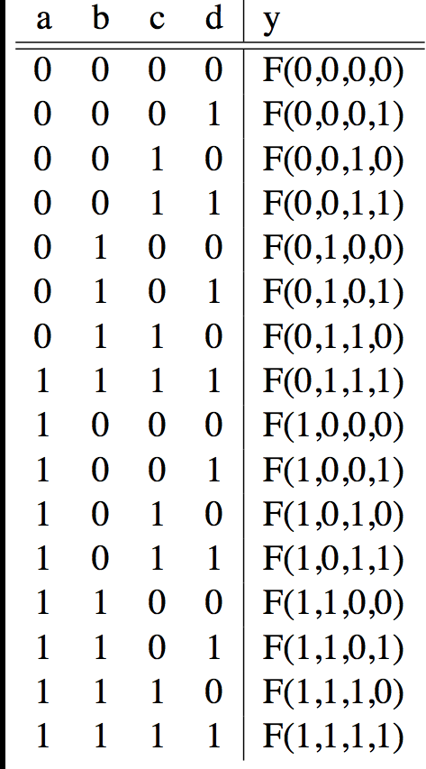
CL: General Form
A
F
B
Y
C
D
0
If N inputs, how many distinct functions F do we have?
Function maps each row to 0 or 1, so 2^(2^{N}) possible functions

Slide 21
CL: Multiple Outputs
A
F
X
B
Y
C
D
Z
For 3 outputs, just three separate functions: X(A,B,C,D), Y(A,B,C,D), and Z(A,B,C,D)
Can show functions in separate columns without adding any rows!

Slide 22



Logic Gates (1/2)
Special names and symbols:
Circle means NOT!
a | c
0 | 1
1 | 0
NOT
a | b | c
0 | 0 | 0
0 | 1 | 0
1 | 0 | 0
1 | 1 | 1
AND
a | b | c
0 | 0 | 0
0 | 1 | 1
1 | 0 | 1
1 | 1 | 1
OR

Slide 23



Logic Gates (2/2)
Special names and symbols:
a | b | c
0 | 0 | 1
0 | 1 | 1
1 | 0 | 1
1 | 1 | 0
NAND
a | b | c
0 | 0 | 1
0 | 1 | 0
1 | 0 | 0
1 | 1 | 0
NOR
a | b | c
0 | 0 | 0
0 | 1 | 1
1 | 0 | 1
1 | 1 | 0
XOR

Slide 24
More Complicated Truth Tables
3-Input Majority
2-bit Adder
a | b | c | y
0 | 0 | 0 | 0
0 | 0 | 1 | 0
0 | 1 | 0 | 0
0 | 1 | 1 | 1
1 | 0 | 0 | 0
1 | 0 | 1 | 1
1 | 1 | 0 | 1
1 | 1 | 1 | 1
a₁
+
c₂
a₀
c₁
b₁
b₀
c₀
3 separate functions
A |  | B |  | C
a₁ | a₀ | b₁ | b₀ | c₂ | c₁ | c₀
 |  |  | .
 |  |  | .
 |  |  | .
How many
rows?

Slide 25
Truth Table to Boolean Expression
Read off of table
For 1, write variable name
For 0, write complement of variable
Sum of Products (SoP)
Take rows with 1’s in output column, sum products of inputs
c =‾ab +‾ba
Product of Sums (PoS)
Take rows with 0’s in output column, product the sum of the complements of the inputs
c = ( a + b ) · (‾a +‾b )
a | b | c
0 | 0 | 0
0 | 1 | 1
1 | 0 | 1
1 | 1 | 0
Notes:
Choice between the two generally comes down to whether the output function has more 0’s or 1’s. Choosing the conversion (SoP/PoS) with less items will result in a shorter expression!
(This example happens to be balanced: 2 0’s and 2 1’s)

Slide 27
1.3等值演算
定义1.9 设A,B是公式，如果对于每个真值赋值v，v(A)=v(B)，则称A和B等值，也称A与B逻辑等价，记为A⇔B。
判断¬(p∨q)和¬p∧¬q是否等值。
p | q | p ∨ q | ¬(p ∨ q) | ¬p | ¬q | ¬p∧¬q
0 | 0 | 0 | 1 | 1 | 1 | 1
0 | 1 | 1 | 0 | 1 | 0 | 0
1 | 0 | 1 | 0 | 0 | 1 | 0
1 | 1 | 1 | 0 | 0 | 0 | 0

Slide 28
等值式模式
零律
A∨1⇔1 A∧0⇔0
幂等律
A∨A⇔A A∧A⇔A
吸收律
A∨(A∧B)⇔A A∧(A∨B)⇔A
同一律
A∧1⇔A
A∨0⇔A
A⊕0⇔A
双重否定
¬¬A⇔A
矛盾律
A∧¬A⇔0
排中律
A∨¬A⇔1
假言易位
A→B⇔¬B→¬A

Slide 29
等值式模式
德•摩根律
¬(A∨B)⇔¬A∧¬B
¬(A∧B)⇔¬A∨¬B
交换律
A∨B⇔B∨A
A∧B⇔B∧A
A⊕B⇔B⊕A

Slide 30
等值式模式
结合律
(A∨B)∨C⇔A∨(B∨C)
(A∧B)∧C⇔A∧(B∧C)
(A⊕B)⊕C⇔A⊕(B⊕C)
分配律
A∨(B∧C)⇔(A∨B)∧(A∨C)
A∧(B∨C)⇔(A∧B)∨(A∧C)
A∧(B⊕C)⇔(A∧B)⊕(A∧C)

Slide 31
等值式模式
A⊕A⇔0
A⊕1⇔¬A
A→B⇔¬A∨B
A↔B⇔(A→B)∧(B→A)
A⊕B⇔(¬A∧B)∨(A∧¬B)
A⊕B⇔¬(A↔B)

Slide 32
Laws of Boolean Algebra
These laws allow us to perform simplification:

Slide 33
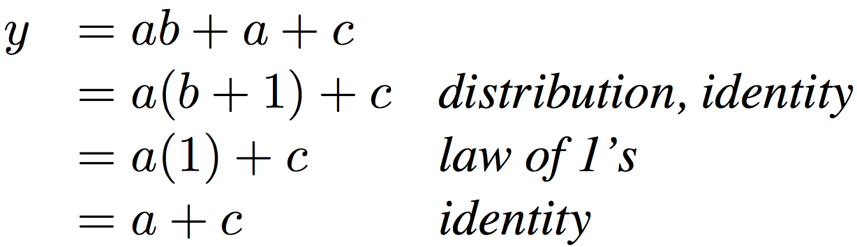
Boolean Algebraic Simplification Example
Notes:
Do on black board
From distribution: a(b +1) + c
Froms laws of 0s and 1s: b+1 = b
= ab + c
Truth Table
a b c y
0 0 0 0
0 0 1 1
0 0 1 1

Slide 34
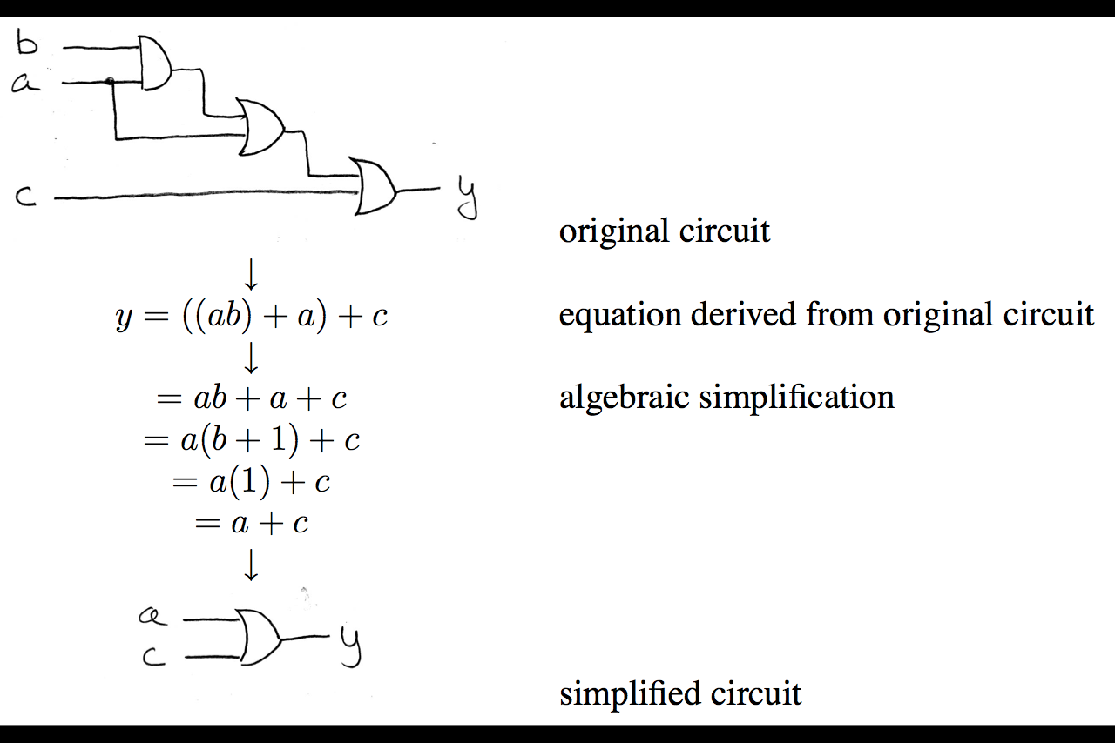
Circuit Simplification
1)
(Transistors and/or Gates)
2)
3)
4)

Slide 35
Converting Combinational Logic
Try all input combinations
Circuit
Diagram
This is difficult to do efficiently!
Truth
Table
Try all input
combinations
Propagate signals through gates
Wire inputs to proper gates
(easiest to use AND, OR, and NOT)
SoP or PoS
Boolean
Expression

Slide 36
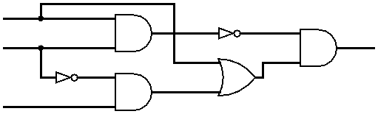
Circuit Simplification Example (1/4)
Simplify the following circuit:
Options:
Test all combinations of the inputs and build the Truth Table, then use SoP or PoS
Write out expressions for signals based on gates
Will show this method here
A
B
D
C

Slide 37
Circuit Simplification Example (2/4)
Simplify the following circuit:
Start from left, propagate signals to the right
Arrive at D = (AB)’(A + B’C)
A
A
AB
(AB)’
B
B
D
A
A+B’C
B’
B’C
C
C

Slide 38
Circuit Simplification Example (3/4)
Simplify Expression:
D = (AB)’(A + B’C)
= (A’ + B’)(A + B’C) DeMorgan’s
= A’A + A’B’C + B’A + B’B’C Distribution
= 0 + A’B’C + B’A + B’B’C Complementarity
= A’B’C + B’A + B’C Idempotent Law
= (A’ + 1)B’C + AB’ Distribution
= B’C + AB’ Law of 1’s
= B’(A + C) Distribution
Which of these is “simpler”?

Slide 39
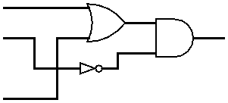
Circuit Simplification Example (4/4)
Draw out final circuit:
D = B’C + AB’ = B’(A + C)
Simplified Circuit:
Reduction from 6 gates to 3!
How many gates do we need for each?
4
3
A
B
D
C
Notes:
Also only has to go through 2 “stages” worth of gates as opposed to 4 previously.
Longest path here is B → NOT → AND → D. Before one of the longest paths was B → NOT → AND → OR → AND → D.

Slide 40
Karnaugh Maps (Optional)
必须会！
Again, this is completely OPTIONAL material
Recommended you use .pptx to view animations
Karnaugh Maps (K-maps) are an alternate way to simplify Boolean Algebra
This technique is normally taught in CS150
We will never ask you to use a K-map to solve a problem, but you may find it faster/easier if you choose to learn how to use it
For more info, see: http://en.wikipedia.org/wiki/Karnaugh_map

Slide 41
Underlying Idea
Using Sum of Products, “neighboring” input combinations simplify
“Neighboring”: inputs that differ by a single signal
e.g. ab + a’b = b, a’bc + a’bc’ = a’b, etc.
Recall: Each product only appears where there is a 1 in the output column
Idea: Let’s write out our Truth Table such that the neighbors become apparent!
Need a Karnaugh map for EACH output

Slide 42
Reorganizing the Truth Table
Split inputs into 2 evenly-sized groups
One group will have an extra if an odd # of inputs
Write out all combinations of one group horizontally and all combinations of the other group vertically
Group of n inputs → 2^{n} combinations
Successive combinations change only 1 input
2 Inputs: 3 Inputs:
B
AB
 | 00 | 01 | 11 | 10
0
1
 | 0 | 1
0
1
C
A
Notes:
Choice of split is not essential (changes order of how you fill in values from the Truth Table).

Slide 43
K-map: Majority Circuit (1/2)
Filling in the Karnaugh map:
ab
a | b | c | y
0 | 0 | 0 | 0
0 | 0 | 1 | 0
0 | 1 | 0 | 0
0 | 1 | 1 | 1
1 | 0 | 0 | 0
1 | 0 | 1 | 1
1 | 1 | 0 | 1
1 | 1 | 1 | 1
 | 00 | 01 | 11 | 10
0
1
c
0
0
0
1
0
1
1
1
0
0
0
1
1
1
0
1
0
0
0
1
1
1
0
1
Each row of truth table corresponds to ONE cell of Karnaugh map
Recommended you view the animation on this slide on the Powerpoint (pptx)
Note the funny jump when you go from input 011 to 100 (most mistakes made here)

Slide 44
K-map: Majority Circuit (2/2)
Group neighboring 1’s so all are accounted for:
Each group of neighbors becomes a product term in output
y =
Larger groups become smaller terms
The single 1 in top row → abc’
Vertical group of two 1’s → ab
If entire lower row was 1’s → c
ab
 | 00 | 01 | 11 | 10
0
1
c
0
0
0
1
1
1
0
1
bc
+ ab
+ ac
bc
+ ab
+ ac
Single cell can be part of many groups

Slide 45
General K-map Rules
ab
Only group in powers of 2
Grouping should be of size 2^{i} × 2^{j}
Applies for both directions
Wraps around in all directions
“Corners” case is extreme example
Always choose largest groupings possible
Avoid single cells whenever possible
y =
 | 00 | 01 | 11 | 10
00 | 1 | 0 | 0 | 1
01 | 0 | 1 | 1 | 0
11 | 0 | 1 | 1 | 1
10 | 1 | 0 | 0 | 1
cd
NOT a valid group
IS a valid group
IS a valid group
“Corners” case
1 of 2 good choices here (spot the other?)
bd
+ b’d’
+ acd

Slide 46
提纲
内容主要取材：CS61C的17讲、18讲
http://inst.eecs.berkeley.edu/~cs61c/su12
晶体管
门电路
运算
加法、减法、乘法、除法

Slide 47
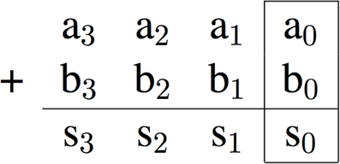
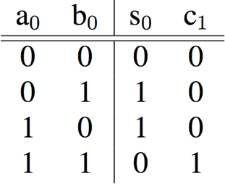


Adder/Subtractor: 1-bit LSB Adder
Carry-out bit

Slide 48
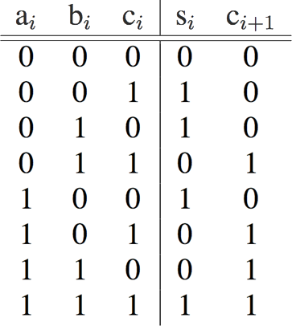
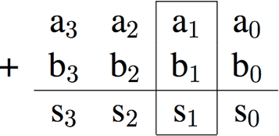


Adder/Subtractor: 1-bit Adder
Possible carry-in c₁
Here defining XOR of many inputs to be 1 when and odd number of inputs are 1

Slide 49
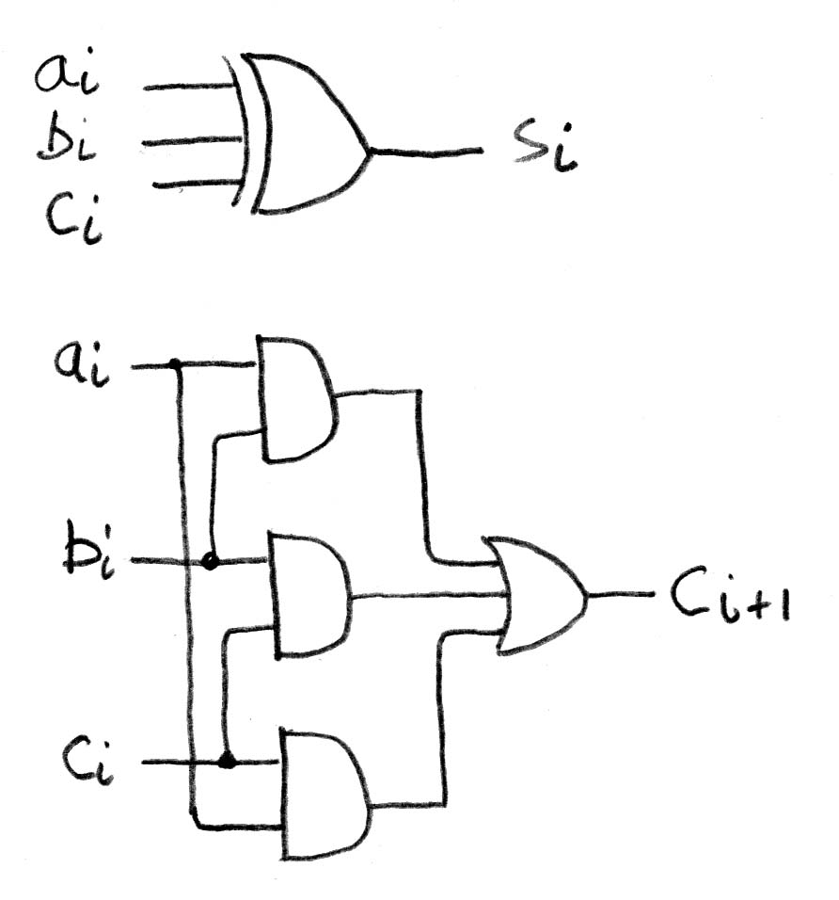
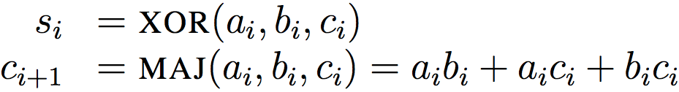
Adder/Subtractor: 1-bit Adder
Circuit Diagrams:

Slide 50
加减法运算
加法单元（全加器）
S_{i}
C_{i+1}
∑
C_{i}
A_{i}
B_{i}

Slide 51
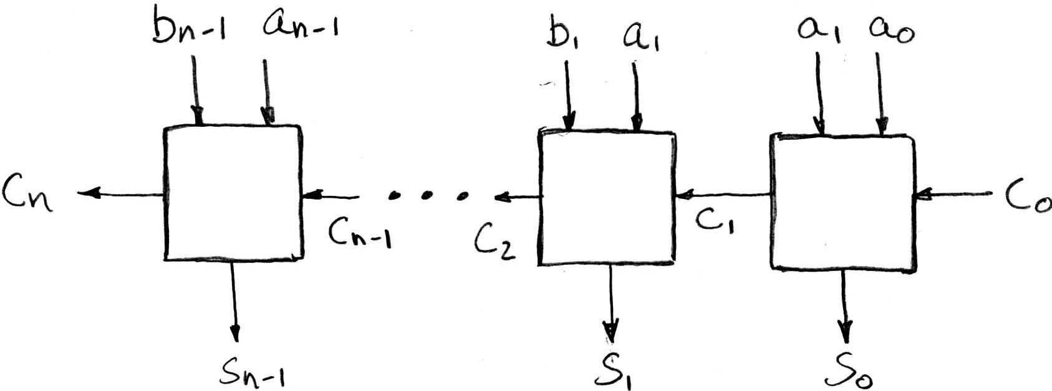
N x 1-bit Adders ◊ N-bit Adder
Connect CarryOut_{i-1} to CarryIn_{i} to chain adders:
b₀
+
+
+

Slide 52
作业1
证明相等

Slide 53
作业2
《数字设计和计算机体系结构》
WORD：1.32、1.34、1.48、1.50、1.51、1.62、1.63、2.1、2.7、2.9、2.16、2.19
2.16、2.19：同时要求用卡诺图化简
LogicSim
《数字设计》：1.60、2.7
给出真值表，并且用LogicSim模拟验证
构造1位加法器，并模拟
构造4位加法器，并模拟
学习使用层次设计

