Slide 1
Logisim
Open-source (i.e. free!) “graphical tool for designing and simulating logic circuits”
Runs on Java on any computer
Download to your home computer via class login or the Logisim website (we are using version 2.7.1)
No programming involved
Unlike Verilog, which is a hardware description language (HDL)
Click and drag; still has its share of annoying quirks
http://ozark.hendrix.edu/~burch/logisim/

Slide 2
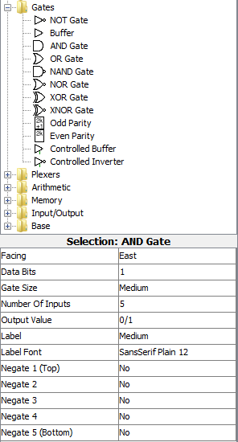
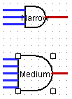
Gates in Logisim
Click gate type, click to place
Can set options before placing or select gate later to change
Types of Gates
Options
bus width n
# inputs
labeling not necessary, but can help

Slide 3
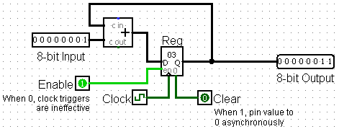
Registers in Logisim
Flip-flops and Registers in “Memory” folder
8-bit accumulator:

Slide 4
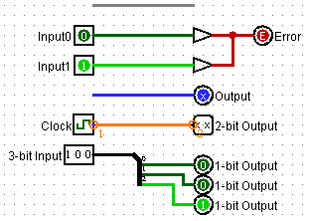
Wires in Logisim
Click and drag on existing port or wire
Color schemes:
Gray: unconnected
Dark Green: low signal (0)
Light Green: high signal (1)
Red: error
Blue: undetermined signal
Orange: incompatible widths
Tunnels: all tunnels with same label are connected
“Splitter” used to adjust bus widths

Slide 5
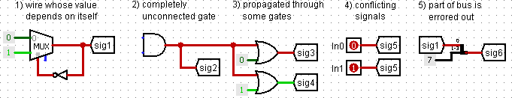
Common Mistakes in Logisim
Connecting wires together
Crossing wires vs. connected wires
Losing track of which input is which
Mis-wiring a block (e.g. CLK to Enable)
Grabbing wrong wires off of splitter
Errors:

Slide 6
Agenda
State Elements Continued
Administrivia
Logisim Introduction
Finite State Machines
Multiplexers
ALU Design
Adder/Subtracter

Slide 7
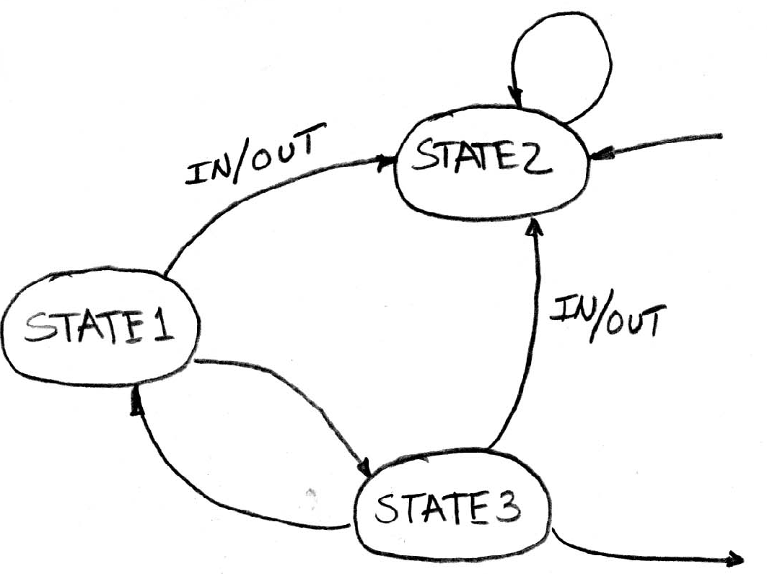
Finite State Machines (FSMs)
You may have seen FSMs in other classes
Function can be represented with a state transition diagram
With combinational logic and registers, any FSM can be implemented in hardware!
. . .

Slide 8
FSM Overview
An FSM (in this class) is defined by:
A set of states S (circles)
An initial state s₀ (only arrow not between states)
A transition function that maps from the current input and current state to the output and the next state (arrows between states)
State transitions are controlled by the clock:
On each clock cycle the machine checks the inputs and generates a new state (could be same) and new output

Slide 9
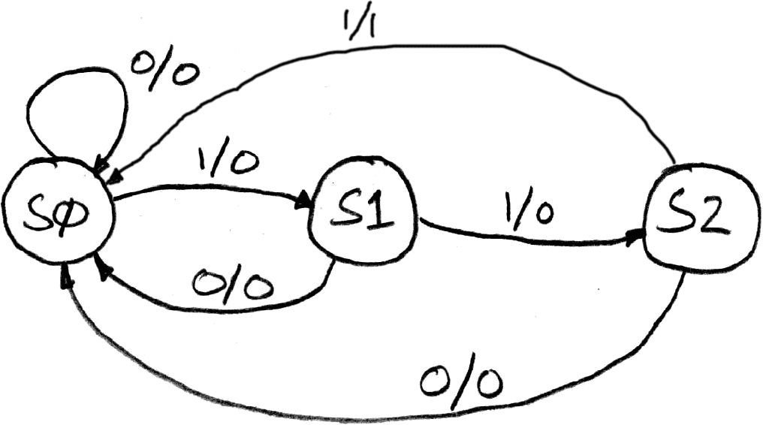
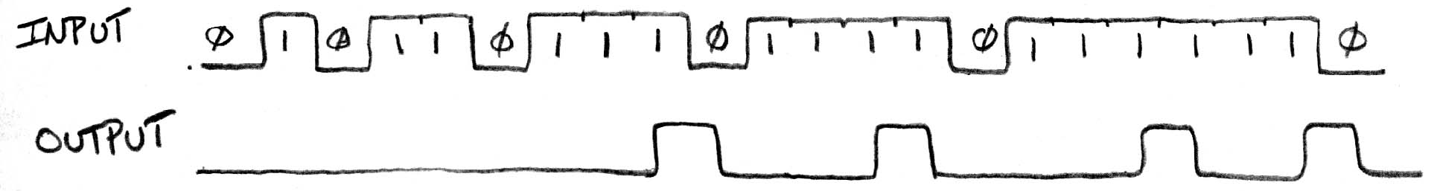
Example: 3 Ones FSM
FSM to detect 3 consecutive 1’s in the Input
States: S0, S1, S2
Initial State: S0
Transitions of form:
input/output

Slide 10
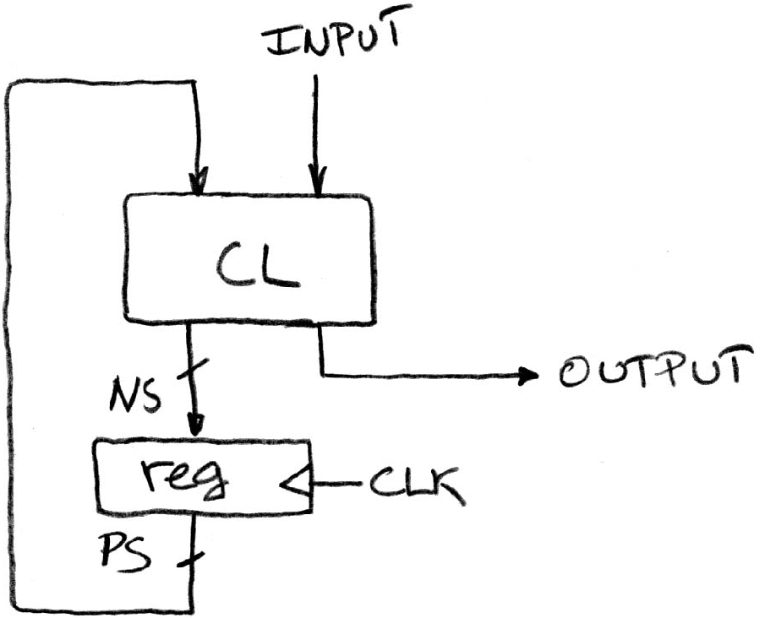
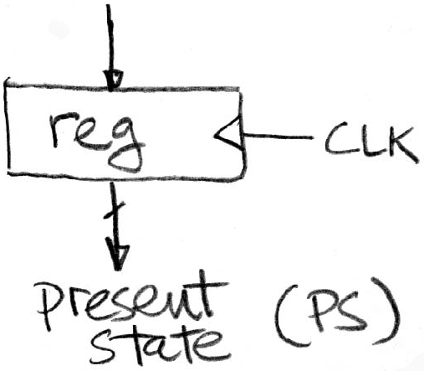
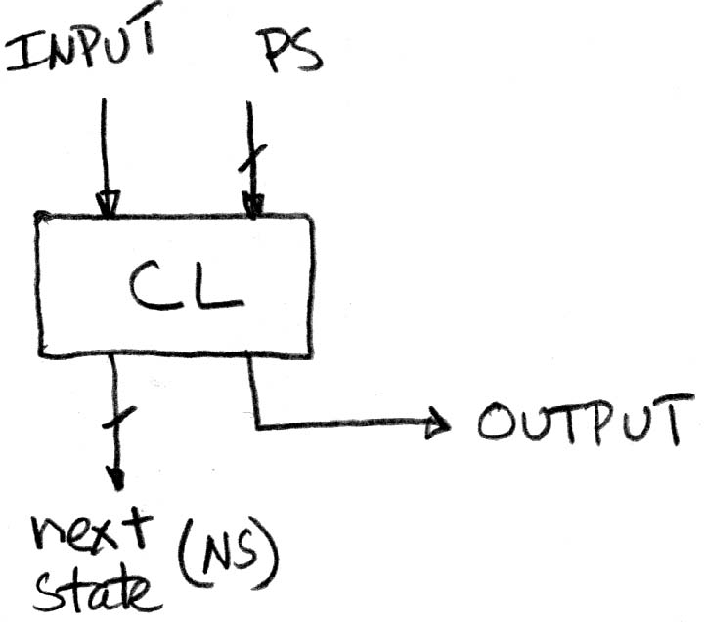
Hardware Implementation of FSM
Register holds a representation of the FSM’s state
Must assign a unique bit pattern for each state
Output is present/current state (PS/CS)
Input is next state (NS)
Combinational Logic implements transition function (state transitions + output)
+
=

Slide 11
FSM: Combinational Logic
Read off transitions into Truth Table!
Inputs: Current State (CS) and Input (In)
Outputs: Next State (NS) and Output (Out)
Implement logic for EACH output (2 for NS, 1 for Out)
CS | In | NS | Out
00 | 0 | 00 | 0
00 | 1 | 01 | 0
01 | 0 | 00 | 0
01 | 1 | 10 | 0
10 | 0 | 00 | 0
10 | 1 | 00 | 1
Notes:
In lecture: Implement logic for Out (1 NOT, 2 AND gates)

Slide 12
Unspecified Output Values (1/2)
Our FSM has only 3 states
2 entries in truth table are undefined/unspecified
Use symbol ‘X’ to mean it can be either a 0 or 1
Make choice to simplify final expression
CS | In | NS | Out
00 | 0 | 00 | 0
00 | 1 | 01 | 0
01 | 0 | 00 | 0
01 | 1 | 10 | 0
10 | 0 | 00 | 0
10 | 1 | 00 | 1
11 | 0 | XX | X
11 | 1 | XX | X

Slide 13
Unspecified Output Values (2/2)
Let’s find expression for NS₁
Recall: 2-bit output is just a 2-bit bus, which is just 2 wires
Boolean algebra:
NS₁ = CS₁’CS₀In + CS₁CS₀In’ + CS₁CS₀In
NS₁ = CS₀In
Karnaugh Map:
NS₁ = CS₀In
CS | In | NS | Out
00 | 0 | 00 | 0
00 | 1 | 01 | 0
01 | 0 | 00 | 0
01 | 1 | 10 | 0
10 | 0 | 00 | 0
10 | 1 | 00 | 1
11 | 0 | XX | X
11 | 1 | XX | X
Differs by 2
Is neighbor
CS
 | 00 | 01 | 11 | 10
0 | 0 | 0 | X | 0
1 | 0 | 1 | X | 0
In

Slide 14
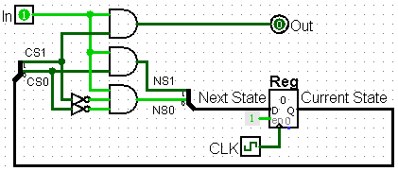
3 Ones FSM in Hardware
2-bit Register needed for state
CL: NS₁ = CS₀In, NS₀ = CS₁’CS₀’In, Out = CS₁In

Slide 15
Agenda
State Elements Continued
Administrivia
Logisim Introduction
Finite State Machines
Multiplexers
ALU Design
Adder/Subtracter

Slide 16
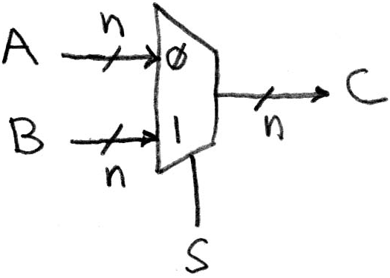
Data Multiplexor
Multiplexor (“MUX”) is a selector
Place one of multiple inputs onto output (N-to-1)
Shown below is an n-bit 2-to-1 MUX
Input S selects between two inputs of n bits each
This input is passed to output if selector bits match shown value

Slide 17
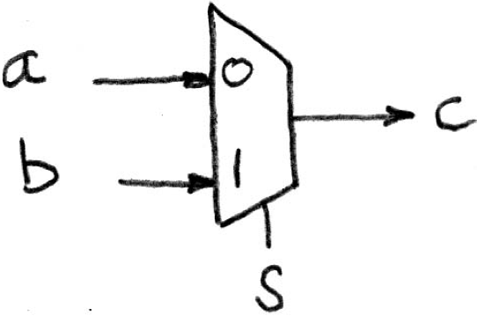
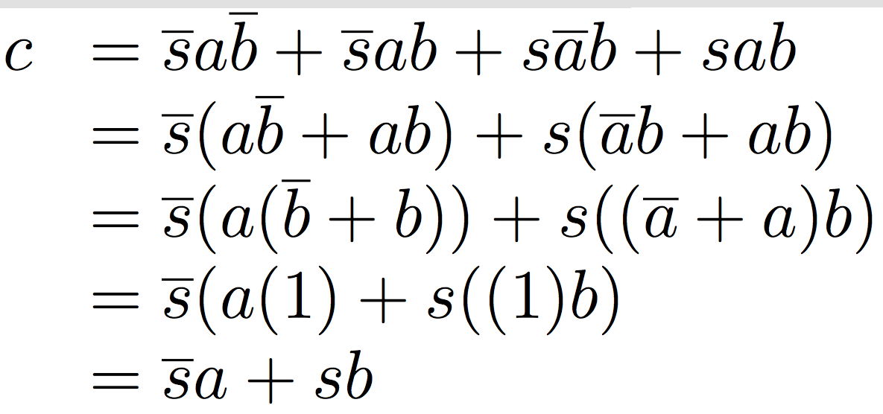
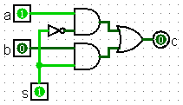
Implementing a 1-bit 2-to-1 MUX
Schematic:
Truth Table:
Boolean Algebra:
Circuit Diagram:
s | a | b | c
0 | 0 | 0 | 0
0 | 0 | 1 | 0
0 | 1 | 0 | 1
0 | 1 | 1 | 1
1 | 0 | 0 | 0
1 | 0 | 1 | 1
1 | 1 | 0 | 0
1 | 1 | 1 | 1

Slide 18
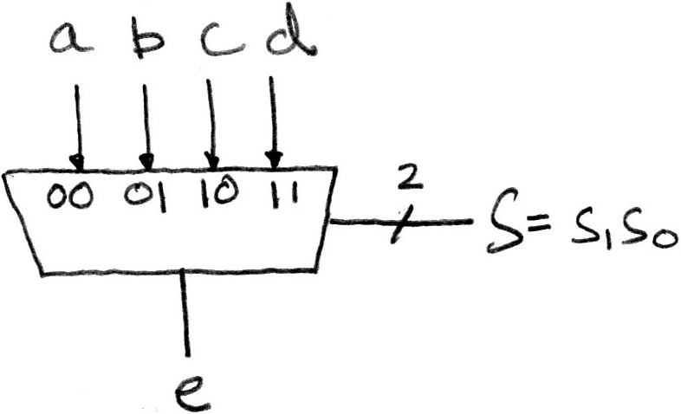
1-bit 4-to-1 MUX (1/2)
Schematic:
Truth Table: How many rows?
Boolean Expression: e = s₁’s₀’a + s₁’s₀b + s₁s₀’c + s₁s₀d

Slide 19
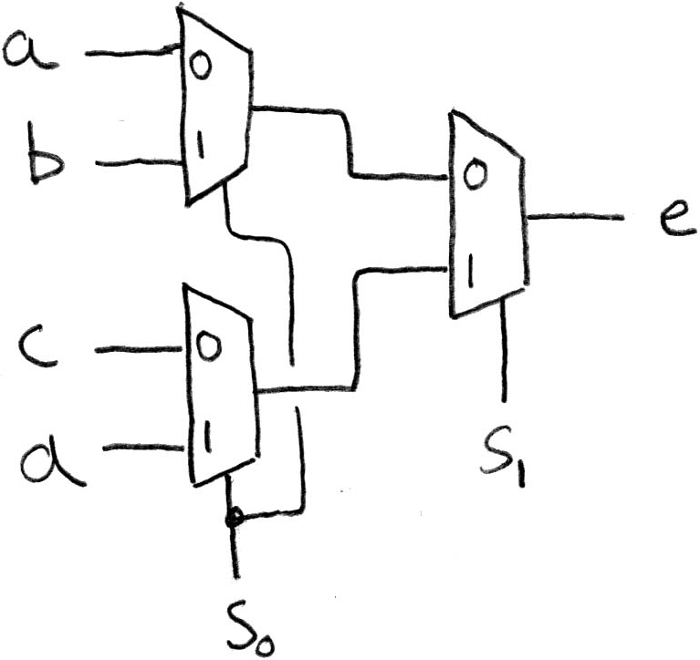
1-bit 4-to-1 MUX (2/2)
Can we leverage what we’ve previously built?
Alternative hierarchical approach:

Slide 20
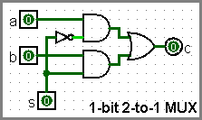
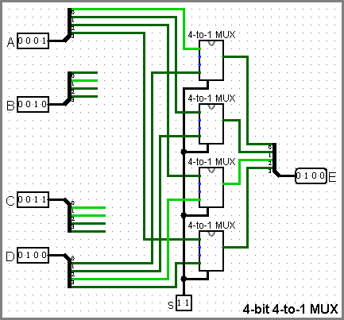
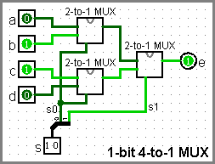
Subcircuits Example
Logisim equivalent of procedure or method
Every project is a hierarchy of subcircuits
Incomplete wiring shown here

