Slide 1
计算机学院课程
计算机组成
MIPS体系结构概述
高小鹏
北京航空航天大学计算机学院
系统结构研究所

Slide 2
提纲
寄存器：R0~R31，PC
存储器及存储器视图
输入输出
中断
协处理器

Slide 3
提纲
寄存器：R0~R31，PC
存储器及存储器视图
输入输出
中断
协处理器

Slide 4
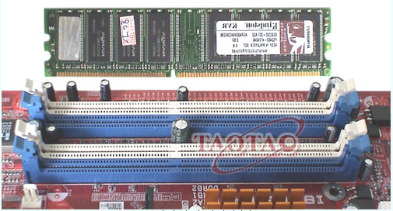

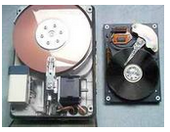
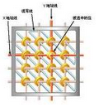
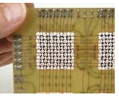
1.1 存储系统概述
存储器分类
按介质分类：
半导体存储器
磁介质存储器
光盘存储器
按访问方式分类：
随机访问存储器 （Random Access Memory—RAM）
只读存储器 （Read Only Memory—ROM）
顺序访问存储器 （Tape）
直接访问存储器 （Disk）
按功能分类：
高速缓冲存储器
主存储器
辅助存储器
控制存储器

Slide 5
1.1 存储系统概述
存储器的性能指标
访问时间（Access Time）：T_{A}
随机访问存储器：访问时间指读或写操作所用时间，即从给定地址到存储器完成读或写操作所需时间。
其他类型：指将读写机构定位到目标位置所需的时间。
存储周期（Cycle Time）：T_{C}
仅对RAM而言，指两次访问存储单元间的最小时间间隔。
T_{C} > T_{A}
带宽（Bandwidth）／数据传输率（Transfer Rate）
一般的随机访问存储器：1／Cycle Time；
其他类型：T_{N}=T_{A}+N/R
T_{N}：读写N Bits所需的平均时间
T_{A}：访问时间
N：N Bits
R：存储部件的数据传输率（ bits /s）

Slide 6
1.1 存储系统概述
存储器的层次/性能特征
Processor
Control
Tertiary
Storage
(Tape)
Secondary
Storage
(Disk)
Second
Level
Cache
(SRAM)
Main
Memory
(DRAM)
Registers
Datapath
On-Chip
Cache
Speed (ns):
1s
10s
100s
10,000,000s
(10s ms)
10,000,000,000s
(10s sec)
Size (bytes):
100s
Ks
Ms
Gs
Ts

Slide 7
1.1 存储系统概述
存储器的层次结构
二级存储系统指：高速缓冲存储器（Cache）＋主存储器

Slide 8
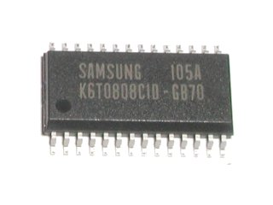
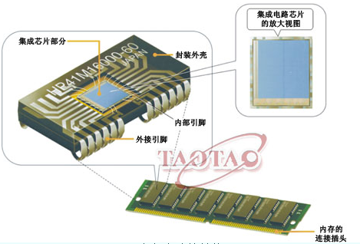
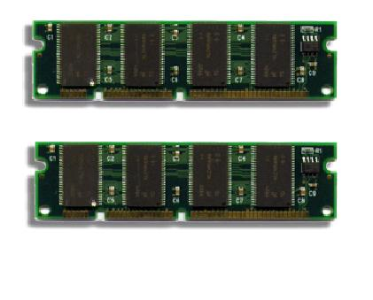
1.2 半导体存储器
静态随机访问存储器SRAM（Static RAM）
SRAM：静态存储器，相对动态而言，集成度低，但不必刷新。
动态随机访问存储器DRAM（Dynamic RAM）
DRAM：动态存储器，需要刷新，相对而言，集成度高。
SRAM
DRAM
http://hi.baidu.com/zhonggongxun/blog/item/23438af3deccb21bb07ec583.html

Slide 9
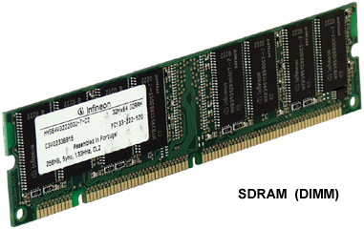
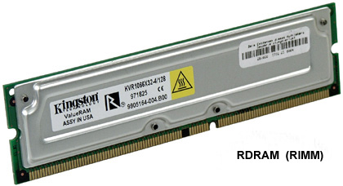
1.2 半导体存储器
目前主流DRAM
SDRAM（ Synchronous DRAM）：同步DRAM，与CPU采用相同时钟，避免了不必要的等待周期，减少数据存储时间，数据可在脉冲上升期便开始传输。SDRAM内存又分为PC66、PC100、PC133等不同规格，相应带宽分别为528MB/S、 800MB/S和1.06GB/S。
RDRAM（Rambus DRAM）：美国RAMBUS公司开发的一种内存。它采用串行数据传输模式，外频可到600MHz和800MHz，具有较高的带宽。由于无法与原有制造工艺兼容，虽然曾受到英特尔公司的大力支持，却始终没有成为主流。

Slide 10
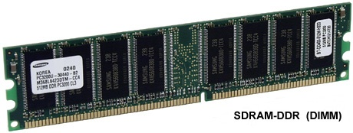
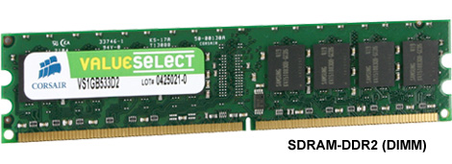
1.2 半导体存储器
目前主流DRAM
DDR（Double Data Rate）SDRAM：双倍速率SDRAM。SDRAM只在一个时钟的上升期传输一次数据；而DDR内存则在一个时钟的上升期和下降期各传输一次数据，因此称为双倍速率SDRAM。DDR SDRAM可以在与SDRAM相同的总线频率下达到更高的数据传输率。
DDR2 （Double Data Rate 2） SDRAM：DDR2内存拥有两倍于DDR内存预读取能力，换句话说，DDR2内存 每个时钟能够以4倍外部总线的速度读/写数据，在同样100MHz的工作频率下，DDR的实际频率为200MHz，而DDR2则可以达到400MHz。 DDR2内存采用1.8V电压，相对于DDR标准的2.5V，降低了不少。

Slide 11
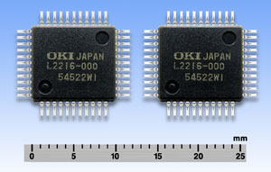
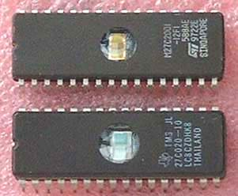
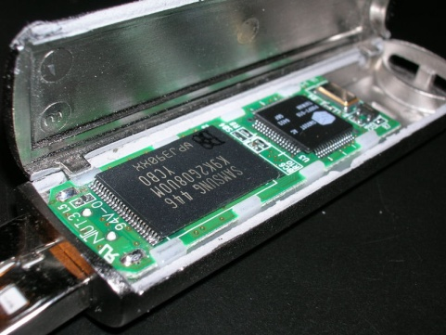
1.2 半导体存储器
只读存储器（ROM）
固定掩膜（Masks）ROM
PROM（Programmable ROM）：一次性可编程
EPROM（Erasable PROM）：可擦除可编程（紫外线擦除）
EEPROM（Electrically Erasable PROM）：电擦除
Flash Memory（闪存）：本质上属于电擦除可编程ROM，如SM（Smart Media）卡、CF (Compact Flash)卡，MMC（Multi Media Card）卡、SD（Secure Digital）卡和记忆棒（Memory Stick）等 。
Mask ROM
EPROM
U盘上的Flash memory

Slide 12
提纲
寄存器：R0~R31，PC
存储器及存储器视图
输入输出
中断
协处理器

Slide 13
协处理器
PC[31:28]
M8
0
1
2
3
4
5
指
令
寄
存
器
指令[25:0]
26
<<2
28
PC
指令
存储器
指令
[31:26]
S2
寄存器堆
Read
Reg1
Exc
Vector
Addr
指令
[25:21]
Read
Data1
M3
Data
Read
Reg2
0
1
指令
[20:16]
A
M1
Zero
Ov
指令
[15:0]
0
1
2
Write
Reg
ALU
1F
Read
Data2
B
M4
ALU
结果
M6
4
0
1
2
3
0
1
2
3
4
数据
存储器
M2
Write
Data
ALUOut
Addr
0
1
2
ReadData
Write
Data
S1
移位
数据扩展
32
<<2
16
符号扩展
[4:0]
M5
0
1
数据
寄存器
M9
指令[10:6]
乘/除
0
1
2
CP0
乘/除
结果
Write
data
Read
data
Flag
0E
M7
Reg
index
EPC
指令[15:11]
0
1
Notes:
13

Slide 14
提纲
寄存器：R0~R31，PC
存储器及存储器视图
输入输出
中断
协处理器

Slide 15

Motivation for Input/Output
I/O is how humans interact with computers
I/O gives computers long-term memory.
I/O lets computers do amazing things:
Computer without I/O like a car without wheels; great technology, but gets you nowhere
MIT Media Lab
“Sixth Sense”

Slide 16
I/O Device Examples and Speeds
I/O speeds: 7 orders of magnitude between mouse and LAN
Device | Behavior | Partner | Data Rate (KB/s)
Keyboard | Input | Human | 0.01
Mouse | Input | Human | 0.02
Voice output | Output | Human | 5.00
Floppy disk | Storage | Machine | 50.00
Laser printer | Output | Human | 100.00
Magnetic disk | Storage | Machine | 10,000.00
Wireless network | Input or Output | Machine | 10,000.00
Graphics display | Output | Human | 30,000.00
Wired LAN network | Input or Output | Machine | 125,000.00
When discussing transfer rates, use SI prefixes (10^{x})

Slide 17






What do we need for I/O to work?
Files
APIs
A way to connect many types of devices
A way to control these devices, respond to them, and transfer data
A way to present them to user programs so they are useful
Operating System
Proc
Mem
PCI Bus
SCSI Bus
ctrl reg.
data reg.

Slide 18
Instruction Set Architecture for I/O
What must the processor do for I/O?
Input: reads a sequence of bytes
Output: writes a sequence of bytes
Some processors have special input and output instructions
Alternative model (used by MIPS):
Use loads for input, stores for output (in small pieces)
Called Memory Mapped Input/Output
A portion of the address space dedicated to communication paths to Input or Output devices (no memory there)

Slide 19
Memory Mapped I/O
Certain addresses are not regular memory
Instead, they correspond to registers in I/O devices
address
0xFFFFFFFF
0xFFFF0000
control reg.
data reg.
0

Slide 20
Processor-I/O Speed Mismatch
1 GHz microprocessor can execute 1 billion load or store instr/sec (4,000,000 KB/s data rate)
Recall: I/O devices data rates range from 0.01 KB/s to 125,000 KB/s
Input: Device may not be ready to send data as fast as the processor loads it
Also, might be waiting for human to act
Output: Device not be ready to accept data as fast as processor stores it
What can we do?

Slide 21
Processor Checks Status Before Acting
Path to a device generally has 2 registers:
Control Register says it’s OK to read/write (I/O ready)
Data Register contains data
Processor reads from control register in a loop, waiting for device to set Ready bit (0 → 1)
Processor then loads from (input) or writes to (output) data register
Resets Ready bit of control register (1 → 0)
This process is called “Polling”

Slide 22
I/O Example (Polling in MIPS)
Input: Read from keyboard into $v0
lui $t0, 0xffff # ffff0000 Waitloop: lw $t1, 0($t0) # control reg andi $t1,$t1,0x1 beq $t1,$zero, Waitloop lw $v0, 4($t0) # data reg
Output: Write to display from $a0
lui $t0, 0xffff # ffff0000 Waitloop: lw $t1, 8($t0) # control reg andi $t1,$t1,0x1 beq $t1,$zero, Waitloop sw $a0,12($t0) # data reg
“Ready” bit is from processor’s point of view!

Slide 23
Cost of Polling?
Processor specs: 1 GHz clock, 400 clock cycles for a polling operation (call polling routine, accessing the device, and returning)
Determine % of processor time for polling:
Mouse: Polled 30 times/sec so as not to miss user movement
Floppy disk: Transferred data in 2-Byte units with data rate of 50 KB/sec. No data transfer can be missed.
Hard disk: Transfers data in 16-Byte chunks and can transfer at 16 MB/second. Again, no transfer can be missed.

Slide 24
% Processor time to poll
Mouse polling:
Time taken: 30 [polls/s] × 400 [clocks/poll] = 12K [clocks/s]
% Time: 1.2×10⁴ [clocks/s] / 10⁹ [clocks/s] = 0.0012%
Polling mouse little impact on processor
Disk polling:
Freq: 16 [MB/s] / 16 [B/poll] = 1M [polls/s]
Time taken: 1M [polls/s] × 400 [clocks/poll] = 400M [clocks/s]
% Time: 4×10⁸ [clocks/s] / 10⁹ [clocks/s] = 40%
Unacceptable!
Problems: polling, accessing small chunks
Notes:
was p 677 in book (not current edition)

Slide 25
Alternatives to Polling?
Wasteful to have processor spend most of its time “spin-waiting” for I/O to be ready
Would like an unplanned procedure call that would be invoked only when I/O device is ready
Solution: Use exception mechanism to help trigger I/O, then interrupt program when I/O is done with data transfer
This method is discussed next

Slide 26
提纲
寄存器：R0~R31，PC
存储器及存储器视图
输入输出
异常/中断
协处理器

Slide 27
Exceptions and Interrupts
“Unexpected” events requiring change in flow of control
Different ISAs use the terms differently
Exception
Arises within the CPU (e.g. undefined opcode, overflow, syscall, TLB Miss)
Interrupt
From an external I/O controller
Dealing with these without sacrificing performance is difficult!

Slide 28
Handling Exceptions (1/2)
In MIPS, exceptions managed by a System Control Coprocessor (CP0)
Save PC of offending (or interrupted) instruction
In MIPS: save in special register called Exception Program Counter (EPC)
Save indication of the problem
In MIPS: saved in special register called Cause register
In simple implementation, might only need 1-bit (0 for undefined opcode, 1 for overflow)
Jump to exception handler code at address 0x80000180

Slide 29
Handling Exceptions (2/2)
Operating system is also notified
Can kill program (e.g. segfault)
For I/O device request or syscall, often switch to another process in meantime
This is what happens on a TLB misses and page faults

Slide 30
Exception Properties
Re-startable exceptions
Pipeline can flush the instruction
Handler executes, then returns to the instruction
Re-fetched and executed from scratch
PC+4 saved in EPC register
Identifies causing instruction
PC+4 because it is the available signal in a pipelined implementation
Handler must adjust this value to get right address
Notes:
Non-re-startable exception example: arithmetic overflow. If instruction completes, can’t show offending values
Re-startable exception example: I/O device interrupt.

Slide 31
Handler Actions
Read Cause register, and transfer to relevant handler
OS determines action required:
If restartable exception, take corrective action and then use EPC to return to program
Otherwise, terminate program and report error using EPC, Cause register, etc. (e.g. our best friend the segfault)

Slide 32
I/O Interrupt
An I/O interrupt is like an exception except:
An I/O interrupt is “asynchronous”
More information needs to be conveyed
“Asynchronous” with respect to instruction execution:
I/O interrupt is not associated with any instruction, but it can happen in the middle of any given instruction
I/O interrupt does not prevent any instruction from running to completion
Notes:
How does an I/O interrupt different from the exception you already learned?
Well, an I/O interrupt is asynchronous with respect to the instruction execution while exception such as overflow or page fault are always associated with a certain instruction.
Also for exception, the only information needs to be conveyed is the fact that an exceptional condition has occurred but for interrupt, there is more information to be conveyed.
Let me elaborate on each of these two points.
Unlike exception, which is always associated with an instruction, interrupt is not associated with any instruction. The user program is just doing its things when an I/O interrupt occurs.
So I/O interrupt does not prevent any instruction from completing so you can pick your own convenient point to take the interrupt.
As far as conveying more information is concerned, the interrupt detection hardware must somehow let the OS know who is causing the interrupt.
Furthermore, interrupt requests needs to be prioritized. The hardware that can do all these looks like this.
+2 = 64 min. (Y:44)

Slide 33
Interrupt-Driven Data Transfer
Memory
(1) I/O
interrupt
add
sub
and
or
user
program
(2) save PC
(3) jump to interrupt
service routine
read
store
...
eret
(5)
interrupt
service
routine
(4) perform transfer
Notes:
That is, whenever an I/O device needs attention from the processor, it interrupts the processor from what it is currently doing.
This is how an I/O interrupt looks in the overall scheme of things. The processor is minding its business when one of the I/O device wants its attention and causes an I/O interrupt.
The processor then save the current PC, branch to the address where the interrupt service routine resides, and start executing the interrupt service routine.
When it finishes executing the interrupt service routine, it branches back to the point of the original program where we stop and continue.
The advantage of this approach is efficiency. The user program’s progress is halted only during actual transfer.
The disadvantage is that it require special hardware in the I/O device to generate the interrupt. And on the processor side, we need special hardware to detect the interrupt and then to save the proper states so we can resume after the interrupt.
+2 = 62 min. (Y:42)

Slide 34
增加EPC
ECP：保存中断/异常时的PC
以便从中断/异常服务程序返回被中断指令
中断/异常服务程序返回指令：ERET
PC计算
PC
IMM
EPC
NPC
PC+4
EPC
PC
指
令
寄
存
器
26
指令
存储器
指令
[31:26]
寄存器堆
Read
Reg1
Addr
指令
[25:21]
Read
Data1
Data
指令
[20:16]
Read
Reg2
A
M1
Zero
Ov
数据
存储器
指令
[15:0]
0
1
2
Write
Reg
ALU
ALUOut
Addr
Read
Data2
B
ALU
结果
ReadData
1F
0
1
Write
Data
Write
Data
0
1
2
数据
寄存器
16
扩展
32

Slide 35
修改NPC
NPC需要增加输出：异常处理程序的地址
系统复位时输出：0xBFC0_0000
硬件中断时输出：0xBFC0_0400
其他异常时输出：0xBFC0_0380
EPC
PC计算
PC
IMM
EPC
NPC
PC+4
PC
指
令
寄
存
器
26
指令
存储器
指令
[31:26]
寄存器堆
Read
Reg1
Addr
指令
[25:21]
Read
Data1
Data
指令
[20:16]
Read
Reg2
A
M1
Zero
Ov
数据
存储器
指令
[15:0]
0
1
2
Write
Reg
ALU
ALUOut
Addr
Read
Data2
B
ALU
结果
ReadData
1F
0
1
Write
Data
Write
Data
0
1
2
数据
寄存器
16
扩展
32

Slide 36
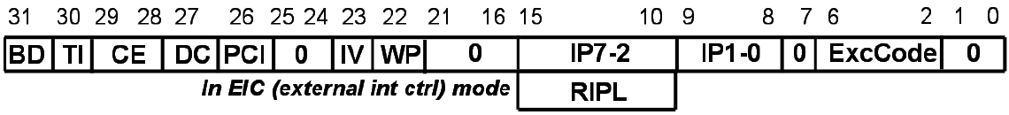
增加CAUSE寄存器
记录当前哪些硬件中断正在有效
IP[7:2]：6个硬件中断
EPC
IP[7:2]
PC计算
PC
IMM
EPC
NPC
PC+4
PC
指
令
寄
存
器
26
指令
存储器
指令
[31:26]
寄存器堆
CAUSE
Read
Reg1
Addr
指令
[25:21]
Read
Data1
Data
指令
[20:16]
Read
Reg2
A
M1
Zero
Ov
数据
存储器
指令
[15:0]
0
1
2
Write
Reg
ALU
ALUOut
Addr
Read
Data2
B
ALU
结果
ReadData
1F
0
1
Write
Data
Write
Data
0
1
2
数据
寄存器
16
扩展
32

Slide 37
增加SR寄存器(1)
中断屏蔽：允许哪些硬件中断
IM[7:2]：6个硬件中断
IM[7:2]
EPC
PC计算
PC
IMM
EPC
NPC
PC+4
SR
PC
指
令
寄
存
器
26
指令
存储器
指令
[31:26]
寄存器堆
CAUSE
Read
Reg1
Addr
指令
[25:21]
Read
Data1
Data
指令
[20:16]
Read
Reg2
A
M1
Zero
Ov
数据
存储器
指令
[15:0]
0
1
2
Write
Reg
ALU
ALUOut
Addr
Read
Data2
B
ALU
结果
ReadData
1F
0
1
Write
Data
Write
Data
0
1
2
数据
寄存器
16
扩展
32

Slide 38
增加SR寄存器(2)
全局中断使能：1-允许中断；0-禁止中断
IE
EPC
PC计算
PC
IMM
EPC
NPC
PC+4
SR
PC
指
令
寄
存
器
26
指令
存储器
指令
[31:26]
寄存器堆
CAUSE
Read
Reg1
Addr
指令
[25:21]
Read
Data1
Data
指令
[20:16]
Read
Reg2
A
M1
Zero
Ov
数据
存储器
指令
[15:0]
0
1
2
Write
Reg
ALU
ALUOut
Addr
Read
Data2
B
ALU
结果
ReadData
1F
0
1
Write
Data
Write
Data
0
1
2
数据
寄存器
16
扩展
32

Slide 39
增加SR寄存器(3)
EXL：进入中断后，必须标记，防止再次进入
重入需要OS的配合，特别是堆栈
EXL
EPC
PC计算
PC
IMM
EPC
NPC
PC+4
SR
PC
指
令
寄
存
器
26
指令
存储器
指令
[31:26]
寄存器堆
CAUSE
Read
Reg1
Addr
指令
[25:21]
Read
Data1
Data
指令
[20:16]
Read
Reg2
A
M1
Zero
Ov
数据
存储器
指令
[15:0]
0
1
2
Write
Reg
ALU
ALUOut
Addr
Read
Data2
B
ALU
结果
ReadData
1F
0
1
Write
Data
Write
Data
0
1
2
数据
寄存器
16
扩展
32

Slide 40
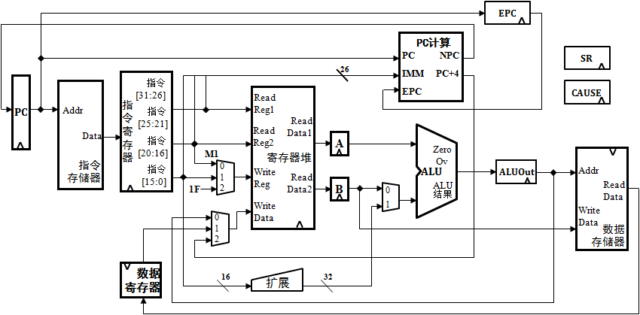
中断响应机制：控制器(1)
检测：每条指令的最后1个状态
如果有，则进入中断响应状态
检测时需要判断是否中断允许位
解决方法：
assign IntReq = |HWInt[7:2] & |IM[7:2] & IE & !EXL ;
S0
Fetch
S1
DCD/RF
S2
MA
S6
EXE
S8
Branch
S9
Jmp
S3
MR
S5
MW
S7
WB
S10
INT
S4
MWB
IntReq

Slide 41
中断响应机制：控制器(2)
处理：保存PC/跳转/关中断均在中断响应状态完成
保存：将PC保存在EPC中
注意：PC已经存储新指令地址了
跳转：控制NPC产生中断处理程序入口地址，并写入PC
关中断：EXL置位，防止再次进入
S0
Fetch
S1
DCD/RF
S2
MA
S6
EXE
S8
Branch
S9
Jmp
S3
MR
S5
MW
S7
WB
S10
INT
●
S4
MWB

系统需求：
在同一周期完成
实现技巧：
PC/EPC/EXL写使能同时产生


Slide 42
中断响应机制：中断服务程序
框架结构：保存现场、中断处理、恢复现场、中断返回
1、保存现场
将所有寄存器都保存在堆栈中
2、中断处理
读取特殊寄存器了解哪个硬件中断发生
执行对应的处理策略
3、恢复现场
从堆栈中恢复所有寄存器
4、中断返回
执行eret指令
1、3、4：通用
2：针对特定设备

Slide 43
中断响应机制：ERET指令
恢复PC，开中断
恢复PC：将EPC写入EPC
开中断：清除EXL，允许再次产生

EXL清0

Slide 44
CP0：0号协处理器
包含EPC、SR、CAUSE等特殊寄存器
EPC
PC计算
PC
IMM
EPC
NPC
PC+4
SR
PC
指
令
寄
存
器
26
指令
存储器
指令
[31:26]
寄存器堆
CAUSE
Read
Reg1
Addr
指令
[25:21]
Read
Data1
Data
指令
[20:16]
Read
Reg2
A
M1
Zero
Ov
数据
存储器
指令
[15:0]
0
1
2
Write
Reg
ALU
ALUOut
Addr
Read
Data2
B
ALU
结果
ReadData
1F
0
1
Write
Data
Write
Data
0
1
2
数据
寄存器
16
扩展
32

Slide 45
中断响应机制分析：软硬件协同
设备 | CP0 | CPU | 中断服务程序
6个硬件中断
IntReq =
f(IE/EXL/IM/IP)
指令最后周期检测IntReq
EPC ← PC
EXL置位
PC←硬件中断服务程序入口
保存现场
中断处理
恢复现场
ERET
PC ← EPC
EXL清除

Slide 46
Interrupt-Driven I/O Example (1/2)
Assume the following system properties:
500 clock cycle overhead for each transfer, including interrupt
Disk throughput of 16 MB/s
Disk interrupts after transferring 16 B
Processor running at 1 GHz
If disk is active 5% of program, what % of processor is consumed by the disk?
5% × 16 [MB/s] / 16 [B/inter] = 50,000 [inter/s]
50,000 [inter/s] × 500 [clocks/inter] = 2.5×10⁷ [clocks/s]
2.5×10⁷ [clocks/s] / 10⁹ [clock/s] = 2.5% busy

Slide 47
Interrupt-Driven I/O Example (2/2)
2.5% busy (interrupts) much better than 40% (polling)
Real Solution: Direct Memory Access (DMA) mechanism
Device controller transfers data directly to/from memory without involving the processor
Only interrupts once per page (large!) once transfer is done

Slide 48
提纲
寄存器：R0~R31，PC
存储器及存储器视图
输入输出
异常/中断
协处理器

Slide 49
协处理器0（CP0）
4个寄存器：SR、Cause、EPC、PRId
阅读《See MIPS Run Linux》第3章
无关寄存器及无关位可以不阅读
理解要点：
SR：用于对系统进行控制
指令可读可写
Cause：指令读取，硬件控制写入
IP[7:2]：对应外部6个中断源
ExcCode：异常/中断发生时控制器控制写入编码值
EPC：用于保存异常/中断发生时的PC
保存PC：硬件控制写入
指令读取：中断服务程序
PRId：处理器ID
可以用于实现个性的编码☺
寄存器号 | 寄存器
12 | SR
13 | CAUSE
14 | EPC
15 | PrID

Slide 50
协处理器指令及用途
指令：MFC0、MTC0
不能直接修改CP0寄存器，必须借助通用寄存器
MFC0：读取CP0寄存器至通用寄存器
SR：获取处理器的控制信息
Cause：获取处理器当前所处于的状态
EPC：获取被异常/中断的指令地址
PRId：读取处理器ID（可以读取你的个性签名☺）
MTC0：通用寄存器值写入CP0寄存器
SR：对处理器进行控制，例如关闭中断
EPC：操作系统中将用于多任务切换

Slide 51
设计CP0：模块接口
信号名 | 方向 | 用途 | 产生来源及机制
PC[31:2] | I | 用于保存PC | PC
DIn[31:0] | I | CP0寄存器的写入数据 | 执行MTC0指令时产生 数据来自GPR[rt]
HWInt[5:0] | I | 6个设备中断
Sel[4:0] | I | 用于选择CP0内部的寄存器 | 执行MFC0/MTC0指令时产生
Wen | I | CP0寄存器写使能 | 执行MTC0指令时产生
EXLSet | I | 用于置位SR的EXL(EXL为1) | CPU控制器在中断响应状态产生
EXLClr | I | 用于清除SR的EXL(EXL为0) | CPU执行ERET指令时产生
clk | I | 时钟
rst | I | 复位
IntReq | O | 中断请求，输出至CPU控制器 | 是HWInt/IM/EXL/IM的函数
EPC[31:2] | O | EPC寄存器输出至NPC
DOut[31:0] | O | CP0寄存器的输出数据 | 执行MFC0指令时产生 数据写入GPR[rt]

Slide 52
设计CP0：SR
由于无用位较多，因此只定义有用位
reg [15:10] im ;
reg exl, ie ;
SR整体表示为：{16’b0, im, 8’b0, exl, ie}
im，ie的行为很简单
if (当Wen有效并且Sel为对应的寄存器编号)
{im, exl, ie} <= {DIn[15:10], DIn[1], DIn[0]} ;
reg [5:0] im与reg [15:10] im
是等价的，但后者编码风格更好

Slide 53
设计CP0：SR
exl要复杂一些：除了类似im/ie的行为外，还必须有置位和清除的功能。以置位为例：
if (EXLSet)
exl <= 1’b1 ;

Slide 54
设计CP0：Cause
Cause：只需定义6位寄存器，不断的锁存HWInt[5:0]
reg [15:10] hwint_pend ;
Cause整体表示为：{16’b0, hwint_pend, 10’b0}

Slide 55
设计CP0：EPC
定义30位寄存器
reg [32:2] epc;
为什么不需要32位？

Slide 56
设计CP0：PRId
用于对公司/指令集版本等进行标识
Intel处理器也有ID，CPU-Z就可以读取
目前可以任意选则用一个4字节的编码值，如
0x1234_5678

Slide 57
设计CP0：输出CP0寄存器
除了SR/Cause/EPC/PRId外，一律输出0。
可以设计一个5选1的MUX。
也可以用行为描述，样例代码：
assign DOut = (Sel==12) ? {16’b0, im, 8’b0, exl, ie} ：
XXXXXXXXXXXXXXXXXXXXXXXXXXXXXXXXXXXXXX :
XXXXXXXXXXXXXXXXXXXXXXXXXXXXXXXXXXXXXX :
XXXXXXXXXXXXXXXXXXXXXXXXXXXXXXXXXXXXXX :
32’b0 ;

Slide 59
增加SR寄存器(3)
EXL：进入中断后，必须标记，防止再次进入
EXL
EPC
PC计算
PC
IMM
EPC
NPC
PC+4
SR
PC
指
令
寄
存
器
26
指令
存储器
指令
[31:26]
寄存器堆
CAUSE
Read
Reg1
Addr
指令
[25:21]
Read
Data1
Data
指令
[20:16]
Read
Reg2
A
M1
Zero
Ov
数据
存储器
指令
[15:0]
0
1
2
Write
Reg
ALU
ALUOut
Addr
Read
Data2
B
ALU
结果
ReadData
1F
0
1
Write
Data
Write
Data
0
1
2
数据
寄存器
16
扩展
32

Slide 60
中断响应机制分析：软硬件协同
CP0 | CPU | 中断服务程序
add
sub
and
or
6个硬件中断
IntReq =
f(IE/EXL/IM/IP)
指令最后周期检测IntReq
EPC ← PC
EXL置位
PC←硬件中断服务程序入口
add
sub
and
or
保存现场
中断处理
恢复现场
ERET
PC ← EPC
EXL清除

