Slide 1
计算机学院课程
计算机组成
MIPS控制
高小鹏
北京航空航天大学计算机学院
系统结构研究所

Slide 2
提纲
内容主要取材
CS617的21讲
快速回顾数据通路
实现控制
时钟方法

Slide 3
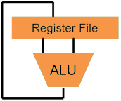
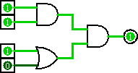
Great Idea #1: Levels of Representation/Interpretation
Higher-Level Language Program (e.g. C)
temp = v[k];
v[k] = v[k+1];
v[k+1] = temp;
Compiler
lw $t0, 0($2)
lw $t1, 4($2)
sw $t1, 0($2)
sw $t0, 4($2)
Assembly Language Program (e.g. MIPS)
Assembler
0000 1001 1100 0110 1010 1111 0101 1000
1010 1111 0101 1000 0000 1001 1100 0110
1100 0110 1010 1111 0101 1000 0000 1001
0101 1000 0000 1001 1100 0110 1010 1111
Machine Language Program (MIPS)
We are here
Machine Interpretation
Hardware Architecture Description (e.g. block diagrams)
Architecture Implementation
Logic Circuit Description (Circuit Schematic Diagrams)

Slide 4
Hardware Design Hierarchy
system
Today
datapath
control
code registers
state registers
combinational logic
multiplexer
comparator
register
logic
switching networks

Slide 5
提纲
内容主要取材
CS617的21讲
快速回顾数据通路
实现控制
时钟方法

Slide 6
Datapath Review
Part of the processor; the hardware necessary to perform all operations required
Depends on exact ISA, RTL of instructions
Major components:
PC and Register File (RegFile holds registers)
Instruction and Data Memory
ALU for operations (on two operands)
Extender (sign/zero extend)

Slide 7
Five Stages of the Datapath
rd
Register
File
ALU
PC
instruction
memory
rs
Data
memory
rt
+4
imm
MUX
1. Instruction
Fetch
1. Instruction
Fetch
2. Decode/
Register Read
2. Decode/
Register Read
3. Execute
3. Execute
4. Memory
4. Memory
5. Register
Write
5. Register
Write

Slide 8
Datapath and Control
Route parts of datapath based on ISA needs
Add MUXes to select from multiple inputs
Add control signals for component inputs and MUXes
Analyze control signals
How wide does each one need to be?
For each instruction, assign appropriate value for correct routing

Slide 9
MIPS-lite Instruction Fetch
nPC_sel
zero
4
Addr
Adder
Instruction
0
Instruction
Memory
32
MUX
PC
Adder
1
PC Ext
CLK
imm16
Instr Fetch Unit

Slide 10
MIPS-lite Datapath Control Signals
ExtOp: 0 → “zero”; 1 → “sign”
ALUsrc: 0 → busB; 1 → imm16
ALUctr: “ADD”, “SUB”, “OR”
nPC_sel: 0 → +4; 1 → branch
MemWr: 1 → write memory
MemtoReg: 0 → ALU; 1 → Mem
RegDst: 0 → “rt”; 1 → “rd”
RegWr: 1 → write register
RegDst
rd
rt
nPC_sel
Instr
Fetch
Unit
1
0
CLK
RegWr
rs
rt
ALUctr
5
5
5
zero
MemtoReg
RW
RA
RB
busA
32
MemWr
busW
RegFile
=
ALU
32
32
busB
0
0
CLK
32
32
WrEn
Addr
Data
Memory
imm16
Extender
1
Data In
1
16
32
ALUSrc
CLK
ExtOp

Slide 11
提纲
内容主要取材
CS617的21讲
快速回顾数据通路
实现控制
时钟方法

Slide 12
Processor Design Process
Five steps to design a processor:
1. Analyze instruction set → datapath requirements
2. Select set of datapath components & establish clock methodology
3. Assemble datapath meeting the requirements
4. Analyze implementation of each instruction to determine setting of control points that effects the register transfer
5. Assemble the control logic
Formulate Logic Equations
Design Circuits
Processor
Input
Control
Memory
Datapath
Output
Now

Slide 13
Purpose of Control
Instr
Memory
Instruction<31:0>
<31:26>
<25:21>
<20:16>
<15:11>
<5:0>
<0:15>
opcode
rs
rt
rd
funct
imm16
Controller
nPC_sel
RegWr
RegDst
ExtOp
ALUSrc
ALUctr
MemWr
MemtoReg
Datapath

Slide 14
MIPS-lite Instruction RTL
Instr Register Transfer Language
addu R[rd]←R[rs]+R[rt]; PC←PC+4
subu R[rd]←R[rs]–R[rt]; PC←PC+4
ori R[rt]←R[rs]+zero_ext(imm16); PC←PC+4
lw R[rt]←MEM[R[rs]+sign_ext(imm16)]; PC←PC+4
sw MEM[R[rs]+sign_ext(imm16)]←R[rs]; PC←PC+4
beq if(R[rs]==R[rt]) then PC←PC+4+[sign_ext(imm16)||00] else PC←PC+4

Slide 15
MIPS-lite Control Signals (1/2)
Instr Control Signals
addu ALUsrc=RegB, ALUctr=“ADD”, RegDst=rd, RegWr, nPC_sel=“+4”
subu ALUsrc=RegB, ALUctr=“SUB”, RegDst=rd, RegWr, nPC_sel=“+4”
ori ALUsrc=Imm, ALUctr=“OR”, RegDst=rt, RegWr, ExtOp=“Zero”, nPC_sel=“+4”
lw ALUsrc=Imm, ALUctr=“ADD”, RegDst=rt, RegWr, ExtOp=“Sign”, MemtoReg, nPC_sel=“+4”
sw ALUsrc=Imm, ALUctr=“ADD”, MemWr, ExtOp=“Sign”, nPC_sel=“+4”
beq ALUsrc=RegB, ALUctr=“SUB”, nPC_sel=“Br”

Slide 16
MIPS-lite Control Signals (2/2)
See MIPS
func
10 0000
10 0010
n/a
Green Sheet
op
00 0000
00 0000
00 1101
10 0011
10 1011
00 0100
add
sub
ori
lw
sw
beq
RegDst
1
1
0
0
X
X
ALUSrc
0
0
1
1
1
0
MemtoReg
0
0
0
1
X
X
Control Signals
RegWrite
1
1
1
1
0
0
MemWrite
0
0
0
0
1
0
nPC_sel
0
0
0
0
0
1
ExtOp
X
X
0
1
1
X
ALUctr<2:0>
Add
Subtract
Or
Add
Add
Subtract
All Supported Instructions
Now how do we implement this table with CL?

Slide 17
Generating Boolean Expressions
Idea #1: Treat instruction names as Boolean variables!
opcode and funct bits are available to us
Use gates to generate signals that are 1 when it is a particular instruction and 0 otherwise
Examples:
beq = op[5]’∙op[4]’∙op[3]’∙op[2]∙op[1]’∙op[0]’
Rtype = op[5]’∙op[4]’∙op[3]’∙op[2]’∙op[1]’∙op[0]’
add = Rtype∙funct[5]∙funct[4]’∙funct[3]’ ∙funct[2]’∙funct[1]’∙funct[0]’

Slide 18
Generating Boolean Expressions
Idea #2: Use instruction variables to generate control signals
Make each control signal the combination of all instructions that need that signal to be a 1
Examples:
MemWrite = sw
RegWrite = add + sub + ori + lw
What about don’t cares (X’s)?
Want simpler expressions; set to 0!
Read from row of table

Slide 19
Controller Implementation
Use these two ideas to design controller:
opcode
funct
add
“OR” Logic
RegDst
“AND” Logic
ALUSrc
sub
MemtoReg
ori
RegWrite
lw
MemWrite
sw
nPC_sel
Generate instruction signals
Generate control signals
ExtOp
beq
ALUctr[0]
ALUctr[1]

Slide 20
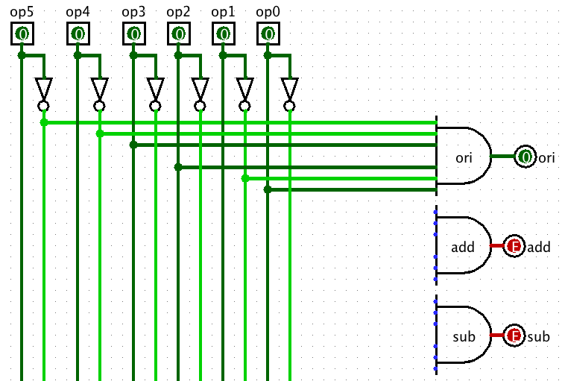
AND Control Logic in Logisim
Notes:
Logisim file called “Control Plane MIPS.circ”

Slide 21
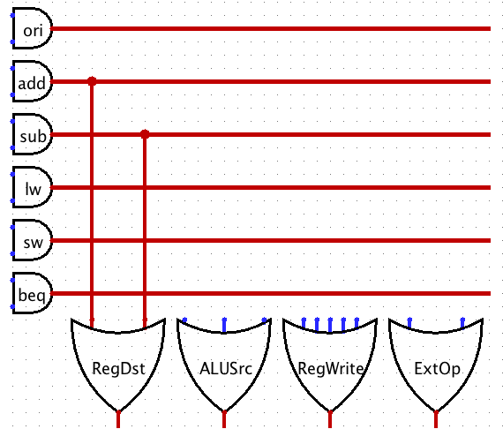
OR Control Logic in Logisim

Slide 22

Great Idea #1: Levels of Representation/Interpretation
Higher-Level Language Program (e.g. C)
temp = v[k];
v[k] = v[k+1];
v[k+1] = temp;
Compiler
lw $t0, 0($2)
lw $t1, 4($2)
sw $t1, 0($2)
sw $t0, 4($2)
CALL HOME, WE’VE MADE HARDWARE/SOFTWARE CONTACT!!!
Assembly Language Program (e.g. MIPS)
Assembler
0000 1001 1100 0110 1010 1111 0101 1000
1010 1111 0101 1000 0000 1001 1100 0110
1100 0110 1010 1111 0101 1000 0000 1001
0101 1000 0000 1001 1100 0110 1010 1111
Machine Language Program (MIPS)
Machine Interpretation
Hardware Architecture Description (e.g. block diagrams)
Architecture Implementation
Logic Circuit Description (Circuit Schematic Diagrams)

Slide 23
提纲
内容主要取材
CS617的21讲
快速回顾数据通路
实现控制
时钟方法

Slide 24
Register Timing Terms (Review)
Setup Time: how long the input must be stable before the CLK trigger for proper input read
Hold Time: how long the input must be stable after the CLK trigger for proper input read
“CLK-to-Q” Delay: how long it takes the output to change, measured from the CLK trigger

Slide 25
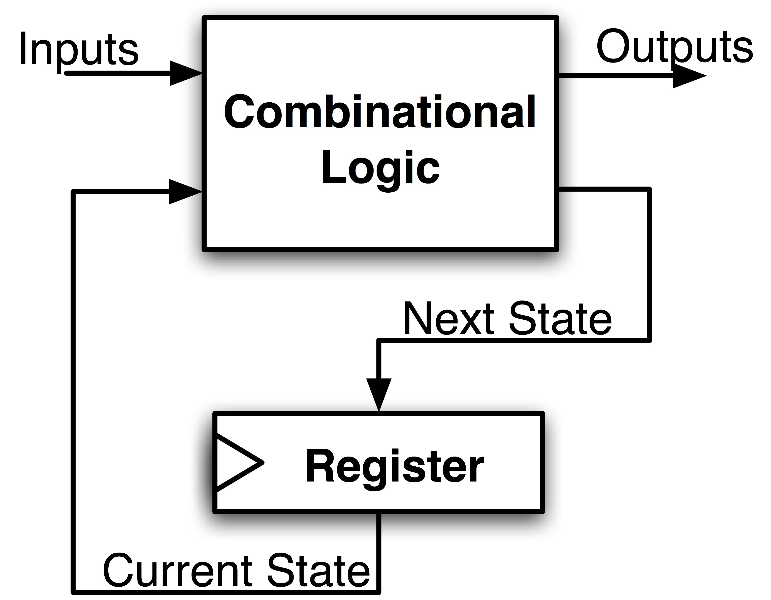
Maximum Clock Frequency
What is the max frequency of this circuit?
Limited by how much time needed to get correct Next State to Register
Max Delay =
Max Freq = 1/Max Delay
Setup Time
+ CLK-to-Q Delay
+ CL Delay
Notes:
Hold time is included in CLK-to-Q delay.

Slide 26
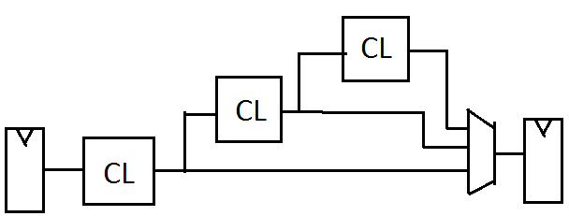
The Critical Path
The critical path is the longest delay between any two registers in a circuit
The clock period must be longer than this critical path, or the signal will not propagate properly to that next register
Critical Path =
CL Delay 1
+ CL Delay 2
+ CL Delay 3
+ Adder Delay
3
2
4
1
+
Reg
Reg

Slide 27
Clocking Methodology
Clk
.
.
.
.
.
.
.
.
.
.
.
.
Storage elements (RegFile, Mem, PC) triggered by same clock
Critical path determines length of clock period
This includes CLK-to-Q delay and setup delay
So far we have built a single cycle CPU – entire instructions are executed in 1 clock cycle
Up next: pipelining to execute instructions in 5 clock cycles

Slide 28
Register-Register Timing: One Complete Cycle for addu
Clk
Clk-to-Q
PC
Old Value
New Value
Rs, Rt, Rd,
Op, Func
Instruction Memory Access Time
Old Value
New Value
Delay through Control Logic
ALUctr
Old Value
New Value
RegWr
Old Value
New Value
Register File Access Time
busA, B
Old Value
New Value
ALU Delay
busW
Old Value
New Value
RegWr
Rd
Rs
Rt
ALUctr
Setup Time
5
5
5
busA
32
Register Write
Occurs Here
busW
Rw
Ra
Rb
32
RegFile
busB
ALU
clk
32
Notes:
Let’s take a more quantitative picture of what is happening.
At each clock tick, the Program Counter will present its latest value to the Instruction memory after Clk-to-Q time.
After a delay of the Instruction Memory Access time, the Opcode, Rd, Rs, Rt, and Function fields will become valid on the instruction bus.
Once we have the new instruction, that is the Add or Subtract instruction, on the instruction bus, two things happen in parallel.
First of all, the control unit will decode the Opcode and Func field and set the control signals ALUctr and RegWr accordingly. We will cover this later.
While this is happening (points to Control Delay), we will also be reading the register file (Register File Access Time).
Once the data is valid on busA and busB, the ALU will perform the Add or Subtract operation based on the ALUctr signal.
Hopefully, the ALU is fast enough that it will finish the operation (ALU Delay) before the next clock tick.
At the next clock tick, the output of the ALU will be written into the register file because the RegWr signal will be equal to 1.
+3 = 45 min. (Y:25)

Slide 29
Register-Register Timing: One Complete Cycle for addu
Clk
Clk-to-Q
PC
Old Value
New Value
Rs, Rt, Rd,
Op, Func
Instruction Memory Access Time
Old Value
New Value
Delay through Control Logic
ALUctr
Old Value
New Value
RegWr
Old Value
New Value
Register File Access Time
busA, B
Old Value
New Value
ALU Delay
busW
Old Value
New Value
RegWr
Rd
Rs
Rt
ALUctr
Setup Time
5
5
5
busA
32
Register Write
Occurs Here
busW
Rw
Ra
Rb
32
RegFile
busB
ALU
clk
32
Notes:
Let’s take a more quantitative picture of what is happening.
At each clock tick, the Program Counter will present its latest value to the Instruction memory after Clk-to-Q time.
After a delay of the Instruction Memory Access time, the Opcode, Rd, Rs, Rt, and Function fields will become valid on the instruction bus.
Once we have the new instruction, that is the Add or Subtract instruction, on the instruction bus, two things happen in parallel.
First of all, the control unit will decode the Opcode and Func field and set the control signals ALUctr and RegWr accordingly. We will cover this later.
While this is happening (points to Control Delay), we will also be reading the register file (Register File Access Time).
Once the data is valid on busA and busB, the ALU will perform the Add or Subtract operation based on the ALUctr signal.
Hopefully, the ALU is fast enough that it will finish the operation (ALU Delay) before the next clock tick.
At the next clock tick, the output of the ALU will be written into the register file because the RegWr signal will be equal to 1.
+3 = 45 min. (Y:25)

Slide 30
Single Cycle Performance
Assume time for actions are 100ps for register read or write; 200ps for other events
Minimum clock period is?
Instr | Instr fetch | Register read | ALU op | Memory access | Register write | Total time
lw | 200ps | 100 ps | 200ps | 200ps | 100 ps | 800ps
sw | 200ps | 100 ps | 200ps | 200ps |  | 700ps
R-format | 200ps | 100 ps | 200ps |  | 100 ps | 600ps
beq | 200ps | 100 ps | 200ps |  |  | 500ps
What can we do to improve clock rate?
Will this improve performance as well?
Want increased clock rate to mean faster programs
Notes:
1.25 GHz

Slide 31
作业1
《计算机组成与设计》 | Logicsim | WORD
4.3 |  | 
4.4 |  | 
4.5 | (4.5.1) | 
4.7 |  | 
4.10 |  | 

Slide 32
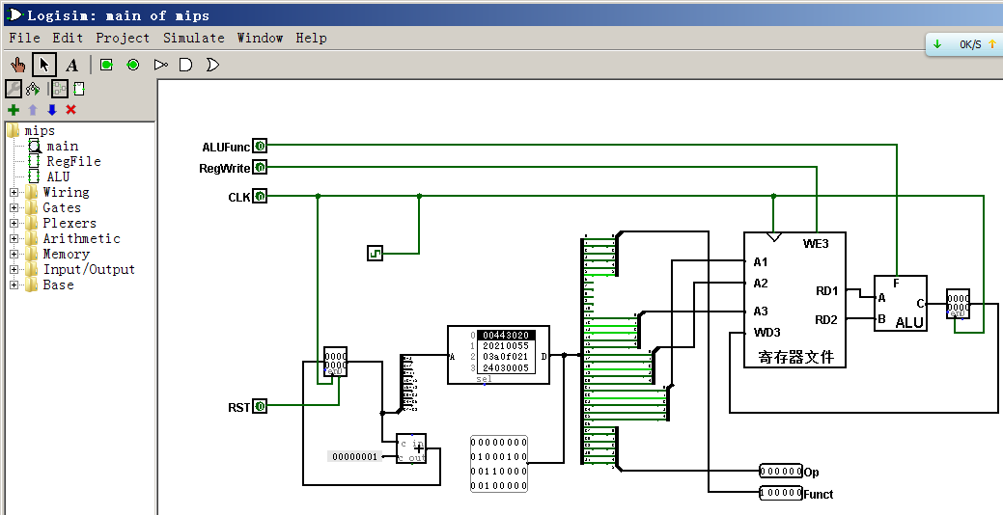
Project3
示意图

Slide 33
Project3
Logicsim
设计1、以作业2为基础，实现PPT中MIPS-lite指令集的单周期数据通路
设计2、以设计1为基础，实现MIPS-lite指令集的单周期数据通路
设计1、设计2应分别是2个独立的设计图
不要直接在设计1的设计图上增加设计2的部分！

Slide 34
Project3
Logicsim
以上次作用3的设计2为基础，实现完整的单周期CPU
构造一个至少20条以上指令的测试程序
每个类型的指令必须出现1次以上
Word
简要论述设计要点，并对测试用例及测试结果进行简单分析

Slide 36
MIPS-lite控制信号
 | ADDU | SUBU | ORI | LW | SW | BEQ
nPC_sel | “+4”
RegDst | rd
ALUSrc | RegB
ALUctl | “ADD”
ExtOp
MemtoReg
RegWr | 1
MemWr
ADDU
SUBU
ORI
LW
nPC_sel

Slide 37
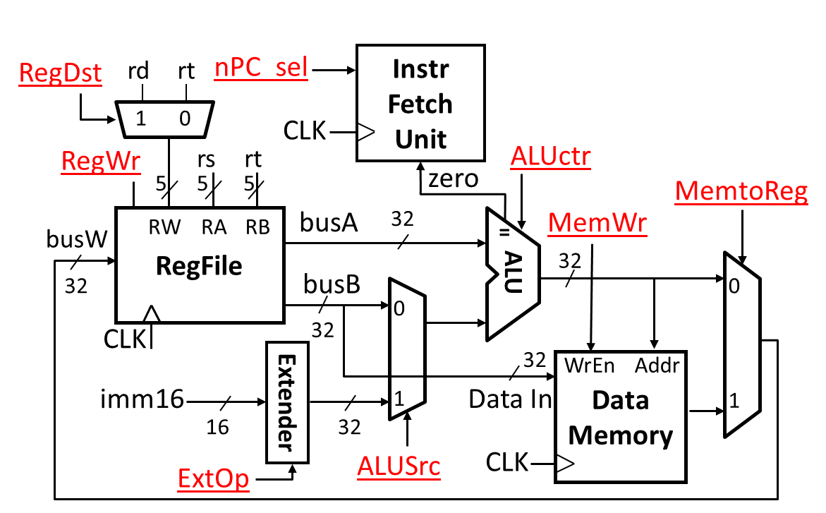
MIPS-lite控制信号
 | ADDU | SUBU | ORI | LW | SW | BEQ
nPC_sel | “+4”
RegDst | rd
ALUSrc | RegB
ALUctl | “ADD”
ExtOp
MemtoReg
RegWr | 1
MemWr

Slide 38
MIPS-lite Control Signals (1/2)
Instr Control Signals
addu ALUsrc=RegB, ALUctr=“ADD”, RegDst=rd, RegWr, nPC_sel=“+4”
subu ALUsrc=RegB, ALUctr=“SUB”, RegDst=rd, RegWr, nPC_sel=“+4”
ori ALUsrc=Imm, ALUctr=“OR”, RegDst=rt, RegWr, ExtOp=“Zero”, nPC_sel=“+4”
lw ALUsrc=Imm, ALUctr=“ADD”, RegDst=rt, RegWr, ExtOp=“Sign”, MemtoReg, nPC_sel=“+4”
sw ALUsrc=Imm, ALUctr=“ADD”, MemWr, ExtOp=“Sign”, nPC_sel=“+4”
beq ALUsrc=RegB, ALUctr=“SUB”, nPC_sel=“Br”

