Slide 1


Budgeting:
Cost, Time, Quality and Scope

Slide 2
Before I may discuss the game I must discuss its rules.
There are 4 variables
Cost
Time
Quality
Scope
There are 2 forces that can act on a project
External
Internal
External forces pick values for 3 of the given variables
Internal forces respond by setting the final variable
If managers pick all 4 then
Quality is forfeit
Time is forfeit

Slide 3
A rival company can make one program in 9 months.
Should I hire 9 programmers to make the same program in 1 month?
What about 18 programmers?

Slide 4
Let me rephrase the question for you.
Sue next door had a kid after nine months.
Should I hire 9 women to make the same child in 1 month?

Slide 5
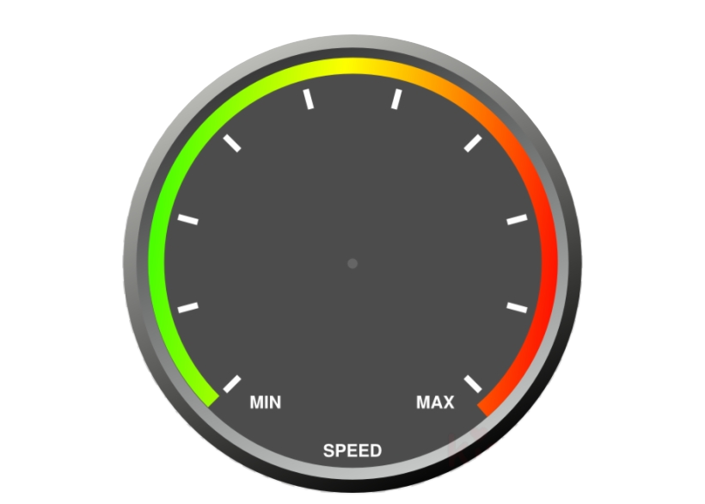
Cost
Money can help
Buy new equipment
Hire specialized staff
Speed up production (somewhat)
Too much money to early can hinder
Too many staff members
Nothing to do
With no money the project halts development

Slide 6
Time
Time is an external factor decided by the client
Made with some event in mind
Too much time can hinder the project with
Too much feedback
Extremely high standards
A tight schedule leads to stress which hurts
The budget
General quality
How much the team can do

Slide 7
Quality
Quality is another external variable controlled by the manager.
Managers should strive for an overall high quality as
It increases moral
Prevents or simplifies bugs
Speeds up the project
However too much quality can hamper the project in odd cases.
AS A PRODUCT MANAGER NEVER EVER INTENTIONALLY LOWER QUALITY!!!
If you do choose to lower quality you can expect
Short term times will increase
Long term problems will ensue

Slide 8
Scope
Scope is the programmers variable
We choose what features are implemented
We choose which features are pushed back
As scope increases
Costs increase
Time required increases
Quality is reduced
We should do everything we can to reduce scope
However we can only reduce scope so much before the customer no longer recognizes the program.
To effectively lower scope we require constant communication with our client to ensure major features aren’t cut.

Slide 9
Summary

Slide 10
Questions?

