Slide 1
“E-commercePortal”
A project minor defense on :
Project Members :
Pratik Adhikari 21125124
Kshitiz Subedi 21125118
Amish Upreti 21125102
Prashav Rimal 21125123
Submitted to :
Department of IT Everest Engineering College

Slide 2
Outline
Background
Objective
Significance of the Project
Literature Review
Methodology
Tools and Environment
Conclusion
References

Slide 3
Background
An online e-commerce portal is a web-based platform designed to facilitate the buying and selling of products or services over the internet.
For users to create accounts and profiles, enabling them to browse, search for, and purchase items online.
To support various payment methods, including COD, digital wallets, and more.
For sellers to manage their inventory, update product listings, and track sales.
To ensure secure transactions and protect customer information through encryption and security protocols.

Slide 4
Objective
To create a user-friendly e-commerce portal web-based platform.
Enable customers to easily browse and purchase products or services.
Implement secure and convenient payment processing methods. Showcase detailed product listings with images and descriptions.
Provide features like shopping carts, wish-lists, and more.
Offer order management and tracking for customers.
Support seller capabilities to manage inventory and update listings.
Ensure data security and protection for customer information.

Slide 5
Significance of the Project
Convenient online shopping.
Efficient checkout and payment processes.
Time and cost-saving compared to traditional shopping methods.
Access to a wide range of products and services in a single centralized platform.
A wide selection of products and sellers for both consumers and businesses.
Overall, improved shopping efficiency and convenience.

Slide 6
Literature Review
E-commerce Marketplace Structure: The platform enables sellers to manage individual storefronts with logistics and inventory control, offering a commission-based revenue model.
Diverse Industry Applicability: Widely used across banking, education, commerce, and tourism, the platform integrates technology to enhance services.
Limited Academic Insight: Despite common technological integration for user registration and transactions, academic research on its impact remains limited.

Slide 7
Tools and Environment
Frontend:
HTML5: It's like the skeleton of our web pages, creating their structure.
CSS3: Think of it as the stylist, making the web pages look good and adding visual touches.
JavaScript: This makes our web pages interactive, adding cool features.
Backend:
PHP: This does the behind-the-scenes work on the server, handling all the important operations.
MySQL: It's like our digital file cabinet, storing and managing data about hotels, guests, rooms, and reservations
Development Tools to be used:
Visual Studio Code: Our digital notepad for writing and editing code.
XAMPP: It's like our virtual workshop, giving us the tools we need to build and test our web application.
Web browsers (e.g., Brave, Firefox, Google Chrome): These are our testing grounds, where we make sure everything works as it should.

Slide 8
Methodology
Incremental Model The incremental model includes following phases:
Requirement analysis: In the first phase of the incremental model, we identify the requirements.
Design & Development: In this phase, the design of the system functionality and the development method are finished with success.
Testing: In the incremental model, the testing phase checks the performance of each existing function as well as additional functionality.
Implementation: Implementation phase enables the coding phase of the development system.

Slide 9
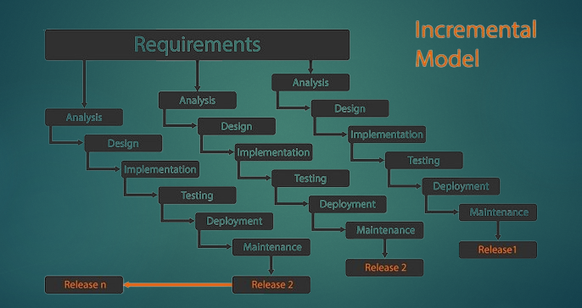
Methodology

Slide 10
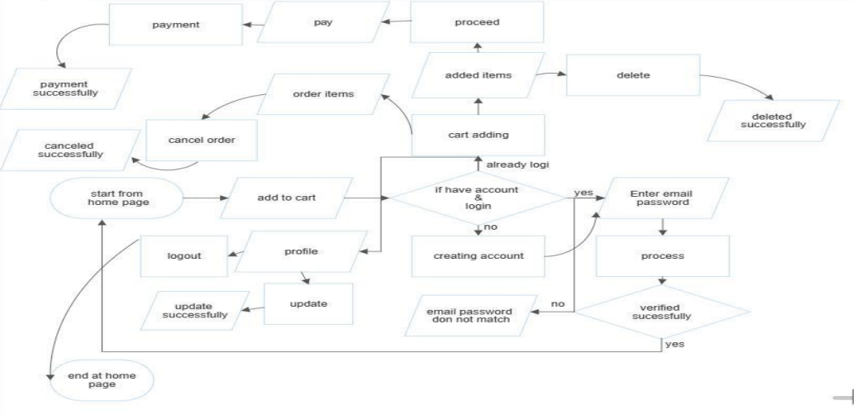
Methodology
Fig : Flowchart of Customer

Slide 11
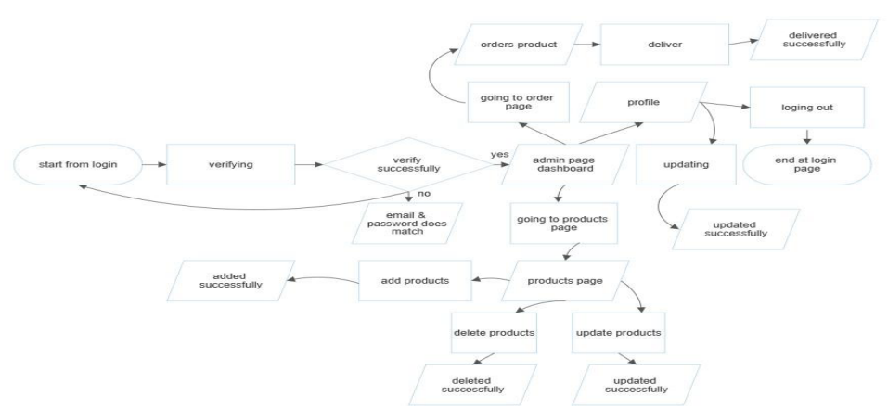
Methodology
Fig : Flowchart of Admin

Slide 12
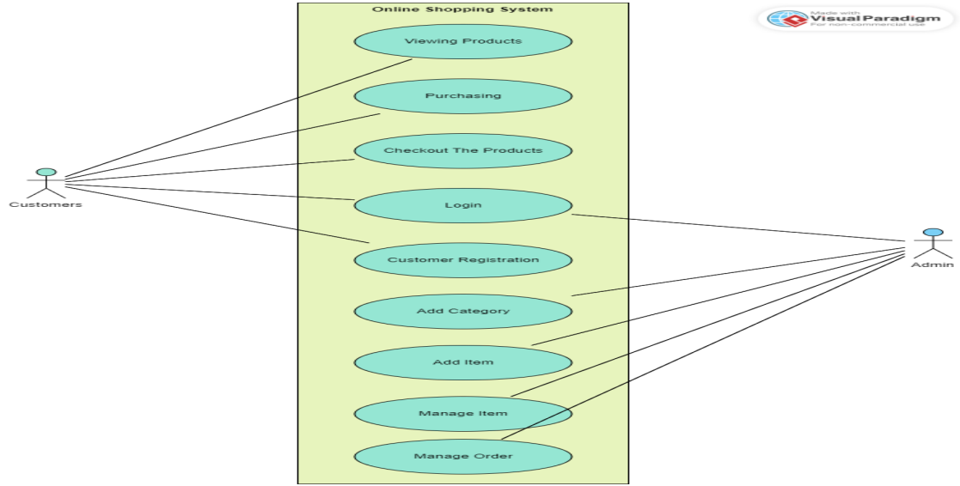
Methodology
Fig: Use Case Diagram

Slide 13
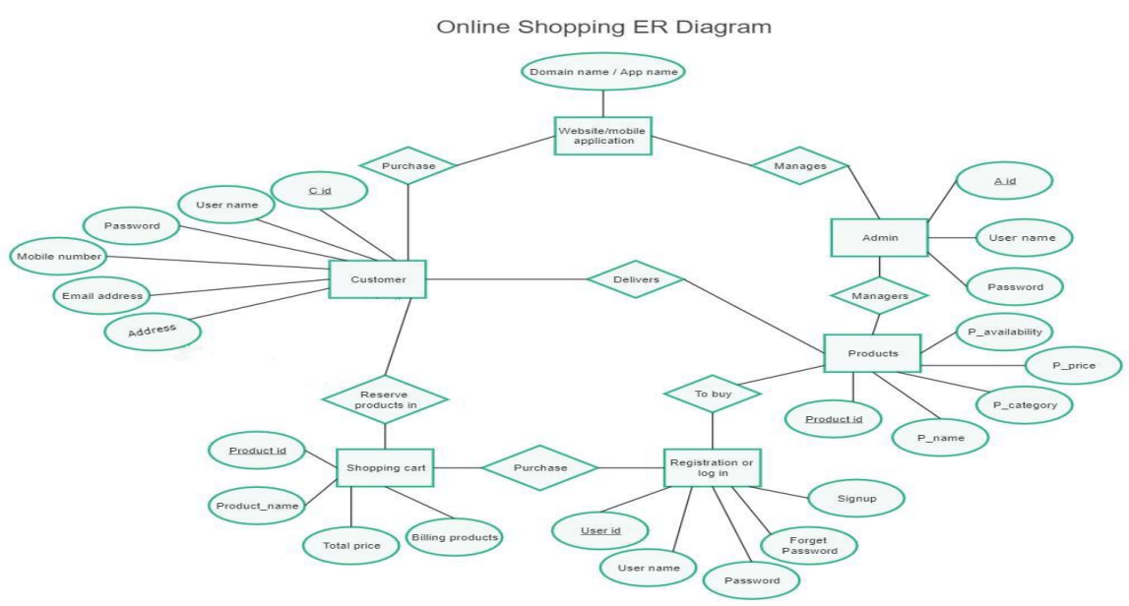
ER-Diagram
Fig : ER- Diagram of Online Shopping

Slide 14
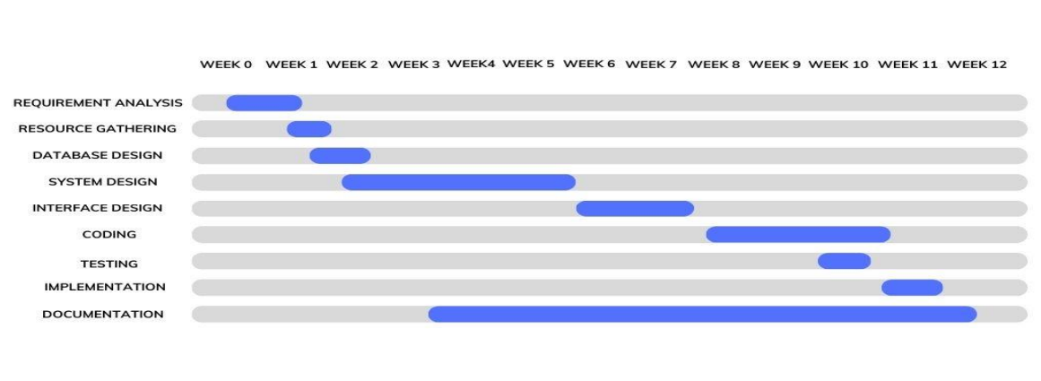
Methodology
Fig : Gantt Chart

Slide 15
Conclusion
Offers a centralized marketplace for buyers and sellers.
Revolutionizes the way people shop and businesses connect with customers.
Provides a wide range of features and tools for a seamless shopping experience.
Creates equal opportunities for businesses of all sizes to reach a diverse customer base

Slide 16
Problems encountered and solved
Problem connecting to MySQL database with backend PHP
We created a db_connection.php file to handle database connection
MySQL not working because something else occupied 3306 port
Changed the port for MySQL to 3307 manually

Slide 17
References
[1] Bibrainia. (2020). Big data use cases in e-commerce industry. Bibrainia Bhattacharjee, D., & Bhatnagar, S. (2019). The role of online job portals in recruitment: A comparative study of Naukri and Monster in India. Journal of Management Development, 38(9), 721-734.
[2] Joines J. L., Scherer, C., & Scheufele, D. A. (2003). Exploring motivations for consumer we use and their implications for e-commerce. Journal of Consumer Marketing, 20(2), 90-108.
[3] Rosencrance, Linda. "E-Commerce Sales to Boom for Next 5 Years." ComputerWorld. 5 Feb 2008.13 Dec 2009.

Slide 18
Thank you!

