Slide 1
Optical Pumping
Trapping Electrons With Light
Elijah K. Dunn
PHSX 516, Dec. 6, 2011

Slide 2
Motivation
Demonstrate Zeeman Splitting
Determine the g-factor of Rb⁸⁵ and Rb⁸⁷
Optical pumping lab rarely gets completed by students
“It is only a small exaggeration to claim these [optical pumping] experiments constitute an atomic physics course.”
-TeachSpin Manual

Slide 3
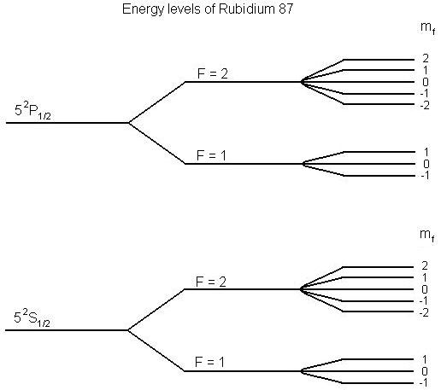

Zeeman Splitting
Fine and Hyperfine states from electron spin dipoles and orbit fields
In the presence of a magnetic field Hyperfine energy states ($F$) are split
$m_{f}=±F$

Slide 4

Induced Transitions
Electron in ${5_{}^{2}S_{1/2} m}_{f}=0$ state
798.4 nm photon induces transition
$∆m=+1$
Spontaneous emission
$∆m=0,+1,−1$
Emission in all directions
Start again!

Slide 5

Pumping
Electrons emit a photon and loose energy
Electrons can deexcite to any $∆m_{f}=−1,0,1$ Zeeman state with equal probability
Highest Zeeman state of the non-excited energy level can not gain a unit of angular momentum
Electrons cannot transition and will accumulate in that level
They have been “pumped” with optical waves!

Slide 6
Zero Field Transition
Electrons are in the pumped state
Maximum transmission of light
Magnetic field diminishes to zero
Zeeman states collapse
Light transmission decreases as absorption increases

Slide 7

EM Transition
$$hf=gμ_{B}B$$
Electrons are in the pumped state
Maximum transmission of light
Input EM wave matches the energy difference between Zeeman states
Transitions occur that drop the electrons out of the pumped state
Light transmission decreases as absorption increases

Slide 8
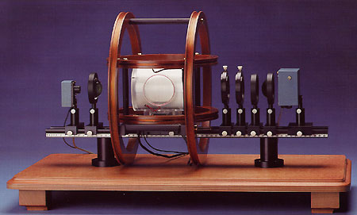
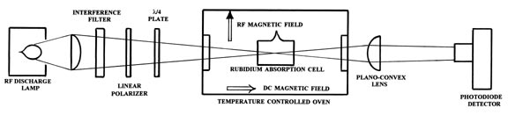
Apparatus
RF discharge lamp
Optics
Pumping Cell
Optics
Detector
Magnetic Coils

Slide 9
Optics
RF discharge lamp provides light
Composed of Rb⁸⁵, Rb⁸⁷ and Xenon gas (buffer)
Plano-convex lens to collimate
Interference filter to transmit 798.4 nm light
Linear polarizer
¼ wave plate to circularly polarize light
Ensures direction independent absorption
Plano-convex lens for focusing
Photodiode detector

Slide 10
Magnetic Coils
Three pairs of Helmholtz coils
Vertical field
1.5 gauss/amp; 1.4 gauss max
Horizontal field
8.8 gauss/amp; 8 gauss max
Horizontal sweep
0.60 gauss/amp; 1 gauss max
Radio Frequency (RF) coil
10 kHz – 100 MHz range
Homogeneity > 2 Gauss over cell

Slide 11
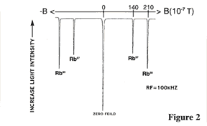
Detection
Photodiode converts light to voltage
Oscilloscope plots photodiode voltage versus coil current
A decrease in light intensity: dip in the scope trace
Dip less than 1% magnitude
High gain (1-1000) allows easy detection
Zero Field Transition
Rb⁸⁷ EM Dip
Rb⁸⁵ EM Dip

Slide 12
Methodology
Temperature stabilization
Alignment
Gain settings
Sweep the horizontal field
Locate Zero Field Transition
Minimize width with vertical field coil
Input EM wave
Search for EM dip
Change frequency

Slide 13

Error and Uncertainty
Coil Current
Current conversion less than 1% offset $V=IR$
Voltmeter uncertainty (0.15%±2)
Inhomogeneity of Helmholtz coil fields
Alignment parallel to geomagnetic field
Area magnetic fields
Moving elevator
Metallic structure

Slide 14
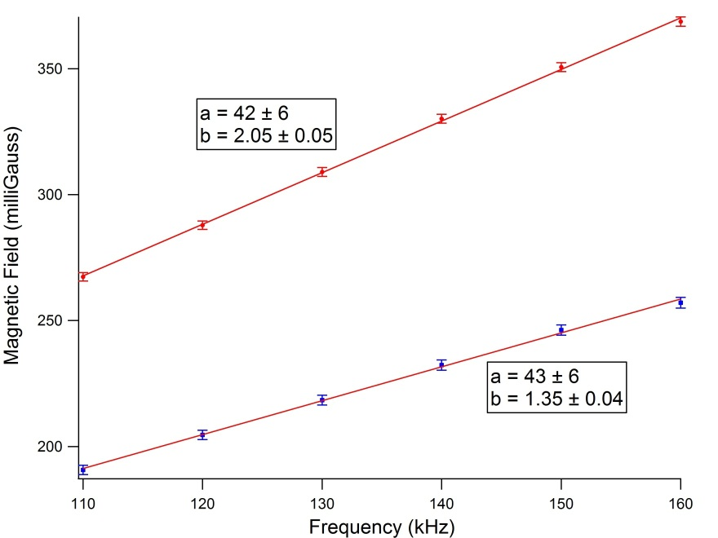

Results
$$g_{{Rb}^{85}}=0.531±0.007$$
$$g_{{Rb}^{87}}=0.340±0.003$$
$B_{E}=106±12$mG

Slide 15

Conclusions
Expected $g_{{Rb}^{85}}=1/2$ $g_{{Rb}^{87}}=1/3$
$B_{E}$ is low
Demonstrated optical pumping for two isotopes
Magnetically isolate apparatus and measure R in the future

Slide 16
Acknowledgements
My partner: S. Halder
Physics Dept. for providing the $14,000 Optical Pumping Apparatus
Prof. Han for suggestions and help

