Slide 1
AI-Driven Loan Sales Chatbot for Tata Capital

Slide 2
The code commandos
Flarance Rani Nandigama
Vignan Lara Institute of technology and science (VLITS)
9398446419
Devi Trushitha Munakala
Vignan Lara Institute of technology and science (VLITS)
8555893662
Paleru Venkata Sravya Reddy
Vignan Lara Institute of technology and science (VLITS)
9391177059
Shafiya Noor Basha
Vignan Lara Institute of technology and science (VLITS)
6303332526
Harika munjeti
Vignan Lara Institute of technology and science (VLITS)
8688056315

Slide 3

Industry Background
Personal loan sales in NBFCs like Tata Capital are still human-driven and slow.
Manual verification, conversations, document handling & underwriting create:
Delays in customer response
High drop-off rates
Inconsistent approval decisions
Missed sales opportunities
Problem in Focus
Existing process is fragmented:
Customer → Sales Agent → KYC Verification → Underwriting → Sanction
No unified workflow, leading to:
Long wait times
Low automation
Human dependency
Lost revenue due to slow approvals
There is a strong need for a fast, intelligent, end-to-end AI-driven sales system.
This Photo by Unknown Author is licensed under CC BY-SA-NC

Slide 4
Executive Summary
This solution proposes an AI-Driven Loan Sales Chatbot designed to automate Tata Capital’s personal loan sales lifecycle from customer conversation to sanction letter generation. Today, loan sales involve manual customer conversations, separate KYC workflows, offline credit checks, and human-generated sanction letters. These fragmented steps cause slow response times, reduced customer satisfaction, and low conversion rates.
Our proposed solution eliminates manual bottlenecks by using an Agentic AI architecture with a Master Agent and multiple Worker Agents. The chatbot interacts in a natural, conversational manner with customers, collects loan requirements, and requests documents where necessary. A Verification Agent validates KYC and documents using mock CRM and API data. An Underwriting Agent applies credit rules, checks credit score, evaluates eligibility, and provides a decision. Upon approval, a Sanction Agent automatically generates a personalized sanction letter (PDF) with loan details and provides a download link to the user.
This end-to-end automation can reduce time-to-sanction from ~20 minutes to under 2 minutes. The solution fits the NBFC industry (B2C) and targets users who want quick, digital loan approvals. By removing manual intervention, the system increases customer completion rates, ensures compliance through audit logs, and significantly improves operational efficiency.

Slide 5
Problem Statement & Proposed Solution
Problem Statement
Manual and fragmented loan sales processes result in:
Long customer wait times
Low digital completion rates
High operational load on human agents
Delays in document verification and credit decisions
Proposed Solution
A web-based Agentic AI Chatbot that automates:
Customer conversation
Data collection
Document verification
Credit assessment
Sanction letter generation
This ensures fast, consistent, explainable decisions.

Slide 6
Approach & Methodology
Value Proposition
Faster approvals
Higher conversions
Error-free underwriting
Fully digital experience
More loans sanctioned with less manual effort
Impact Metrics
Time to sanction
Completion rate
Automation %
Customer satisfaction
Methodology
Conversational AI collects user data
Agentic AI system routes tasks to specialized agents
Mock APIs/KYC database enables validation
Rule-based and score-based underwriting
PDF generator produces sanction letters

Slide 7

Technology Stack
Frontend: Streamlit / Gradio chatbot UI
Backend: Python, LangChain Agent architecture
Data: Mock CRM/credit score CSV/JSON
Verification: Document upload + validation logic
PDF Generation: Python report generation tools
APIs: Mock KYC API, mock bureau API
Deployment Ready: Containers / microservices (future)

Slide 8
Assumptions, Constraints & Decisions
Assumptions
Mock data sufficiently represents CRM/KYC environment
Document uploaded are in supported formats
Constraints
No access to real bureau APIs
Only mock credit scores used
Decision Points
Rule-engine style eligibility (no ML due to time constraints)
Agentic architecture chosen for modularity
Rule engine ensures explainable decisions
Streamlit selected for fastest demo-ready UI

Slide 9
Implementation Feasibility & Scalability
Implementation Feasibility
Modular agents allow easy enhancements
Rule engine ensures easy compliance updates
PDF generation and audit logs support NBFC regulatory needs
Scalability
Stateless microservices possible
Vertical & horizontal scaling of agents
Can integrate with real APIs later
Multi-product support (car loan, business loan, etc.

Slide 10
Solution Components (For Next Round Demo)
Chat interface
Document upload flow
KYC check
Underwriting decision
Audit log outputs

Slide 11
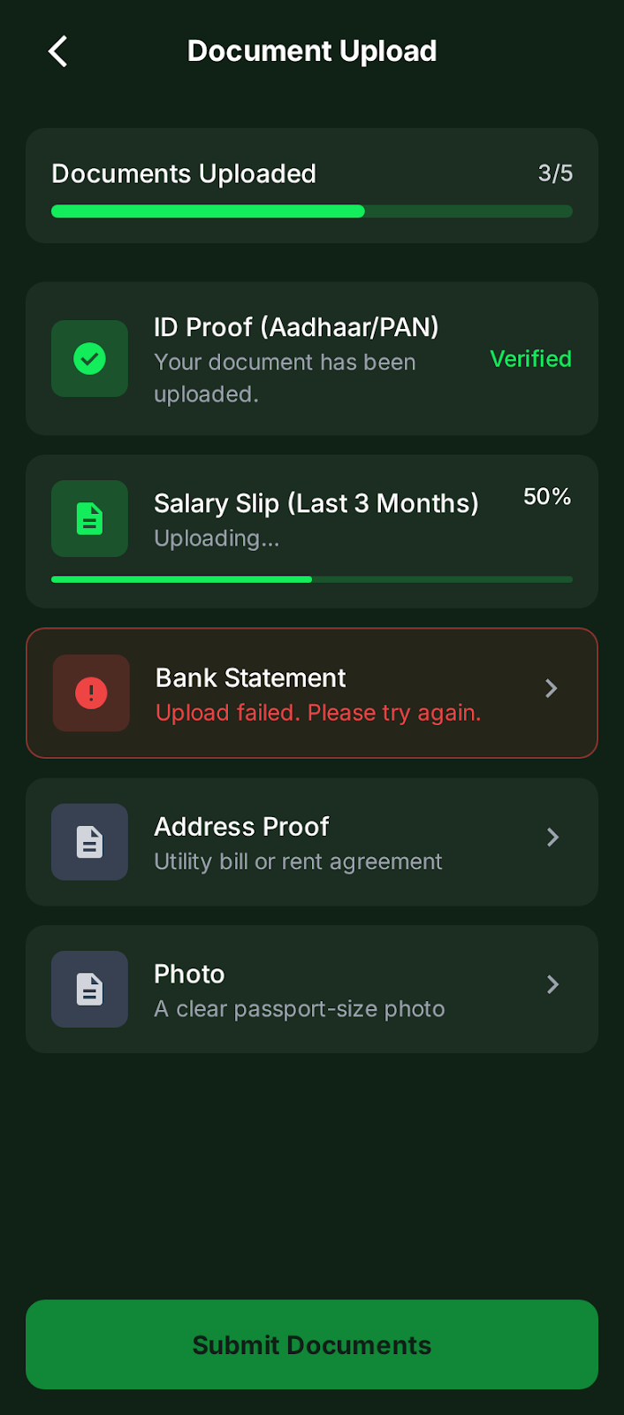
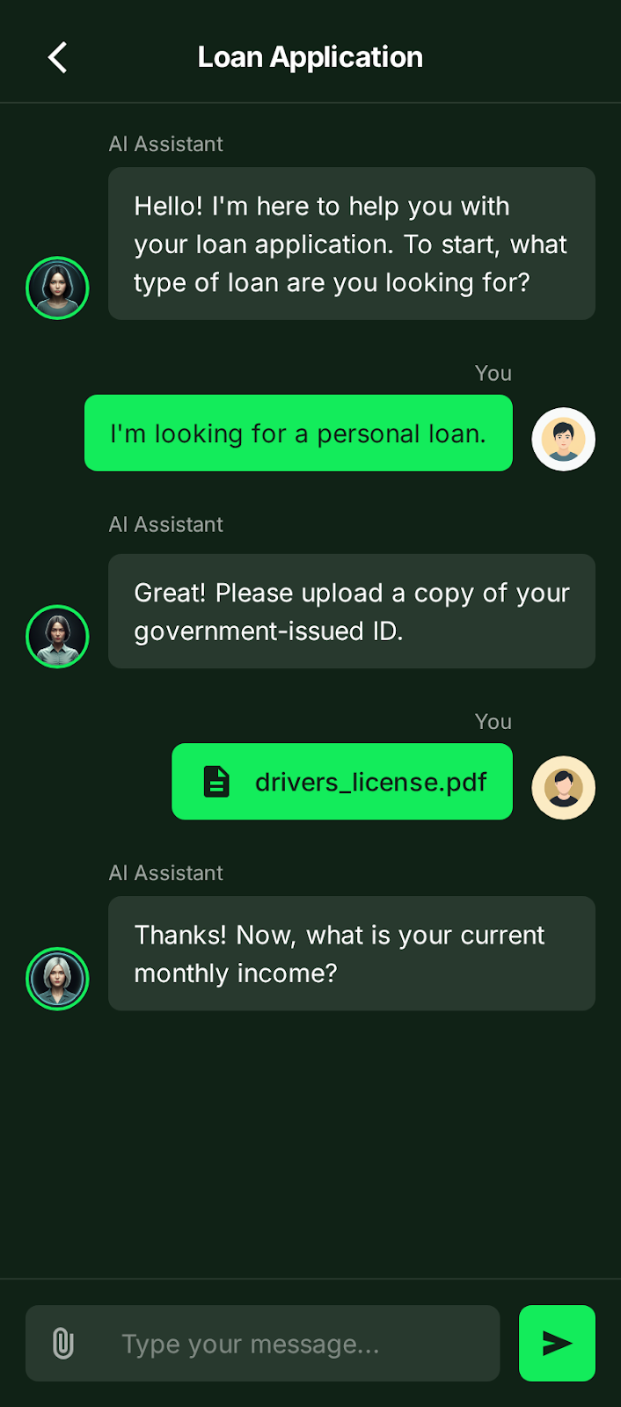
Working Prototype Screenshots

Slide 12
Thank you
Chaperone
An friendly, advice giving ai to solve and make it easier to understand about managing finance
Video : https://www.linkedin.com/posts/flarance-rani-nandigama-ba62a2325_excited-to-share-a-demo-of-my-ai-driven-loan-activity-7407065863121539072-LVhB?utm_source=share&utm_medium=member_desktop&rcm=ACoAAFIXJi4B0vOsF8lEACP14zeMUfWtvF2M5gc

