Slide 1

Web/Python Programming
웹/파이썬 프로그래밍

Slide 2
Today
Identify components of a website
Describe files commonly used in websites
HTML, CSS, Javascript, and images
Identify HTML tags and some coding
Discuss applying style to HTML
Set up templates
Create links
Format text

Slide 3




Components of a website
HTML files and images
Viewed through a web browser
Safari (Apple)
Chrome (Google)
Internet Explorer (Microsoft)
Firefox (Mozilla Foundation)

Slide 4
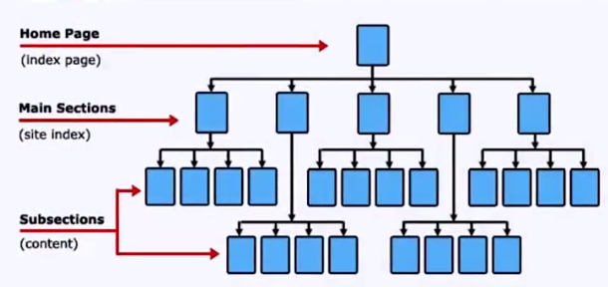
Structure of a website

Slide 5
Files
Files viewed through a web browser
HTML = Hypertext Markup Language
CSS = Cascading Style Sheets
JS = JavaScript
Images

Slide 6
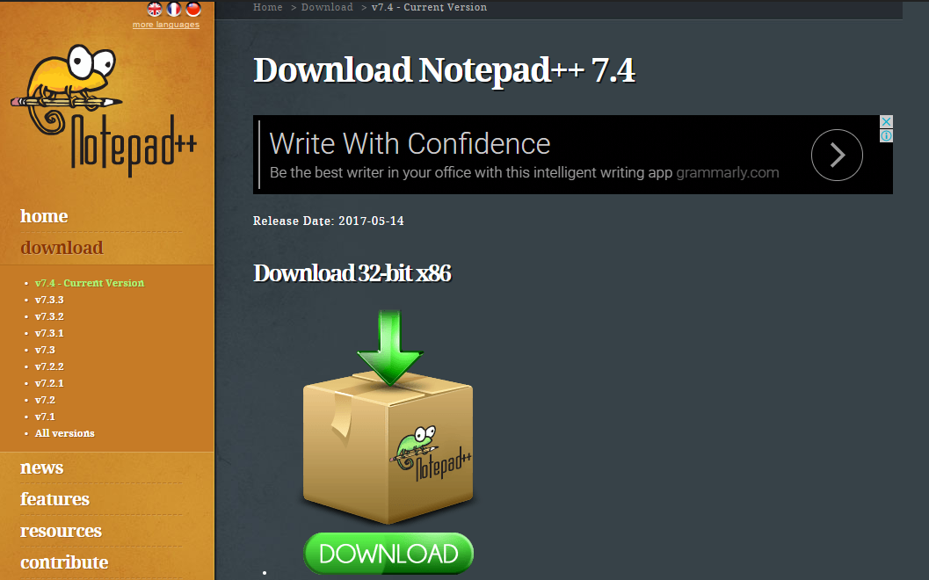
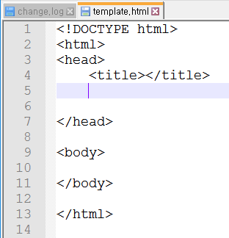
HTML editor
Notepad++

Slide 7
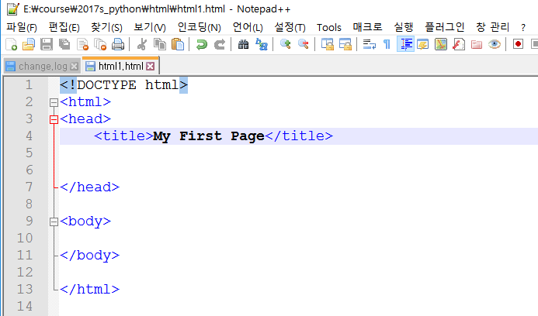
My First Page
언어->H -> HTML 선택
template.html을 다른 이름으로 저장 (ex. html1.html)

Slide 8
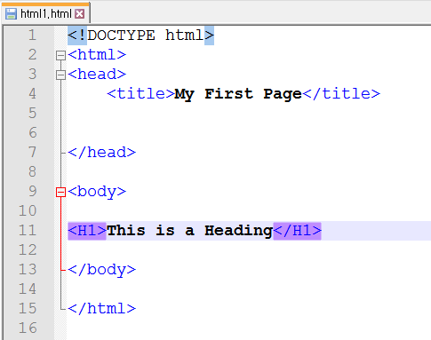
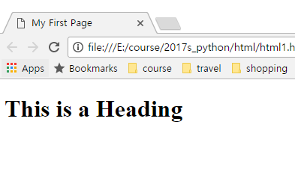
Heading tags

Slide 9
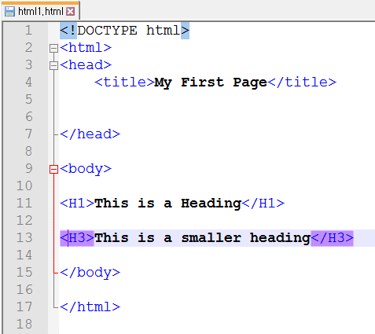
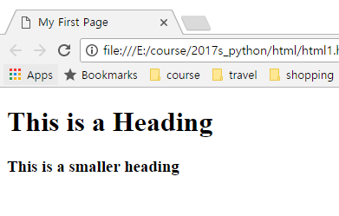
Heading tags

Slide 10
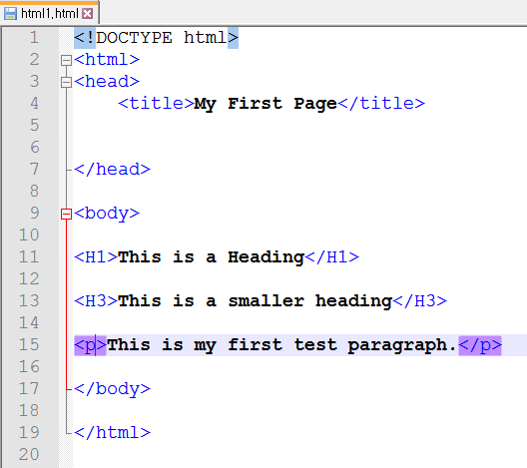
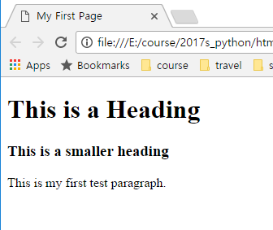
Paragraph tags

Slide 11
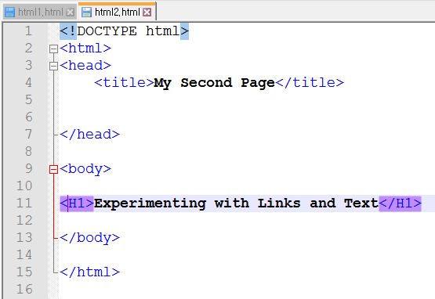
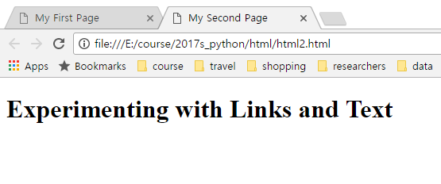
My Second Page

Slide 12
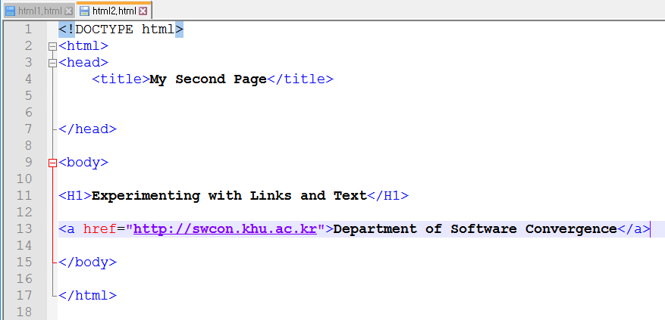
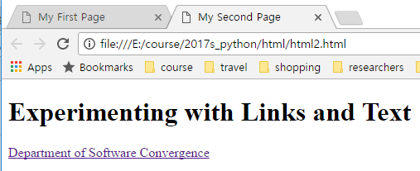
My Second Page

Slide 13
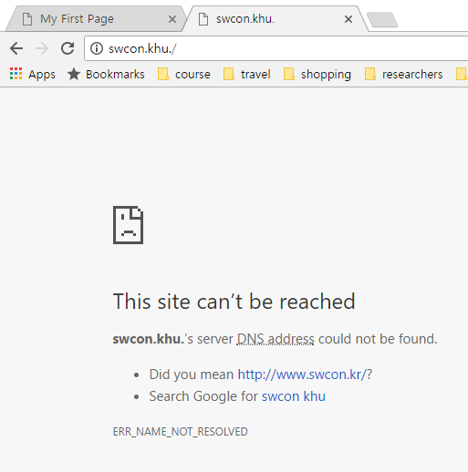
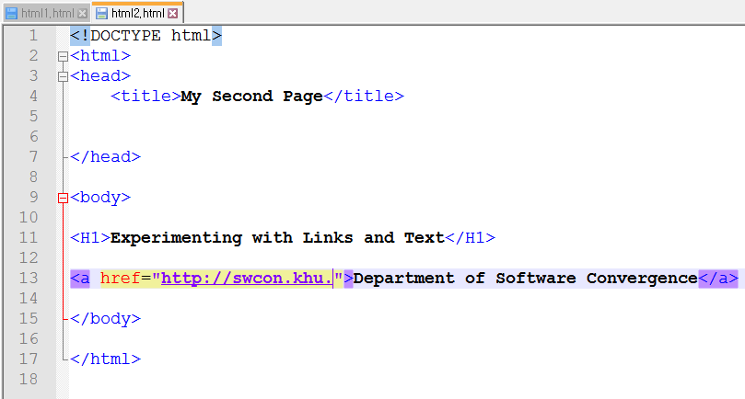
My Second Page

Slide 14
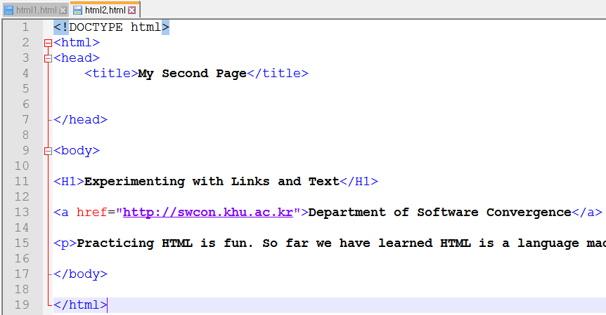
My Second Page
Practicing HTML is fun. So far we have learned HTML is a language made of tags that help us describe how we want our webpages to look. We have tried the head, title, H(heading), and paragraph tags so far. Very few people know all the tags in HTML, but that is okay because we can do a lot with just some basic tags. We can learn about new tags when we need them.

Slide 15
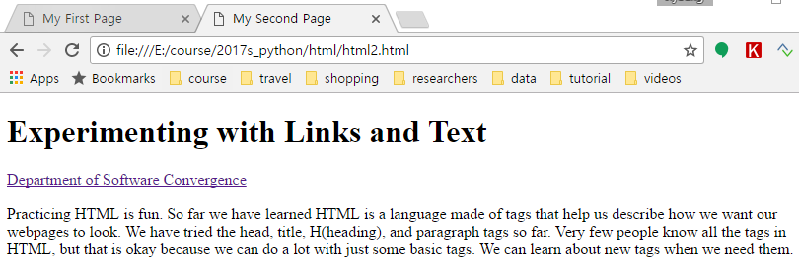
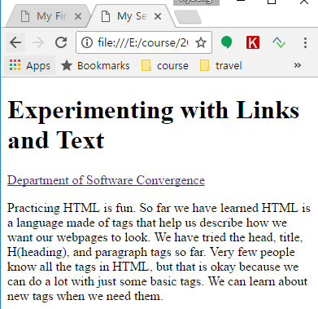
My Second Page

Slide 16
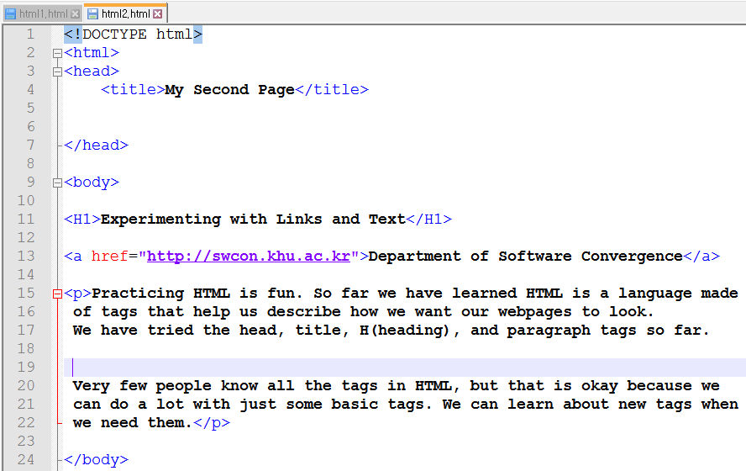
Whitespace ignored

Slide 17
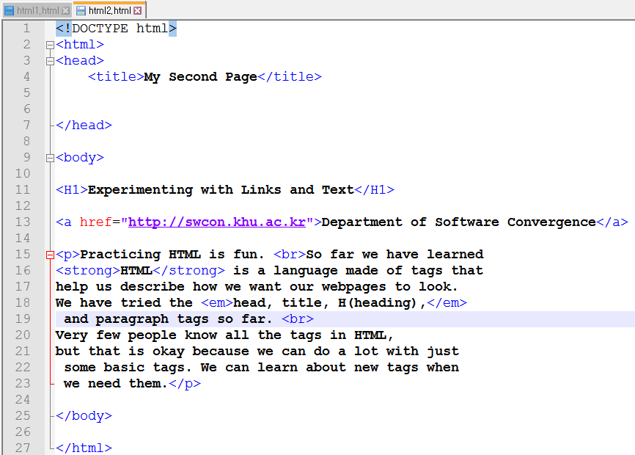
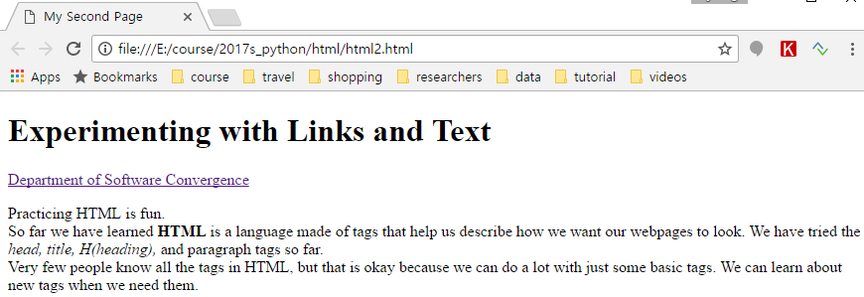
Basic tags
<br>
<strong></strong>
<b></b>: may not work
<em></em>

Slide 18
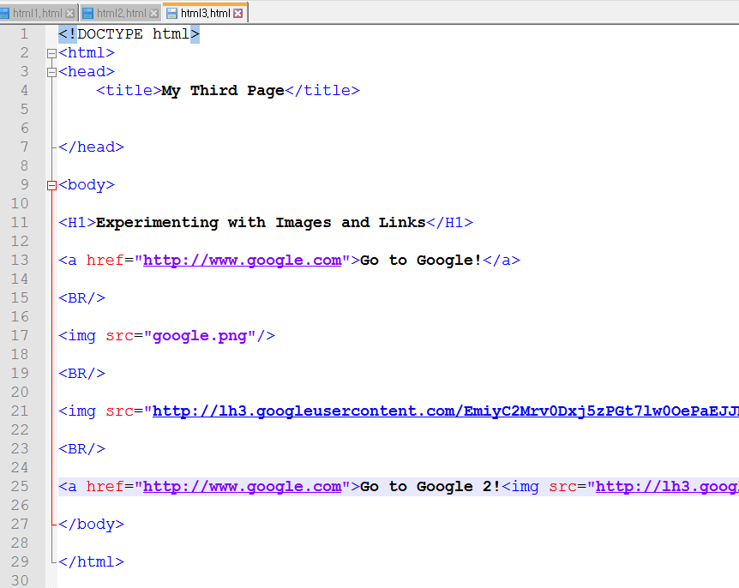
Images and links

Slide 19
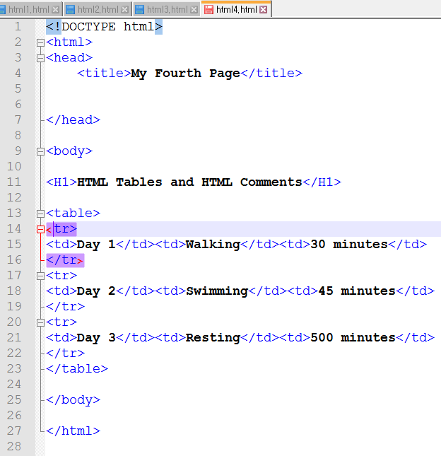
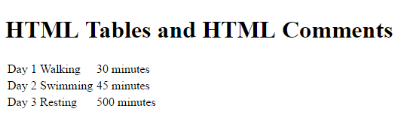
Tables 1

Slide 20
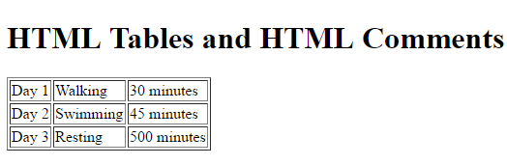
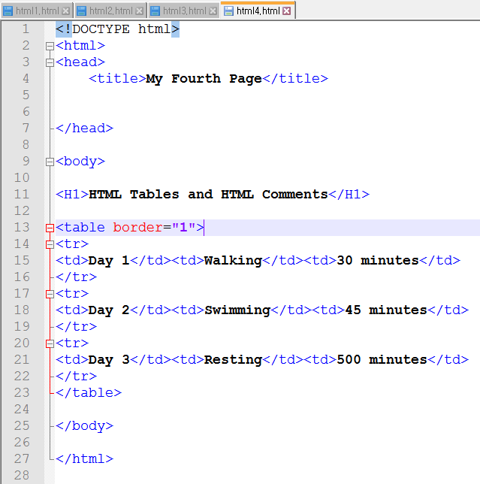
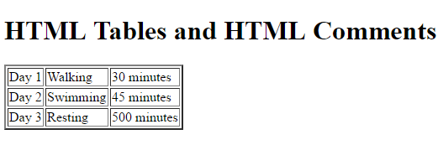
Tables 2

Slide 21
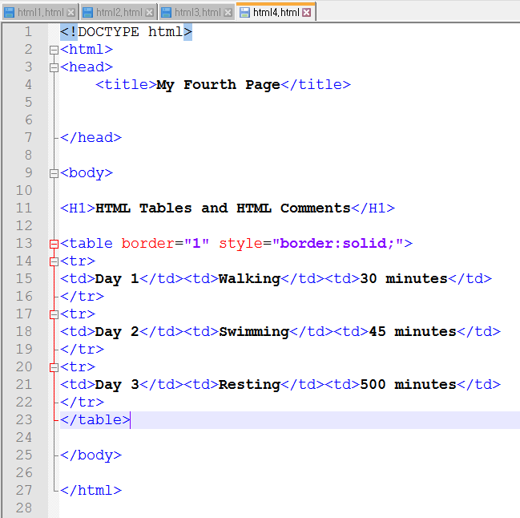
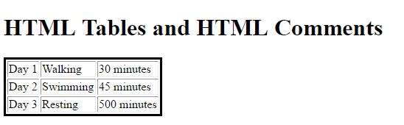
Tables 3

Slide 22
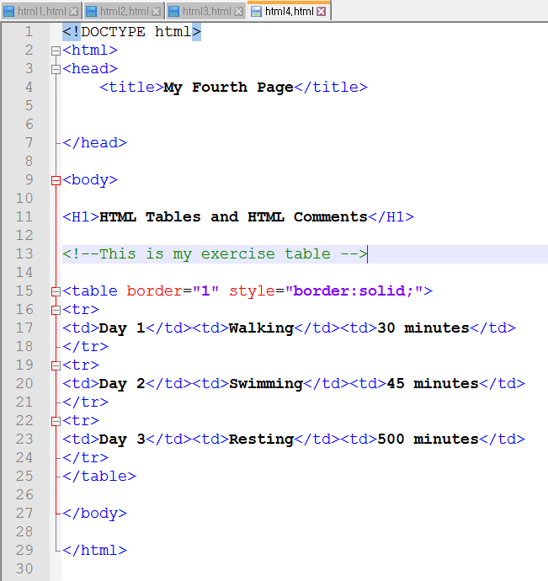
Comments

Slide 23
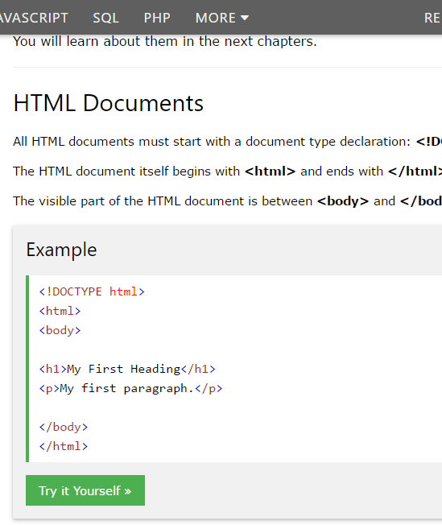
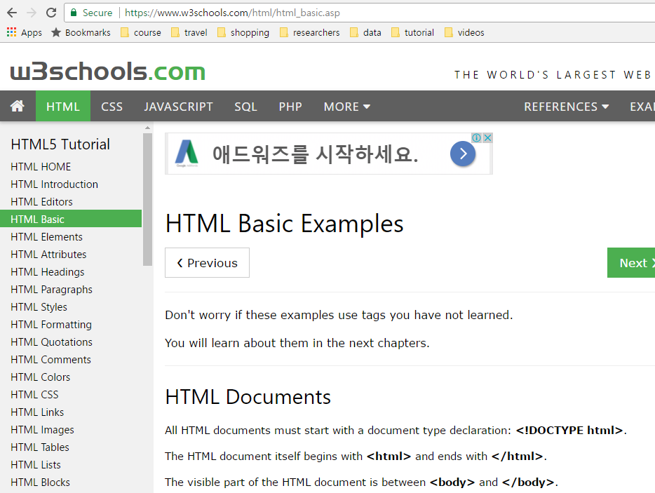
Practice HTML

Slide 24
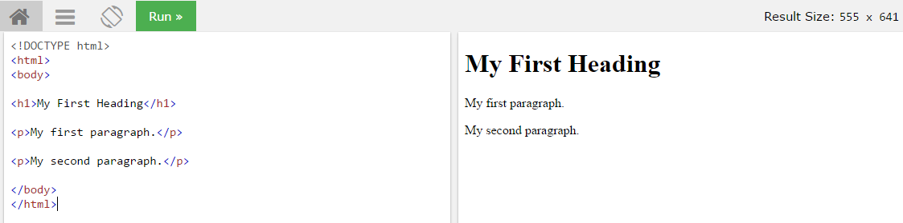
Practice HTML
Try it yourself

Slide 25
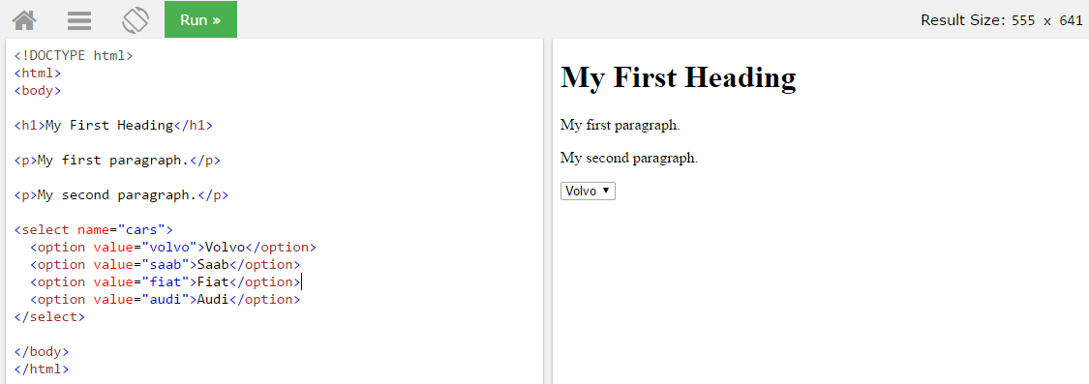
HTML forms -> Form elements

Slide 26
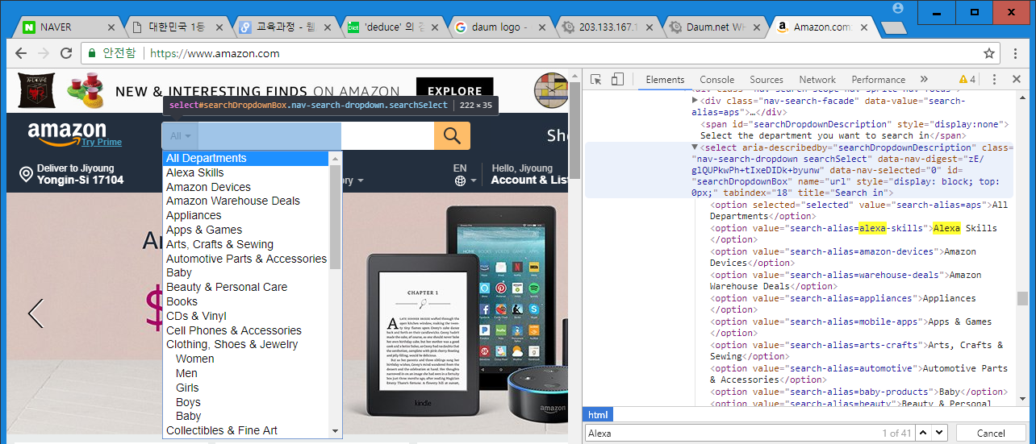
Example: Amazon.com
Chrome 우측상단-> 도구더보기->개발자도구

Slide 27
Adding styles to HTML
Cascading Style Sheets (CSS)
Inline
Can be messy and hard to use
Internal
Using a <style> element in <head> section
External
Using an external CSS file

Slide 28
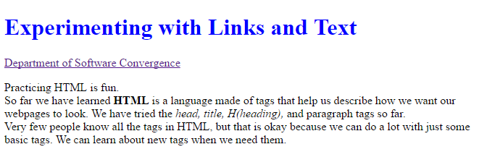
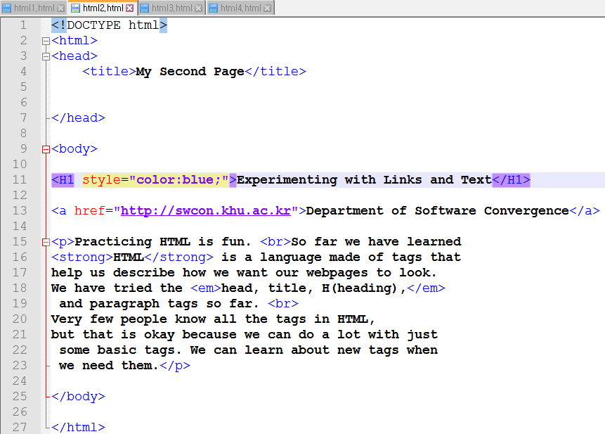
Inline CSS

Slide 29
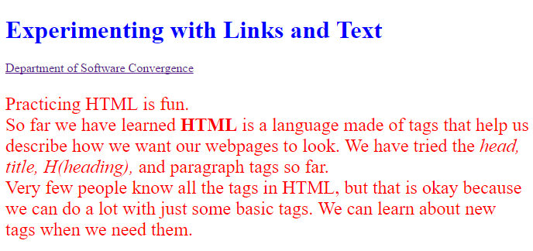
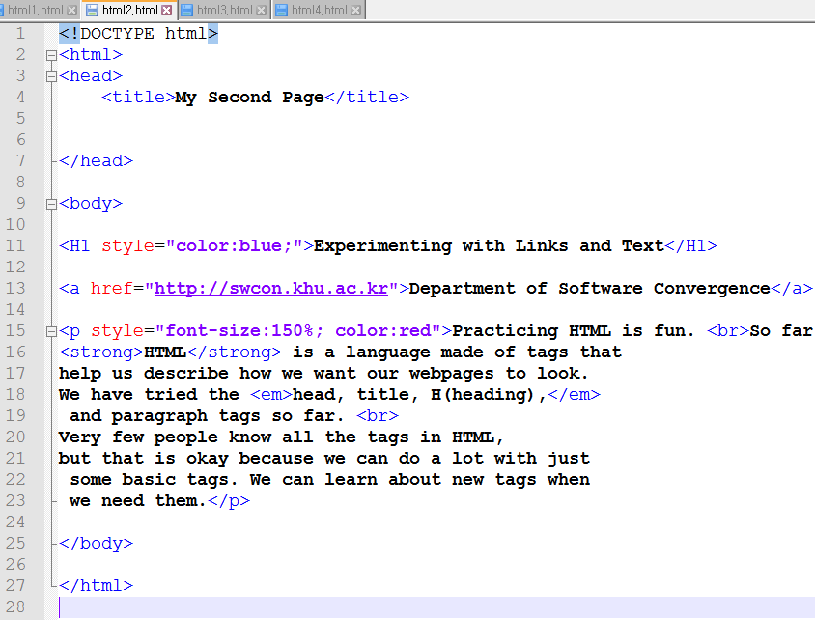
Inline CSS

Slide 30
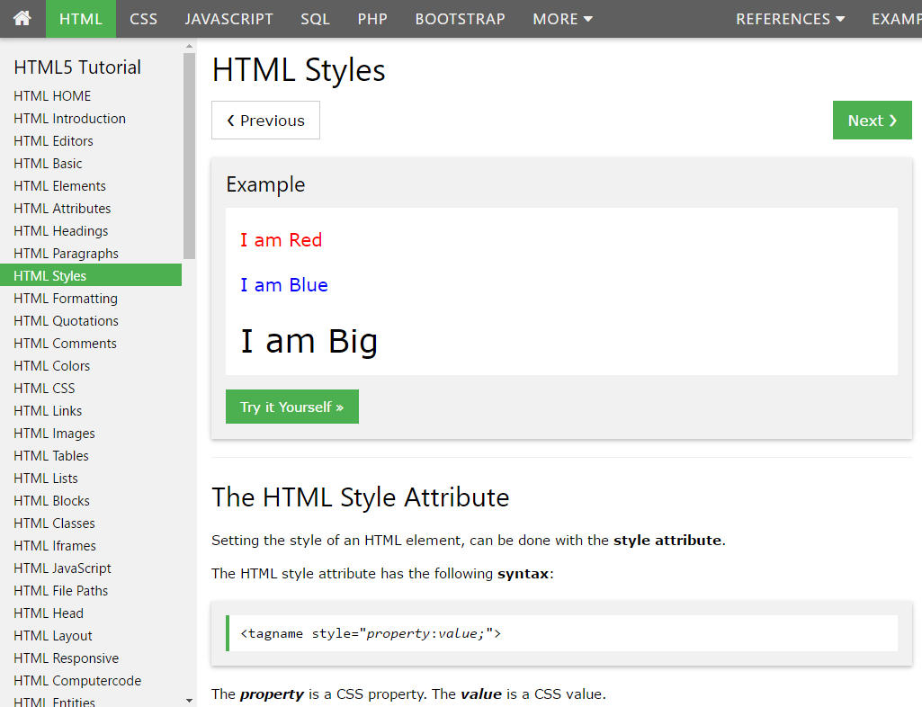

Slide 31
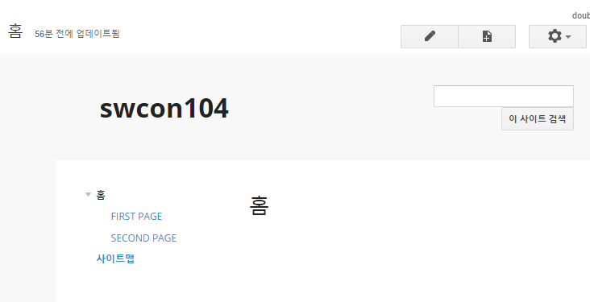
Exercise: Create your webpage
sites.google.com
Log in with your Google account
만들기->기존사이트 도구 사용
기본 템플릿
사이트 이름 (영어로)
URL 확인
로봇이 아닙니다 체크
만들기!

