Slide 1
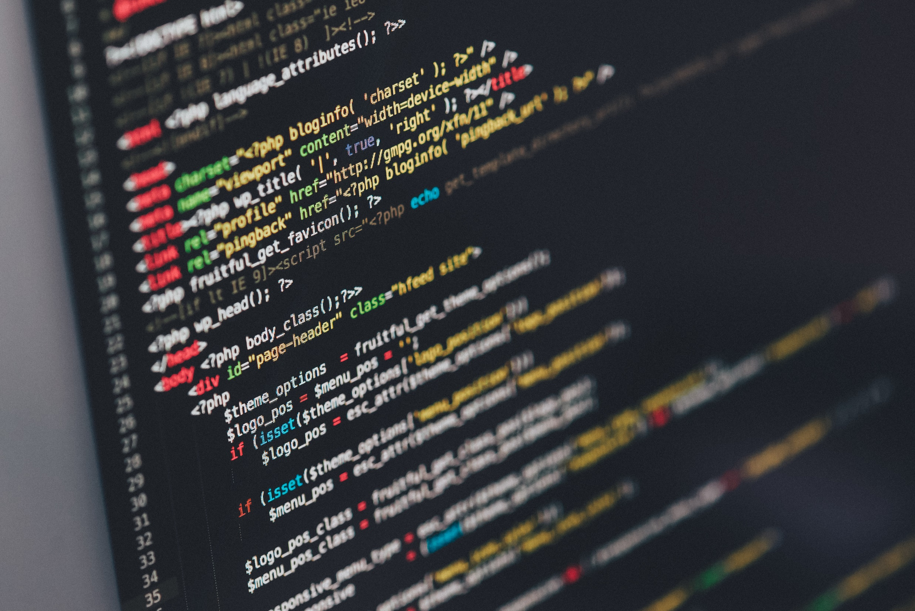
Web/Python Programming
웹/파이썬 프로그래밍

Slide 2
Today
Static web pages
Dynamic web pages
Why do we use Javascript to create web pages?
Write a simple Javascript program
Practice Javascript syntax
Alert and prompts
Events
Gathering user input
Dynamically modify HTML

Slide 3
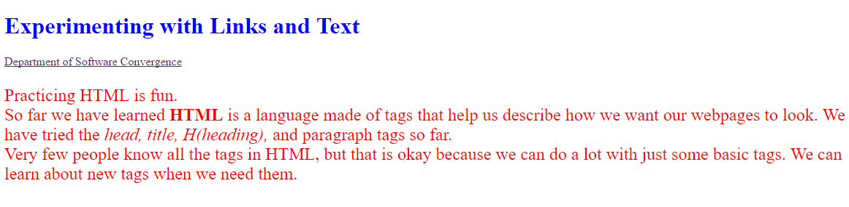
Static web pages

Slide 4
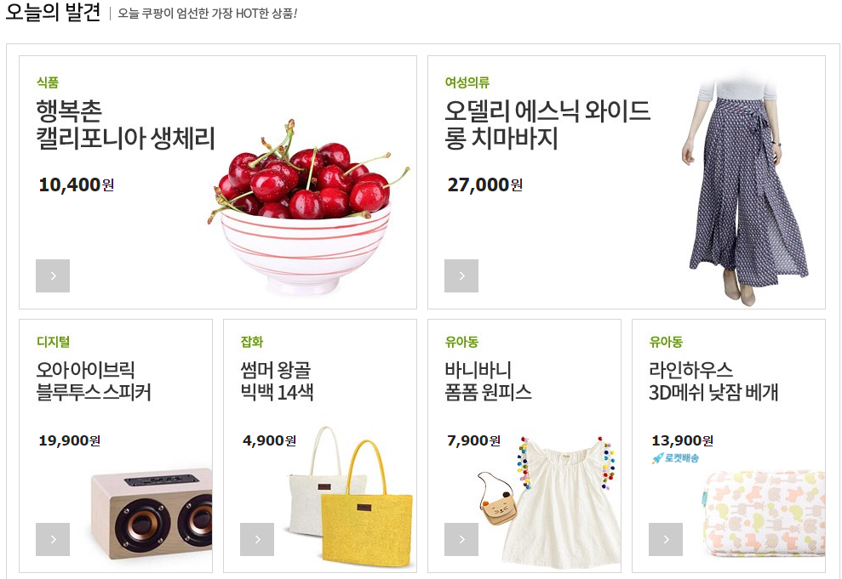
Dynamic web pages
Server-side dynamic web page

Slide 5
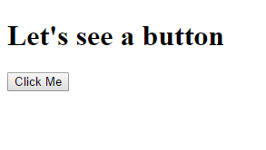
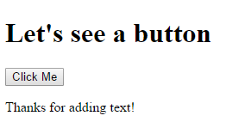
Dynamic web pages
Client-side dynamic web page = Use Javascript!
Click!

Slide 6
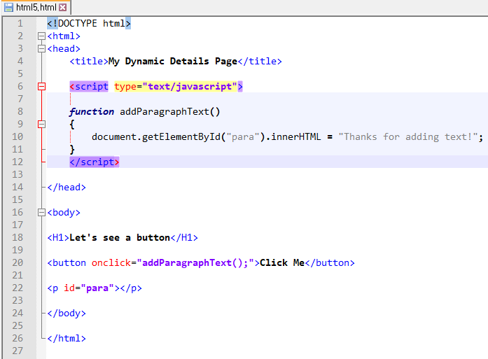
Button example

Slide 7
Button example
onclick = an event
addParagraphText() = a program (function) to execute
“para” = the id that we’re supplying
innerHTML = “Thanks for adding text!”

Slide 8
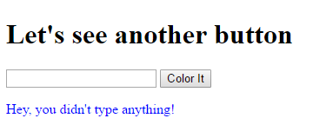
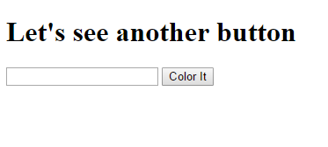
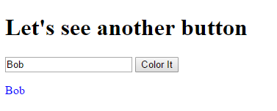
User input example

Slide 9
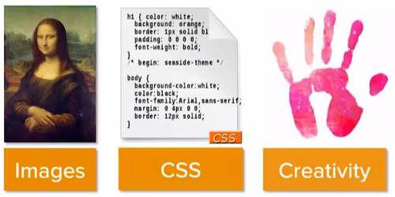
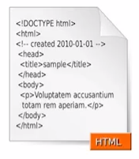
The value of JavaScript
HTML is static
We want our website to be responsive
User takes an action
Respond with action
We can’t do that with plain text HTML
Notes:
화면을 동적으로 바꿔주는게 필요했음 그래서 자바스크립트를 사용..

Slide 10
Responsive pages
HTML is not a programming language
HTML is a markup language that uses tags
If we use a programming language…
Take steps and actions in a sequence
Do things repetitively
Make decisions based on data
JavaScript is a programming language
We can make interactive pages
We can interact with users/ visitors

Slide 11
Button example
JavaScript
JavaScript’s assignment operator
JavaScript ends with a semicolon
JavaScript

Slide 12
Button example
Get an element which has an id =“para”
Assign the string to the element’s innerHTML
Element

Slide 13
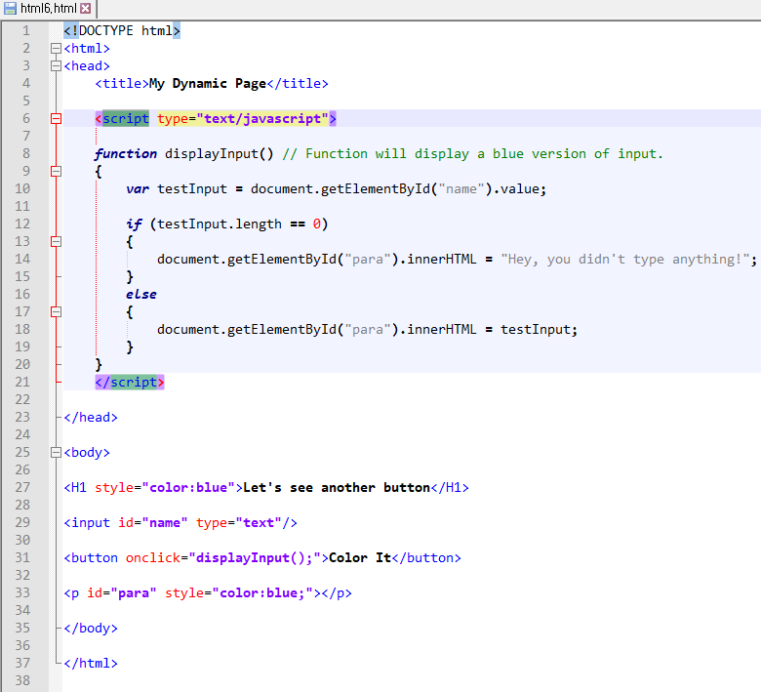
User input example
var
function { }
if (condition){ } else { }
input
Semicolon;
Colon: not used

Slide 14
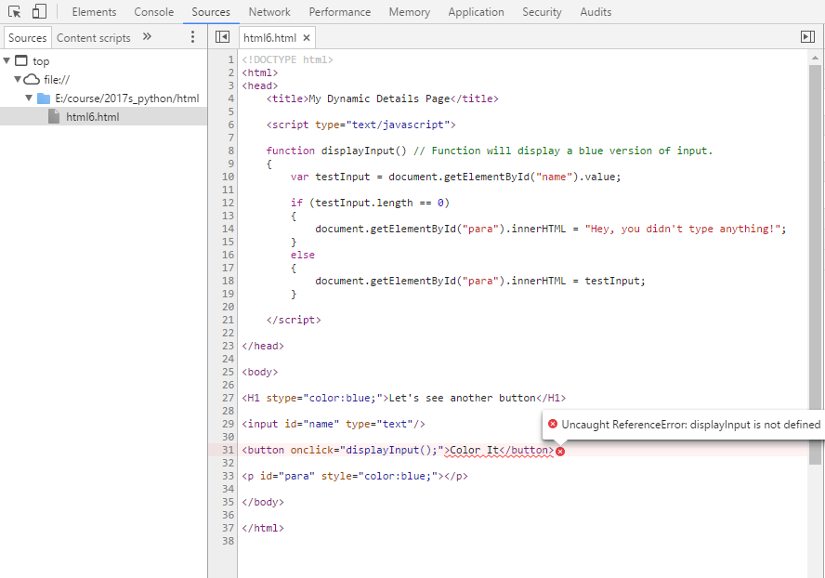
Chrome
Chrome-> ->
More tools ->
Developer tools

Slide 15
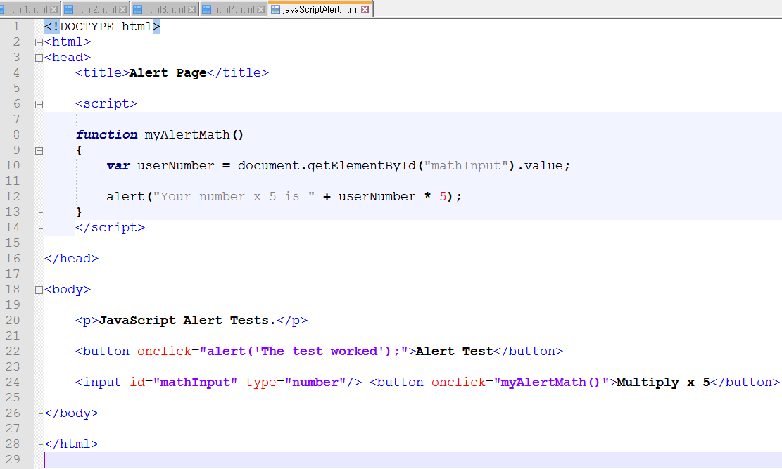
Alert example

Slide 16
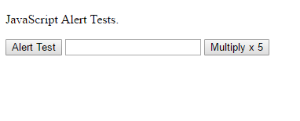
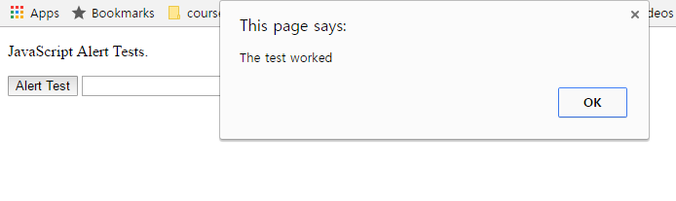
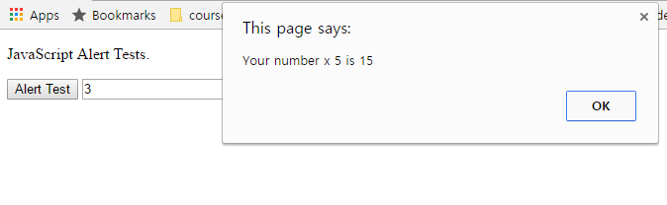
Alert example

Slide 17
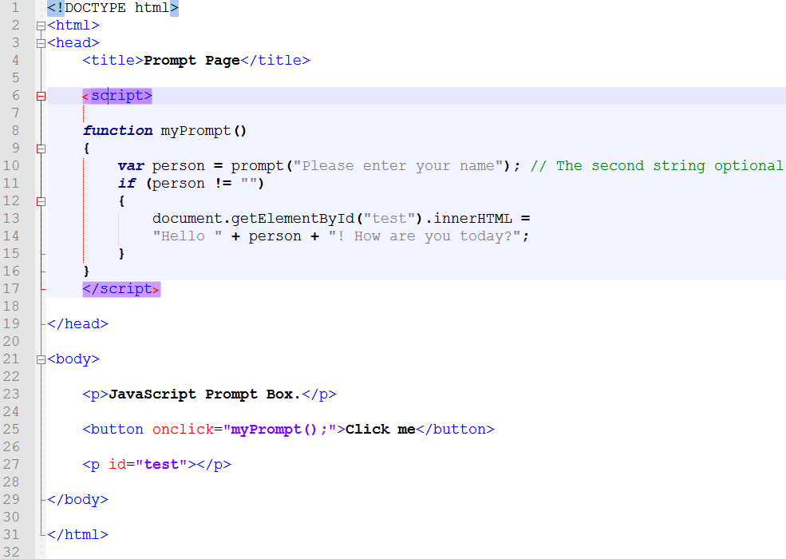
Prompt example

Slide 18
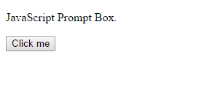
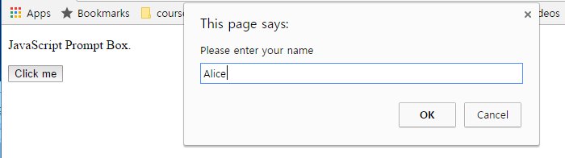
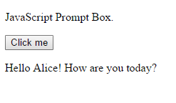
Prompt example

Slide 19
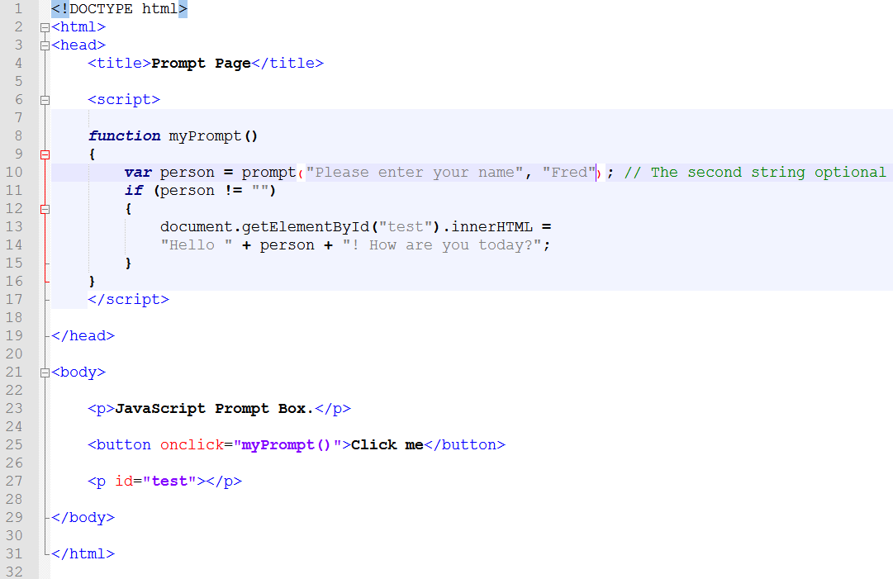
Prompt – set a default value
Notes:
Prompt에 아무 것도 입력하지 않으면 디폴트로 입력해놓은 값을 출력… (내용상 Fred가 출력됨)

Slide 20
Alert and Prompt
Both an alert and a prompt display a pop-up to the user.
An alert simply displays a message to the user.
A Prompt asks the user for some sort of input.

Slide 21
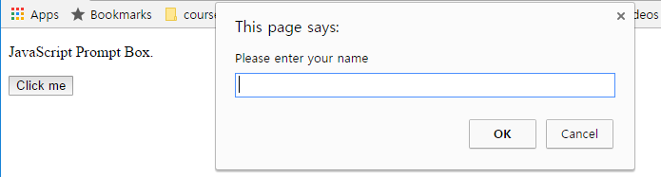
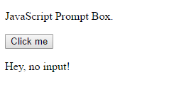
DIY Exercise
If nothing is entered through the prompt, show “Hey, no input” on the web page.

Slide 22
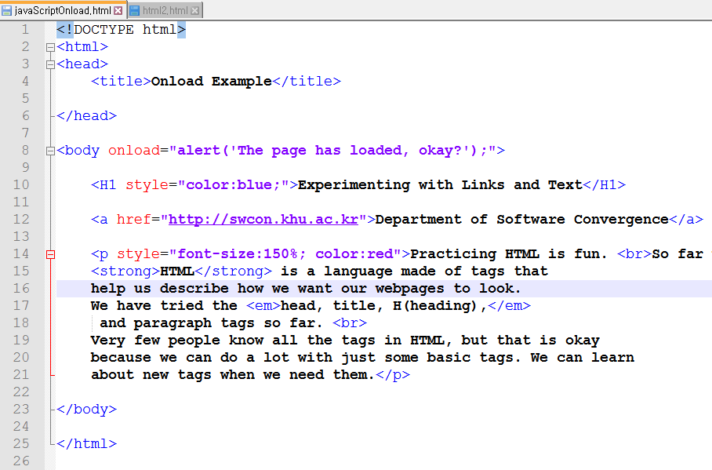
Event
onclick
onload
onblur
onmouseover
Notes:
Onload = body부분을 다 읽고 해당 줄(alert 부분)을 실행
alert를 쓰면 그냥 출력만됨..
jQuery 이용해볼것.(휴대폰용을 위한 툴)

Slide 23
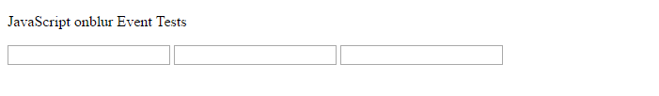

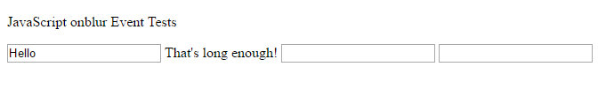
Onblur event

Slide 24
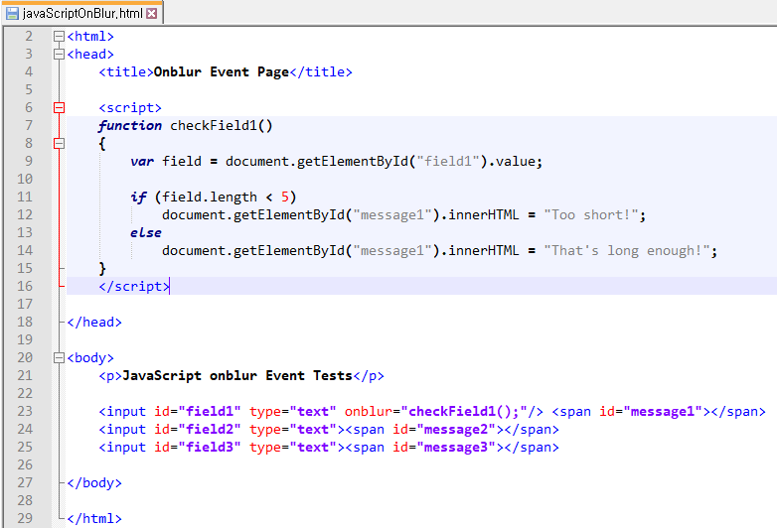
Onblur event

Slide 25


Onblur event exercise (javascriptOnBlur2.html)
Add another function checkfield2.
If the user provide nothing on the second blank (field2), the message “You must provide input!” shows on the right.
If the user provide some text, “Input accepted” shows.

Slide 26
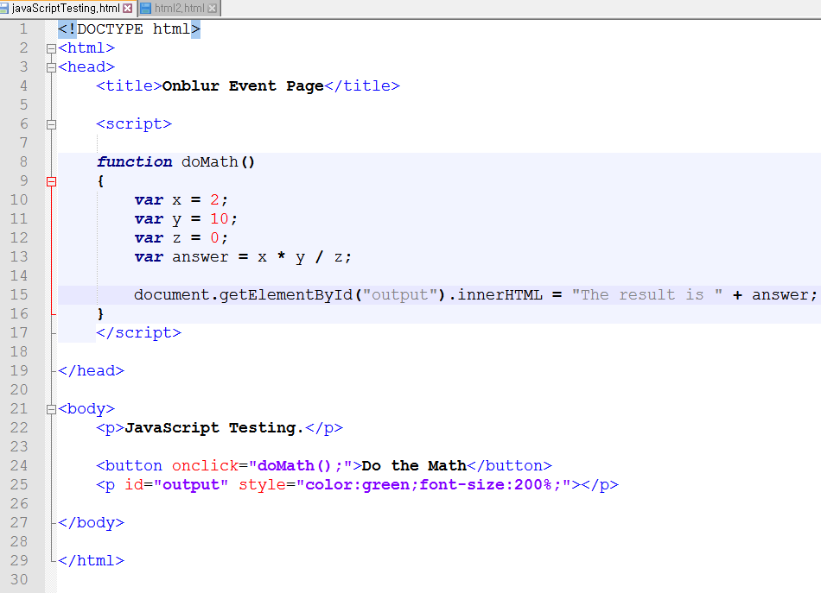
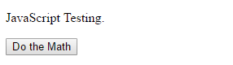
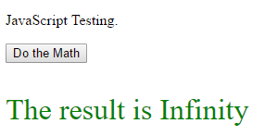
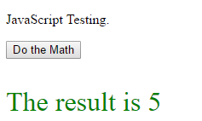
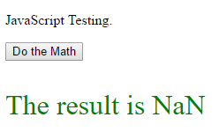
Testing

