Slide 1

Diabetes Analysis and classification using ML
Diabetes Analysis and Classification Using Machine Learning
And Predicting Diabetes Using the Pima Indians Diabetes Dataset
Team no: 8
Team Members:
Kula Karthik Devarasetty.
Likhith Reddy Dereddy.
Likith Sadenalli Eshwarappa.
Under Prof. Kewei “Isaac” Li, Ph.D.

Slide 2
Agenda
Introduction
Approach
Data Collection and Preprocessing
Exploratory Data Analysis
Model Building
Evaluation of the model
Challenges , Conclusion and Future work
Data Splitting and Scaling
References
Dataset Overview
Applications
Prediction Model

Slide 3
INTRODUCTION
What is Diabetes?
Diabetes is a chronic condition where the body is unable to properly regulate blood sugar levels, resulting in high glucose levels in the bloodstream.
Types of Diabetes:
Type 1: The body produces little or no insulin.
Type 2: The body becomes resistant to insulin and doesn't use it effectively.
Gestational Diabetes: Develops during pregnancy and usually resolves after childbirth.
Data Analysis and classification
Data Analysis: involves exploring and interpreting data to uncover patterns, trends, and insights that support decision-making.
Classification: is a machine learning technique used to categorize data into specific groups based on features or patterns.
Objective of the Project:
Our goal is to analyze the Pima Indians Diabetes Dataset and build machine learning classification models to predict whether a person is diabetic based on features like Pregnancies, Glucose, Blood Pressure, Skin Thickness, Insulin, BMI, Diabetes Pedigree Function, and Age.

Slide 4
APPLICATIONS
Early Detection: Helps identify individuals at risk of diabetes in its early stages, allowing timely medical intervention to prevent complications.
Better Diagnosis: Helps healthcare professional in diagnosing diabetes more accurately and efficiently by analyzing key patient data
Personalized Treatment: Enables doctors to design customized treatment plan tailored to each patient’s unique profile, such as age, glucose level, BMI, and other factors

Slide 5
APPROACH
Step 1
Data Collection and Preprocessing
Step 2
Outlier Detection and Treatment
Step 3
Exploratory Data Analysis (EDA)
Step 4
Data splitting and Scaling
Step 5
Model Building
Step 6
Model Evaluation
Step 7
Step 8
Feature Importance Analysis
Prediction Model

Slide 6
Dataset Overview
The dataset used for this project is the Pima Indians Diabetes Dataset, It is available on Kaggle and is commonly used for diabetes classification tasks. This dataset contains information about various factors that are used to predict whether a person has diabetes.
The dataset has 768 rows and 9 columns. Each row represents a patient, and each column represents a different feature related to their health. The features in the dataset are as follows:
Features in the dataset:
Pregnancies: The number of times the patient has been pregnant.
Glucose: The patient's plasma glucose concentration after a 2-hour oral glucose tolerance test.
Blood Pressure: The patient's blood pressure (mm Hg).
Skin Thickness: The thickness of the patient's skin at the triceps (in mm).
Insulin: The amount of insulin in the patient's blood (mu U/ml).
BMI: The patient's body mass index (weight in kg / height in m²).
Diabetes Pedigree Function: A value indicating the likelihood of the patient developing diabetes based on family history.
Age: The patient's age in years.
Outcome: The target variable, (1: diabetic, 0: non-diabetic).

Slide 7
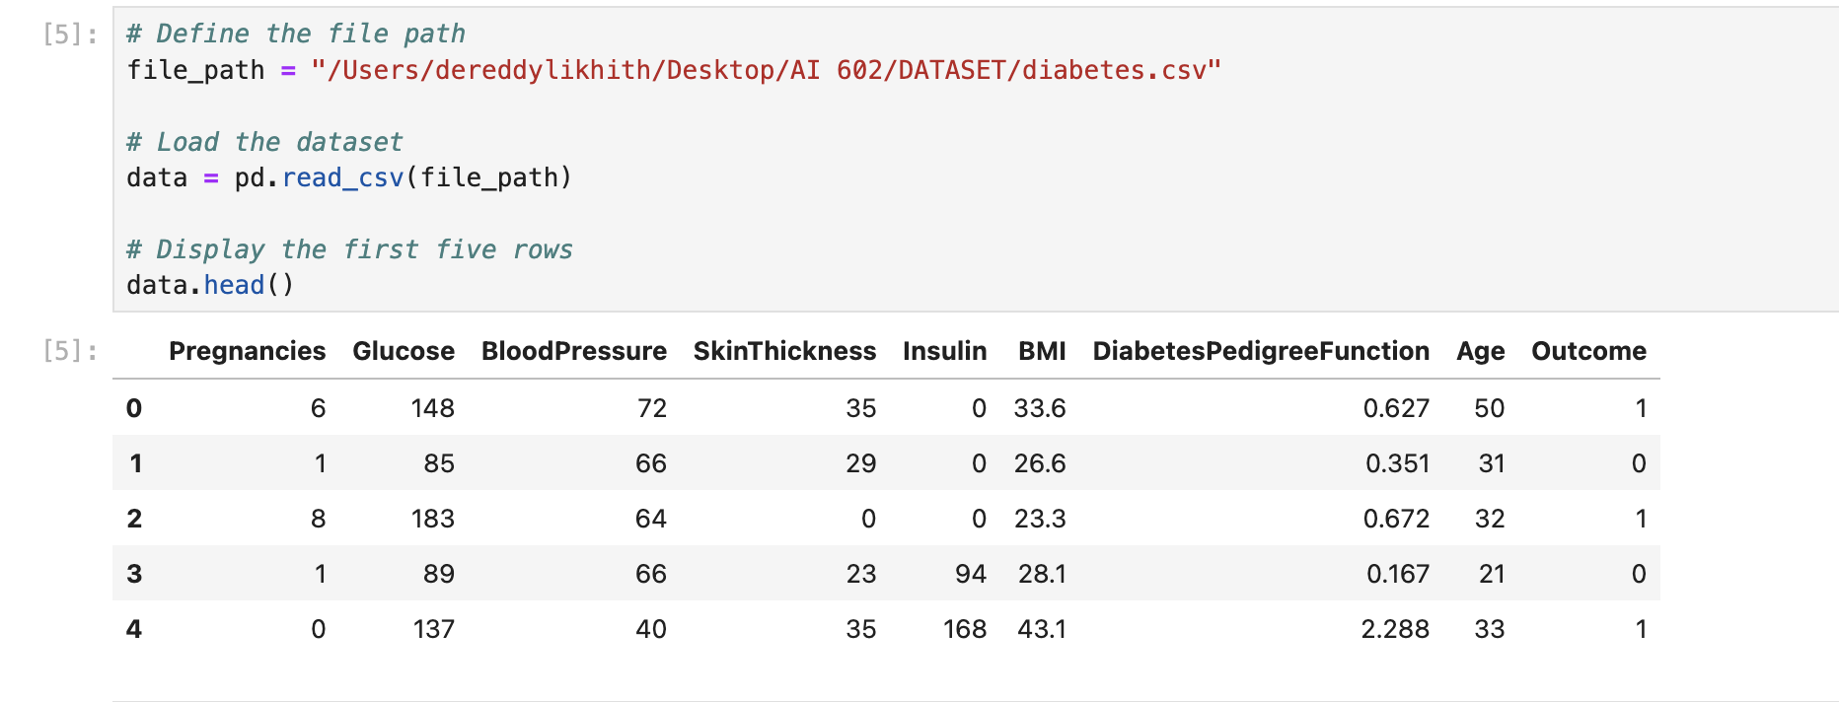
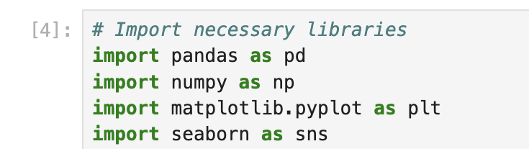
Data Collection and preprocessing
Libraries Imported
NumPy: A Python library for numerical computing, providing support for large multi-dimensional arrays and matrices, along with mathematical functions to operate on them.
Pandas: A data manipulation and analysis library that offers data structures like Data Frames for handling and analyzing structured data.
Matplotlib: A plotting library for creating static, animated, and interactive visualizations in Python.
Seaborn: A statistical data visualization library built on top of Matplotlib, providing a high-level interface for drawing attractive and informative graphs.
Loading The dataset into Jupiter
To load a dataset into a Jupiter environment, you can use the pd.read_csv(‘file path’) function from the Pandas library. This function reads a CSV file and loads it into a Data Frame.
data.head(): Displays the first five rows of the dataset to give you an overview of the data.

Slide 8
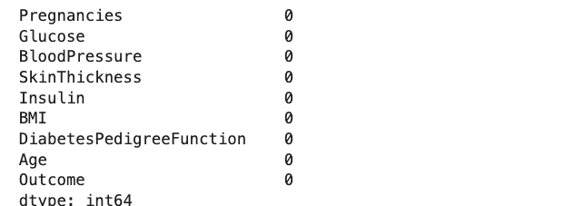
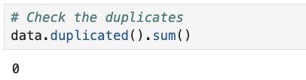
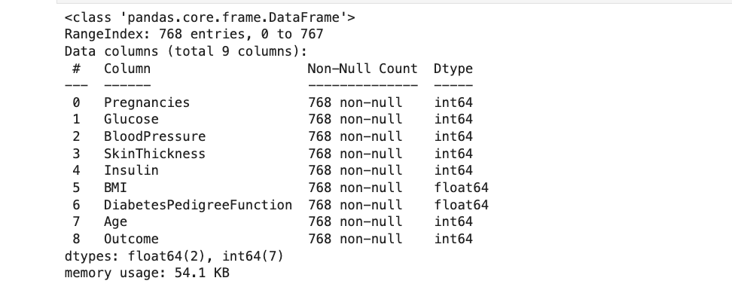
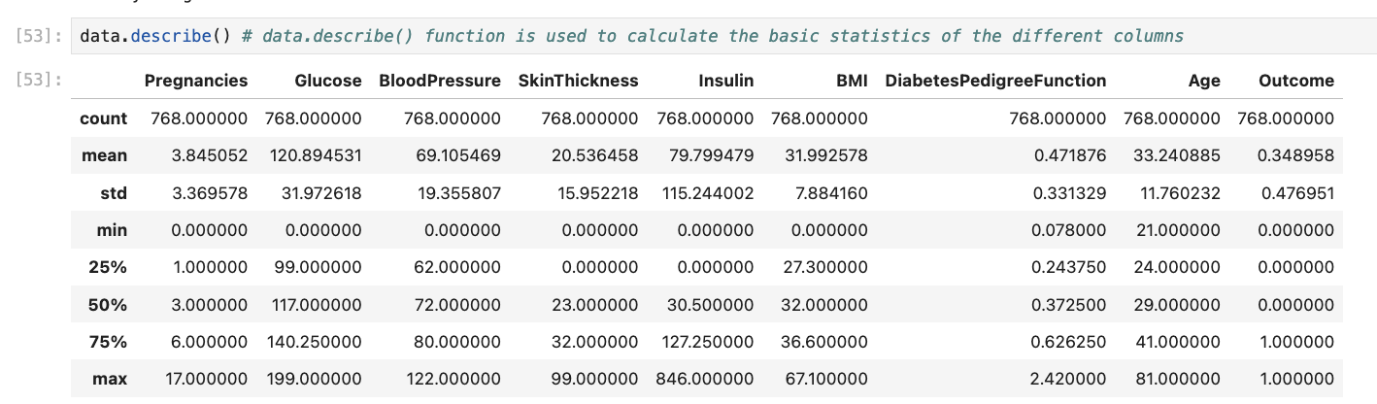
Data Collection and preprocessing
Null Values: I checked for null values in the dataset using data.isnull().sum() and found no missing values.
Duplicate Data: I identified duplicate rows using data.duplicated(), ensuring there were no duplicate entries in the dataset.
Type of data: I examined the data types of each column using data.info() to understand the structure of the dataset.
Basic Stats: I reviewed the basic statistics of the dataset with data.describe() to get an overview of the numeric columns, such as mean, standard deviation, and range of values.
Conclusion

Slide 9
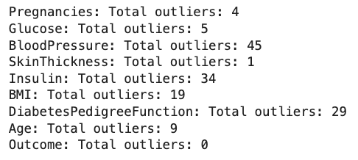
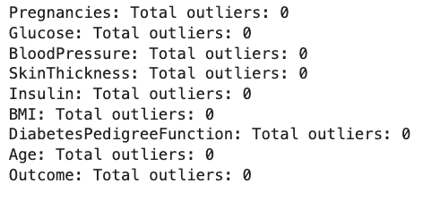
Outliers Detection and Removal
Outliers
Outliers are data points that differ significantly from other values in a dataset. They are unusually high or low compared to the majority of the data and can skew analysis.
Method Used to detect outliers
IQR using Functions: IQR (Interquartile Range) is the difference between the first (Q1) and third (Q3) quartiles in a dataset. It helps in detecting outliers. You can define a function in Python to calculate IQR:
Method used to handle the outliers
The clipping method handles outliers by replacing values above or below a certain threshold with the threshold value itself.
Functions in Python
A function in Python is a block of reusable code that performs a specific task. It takes inputs (parameters), processes them, and may return a result.
Below are the count of outliers in data
After clipping the outliers sucessfully

Slide 10
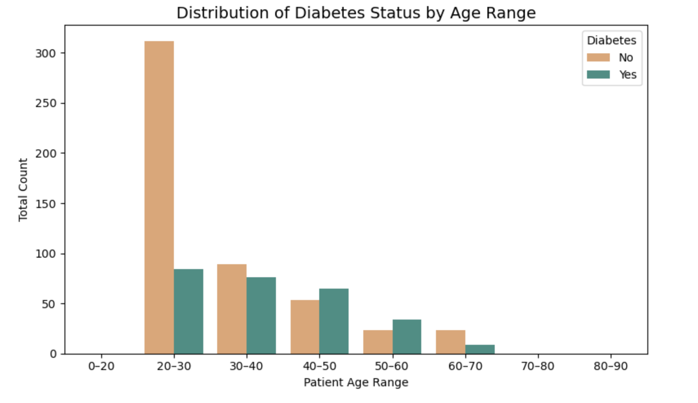
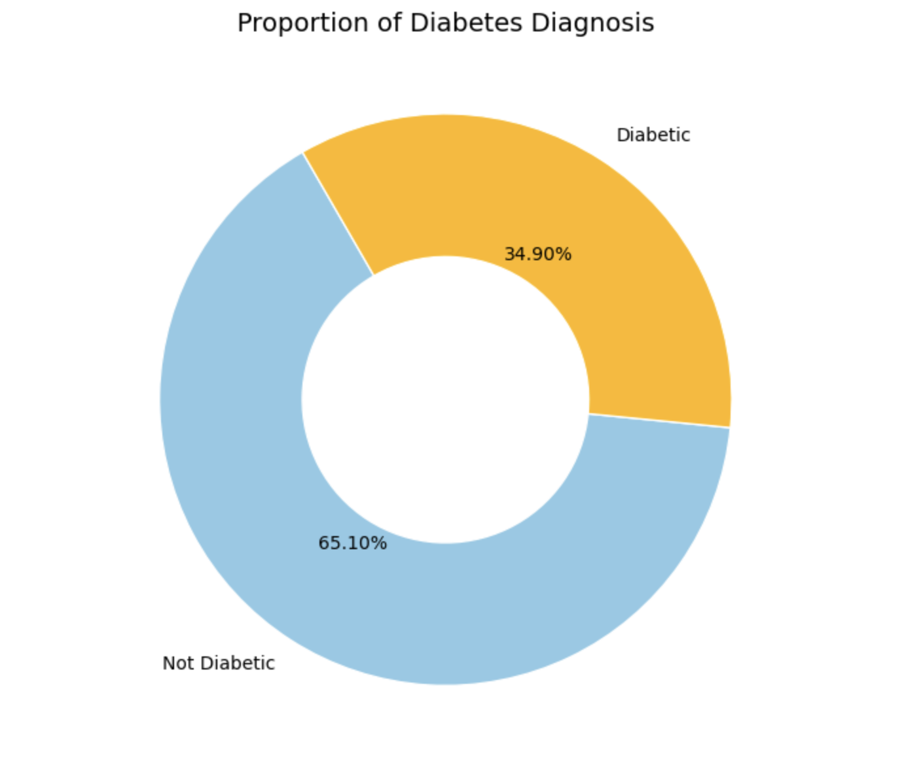

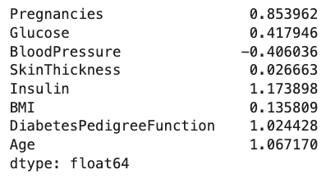
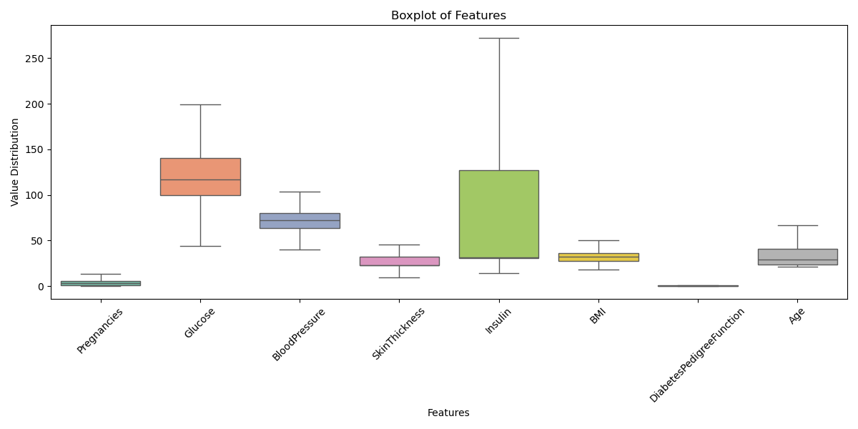
Exploratory Data Analysis (EDA)
Univariate Analysis
Univariate analysis is the examination of a single variable or feature in a dataset to summarize its characteristics, such as distribution, central tendency, and spread.

Slide 11
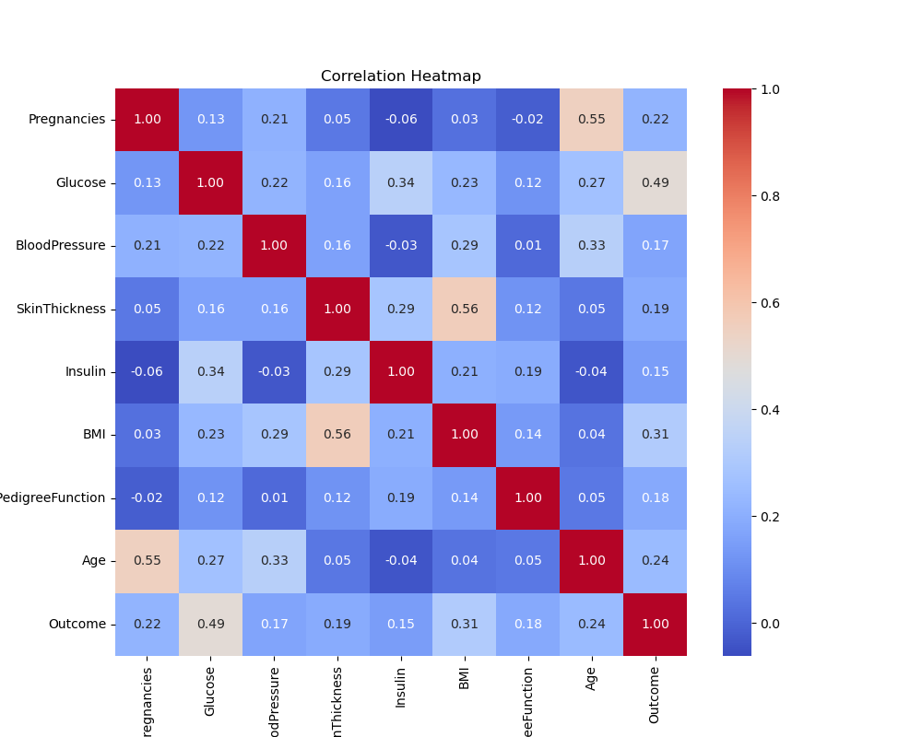
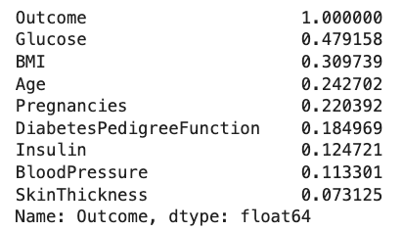
Exploratory Data Analysis
Bivariate Analysis
Bivariate analysis is the process of examining the relationship between two variables. It helps us understand how one variable may influence or be associated with another.
Correlation is a statistical method used to measure the strength and direction of a relationship between two variables.
A positive correlation means both variables increase together.
A negative correlation means one variable increases as the other decreases.
In our analysis, the features Glucose and BMI showed the strongest positive correlation with the target variable (Outcome).
Glucose has the highest correlation score of 0.479, indicating a strong link between higher glucose levels and a higher chance of diabetes.
BMI also shows a positive correlation of 0.310, meaning higher BMI is also associated with increased diabetes risk.

Slide 12
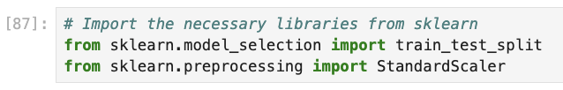
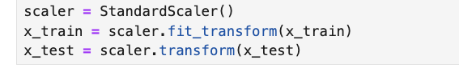
Data Splitting and Scaling
Data Splitting and Training
Data splitting is the process of dividing a dataset into two or more parts, usually into training and testing sets. The training set is used to build and train models, while the testing set evaluates the model's performance on unseen data. In this project I firstly divided the data into the dependent and the independent Variables.
# Independent Variables (x) : data[['Pregnancies','Glucose','BloodPressure','SkinThickness','Insulin','BMI','DiabetesPedigreeFunction','Age’]]
# Dependent Variables (y): data['Outcome’]
The code splits the dataset into training and testing sets using train_test_split from sklearn, with a test size of 20% and a training size of 80%. The random_state=42 ensures reproducibility. The shapes of the resulting x_train, x_test, y_train, and y_test are then printed to verify the split.
Standardization
Standardization is the process of scaling data so that it has a mean of 0 and a standard deviation of 1. This makes the data easier to compare and helps improve the performance of machine learning models.

Slide 13
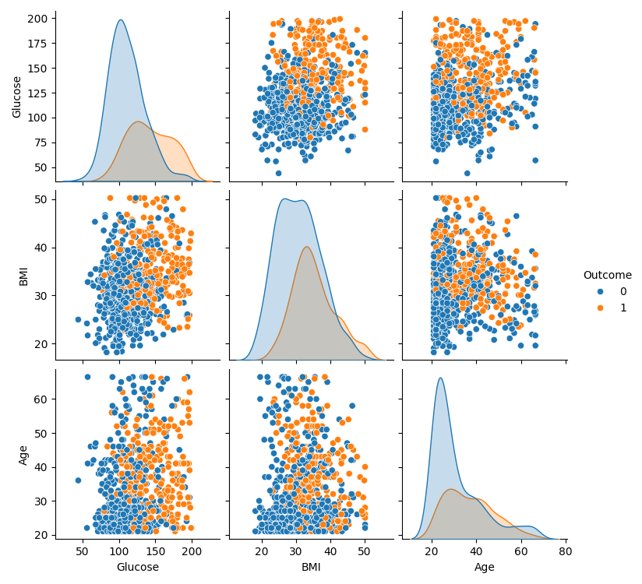
Model Building
Models Used In this project
Logistic Regression: A machine learning algorithm used to predict a binary outcome (e.g., yes/no)
based on input features by modeling the data with a sigmoid function.
Decision Tree Classifier: A tree-like model that splits data into branches
based on conditions, used for classification by making decisions at each node.
Random Forest Regressor: An ensemble learning method that uses multiple decision trees
to predict continuous values by averaging their outputs.
XGBoost Classifier: An advanced machine learning algorithm that uses gradient boosting
to build a series of decision trees for high-performance classification tasks.

Slide 14
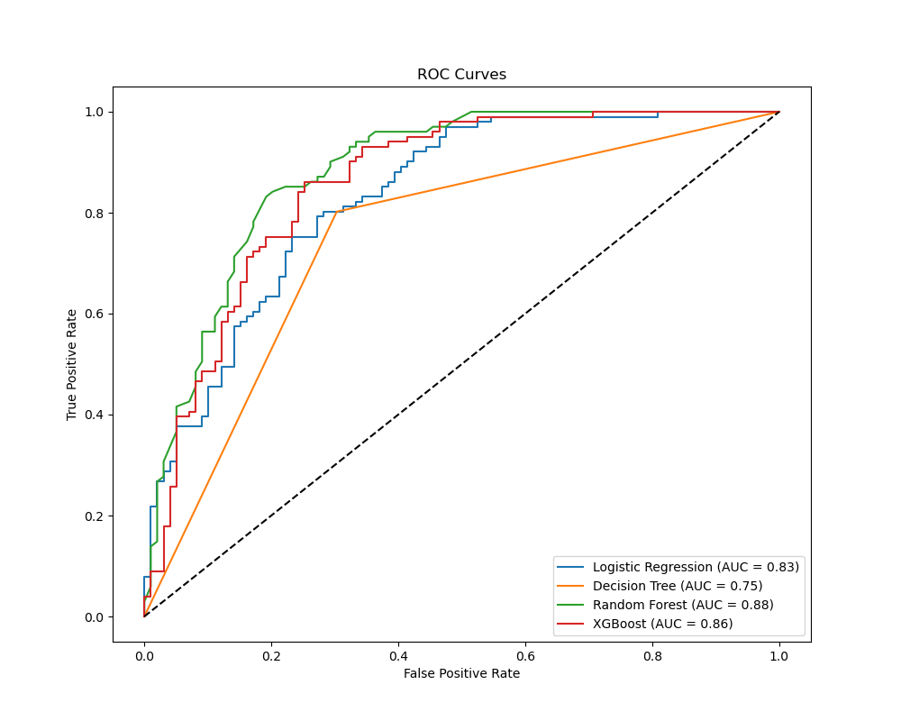
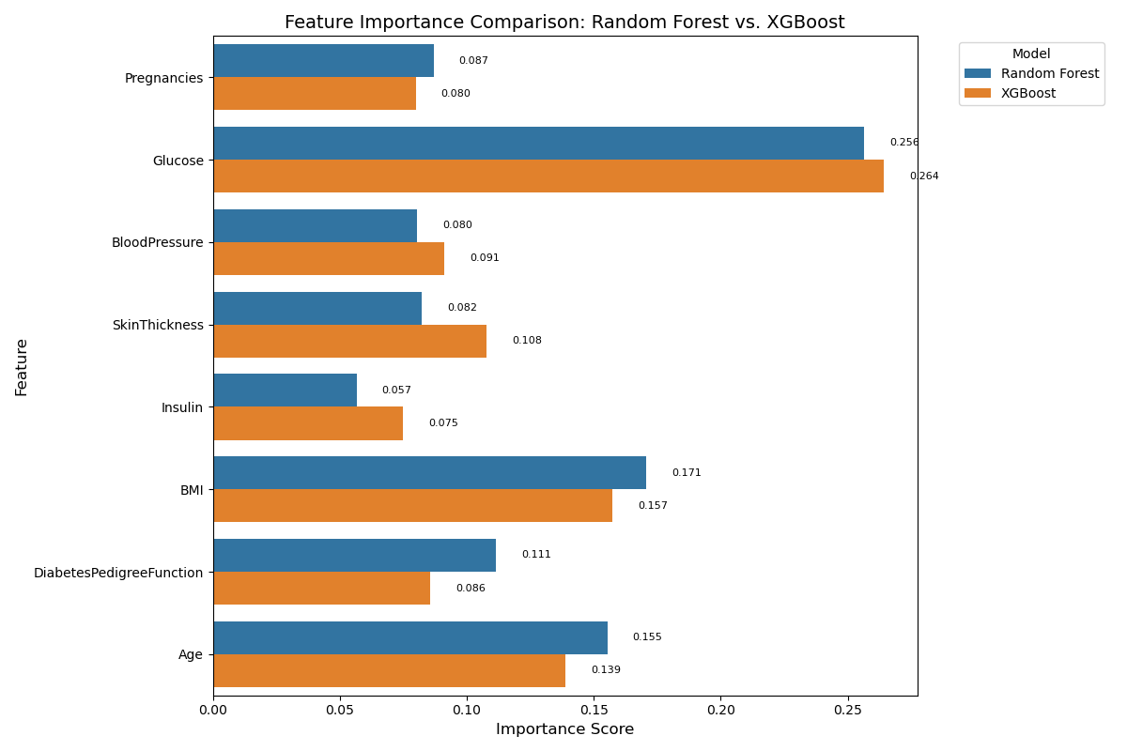
Model Evaluation

Slide 15
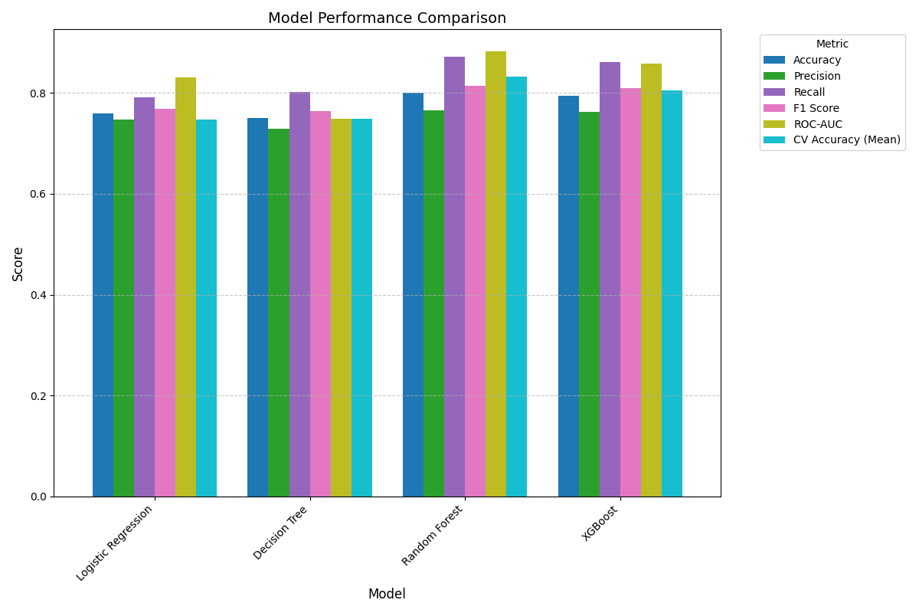
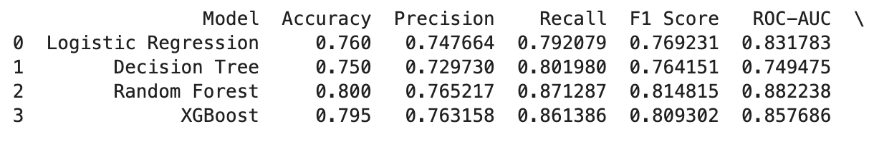
Model Evaluation
Results of Classification Models
Model | Accuracy | Precision | Recall | F1 Score
Logistic Regression | 76% | 74% | 79% | 76%
Decision Tree Classifier | 75% | 72% | 80% | 76%
Random Forest Classifier | 80% | 76% | 87% | 81%
XGBoost Classifier | 79% | 76% | 86% | 80%
Result
The Random Forest Classifier outperforms the other models, achieving the highest accuracy, precision, recall, and F1 score.

Slide 16
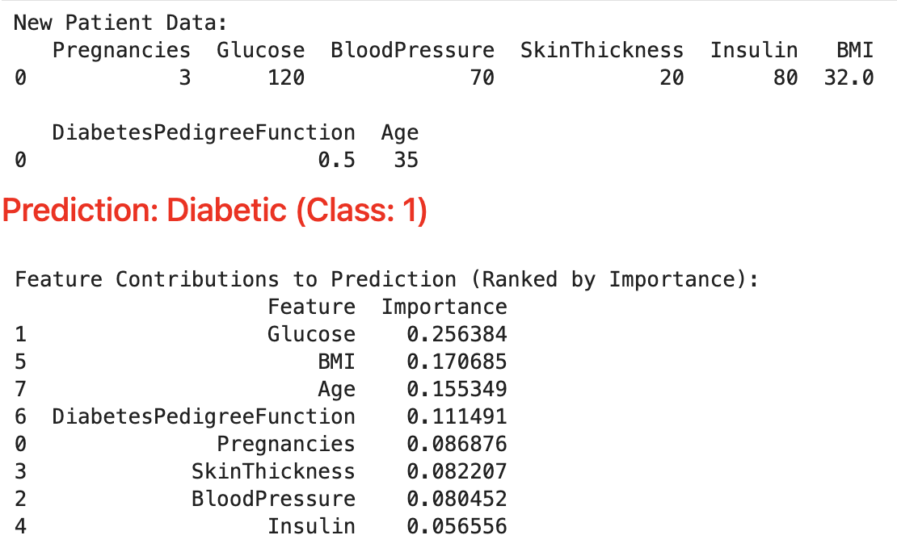
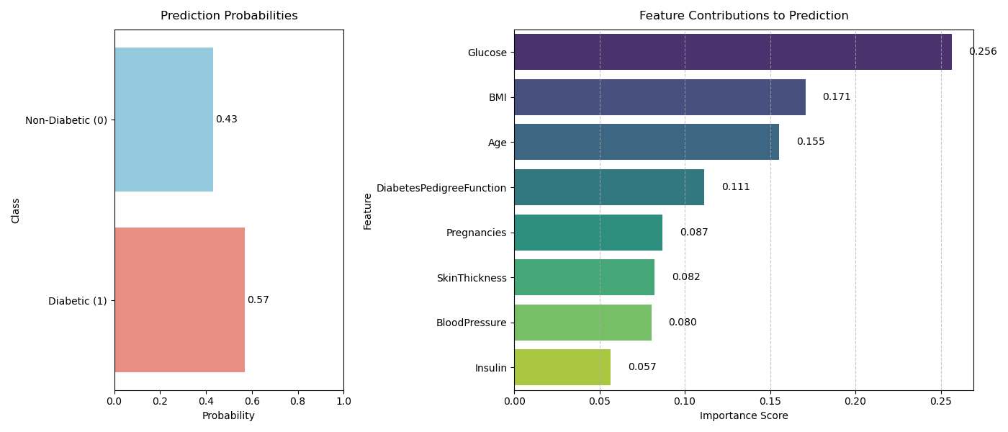
Random Forest Prediction

Slide 17
Challenges, Conclusion and Future Work
Challenges
We observed skewness in the Insulin, Diabetes Pedigree Function, and Age features. Insulin was right-skewed, while most values of the Diabetes Pedigree Function were concentrated below the median. The Age variable showed a non-uniform distribution across the dataset. This skewness was important to address, as it could negatively affect the model’s performance by causing it to focus more on common values and ignore the less frequent but significant ones.
Conclusion
The analysis revealed a class imbalance with more non-diabetic cases, and features like glucose, BMI, and age showed strong links to diabetes. Skewness in variables such as insulin and age could affect model accuracy, highlighting the need for proper preprocessing.
Future Work
Log transformation didn’t improve the distribution or model performance, so other techniques like power transforms will be explored.
Feature engineering methods will be applied to better handle skewness and enhance model learning.
A hybrid model combining the strengths of two algorithms will be developed to boost prediction accuracy.

Slide 18
References
[1]Rani,K.U.(2011). Analysis on Diabetes Dataset Using Classification Algorithms and Data Mining Techniques.International Journal of Science and Research (IJSR), 2(9), 1–4.
[2] Kuhn,M.,&Johnson,K.(2013). Applied Predictive Modeling. Springer. (For preprocessing, feature engineering, and handling skewness)
[3] Chen,T.,&Guestrin,C.(2016). XGBoost: A Scalable Tree Boosting System . Proceedings of the 22nd ACM SIGKDD International Conference on Knowledge Discovery and Data Mining.
[4] Huang, R. (2021) – “Prediction of Pima Indians Diabetes with Machine Learning Algorithms.”

Slide 19
Questions

