Slide 2
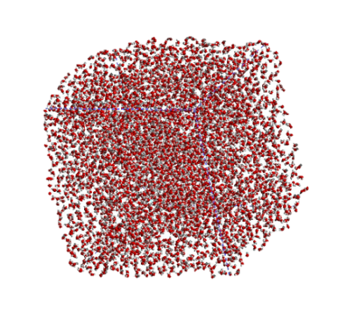
GPUOcelot
NVCC (compiler)
PTX code
Emulator/
Trace Generator
Heterogeneous Architecture
Timing & Power
Simulator
CUDA code (*.cu)
X86 Binaries
Pin
Trace Generator

Slide 3
Input Queue
Cache access flow
Cache access
Fill flow
Fill Queue
Write-back
Cache
Cache miss
Cache fill
Router
From lower-level cache or dram
WB Queue
Output Queue
To lower-level cache or dram

Slide 4
Queues
Cache
L1
Router
Queues
Cache
L2
Router
Ring Network
Queues
Queues
Queues
Queues
Cache
Cache
Cache
Cache
L3
Router
L3
Router
L3
Router
L3
Router

Slide 5
Core 1
Core 2
Core N
Queues
Queues
Queues
Cache
Cache
Cache
L1
L1
…
L1
Queues
Queues
Queues
Cache
Cache
Cache
Router
L2
Router
L2
Router
L2
MC
Ring Network
MC
Queues
Queues
Queues
Queues
Cache
Cache
Cache
Cache
L3
Router
L3
Router
L3
Router
L3
Router

Slide 6
Queues
All L1 components are active, but L1 does not have local router. Thus, L1 must use L2’s router.
Cache
L1
All L2 components are disabled except output queue and router.
L2
Router

Slide 7
#Threads | Trace Type | (Optional Fields)
1st thread ID | Start Instruction No.
2nd thread ID | Start Instruction No.
3rd thread ID | Start Instruction No.
..
Nth thread ID | Start Instruction No.
CPU 4 x86 0 0 1 0 2 0 3 0 | GPU 2048 newptx 8 0 0 1 0 2 0 3 0 65536 0 65537 0 …
Thread
Block 0
Thread Block 1
(a) Trace.txt Format
(b) Trace.txt Examples

Slide 8
x86 // Trace format 4 // Total # of threads 0 0 // 1st thread ID | Start Instruction No. 1 0 // 2nd thread ID | Start Instruction No. 2 0 // 3rd thread ID | Start Instruction No. 3 0 // 4th thread ID | Start Instruction No. (a) Trace.txt (CPU)
GPU // Trace format newptx // Trace Type 14 // GPU Trace version 6 // Max blocks per core 2048 // Total # of (warp) 0 0 1st warp ID | Start Instruction No. 1 0 2nd warp ID | Start Instruction No. 2 0 3rd warp ID | Start Instruction No. 3 0 4th warp ID | Start Instruction No. 65536 0 65537 0 … (b) GPU Trace.txt
Thread
Block 0
Thread Block 1

