Slide 1
Network Embedding
Le Lyu

Slide 2
Outline

Slide 3

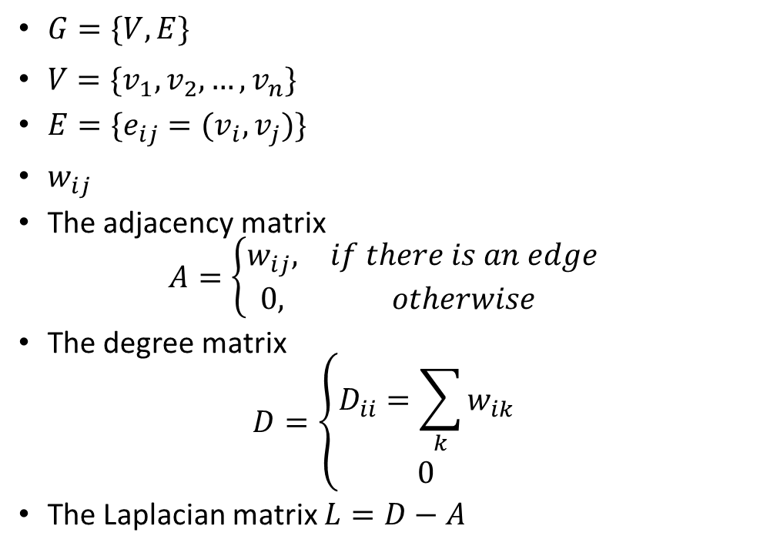


Graph
$G=\{V,E\}$
$V=\{v_{1},v_{2},…,v_{n}\}$
$E=\{e_{ij}=(v_{i},v_{j})\}$
$w_{ij}$
The adjacency matrix
$$A=\left\{\begin{matrix}w_{ij}, & if there is an edge \\ 0, & otherwise\end{matrix}\right.$$
The degree matrix
$$D=\left\{\begin{aligned}D_{ii}=\sum_{k}{w_{ik}} \\ 0\end{aligned}\right.$$
The Laplacian matrix $L=D−A$
$$v_{i}$$
$$v_{j}$$
$$w_{ij}$$

Slide 4
Basis
Local adjacency
DeepWalk
Node2Vec
GCN
Structural similarity
Struc2Vec
GraphWave
network

Slide 5
Application
Node classification
Link prediction
?
?
?
B
A
?
?

Slide 6
Machine Learning Lifecycle
Raw Data
Learning Algorithm
Model
Structured Data
Feature
Engineering
Automatically
Learn the features
Downstream
prediction task

Slide 7



Feature Learning in Graphs
Efficient task-independent feature learning for machine learning in networks!
node
$$u$$
$$f:u→R^{d}$$
$$R^{d}$$
Feature representation
embedding

Slide 8
Graph representations learning is hard
Images are fixed size
CNN
Text is linear
word2vec
Graphs are neither of these
Node numbering is arbitrary (node isomorphism problem)
Much more complicated structure

Slide 9
Two ideas
“Linearizing” the graph
Create a “sentence” for each node by random walks
Graph convolution networks
Propagate information between the nodes of the graph

Slide 10






Graph Convolutional Networks
Neighborhood Aggregation (key idea): generate node embeddings based on local neighborhoods.
Chebyshev polynomial
Approximate (Filter):
Notes:
谱图卷积不再依赖于整个图，
而只是依赖于距离中心节点K步之内的节点（即K阶邻居）

Slide 11
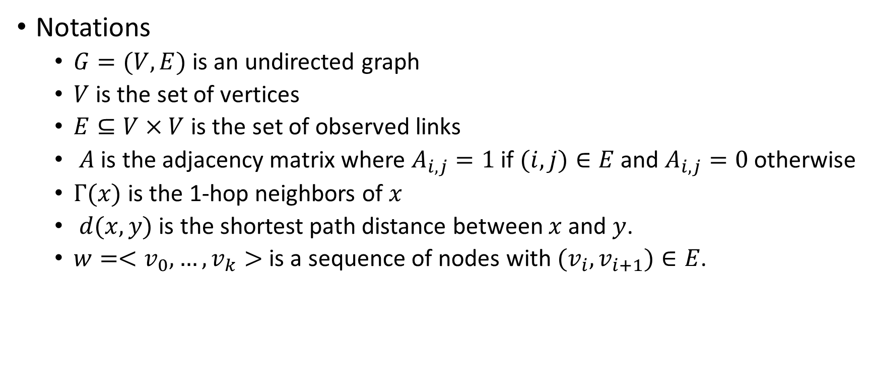
Link prediction
Notations
$G=(V,E)$ is an undirected graph
$V$ is the set of vertices
$E⊆V×V$ is the set of observed links
$A$ is the adjacency matrix where $A_{i,j}=1$ if $(i,j)∈E$ and $A_{i,j}=0$ otherwise
$Γ(x)$ is the 1-hop neighbors of $x$
$d(x,y)$ is the shortest path distance between $x$ and $y$.
$w=<v_{0},…,v_{k}>$ is a sequence of nodes with $(v_{i},v_{i+1})∈E$.

Slide 12
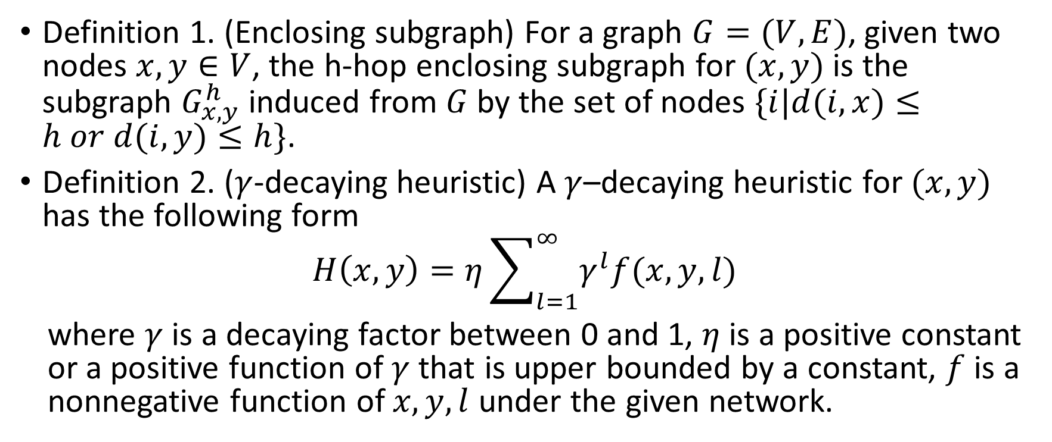
Link prediction
Definition 1. (Enclosing subgraph) For a graph $G=(V,E)$, given two nodes $x,y∈V$, the h-hop enclosing subgraph for $(x,y)$ is the subgraph $G_{x,y}^{h}$ induced from $G$ by the set of nodes $\{i|d(i,x)≤h or d(i,y)≤h\}$.
Definition 2. ($γ$-decaying heuristic) A $γ$–decaying heuristic for $(x,y)$ has the following form
$$H\left(x,y\right)=η\sum_{l=1}^{∞}{γ^{l}f(x,y,l)}$$
where $γ$ is a decaying factor between 0 and 1, $η$ is a positive constant or a positive function of $γ$ that is upper bounded by a constant, $f$ is a nonnegative function of $x,y,l$ under the given network.

Slide 13
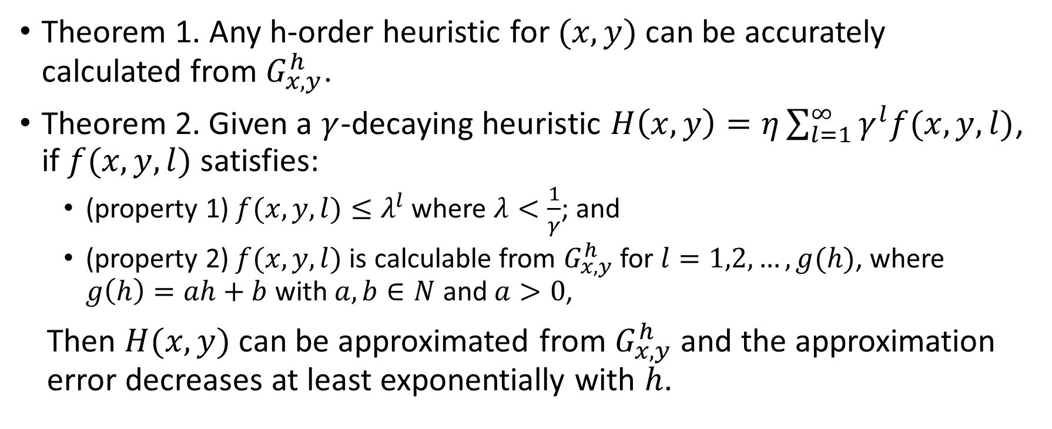
Link prediction
Theorem 1. Any h-order heuristic for $(x,y)$ can be accurately calculated from $G_{x,y}^{h}$.
Theorem 2. Given a $γ$-decaying heuristic $H\left(x,y\right)=η\sum_{l=1}^{∞}{γ^{l}f(x,y,l)}$, if $f(x,y,l)$ satisfies:
(property 1) $f(x,y,l)≤λ^{l}$ where $λ<\frac{1}{γ}$; and
(property 2) $f(x,y,l)$ is calculable from $G_{x,y}^{h}$ for $l=1,2,…,g(h)$, where $g\left(h\right)=ah+b$ with $a,b∈N$ and $a>0$,
Then $H(x,y)$ can be approximated from $G_{x,y}^{h}$ and the approximation error decreases at least exponentially with $h$.

Slide 14
PageRank

Slide 15
PageRank

