Slide 1
Bayesian Spiking Networks
expectation maximization & Homeostatic plasticity
Based on Habenschuss et aL.

Slide 2
Content
Unsupervised Learning
What is it?
Why is it relevant?
Generative Models
Mixture Models
Corresponding Network
Expectation Maximization
Homeostatic Plasticity
Experiments
Conclusion

Slide 3
How does the Brain learn?
Brain has to learn a mapping
Representation can be seen as the causes of the sensory input
Abstract concept of tiger causes you hearing roaring soundwaves
Mapping can be learned in multiple ways:
From example tuples of sensory input and abstract representation → Supervised Learning
From sensory input only by utilizing correlations of different inputs → Unsupervised Learning
Brain has to use unsupervised learning
"Tiger"

Slide 4
Probabilistic Modeling
Describe observations by probability distributions
Brain wants P(Cause | Observation)
Two approaches
Discriminative Model
Model decision boundary
P(Cause | Observation)
Required for optimization
Observations and Causes
Generative Model
Model class-dependent data structure
P(Cause, Observation)
Required for optimization
Only Observations

Slide 5

Generative Models can also Predict
Infer cause from a generative model using Bayes rule
$$P\left(Z | Y\right)=\frac{P\left(Z, Y\right)}{P(Y)}= \frac{P\left(Z, Y\right)}{\sum_{Z}{P\left(Z, Y\right)}}$$
"Tiger"
Observation ($Y$) Cause ($Z$)
Image taken from [7]

Slide 6
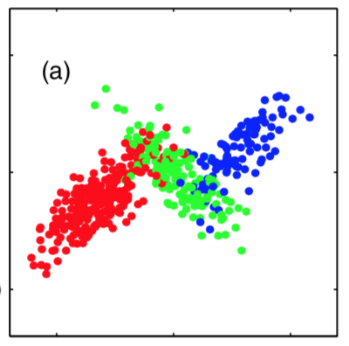
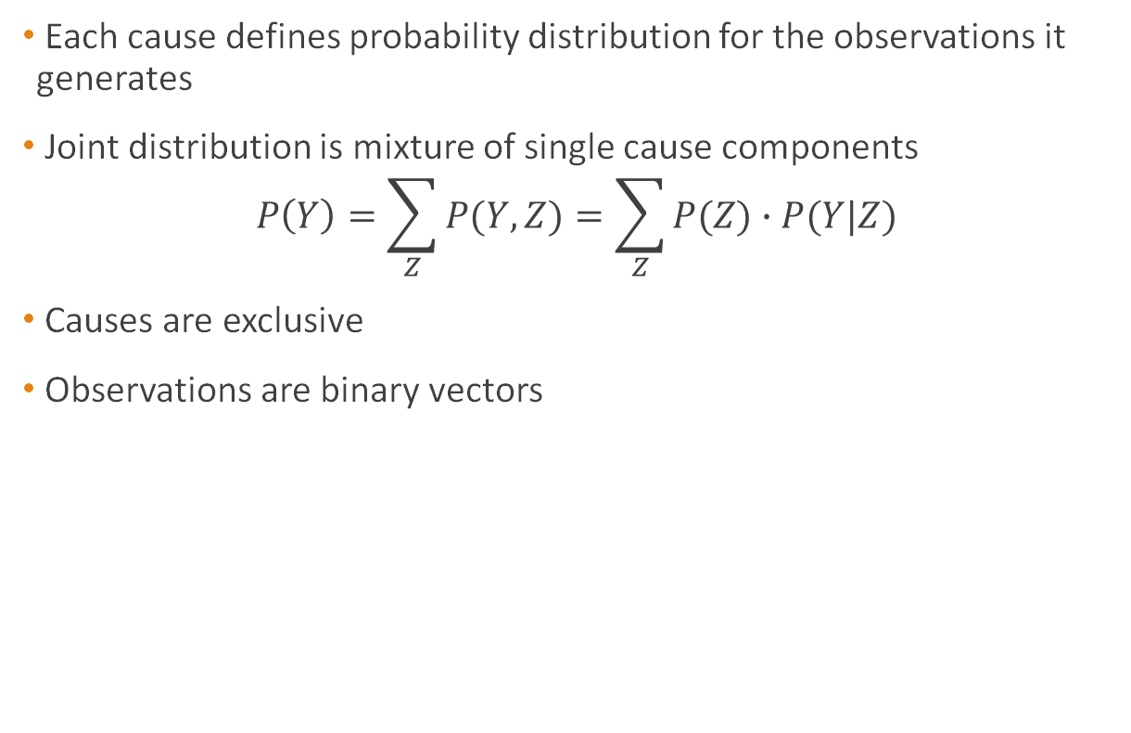
Generative Mixture Model (GMM)
Each cause defines probability distribution for the observations it generates
Joint distribution is mixture of single cause components
$$P\left(Y\right)=\sum_{Z}{P(Y, Z)=\sum_{Z}{P(Z)∙P(Y|Z)}}$$
Causes are exclusive
Observations are binary vectors
Image taken from [6]

Slide 7
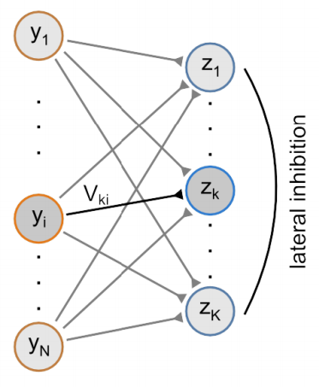
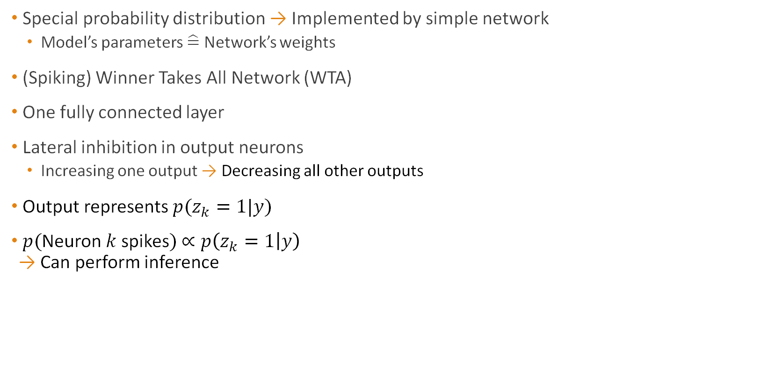
The Model corresponds to a Network
Special probability distribution → Implemented by simple network
Model’s parameters $\hat{=}$ Network’s weights
(Spiking) Winner Takes All Network (WTA)
One fully connected layer
Lateral inhibition in output neurons
Increasing one output → Decreasing all other outputs
Output represents $p(z_{k}=1|y)$
$p($Neuron $k$spikes$)$ $∝p\left(z_{k}=1 | y\right)$ → Can perform inference
Image taken from [1]

Slide 8

How does this Network Learn?
Modify network’s weights by learning rules
Maximize likelihood of observations $p(y)$
No closed form solution due to unknown causes
Use iterative maximization procedure
→ Expectation Maximization

Slide 9
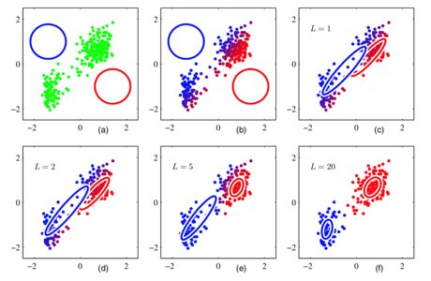

Expectation Maximization
Initialize model parameters
E: for each input compute probability of being caused by each cause
M: update parameters to describe calculated probabilities best
Guaranteed to converge to (local) optimum
Perform updates using Gradient Ascent
→ Gives learning rules
Images taken from [6]

Slide 10
Input Normalization & Non-Local Terms
Update Rules contain non local terms
→ At one synapse information about all weights is needed
Non-locality is biologically implausible
Input normalization keeps non local terms constant
Not plausible in nature

Slide 11
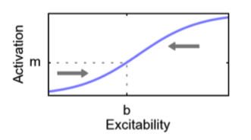
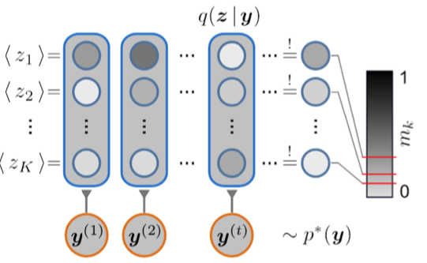
Homeostatic Plasticity
Intrinsic excitability is updated so that average activation stays constant
Introduce constraint
Time averaged firing rate must be constant
Biologically plausible
Non-local terms drop out
Relative average firing rate
Images taken from [1]

Slide 12
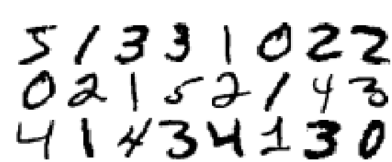
Experimental Setup
Work on binarized MNIST images (digits)
One input neuron per pixel → 784 inputs
Translate pixel values to spike trains
Poisson process with mean frequency
0-pixel → 20 Hz
1-pixel → 90 Hz
12 output neurons
5
1
3
Images taken from [3]

Slide 13
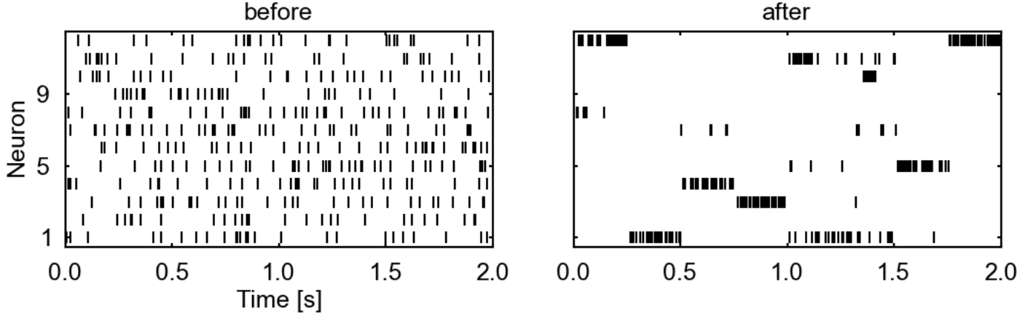

Network Represents Data Efficiently
Network learns sparse coding
Similar to results of Földiak [2]
Using Gaussian Mixture Model for $p(y, z)$ → Same (Hebbian) learning rules as in [2]
Images taken from [1]

Slide 14
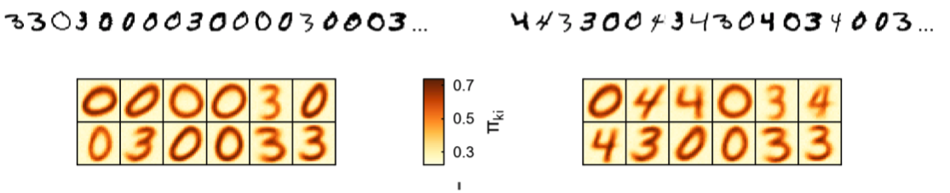
Network adjusts to new patterns
Digits: 0, 3
Digits: 0, 3, 4
Input Samples
Learned Patterns
Time
Images taken from [6]

Slide 15
Conclusion
Expectation Maximization can be used to
Maximize likelihood of the observed data for a given model
Rigorously derive learning rules
Homeostatic Plasticity yields learning rules that are
Local
Biologically plausible
Easy to compute
Alleviates needs for input normalization or non-trivial global computations

Slide 16
References
[1] Habenschuss, Stefan, Johannes Bill, and Bernhard Nessler. "Homeostatic plasticity in Bayesian spiking networks as Expectation Maximization with posterior constraints." Advances in Neural Information Processing Systems. 2012.
[2] Földiak, Peter. "Forming sparse representations by local anti-Hebbian learning." Biological cybernetics 64.2 (1990): 165-170.
[3] Nessler, Bernhard, Michael Pfeiffer, and Wolfgang Maass. "STDP enables spiking neurons to detect hidden causes of their inputs." Advances in neural information processing systems. 2009.
[4] Keck, Christian, Cristina Savin, and Jörg Lücke. "Feedforward inhibition and synaptic scaling–two sides of the same coin?." PLoS computational biology 8.3 (2012): e1002432.
[6] Bishop, Christopher M. Pattern recognition and machine learning. springer, 2006.
[7] Vectorstock. vectorstock.com/royalty-free-vector/colorful-sound-waves-vector-11771199

