Slide 1

Academic Data
Automatic Course Assembly
Group 4
Feliciaan De Palmenaer, Wouter Pinnoo, Stefaan Vermassen & Titouan Vervack
Meeting 10/3/2016
Academic Data - Automatic Course Assembly

Slide 2
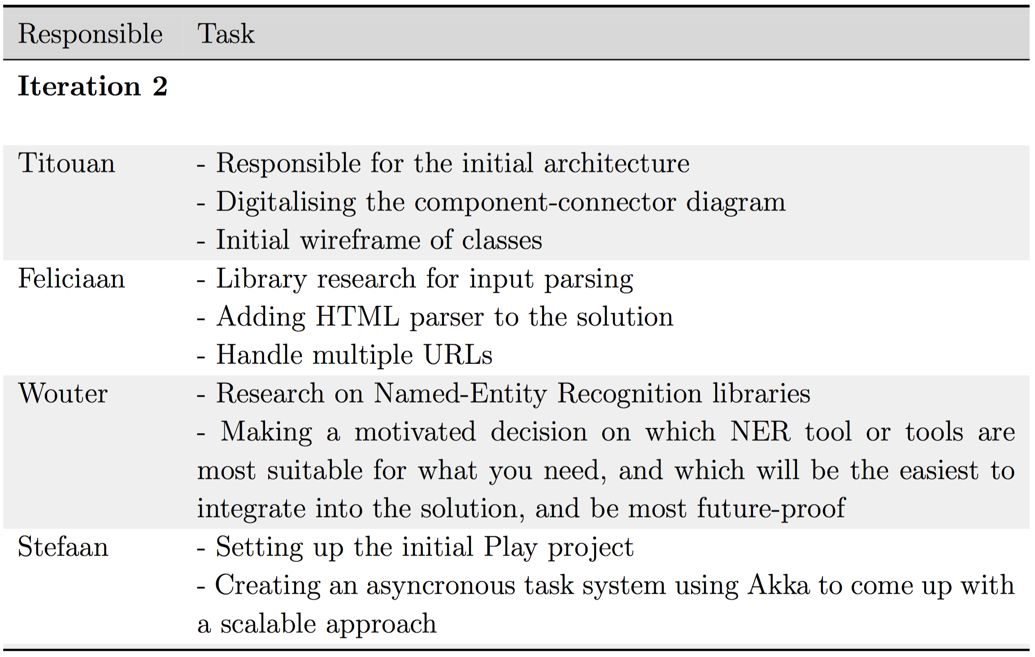
Responsibility

Slide 3
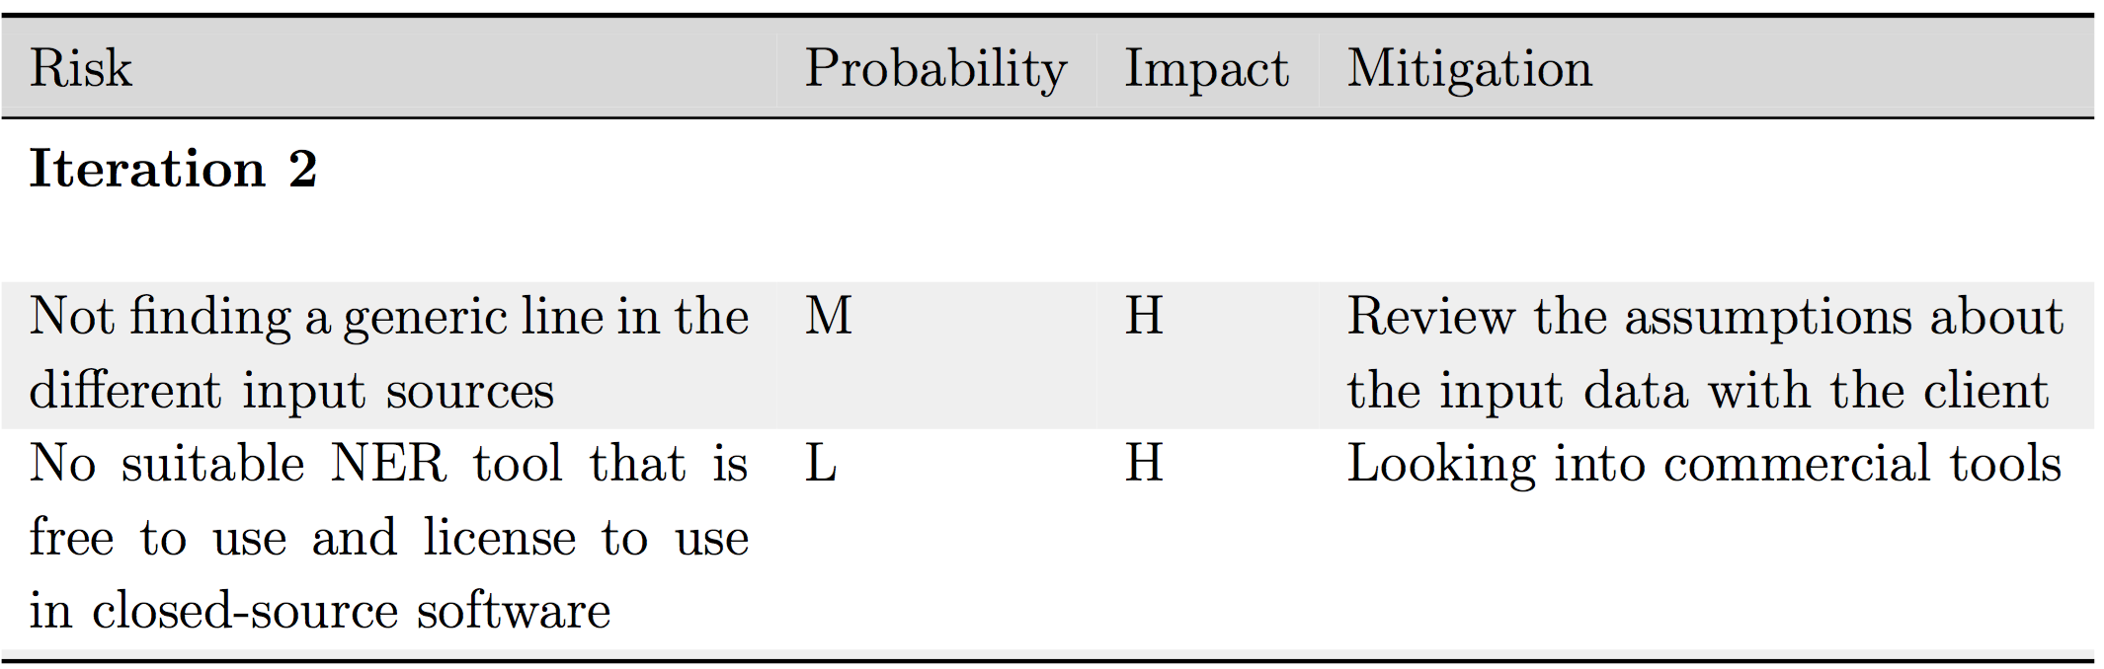
Risk list

Slide 4
Development platform
Play web application framework
Onsophic core in Java
Clean alternative to legacy Enterprise Java stacks
Predictable minimal resource consumption
Akka toolkit for asynchronous task system
NERD API for Named-Entity recognition
Acts as an abstraction for other existing NER APIs
Jsoup as HTML parser
No need to create own syntax tree

Slide 5
Progress
Asynchronous task system:
Submit task
Query status
Get result
High-level architecture
Basic NER library usage

Slide 6
Architecture
Notes:
The user interacts with the Rest API, after the user submits a link, the document grabber fetches the webpage connected to the link, and returns the document to the REST API.
The REST API then sends the document to the DocumentProcessor which first parses the Document in the DocumentParser and then searches for tags in the Entity Recogniser.
The last step is to convert this HTML typed Document to a JSON document which is then returned to the REST API.

Slide 7
Purpose of NER
Notes:
n the assembly process of the JSON-representation of the course, tags will be created in addition to the parsed content of the (HTML-) documents. For each document, these tags will represent the subject of the document. For this purpose, the content of the whole document will have to be scanned, since the title of the document is not always sufficient to serve as tag for the document. For example, user manuals often contain Prerequisites as a title for the first section of the manual. This section will probably contain more useful information than only this subject line.
For the automatic scanning of the document into useful tags, Named-Entity Recognition 6
(NER) will be used. NER uses machine learning techniques to find (sequences of) words in the text, i.e. entities, that can be related to concepts from the semantic web. For example, in the sentence Trump and Clinton are two candidates for the presidential elections of 2016, the entity Trump will be linked to http://dbpedia.org/page/Donald Trump. The used algorithm will make decisions based on relevance of the word to the concept of the semantic web and its confidence.
We think NER is the best solution for the generation of tags, since X NER finds sequences of words that are relevant (i.e. leave out words like ’and’, ’or’,
’the’, etc. X NER provides a measure of relevance, which we can use to sort all entities on. Only
the 5 most relevant concepts in the document will be used as tag for the document.
Several NER libraries exist that serve an API for easy access. We chose to use the NERD API1. This API acts as an abstraction for other existing NER APIs, one of which is the most commonly used NER API: AlchemyAPI. The NERD API provides easy methods to submit a document, choose a NER library and retrieve the results of the chosen extractor.
This abstraction layer will be a big advantage in this project, because we can easily switch from extractors to tune performance and correctness of the tags.
A disadvantage of the NERD API is its license, which prohibits any commercial use of its services. However, we think that the benefit of the abstraction layer outweighs the disadvantage of the license, since one can use the learned results of all the different used extractors gained in this project course to eventually implement the best performing ex- tractor in the project (which will take more effort than implementing this abstraction layer).

Slide 8
Planning
Next sprint (10/03 -> 23/03)
Improve and generalize HTML parser, detect format used on site
Mapping NERD API tags to Onsophic tags
Create JSON output that matches the Onsophic basic API
Later sprints
Find more metadata in webpage
Convert JSON output to the complete Onsophic API

Slide 9
DEMO

