Slide 1

Academic Data
Automatic Course Assembly
Group 4
Feliciaan De Palmenaer, Wouter Pinnoo, Stefaan Vermassen & Titouan Vervack
Meeting 17/3/2016
Academic Data - Automatic Course Assembly

Slide 2
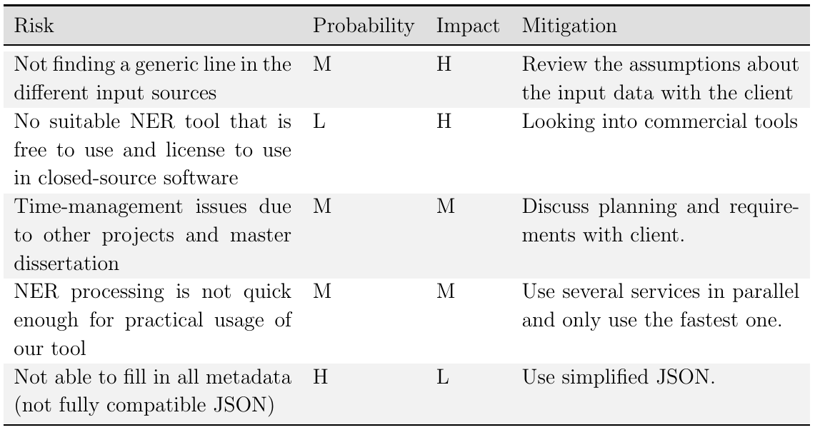
Risk list

Slide 3
Progress
Threading: parallel functionality for the different documents in the same task
Initial parsing attempt: parse section names and output in a JSON format required by Onsophic

Slide 4
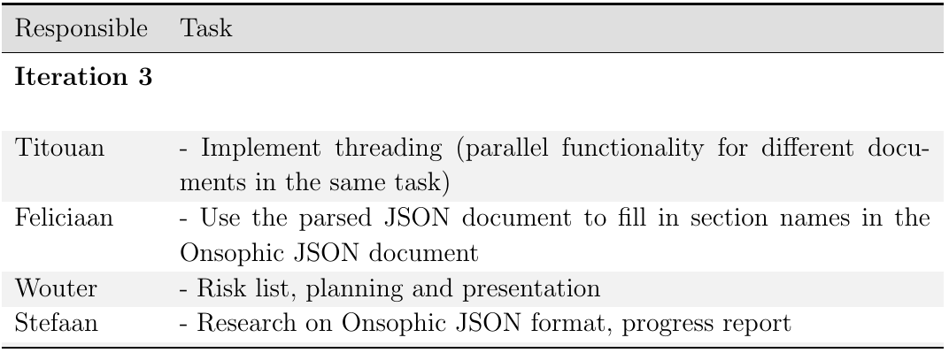
Responsibility

Slide 5
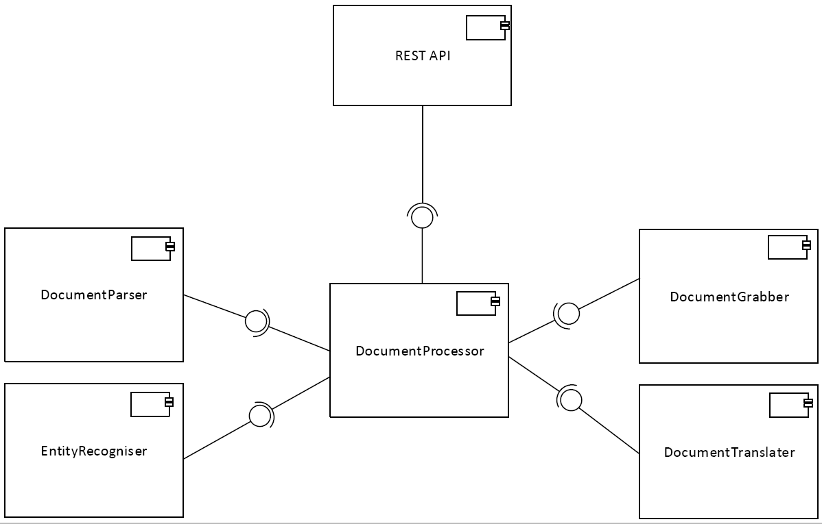
Architecture

Slide 6
Planning
Next iteration (17/03 → 29/04)
divided in 6 sprints (one week each) mostly development progress
Last iteration (29/04 → 20/05)
code freeze, working on demo, presentation, final report, etc.

Slide 7
Planning
Next iteration (17/03 → 29/04)
divided in 6 sprints (one week each)
Sprint 1 → 3
Development of the parser
Estimate bloom level
Sprint 4
Self-reflection on modifiability of our system. Adapt if necessary.
Meet client for feedback. Adapt if necessary.
Sprint 5 → 6
Find generic line in the structure of different input sources

Slide 8
DEMO

