Slide 1
AI-Powered
Code Reviewer & Quality Analyzer
Automated Python Docstring Generation
Aditya Sharma (@FlashyAdi)

Slide 2
Problem Statement & Objectives
•
Manual code reviews are time-consuming processes that require significant effort, leading to inconsistencies in quality and delaying project timelines.
•
Poor or missing documentation reduces code readability, maintainability, and overall developer productivity.
•
Early-stage projects often lack automated quality validation, leading to technical debt.
•
Existing tools focus mainly on syntax and linting, not on docstring quality.
📌 Core Challenge:
Ensuring consistent, high-quality documentation and documentation standards across large codebases at scale.

Slide 3
Core Goals: Enhancing Standards & Efficiency
Automate
Improve
Streamline documentation tasks for efficiency and accuracy.
Enhance readability and consistency across codebases effectively.
Enforce
Reduce
Ensure adherence to PEP 257 documentation standards consistently.
Minimize manual review time and enhance productivity.

Slide 4
System Architecture Overview
User Interface Layer
Streamlit Web Application
Core Processing Layer
AST Parser • LLM Integration • Formatter
AI Engine Layer
GROQ API (LLaMA 3.1-8B)
Validation Layer
PEP-257 Validator • Quality Metrics

Slide 5
Core Modules Overview
📝
📚
✅
Code Parsing
Documentation
Validation
Extracts code structure for analysis and validation.
Generates compliant docstrings from the code analysis.
Enforces compliance with established documentation standards.

Slide 6
Additional Features
📊
📈
💾
Coverage
Dashboard
Export
Measures and ensures documentation completeness and quality.
Visualizes metrics and offers insights for developers.
Outputs data in formats for integration into workflows.

Slide 7
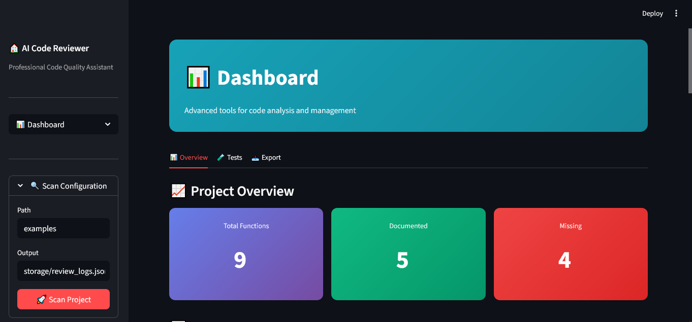
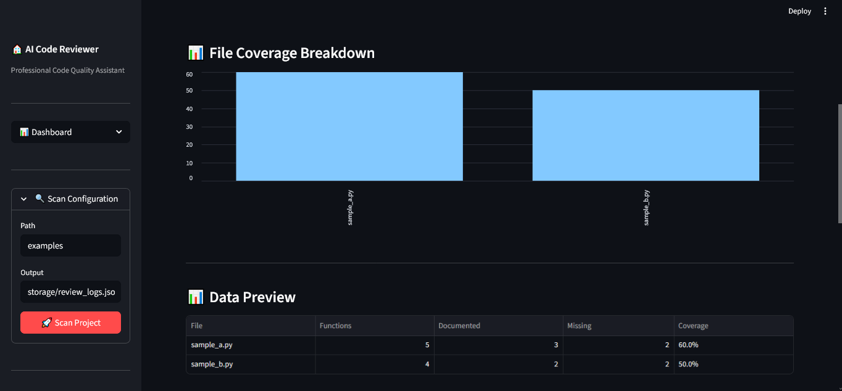
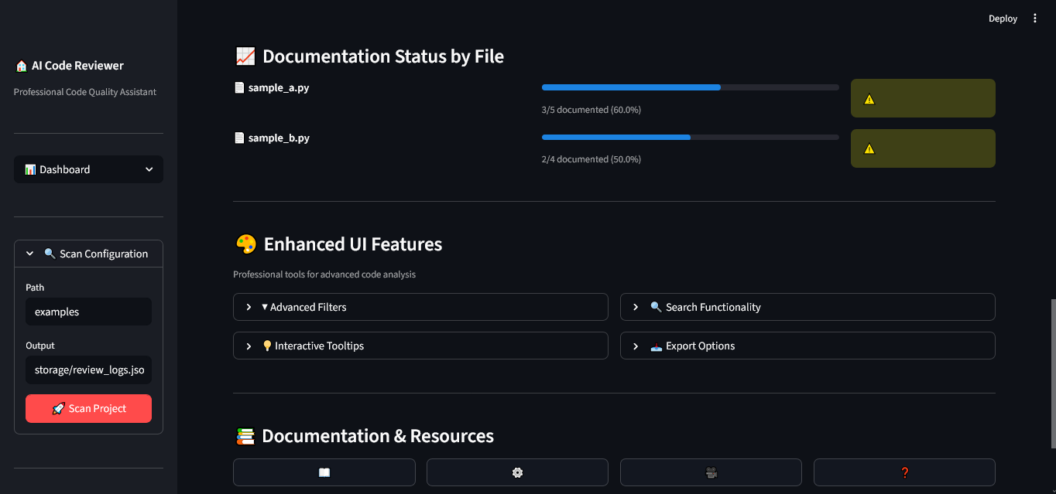
Dashboard Interface

Slide 8
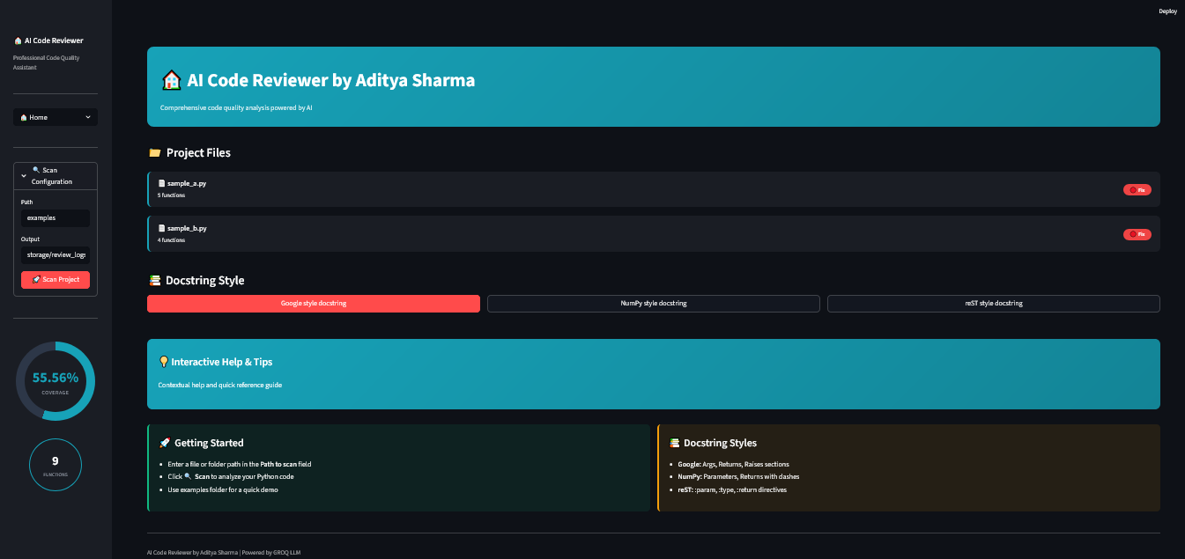
System Interface & Interaction
The platform provides a centralized dashboard to analyze documentation coverage, review AI-generated docstrings, validate standards compliance, and monitor quality metrics. Developers can search and filter code elements, accept or reject AI suggestions, and track validation results through an intuitive navigation workflow.

Slide 9
Automated Testing Overview
✓
Comprehensive automated testing was conducted using pytest
✓
Tests cover all major functional components of the system
✓
Ensures correctness, stability, and production readiness
Test Results: 25+ Tests • 85.7% Pass Rate

Slide 10
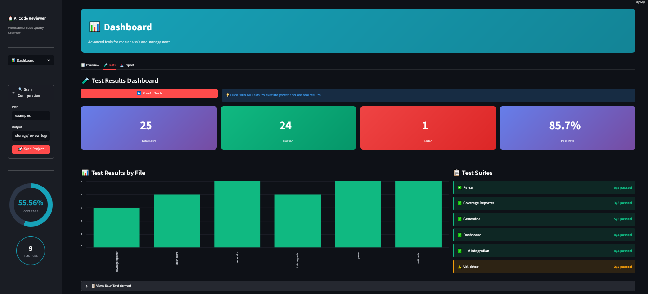
Test Execution Results

Slide 11
Future Enhancements for Our AI Assistant
Collaboration
Packaging
Advanced Analytics
Enhance teamwork capabilities for project development.
Make the tool easily installable for developers.
Monitor trends and metrics for continuous improvement.
Code Improvements
Auto-Fixing
Git Integration
Suggestions to enhance code quality and efficiency.
Automatically resolve documentation problems to save time.
Seamlessly integrate with Git for continuous improvement.

Slide 12
Thank You
- Aditya Sharma (@FlashyAdi)
GitHub: github.com/FlashyAdi/ai-code-reviewer

