Slide 1

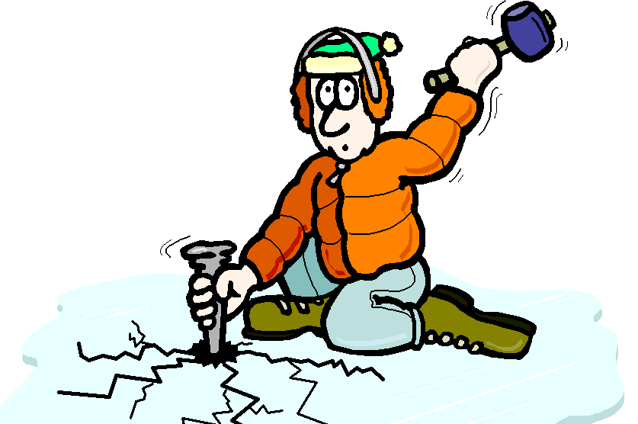

“Agile Emoji Delights” – The Ice Breaker

Slide 2

What are Ice-breakers
Why & Where do we need it

Slide 3

Rules
Each person/Team on the call gets a chance to guess an emoji appearing the Screen
If First Team Not able to Guess, it will pass on to Next Team/person
These emoji are related to Agile/Scrum. Please put your Scrum Caps On ☺

Slide 4
🆕🔨👥

Slide 5
🏃‍♂️🗓️📝

Slide 6
🙏🤝💕

Slide 7
🎉🔎👀

Slide 8
📉🔥📊:

Slide 9
🕺🗣️💬

Slide 10
🤔👥🗒️:

Slide 11
📊🤝📝

Slide 12
💪😨🦁

Slide 13
✅📝👥

Slide 14
📊📝👥

Slide 15
📋🗓️👥

Slide 16
🔎👀🎯

Slide 17
🌟🤝💬

Slide 18
🕺🗣️💬

Slide 19
🔒💪👥

Slide 20
Increment 🆕🔨👥: Sprint Planning 🏃‍♂️🗓️📝 Respect 🙏🤝💕 Sprint Review 🎉🔎👀 Burn-Down Chart 📉🔥📊: Openness 🌟🤝💬: Sprint Retrospective 🤔👥🗒️: Backlog Refinement 📊🤝📝 Product Backlog 📊📝👥 Courage 💪😨🦁: Definition of Done ✅📝👥 Sprint Backlog 📋🗓️👥 Focus 🔎👀🎯: Daily Scrum Call 🕺🗣️💬 Commitment 🔒💪👥

Slide 21

Thank You

