Slide 1
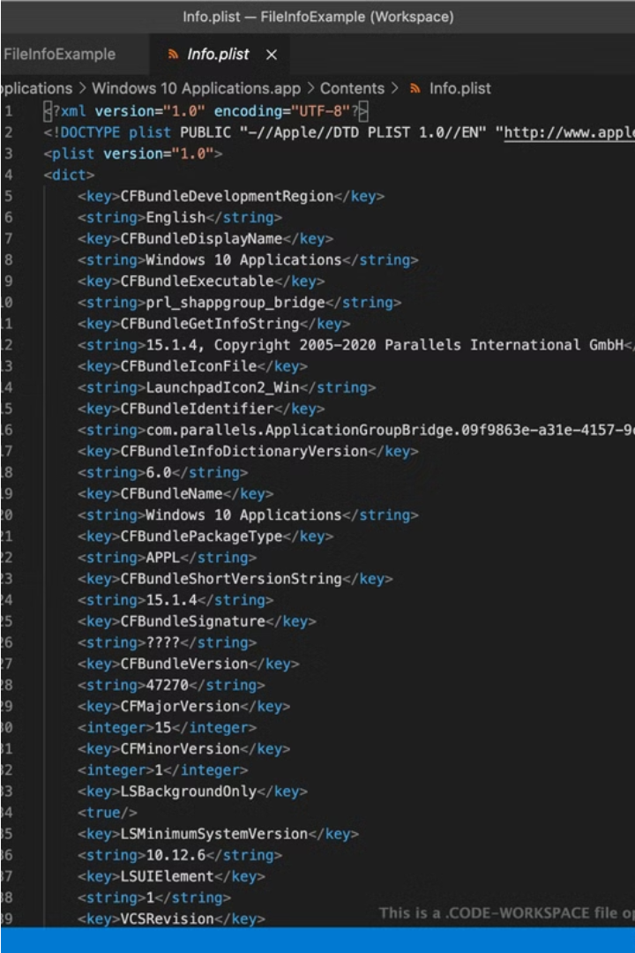

Introduction to Git and GitHub
Git and GitHub are essential tools for modern software development. This presentation will introduce you to the fundamentals of version control, collaborative coding, and how to leverage these powerful technologies to streamline your development workflow.
Ja
by Joel Muturi

Slide 2

What is Git?
1
Distributed Version Control
2
Local Repositories
Git is a distributed version control system that allows multiple developers to collaborate on a project by tracking changes to the codebase over time.
Each developer has a complete copy of the project's history on their local machine, providing flexibility and offline capabilities.
3
Branching and Merging
Git's branching model enables developers to experiment with new features or bug fixes without disrupting the main codebase.

Slide 3
Git Basics: Repositories, Commits, and Branches
Repositories
Branches
A Git repository is a collection of files and their revision history, stored locally or on a remote server.
Branches are independent lines of development that enable parallel work and experimentation within the same repository.
1
2
3
Commits
Commits are snapshots of the project at a specific point in time, allowing you to track changes and revert if necessary.

Slide 4
Collaborating with GitHub
Remote Repositories
Pull and Push
Issue Tracking
GitHub provides a platform for hosting and sharing Git repositories, facilitating collaboration among developers.
Developers can "pull" the latest changes from the remote repository and "push" their local commits to the shared codebase.
GitHub's issue tracker helps teams organize, discuss, and resolve development tasks and bug reports.

Slide 5
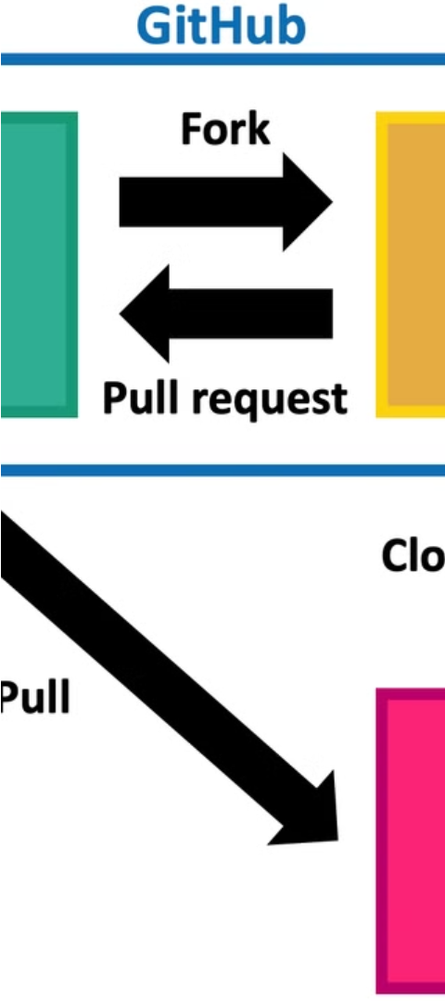
Forking and Pull Requests
1
Forking
Forking is the process of creating a personal copy of a repository, allowing you to work independently on a project.
2
Pull Requests
Pull requests enable you to propose changes to the original repository and collaborate with the project maintainers.
3
Code Review
Pull requests facilitate code review, where maintainers can provide feedback and ensure quality before merging changes.

Slide 6
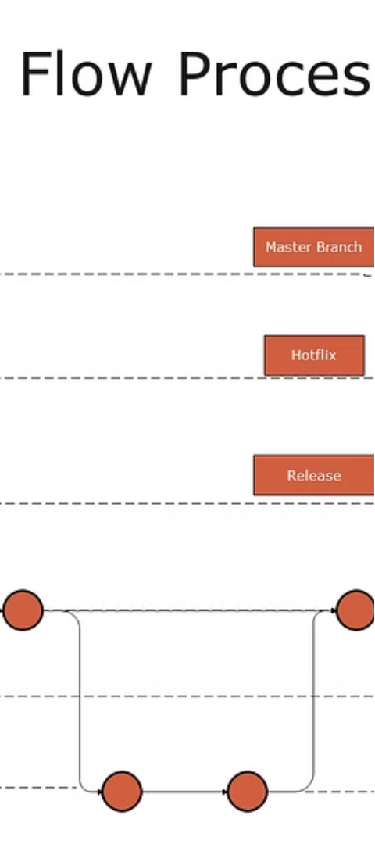
Git Workflows
Centralized Workflow
Feature Branch Workflow
A single, shared repository where all team members collaborate and commit their changes.
Each new feature or bug fix is developed on a separate branch, then merged into the main branch.
Forking Workflow
Developers fork the main repository, work on their own branches, and submit pull requests to the original project.

Slide 7




Git Commands and Best Practices
Clone
Commit
Push
Pull
Create a local copy of a remote repository.
Save changes to the local repository history.
Upload local commits to the remote repository.
Download changes from the remote repository.

Slide 8

Conclusion and Resources
1
Key Takeaways
2
Additional Resources
Git and GitHub are powerful tools that enable version control, collaboration, and efficient software development workflows.
Explore the FreeCodeCamp article and other online tutorials to deepen your understanding of Git and GitHub.

