Slide 1
My holiday advantures
Teo Samaržija

Slide 2
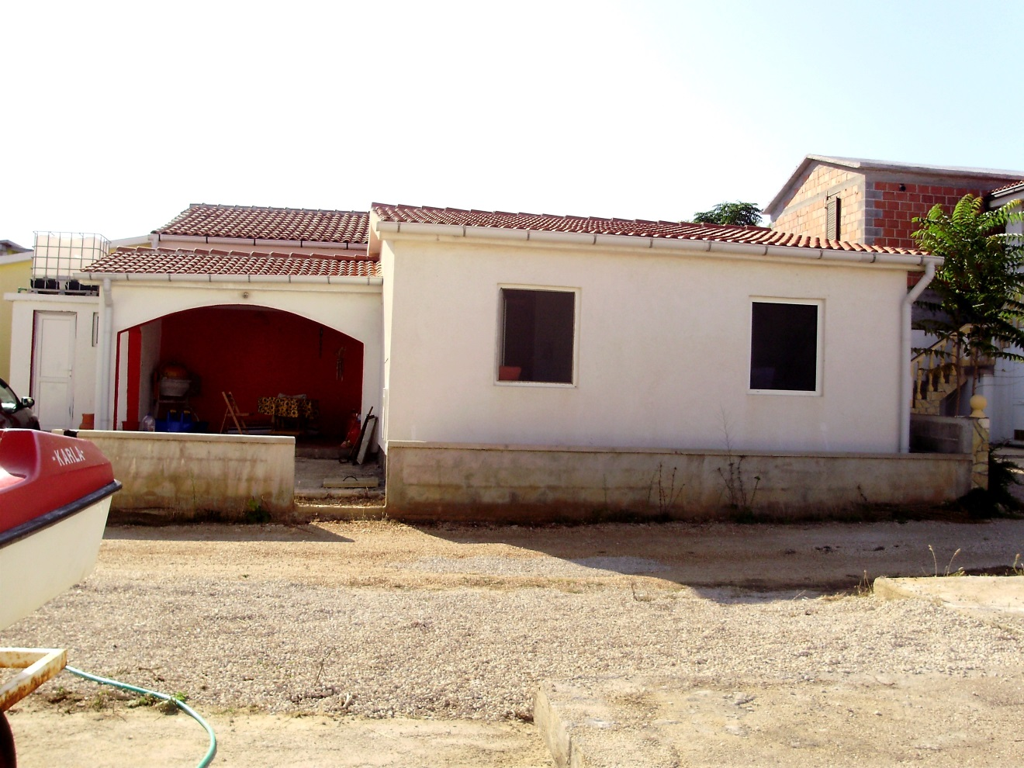
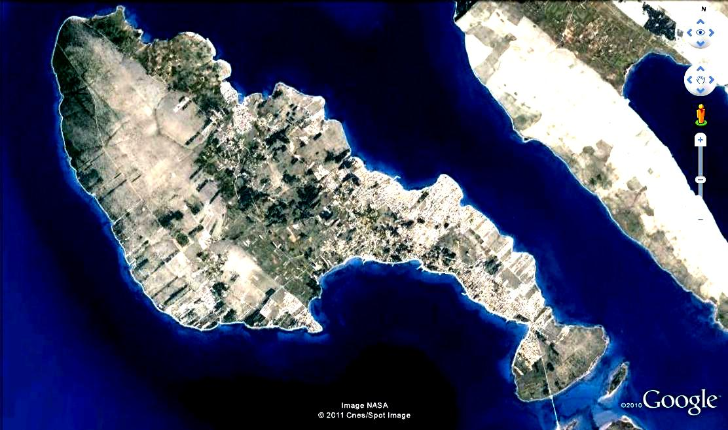

Slide 3
Let’s get out of here!!!
OH, THANK GOD!
What would have happened if we weren’t there!?
HELP!!!

Slide 4
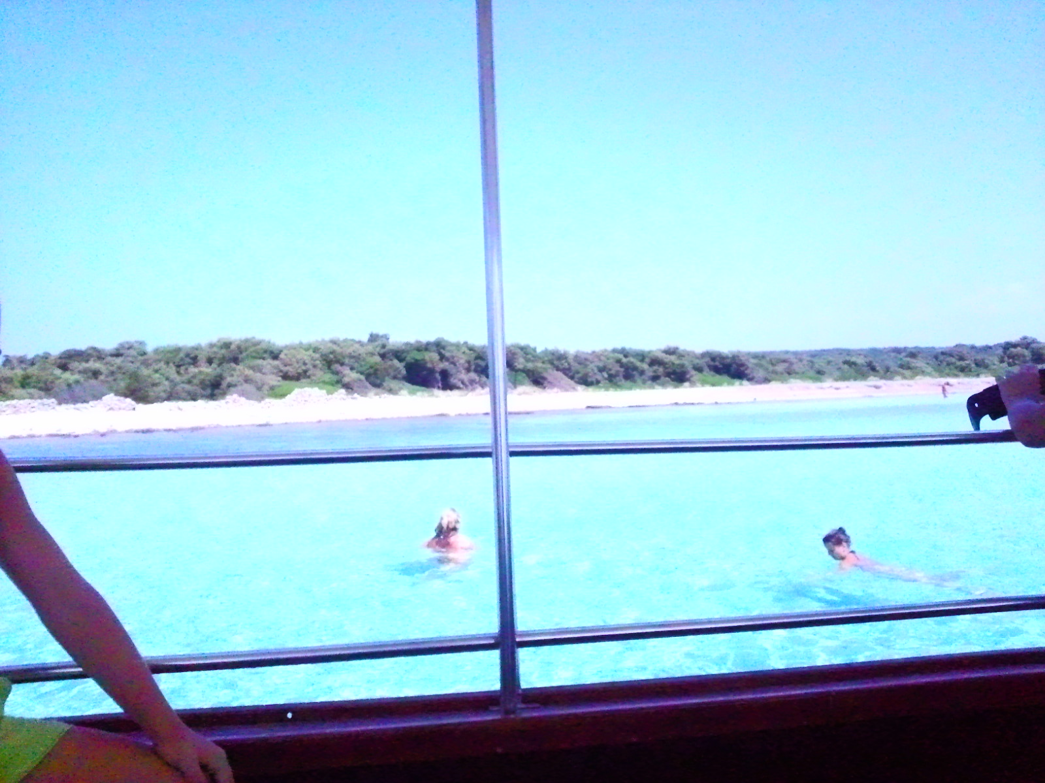
Teo, are you toatally crazy?!
Your fault!
I don’t believe that you didn’t!
Hey, do you think that I would do it on purpose?
Brrr, it’s so cold!

Slide 5
Toys aren’t allowed in this pool!
Oh, sorry, I didn’t know you can swim!
Teo, you begged me to buy you that!
Why aren’t you playing with that?
OK!
What, mum?
I am going to ask him why.
Well, the guard told me not to.

Slide 6
HA!? Someone just called me for help!?
I am not going to tell you my name because I have met as many crazy people as I care to!
HASN’T HASN’T HASN’T HASN’T HASN’T HASN’T...
Who are you?
Where are you?!
Really!? So, Lucia was just teasing me?
Don’t make me strike you with this walkingstick!!!
Milan’s daughter. I thought you knew her.
But, granny, who is Lucia!?
Lucija shouted for help, but I can’t find her!
Granny, look, invisible people can’t die in car accidents!
How do you know if something is real?!
Could you please move for me to pass?
Lucija, where are you!?
Granny is a bit senile.
LUCIJA!!!
Milan isn’t real, and so isn’t his daughter.
Yes, let’s just go in!
What is going on?
Sorry to tell you, granny, but you are completely crazy!!!
You’ve killed Lucija!!!
Hey, Teo, don’t be rude!
I trust my own eyes!
What is going on, granny?
Not my buisness!

Slide 7

HA! What’s that snail doing here?
I’m gonna kill it with my stick!
Look, mum, a wounded snail!
OK, I’d guess.
Let’s leave it here!

Slide 8
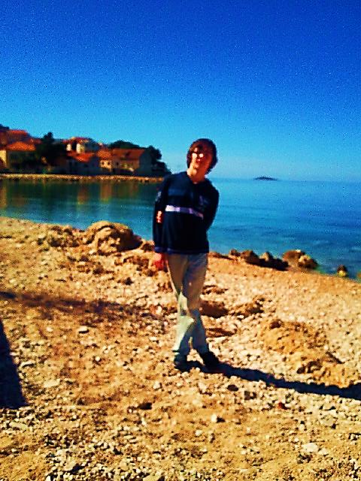
Ah! Then the only thing that’s left is walking down the road for help!?
Wow, driver, how did you do that!?
I’d guess so. There is also no signal either...
I think I do, but I don’t have a pump. Do you?
Has the driver tried to drive backwards?!
Well, we can suck some air out of tires with pump, right?
Why have we just stopped?
It seems that we are stuck under the bridge!!!
Where are we exactly?!
I don’t know!
UH! So, we can’t call someone to help us!?
Does anyone know how to actually do that?!
I don’t have it either!
Guys, let’s just not panic, please!
Probably. He has gone out.
What? I’ve just come back from the toilet.

Slide 9
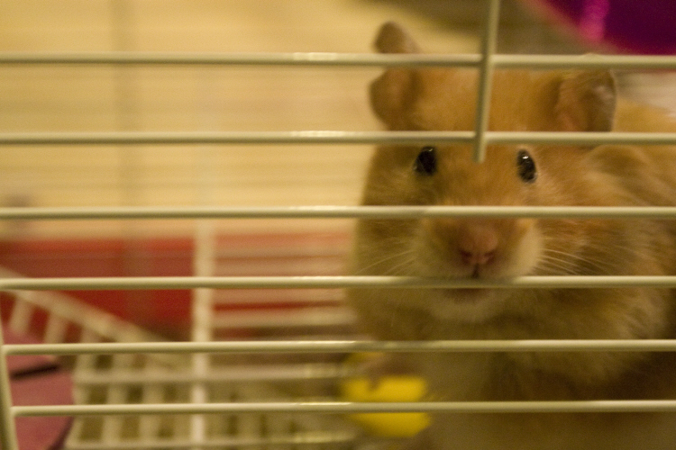
Serious question:
Should you buy it out of slavery?

Slide 10

Thanks for watching!
Made by:
Teo Samaržija, 2. OG
(using only PowerPoint!!!)

