Slide 1
PHP Working with Strings
Copyright © Rahim Virani and others

Slide 2
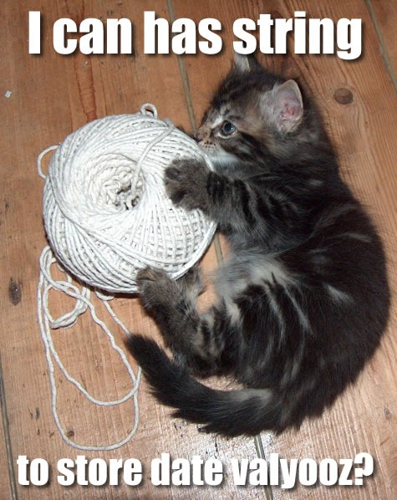
Strings
PHP has a lot of string related functionality.
Strings are the data type we use to store most of the information in our application.
String functions are built-in to PHP and require not additional setup.

Slide 3
Clean up your Strings!
trim() is the function used for cleaning up your strings, by default it cleans the following:
New Line (\n)
Carriage Return (\r)
Horizintal Tabs (\t and \x0B)
Spaces (\0)

Slide 4
Trim has some gentler cousins
Rtrim() - clean up the right hand side (end of the string)
Ltrim() - clean up the left hand side (beginning of the string)

Slide 5
Don’t let people pull your Strings!
htmlspecialchars() is a function that will convert potentially harmful punctuation to html entities. Htmlspecialchars() is to allow special characters not to break things when displayed in a browser but also to safe guard against injection attacks.html. There is also an htmlspecialchars_decode() function that will reverse the process.

Slide 6
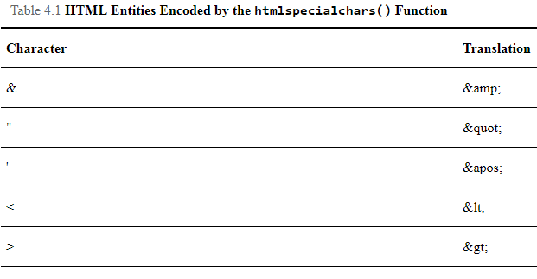
HTML entities that will be encoded by strings are:

Slide 7
Use str_replace for safe input
Always practice safe input, those of you who are security aware will notice that the previous function does not take care of semicolons, equals or parentheses which can also be used for attacks as well. Its not always about security, sometimes you don't want users to copy and paste invalid data from other applications. str_replace is a good fit for either of these applications.

Slide 8
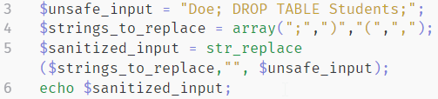
str_replace Example

Slide 9

String Interpolation with printf()
Don't be intimidated by big words like interpolation. This just means that we can put in variables into our strings with shortcuts, then we specify what variables these actually should represent after the expression. Makes things a bit cleaner than what we have previously been doing.

Slide 10
Formatting Strings
With interpolation and the printf function, formatting strings is alot easier. Notice the "%s" in our previous example. These means format the variable as a string. Here is a table of the other options

Slide 11
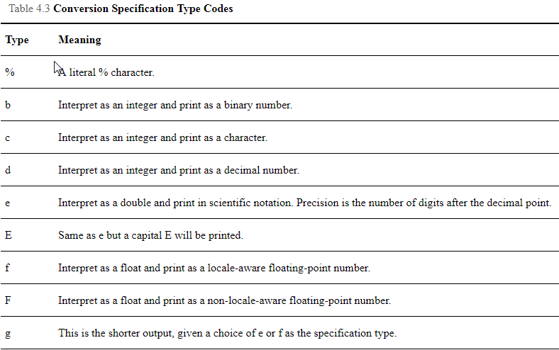
Formatting Strings

Slide 12
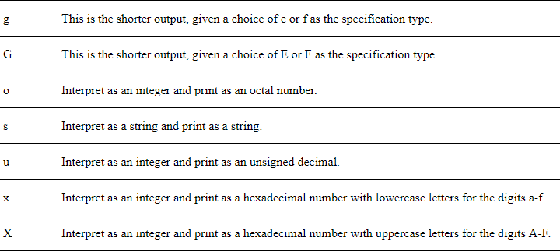
Formatting Strings

Slide 13
Formatting Strings
You can mix the parameters in the string and call them by their order but this is not good form. Here we are printing the second argument $total first and then the first argument $total_shipping second.

Slide 14
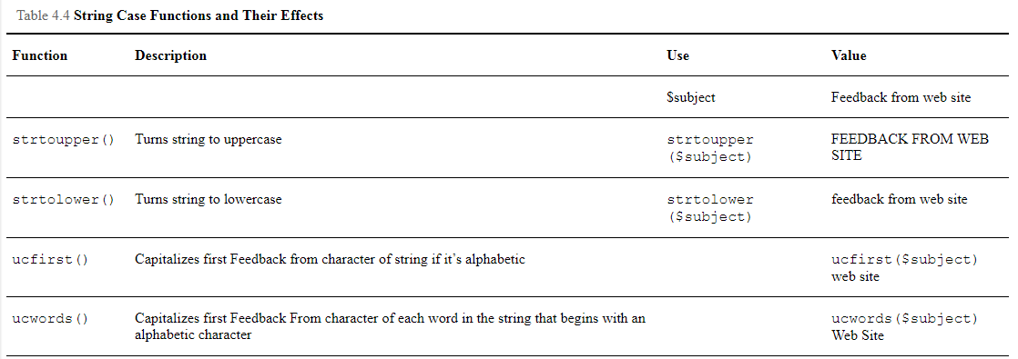
String formatting and Case functions.
You can modify the case of strings eaisly with PHP, the following are four functions to do this.

Slide 15

Joining and Splitting Strings
These functions are very important as they return data in an array.
explode() - takes the input and splits it into pieces specified by the “seperator" string.
array(2) {
[0]=>
string(10) "instructor"
[1]=>
string(17) "douglascollege.ca"
}

Slide 16
Joining and Splitting Strings
implode() - Does the opposite of explode, useful for re-assembling arrays into strings with separated values
string(23) "oranges,apples,bannanas"

Slide 17

Substr() is important for cutting up strings.
You can give the start and length for which you want to cut a string up and have the result returned.
testThis

Slide 18

Compare strings in alphabetical order.
strcmp() will return -1 if the second string is greater than the first and 1 if it is less than. The strings are compared by alphabetical order.

Slide 19
How Long is a piece of string?
PHP solves the age old question with the strlen() function. The answer is 30 characters long. You can often use this function to validate the length of your input.

Slide 20
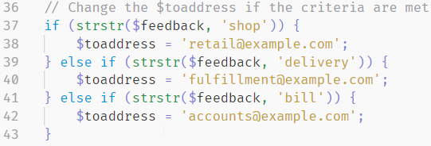
strstr(), strchr() and stristr() - Strings in Strings

Slide 21
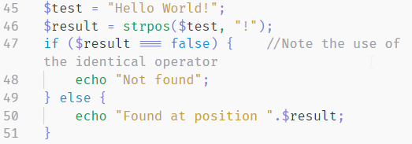
Finding where a needle in a haystack is
We can search for where a character is located in a string (its index). As follows. This is useful if we want to get a substring but we dont know where the needle is.

Slide 22
References

