Slide 1
university_updated_charts
File created on: 4/18/2022 9:46:54 AM

Slide 2
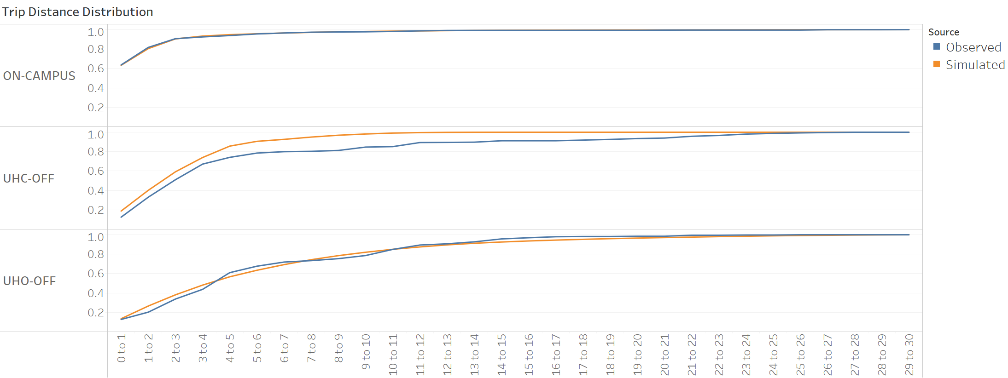

Slide 3
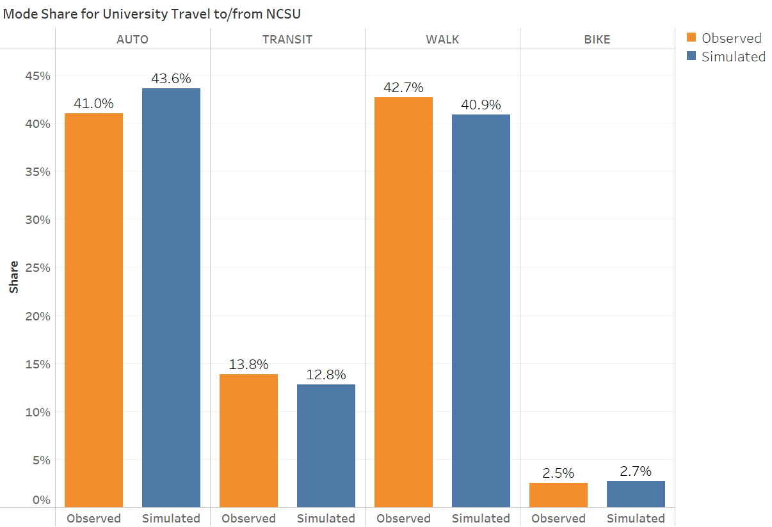

Slide 4
