Slide 1

MRSP
Seminar Project Summer 2025
AI-Based Gesture Animation for Sign Language
Avatars
ROMANETTI FLavien 73100

Slide 2
Introduction
Methodology
Results
Conclusion, Overview

Slide 3
Introduction
Goal : To develop a machine-learning model that can generate realistic hand gesture animations for sign language avatars
Motivation : Developed more realistic hand gesture for Avatars
Use of MediaPipe to capture Keypoint of the hands
Two Models implemented, one for prediciton another for generation of sign gesture
The predictor model is a bidirectional LSTM, while the generator model is also an LSTM but train with force teaching.

Slide 4
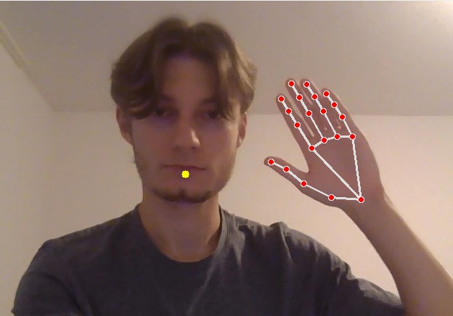
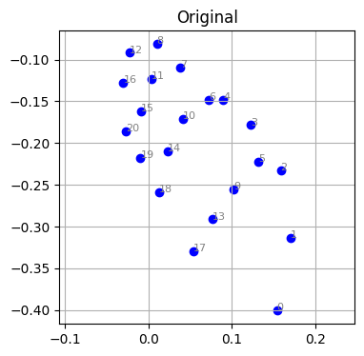
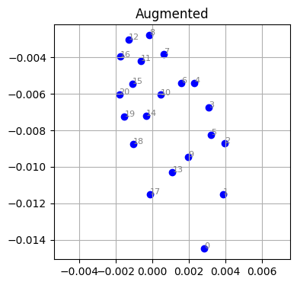
Methodology
Own dataset
70 training, 20 validation samples captured
Then augmented (10 to 15 times) to have enough data for training 10 labels
Screeshot of the program capture.py
Orginal and augmented data light rotation and noise

Slide 5
Methodology
begining of sequence
end of sequence
Bidirectional LSTM Predictor Model
output
memory
input
Recurrent Neural Network
Vector Embedding
LSTM generator with force teaching for the training
Generator Model
LSTM with Force Teaching

Slide 6
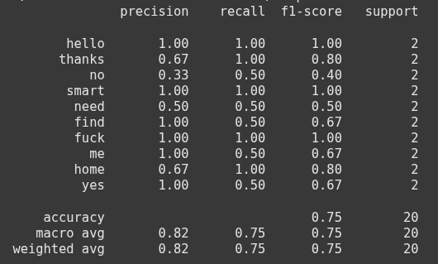
Results
Poor result, some sign are recognize every time while other nearly nether
The accuracy is not homogenous through the sign
The small size of the dataset is certainly the reason for these results
Accuracy result for each sign of the predictor model
Test of the model with runner_predictor.py

Slide 7
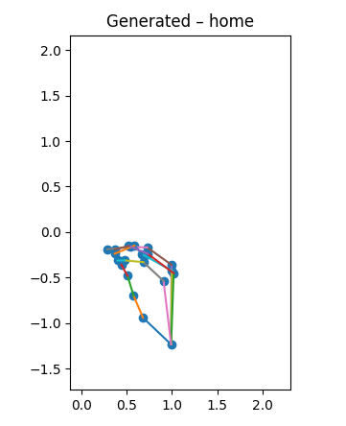
Results
The result are adequate
the model can proprely generate sign gesture animation.
Losses are low for the training and validation set
The task ask for the generator model to execute, animation generation, could also be done by taking the data and building an animation directly
The purpose of this model is to shown the efficiency to generate realistic gesture even if in our case the task is simple
Extract from the animation of the sign home
Test of the model with runner_generator.py
Loss of the model in the last Epochs of the training
Epoch 060 | train 0.07081 | val 0.07614

Slide 8
Conclusion, Overview
Predictor model
Lack of uniform accuracy through the sign Sometimes overconfident in his error Small dataset limitation
Generator model
Smooth and good result
if the sign is know it will be understanded
few labels and simple task, may question the relevance of a small model for animation
Proof of concept for larger model to generate realistic gesture applied to Avatars

