Slide 1
IDS 594 Machine Learning Using Python
IMAGE CLASSIFIER FOR PRODUCT CATEGORIZATION
Bhargavi Surendran
Dinesh Subbarayalu
Divakar Loganathan
Renuka Ramachandran
Shobin Thomas
Shakunthala Narayana Swamy

Slide 2
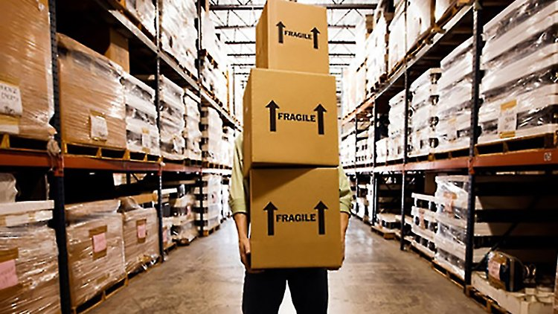
Objective
Introduction
Large retail stores - Very critical to manage inventory efficiently
Keeping up with the stock is one of the most time-consuming tasks
Requires labor with work and discipline to maintain
One of the tedious job is to keep track of the count of each item in inventory and also know where each item is stored
Developing field - Robot that goes around to capture pictures of items in inventory - Just like Google Car
A deep neural net solution to classify image that can help grocery retail company to track shelf inventory,
categorize products and reduce human effort in warehouse

Slide 3
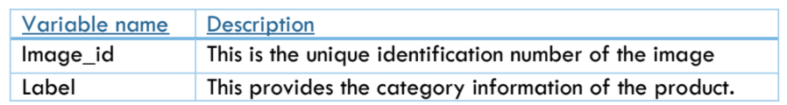
Introduction to Dataset
Source: The dataset is obtained from HackerEarth and has the images for training and testing set.
CSV Files:
The CSV file for the training data had Image ID and labels.
The following is the dataset distribution and description.
There were 2 folders, one containing images to train our model. The other folder had images for which we need to predict the label.
The train data has a total of 3215 data points(images) and the unlabeled data set has 1732 images.
The train data was split in 70:30 ratio for the purpose of predicting and testing

Slide 4
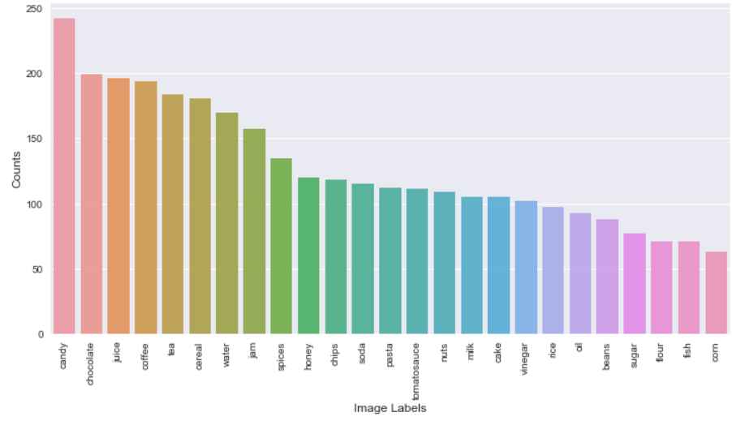
Exploratory Data Analysis
Data distribution:
No. of labels - 25
Uneven distribution of data
Image resolution - 256*256
Scale - RGB
Format - .png

Slide 5
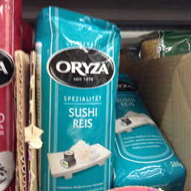
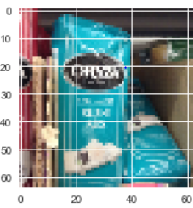
Data Pre-Processing
Resizing - Increased speed of computation; Decreased accuracy
Normalization - Convert to float and divide by 255
Reshaping input to fit the models
Augmentation:
Width shift
Height shift
Rotate image

Slide 6
Algorithms
Classifier - Random Forest
CNN
CNN with Transfer Learning

Slide 7
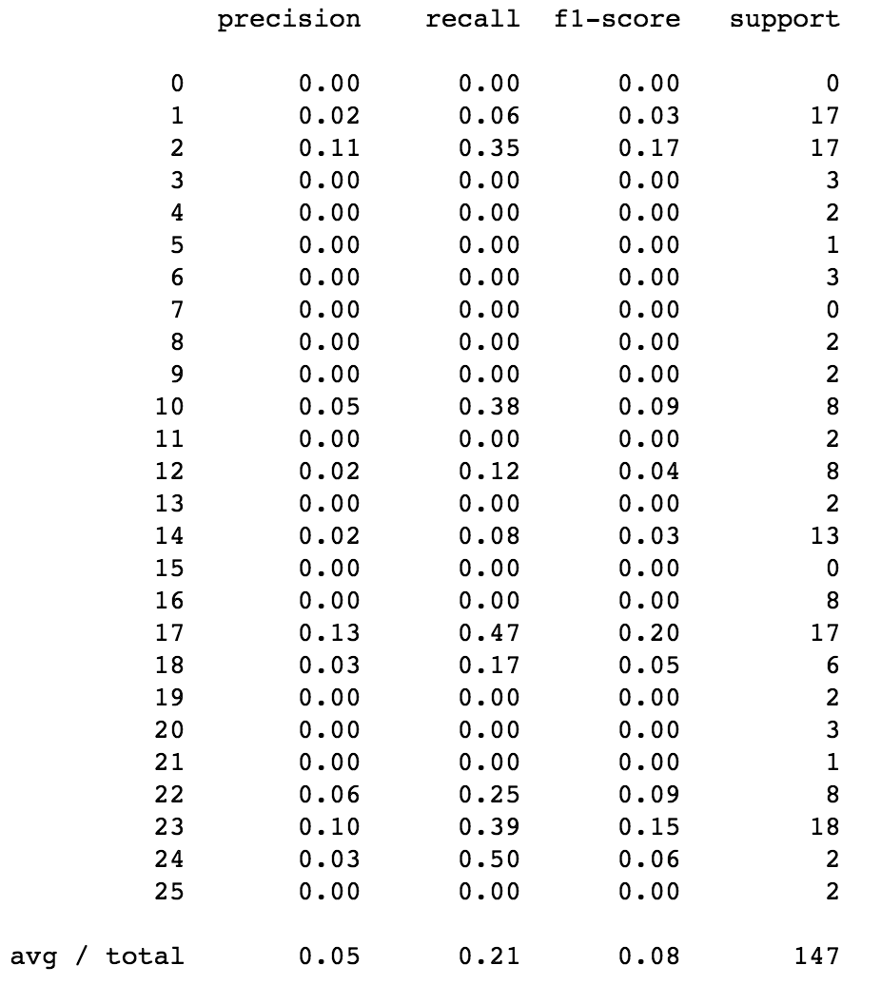
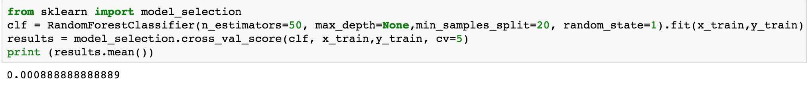
Classifier - Random Forest
Classification Report

Slide 8
CNN
Reduced image resolution to 128*128 from 256*256
Final Model:
3 Blocks of Convolution layers
No. of filters and kernel size varied from layer to layer
Padding -> Yes
Strides -> (1, 1)
Performed Grid Search to identify best values for:
Optimization algorithm
Learning rate
Activation function
Kernel Initializer
No. of layers
No. of Epochs
Batch Size

Slide 9
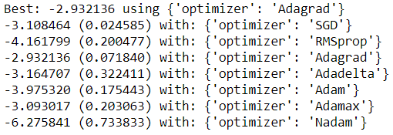
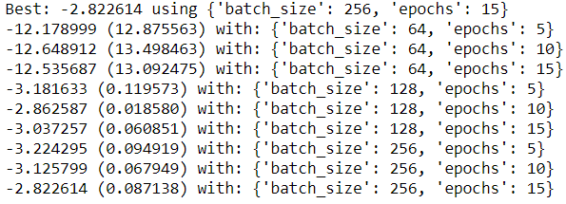

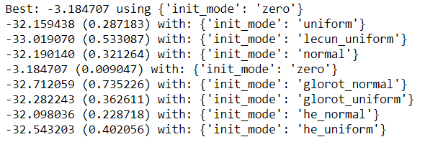
Parameter Tuning
Optimization Algorithm: Batch Size and Epochs
Learning rate: Kernel Initializer:

Slide 10
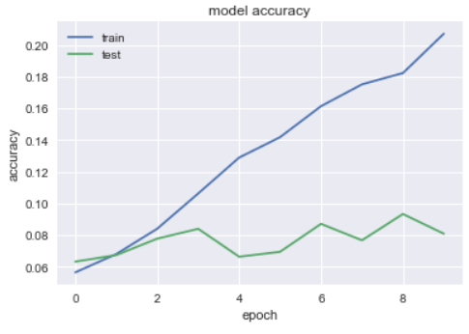
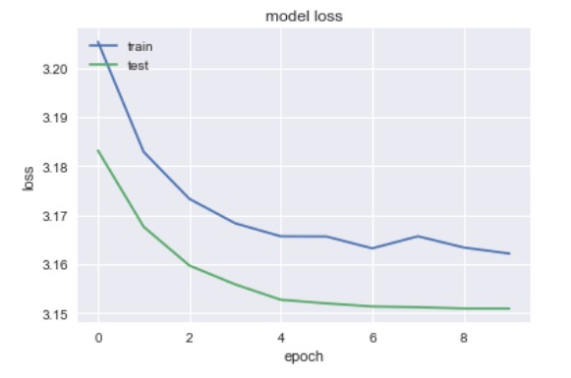
Best Model:
Model | Accuracy | Loss
Convolution layers - 1 | Training: 10.31% Testing: 6.12% | Training: 3.32 Testing: 3.35
Convolution layers - 2 | Training: 7.07% Testing: 7.75% | Training: 3.19 Testing: 3.19
Convolution layers - 3 | Training: 20.71% Testing: 8.08% | Training: 3.18 Testing: 3.18

Slide 11
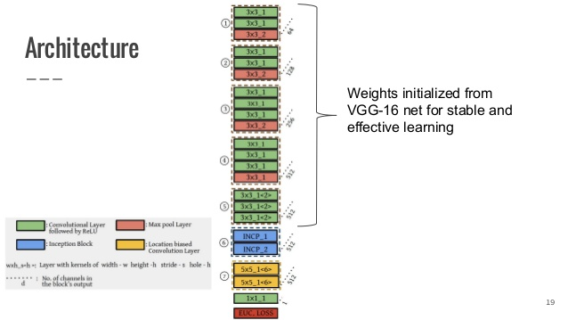
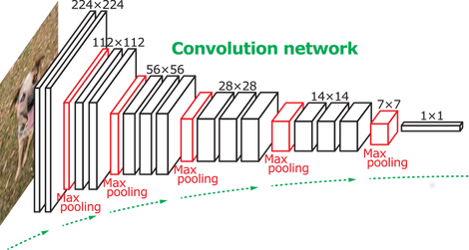
CNN - Transfer Learning
Transfer Learning Model - VGG16
Why Transfer Learning?
Not enough data to train
Best option - Feature extraction with pre-trained weights from beginning layers of net
Keras model of 16 layer network
3x3 convolution and 2x2 pooling are used throughout the whole network
VGG also shows that the depth of the network plays an important role. Deeper networks give better results
Contains around 160M parameters

Slide 12
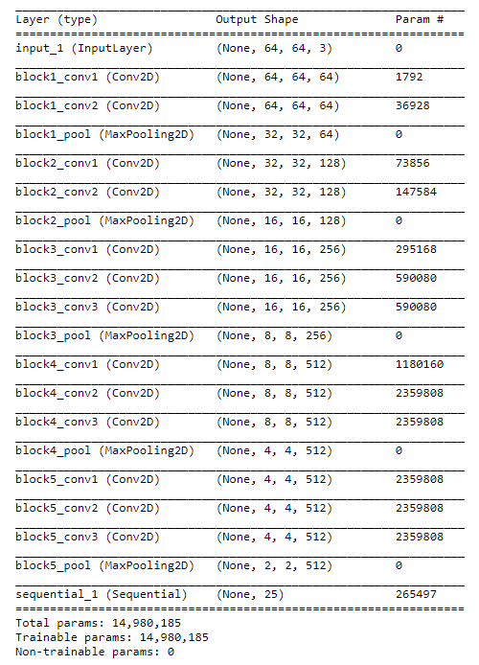
CNN - Transfer Learning
Base Model Summary:

Slide 13
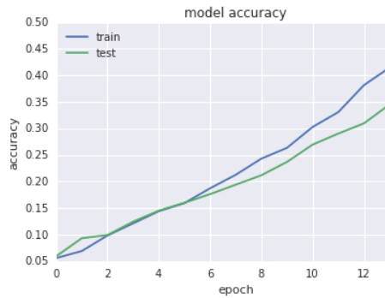
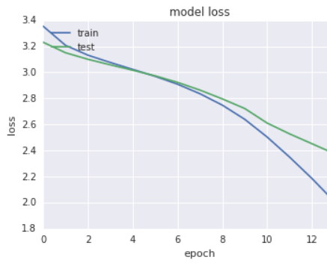
CNN - Transfer Learning
Model Performance:
Model | Accuracy | Loss
Convolution layers - 1 with SGD; Dense Layer size = 512 | Training: 20% Testing: 19% | Training: 2.74 Testing: 2.80
Convolution layers - 2 with SGD; Dense Layer size = 128 | Training: 45% Testing: 32% | Training: 1.78 Testing: 2.34
Convolution layers - 3 with SGD; Dense Layer size = 64 | Training: 47.49% Testing: 34.96% | Training: 1.83 Testing: 2.28

Slide 14
Challenges Faced
Computational capacity - GPU
Data reshaping to apply classifiers
For better computation we used Data Science platform provided by IBM and used Amazon S3 data storage to load the data
Unbalanced dataset
Even among a label, the image wasn’t same. It varied based on brand

Slide 15
Conclusion
The best model was obtained by leveraging Transfer Learning
Scope for improvement:
Pre-processing must be performed more efficiently
With a powerful GPU, can build an accurate model
Account for imbalance in labels

Slide 16
Reference
https://gist.github.com/baraldilorenzo/07d7802847aaad0a35d3
https://elitedatascience.com/keras-tutorial-deep-learning-in-python
https://blog.keras.io/building-powerful-image-classification-models-using-very-little-data.html
https://machinelearningmastery.com/improve-deep-learning-performance/
https://datascience.ibm.com/

