Slide 1
Report
of
Traineeship
Notes:
Hello, I will present my internship to you

Slide 2
SUMMARY
Presentation and History of the Company
Organization
Activities
Presentation of the service
Activities to practice during the course
Notes:
then

Slide 3

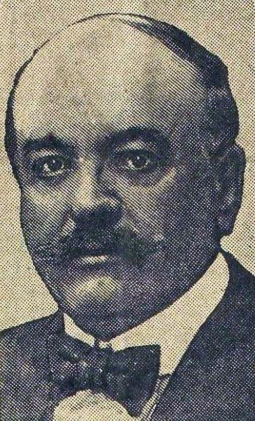
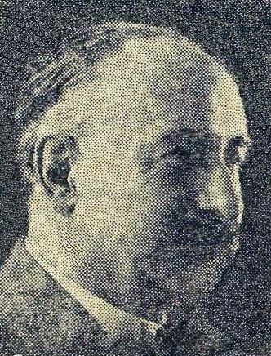
Presentation and History of the Company
Notes:
The Automobile Club de l'Ouest (ACO) is a French 1901 law association for the defense of road users, located in Le Mans. Founded in 1906 by pioneers in mutual insurance and auto insurance. It was designed to ensure the organization of the first Grand Prix of the Automobile Club de France (ACF) which took place in June 1906 on the Sarthe circuit created for the occasion. After a few years, several changes to the route and the regulations, the ACO created and organized the 24 Hours of Le Mans, the first edition of which took place in 1923. The company hired 189 employees.
In January 1906 the Automobile club de la Sarthe (ACS) was created, becoming shortly after the ACO. When it was created, Amédée Bollée and Baron Étienne van Zuylen van Nyevelt were appointed honorary presidents. While it only extended to the base over the city of Le Mans, with 97 members On several occasions the ACO was distinguished for its actions in favor of the defense of motorists. In 1917, Georges Durand created the Automobile and Sports Defense (DAS). Since 1965, it has included one of the most famous driving schools in France, Le Mans Driver. The Club is made up of around 80,000 members, and more than 5,000 licensees. The organization is a privileged interlocutor of the State in matters of road development and user safety. The managers were very involved in the road development of the Great West in the 1970s. The manager's headquarters are located in Le Mans, on the 24 Hours circuit. Today, 17 departments revolve around ACO.

Slide 4

Organization
Notes:
The organization of the company consists of 5 departments:
Human Resources Department: Manages social relations, manages human resources, promotes careers, recruits.
Purchasing Services: Help increase financial results, drive continuous improvement through supplier relationships, protect the business.
Commercial Services: Promotes the sale of the company's products and services.
IT Department (SERI): in charge of all IT, the circuit network and the head office
Marketing Department: responsible for boosting the brand's visibility and increasing sales

Slide 5
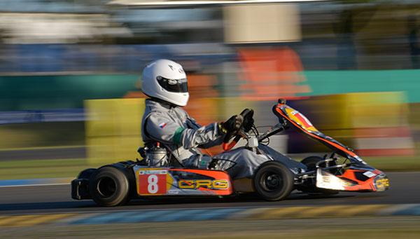

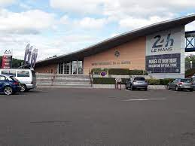
Activities
Notes:
The ACO is known the world over for the races it organizes. The most popular are the 24H (Cars, Motorcycles, Trucks, Kartings, Bicycles), Le Mans Classic and the French Moto Grand Prix. Otherwise the circuit is in operation all year round with licensees from the driving school who ride on the circuit.
There is also the 24H Museum which tells the story of the automobile in Sarthe and the success of its international event. And which also allows a visit to the 24H circuit.
And finally, it is possible to go Karting on the Alain Prost B circuit or the leisure circuit

Slide 6
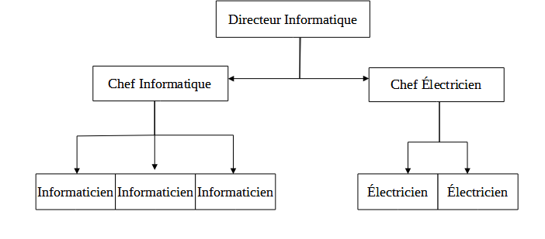
Presentation of the service
Notes:
The SERI (Computer and Network Electrical Service), located at the Technoparc Du Circuit Des 24 Heures, is the company's service which manages all electrical, network and computer matters. It is made up of 9 people:
The SERI has a fairly important activity within the company because it is she who will be called in case of failure of a computer device or when there is an electrical problem and it is also they who manage facilities during events such as the 24 hours of Le Mans

Slide 7
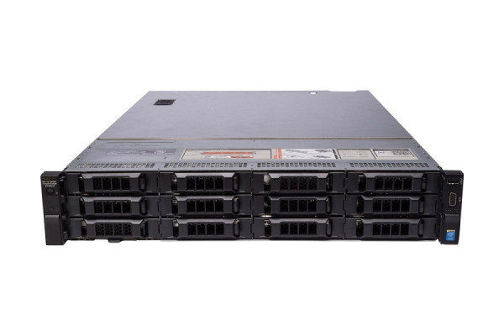

Activities practiced during the internship
Notes:
During my first week, I was shown how to configure a Huawei switch, I took apart a PC tower to clean it and change the hard drive and put in an SSD hard drive, then I did an installation of PC by MDT (Microsoft Deployment Toolkit). In short, MDT is Microsoft's deployment solution. It is based on the Microsoft ADK deployment kit. This solution automates the creation, maintenance and deployment of a custom operating system foundation.
During the second week, I configured a Huawei switch, I also assigned 182 emails for the company. Then we removed a server from a bay and then asked me to configure it to make it a backup server.
For this third week, I attended the preparation of the 24H motorcycles. for example, to install cash registers, run network cables for the TV channels, install telephones for the organizations that come to settle during the 24-hour motorcycle tour and install Wi-Fi in the stands. I witnessed a problem that arose the day before the 24 Hours Motorcycle Race, while the software used to manage the crash track lights was racing. SERI intervened to resolve the problem. During this resolution they found that the error was not coming from the PC but from the server that hosted the software so for a long time they had to switch between two servers for the software to work. Finally, thanks to an outside company, they were able to fix the problem.
During this fourth week, installed all anti-Covid checks on 42 Samsung Galaxy X Cover4 devices to be able to validate the health pass. Then towards the end of the week 21 switch Huawai arrived at the SERI. I was asked to unpack them.
At the start of the fifth week, I started configuring the 21 switches and adding them to the eSight

Slide 8
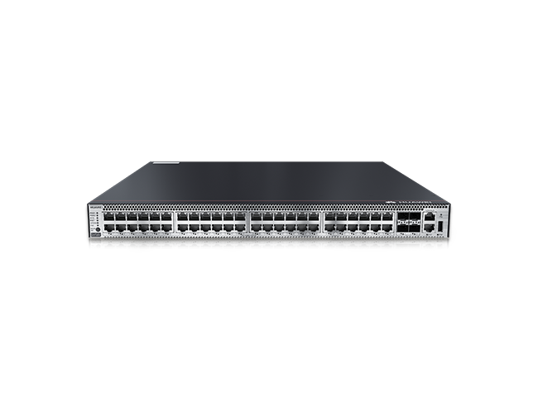
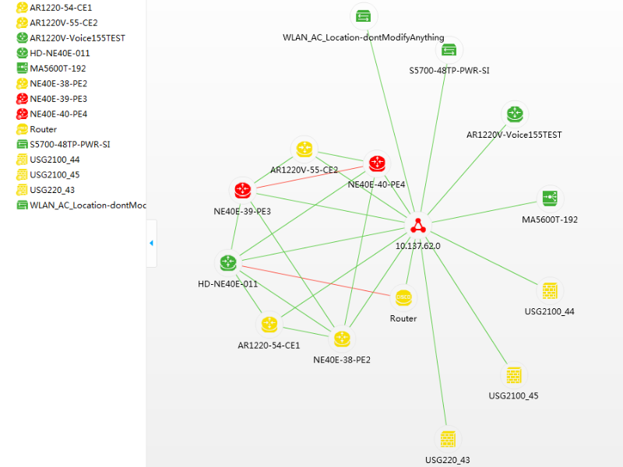
Notes:
To configure the 21 switches and add them to the eSight.
At first I had 21 switches to configure. There was 1 8-port switch, 6 24-port switches and 15 48-port switches. To configure the switches I would copy paste a note I had on my second screen and modify this note according to the number of pigs that had the switch and I changed the IP address. Then once the switches are configured, connect them to the network and try to ping them to see if they were properly configured. Once we were sure of their configuration, we had to add switches to the eSight. To add them on eSight start by going to the network device category. We click on add device, we enter the name of the switch as well as its IP address then we choose the loop in which we want to assign it. We then check the installed OS and patches to see if they are up to date. If they are not up to date we update the OS and the patch. I was able to successfully start eSight thanks to a colleague who supervised me and a PDF.
The purpose of adding the switches on the eSight site is to be able to see the topology of all the switches that are present on the company site. Here is an example of the topology we can have.

