Slide 1
Principal Component Analysis (PCA) for empirical covariances (Part I): application to neurons activity recordings
Analytical Connectionism 2025
Flavio Nicoletti, Chalmers University of Technology, PhD

Slide 2
Analytical Connectionism 2025
Learn the basic tools to perform PCA of empirical covariance matrices. In this tutorial: neuronal activity correlations.
In-class exercise: jupyter notebook tutorial (1 h).
The exercise and the methods discussed in this tutorial are based on the two following publications:
Peyrache, A., Khamassi, M., Benchenane, K. et al. Replay of rule-learning related neural patterns in the prefrontal cortex during sleep. Nat Neurosci 12, 919–926 (2009). https://doi.org/10.1038/nn.2337
Peyrache A, Benchenane K, Khamassi M, Wiener SI, Battaglia FP. Principal component analysis of ensemble recordings reveals cell assemblies at high temporal resolution. J Comput Neurosci. 2010 Aug;29(1-2):309-325. doi: 10.1007/s10827-009-0154-6. Epub 2009 Jun 16. PMID: 19529888; PMCID: PMC2940043.

Slide 3
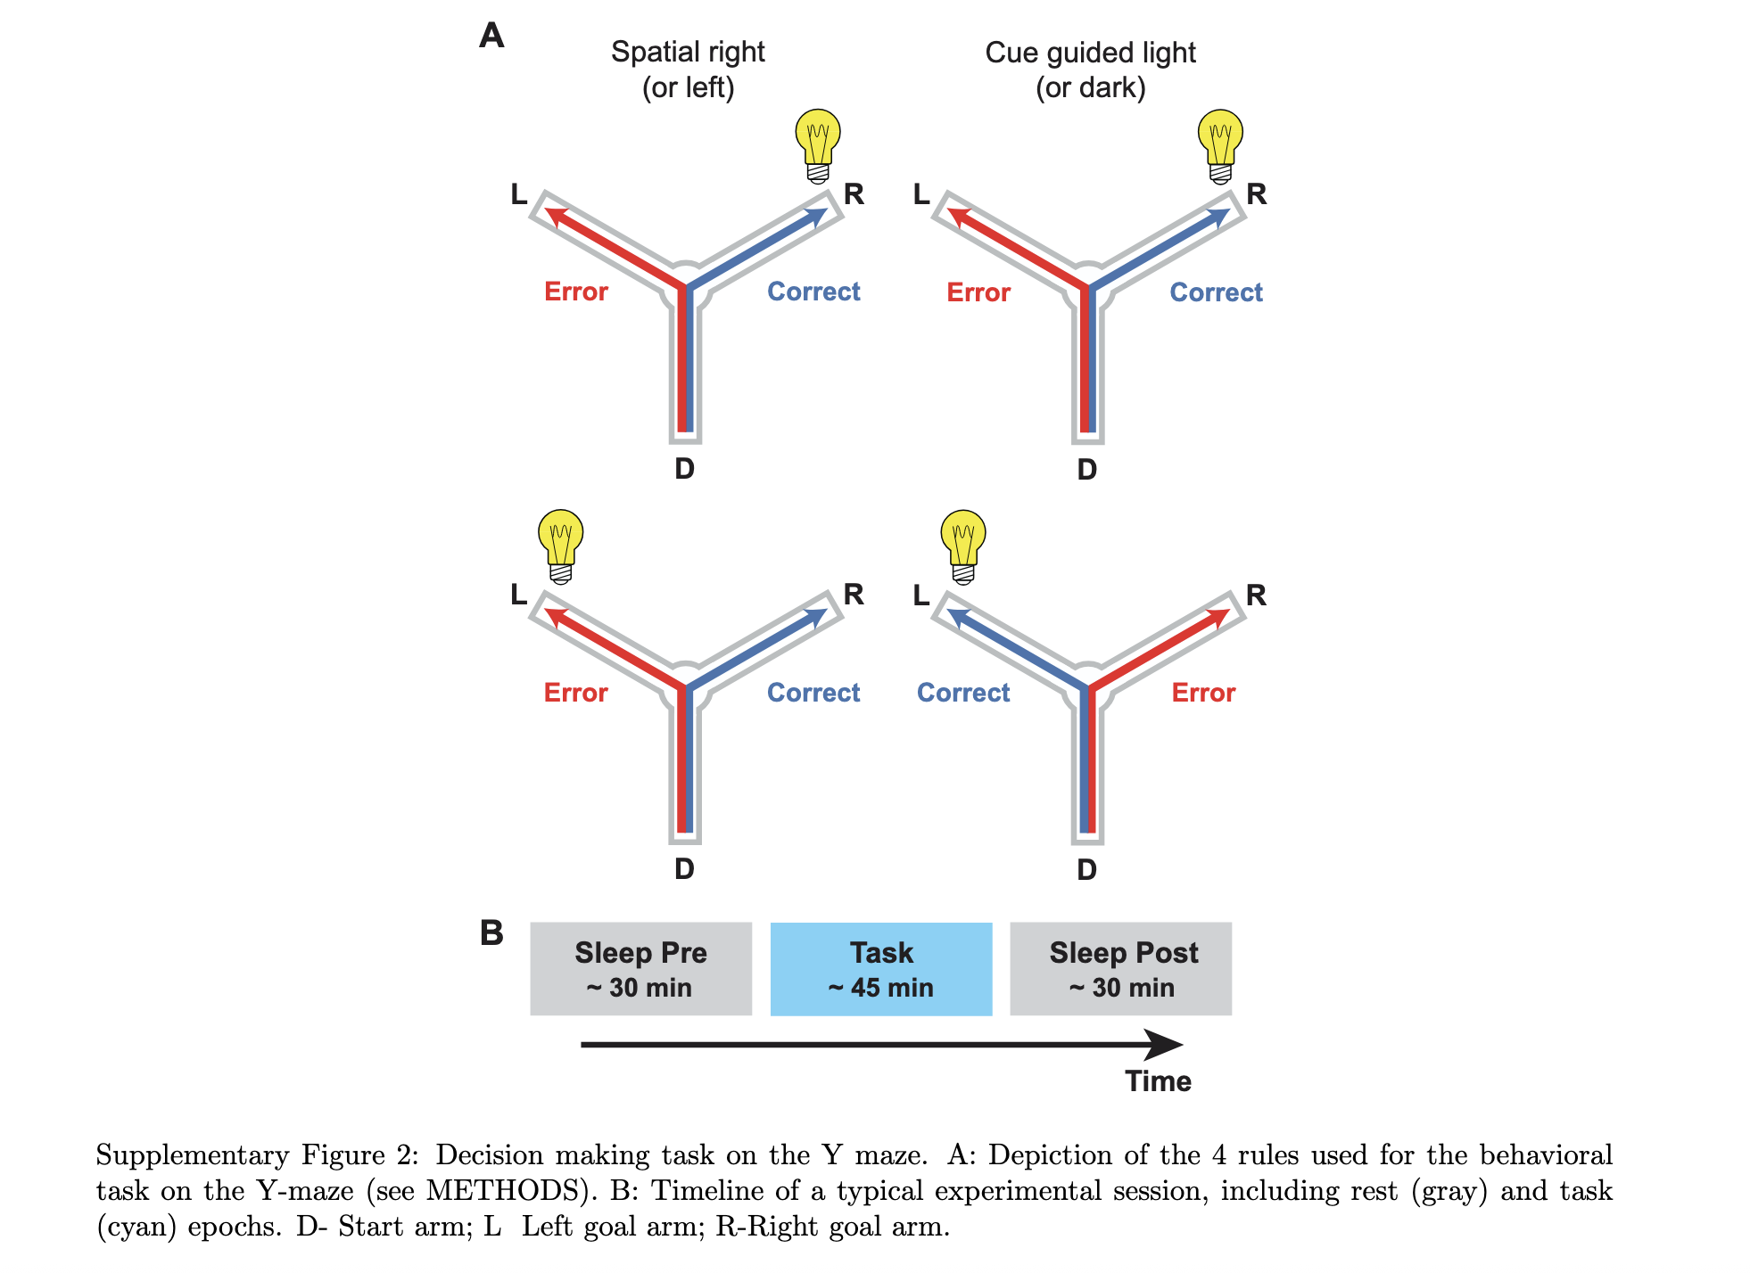
Peyrache, A., Khamassi, M., Benchenane, K. et al. Replay of rule-learning related neural patterns in the prefrontal cortex during sleep. Nat Neurosci 12, 919–926 (2009). https://doi.org/10.1038/nn.2337
Analytical Connectionism 2025

Slide 4
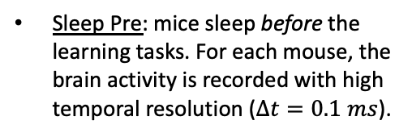
Peyrache, A., Khamassi, M., Benchenane, K. et al. Replay of rule-learning related neural patterns in the prefrontal cortex during sleep. Nat Neurosci 12, 919–926 (2009). https://doi.org/10.1038/nn.2337
Analytical Connectionism 2025

Slide 5
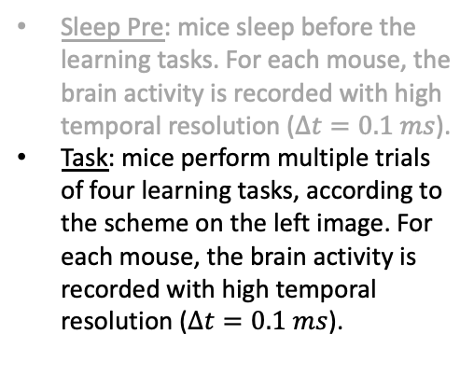
Peyrache, A., Khamassi, M., Benchenane, K. et al. Replay of rule-learning related neural patterns in the prefrontal cortex during sleep. Nat Neurosci 12, 919–926 (2009). https://doi.org/10.1038/nn.2337
Analytical Connectionism 2025

Slide 6
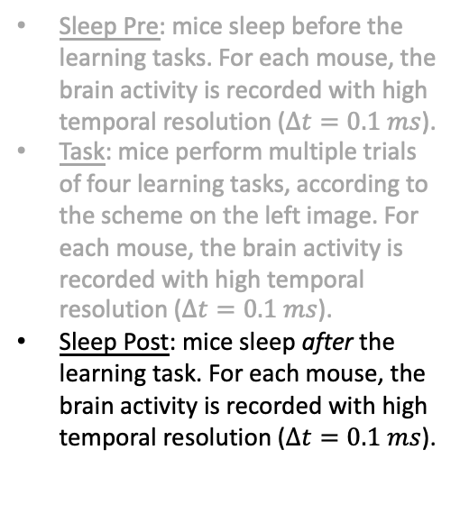
Peyrache, A., Khamassi, M., Benchenane, K. et al. Replay of rule-learning related neural patterns in the prefrontal cortex during sleep. Nat Neurosci 12, 919–926 (2009). https://doi.org/10.1038/nn.2337
Analytical Connectionism 2025

Slide 7
Peyrache, A., Khamassi, M., Benchenane, K. et al. Replay of rule-learning related neural patterns in the prefrontal cortex during sleep. Nat Neurosci 12, 919–926 (2009). https://doi.org/10.1038/nn.2337
Analytical Connectionism 2025
Goal: study the Replay of neural activity patterns during the post-task sleep, use pre-task sleep as a control.

Slide 8
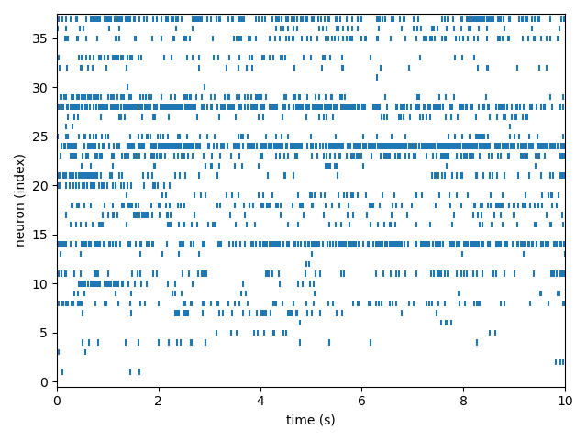
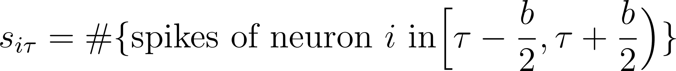
Peyrache A, Benchenane K, Khamassi M, Wiener SI, Battaglia FP. Principal component analysis of ensemble recordings reveals cell assemblies at high temporal resolution. J Comput Neurosci. 2010 Aug;29(1-2):309-325. doi: 10.1007/s10827-009-0154-6. Epub 2009 Jun 16. PMID: 19529888; PMCID: PMC2940043.
Analytical Connectionism 2025
Activity matrix:

Slide 9
Peyrache A, Benchenane K, Khamassi M, Wiener SI, Battaglia FP. Principal component analysis of ensemble recordings reveals cell assemblies at high temporal resolution. J Comput Neurosci. 2010 Aug;29(1-2):309-325. doi: 10.1007/s10827-009-0154-6. Epub 2009 Jun 16. PMID: 19529888; PMCID: PMC2940043.
Analytical Connectionism 2025
Analytical Connectionism 2025
Activity matrix:

Slide 10
Peyrache A, Benchenane K, Khamassi M, Wiener SI, Battaglia FP. Principal component analysis of ensemble recordings reveals cell assemblies at high temporal resolution. J Comput Neurosci. 2010 Aug;29(1-2):309-325. doi: 10.1007/s10827-009-0154-6. Epub 2009 Jun 16. PMID: 19529888; PMCID: PMC2940043.
Analytical Connectionism 2025
Analytical Connectionism 2025
Activity matrix:
b

Slide 11
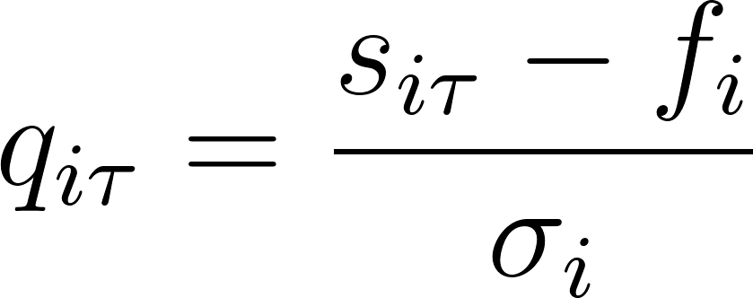
Peyrache A, Benchenane K, Khamassi M, Wiener SI, Battaglia FP. Principal component analysis of ensemble recordings reveals cell assemblies at high temporal resolution. J Comput Neurosci. 2010 Aug;29(1-2):309-325. doi: 10.1007/s10827-009-0154-6. Epub 2009 Jun 16. PMID: 19529888; PMCID: PMC2940043.
Analytical Connectionism 2025
z-Score Activity matrix:
Centered variables! Null model: independent activitations

Slide 12
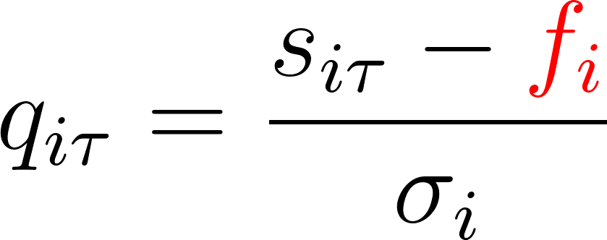
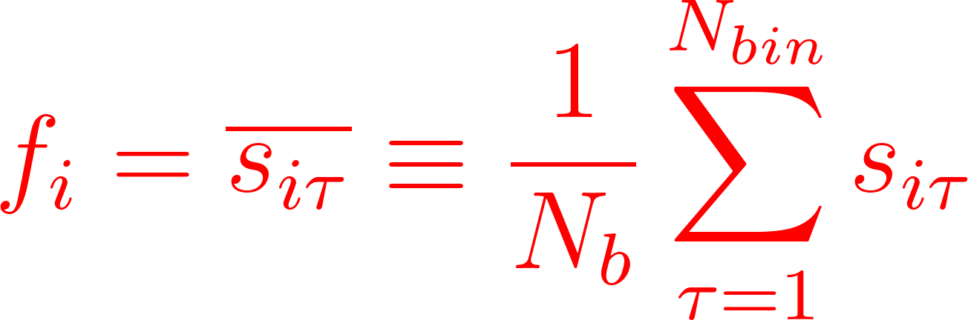
Peyrache A, Benchenane K, Khamassi M, Wiener SI, Battaglia FP. Principal component analysis of ensemble recordings reveals cell assemblies at high temporal resolution. J Comput Neurosci. 2010 Aug;29(1-2):309-325. doi: 10.1007/s10827-009-0154-6. Epub 2009 Jun 16. PMID: 19529888; PMCID: PMC2940043.
Analytical Connectionism 2025
z-Score Activity matrix:

Slide 13
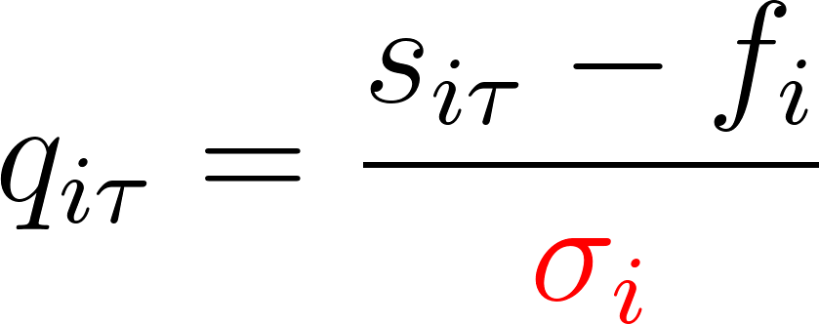
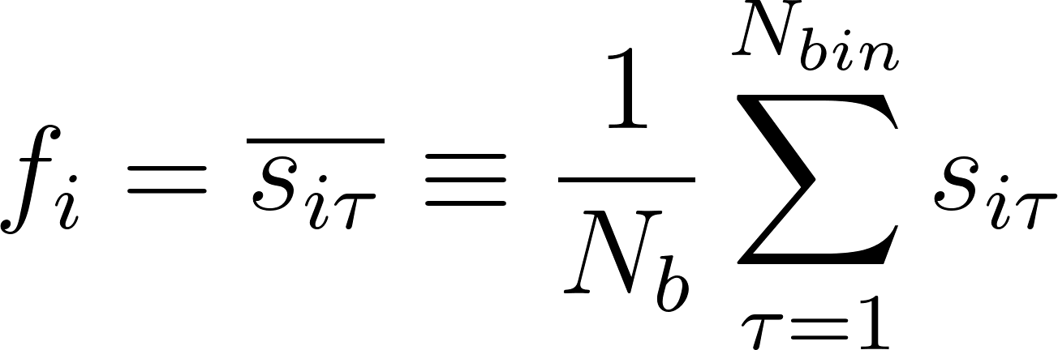
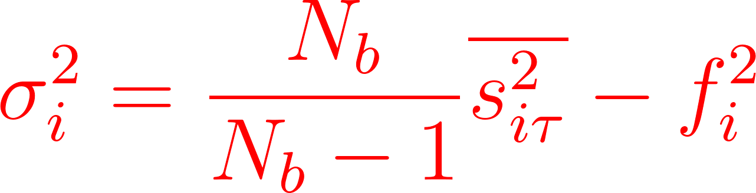
Peyrache A, Benchenane K, Khamassi M, Wiener SI, Battaglia FP. Principal component analysis of ensemble recordings reveals cell assemblies at high temporal resolution. J Comput Neurosci. 2010 Aug;29(1-2):309-325. doi: 10.1007/s10827-009-0154-6. Epub 2009 Jun 16. PMID: 19529888; PMCID: PMC2940043.
Analytical Connectionism 2025
z-Score Activity matrix:

Slide 14
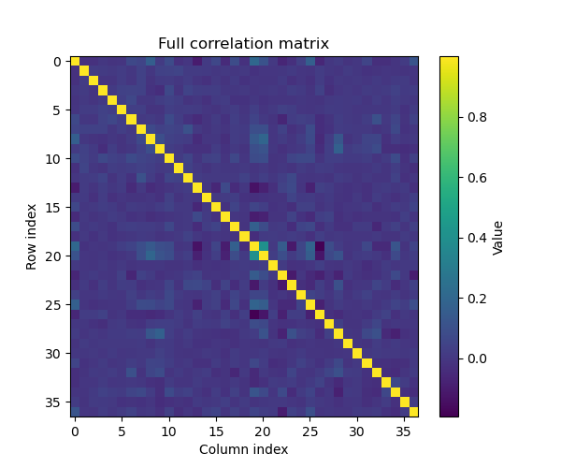
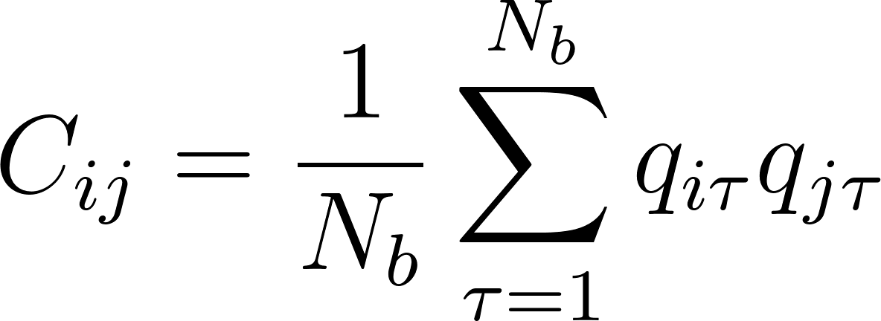
Peyrache A, Benchenane K, Khamassi M, Wiener SI, Battaglia FP. Principal component analysis of ensemble recordings reveals cell assemblies at high temporal resolution. J Comput Neurosci. 2010 Aug;29(1-2):309-325. doi: 10.1007/s10827-009-0154-6. Epub 2009 Jun 16. PMID: 19529888; PMCID: PMC2940043.
Analytical Connectionism 2025
z-Score activity covariance:
where N_b is the number of bins.

Slide 15
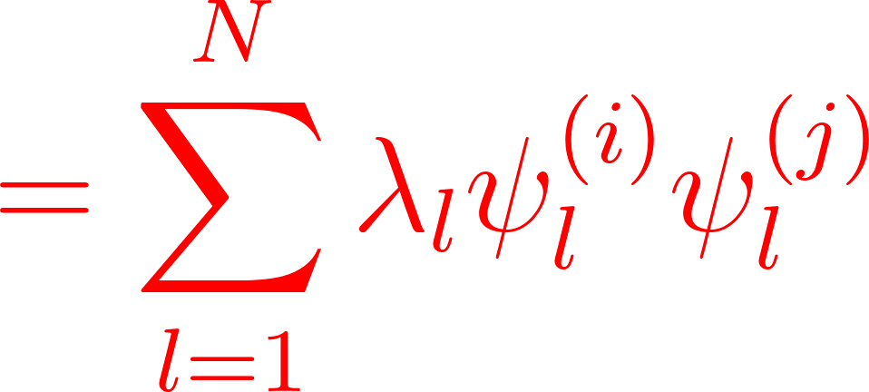
Peyrache A, Benchenane K, Khamassi M, Wiener SI, Battaglia FP. Principal component analysis of ensemble recordings reveals cell assemblies at high temporal resolution. J Comput Neurosci. 2010 Aug;29(1-2):309-325. doi: 10.1007/s10827-009-0154-6. Epub 2009 Jun 16. PMID: 19529888; PMCID: PMC2940043.
Analytical Connectionism 2025
Spectral Decomposition:

Slide 16
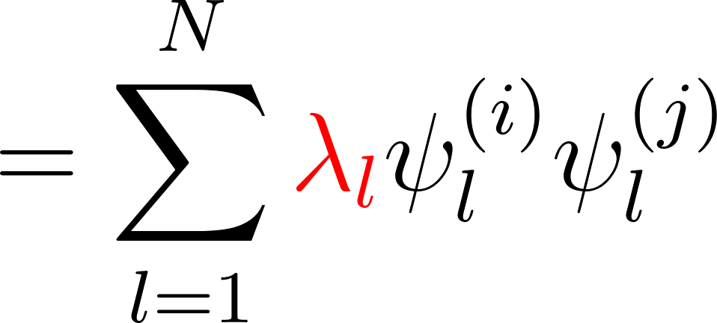

Peyrache A, Benchenane K, Khamassi M, Wiener SI, Battaglia FP. Principal component analysis of ensemble recordings reveals cell assemblies at high temporal resolution. J Comput Neurosci. 2010 Aug;29(1-2):309-325. doi: 10.1007/s10827-009-0154-6. Epub 2009 Jun 16. PMID: 19529888; PMCID: PMC2940043.
Analytical Connectionism 2025
Spectral Decomposition:
where

Slide 17
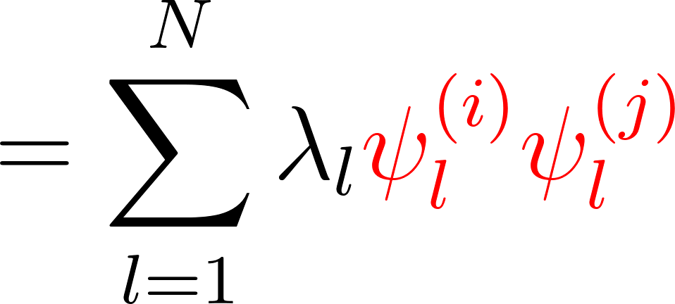


Peyrache A, Benchenane K, Khamassi M, Wiener SI, Battaglia FP. Principal component analysis of ensemble recordings reveals cell assemblies at high temporal resolution. J Comput Neurosci. 2010 Aug;29(1-2):309-325. doi: 10.1007/s10827-009-0154-6. Epub 2009 Jun 16. PMID: 19529888; PMCID: PMC2940043.
Analytical Connectionism 2025
Spectral Decomposition:
where

Slide 18
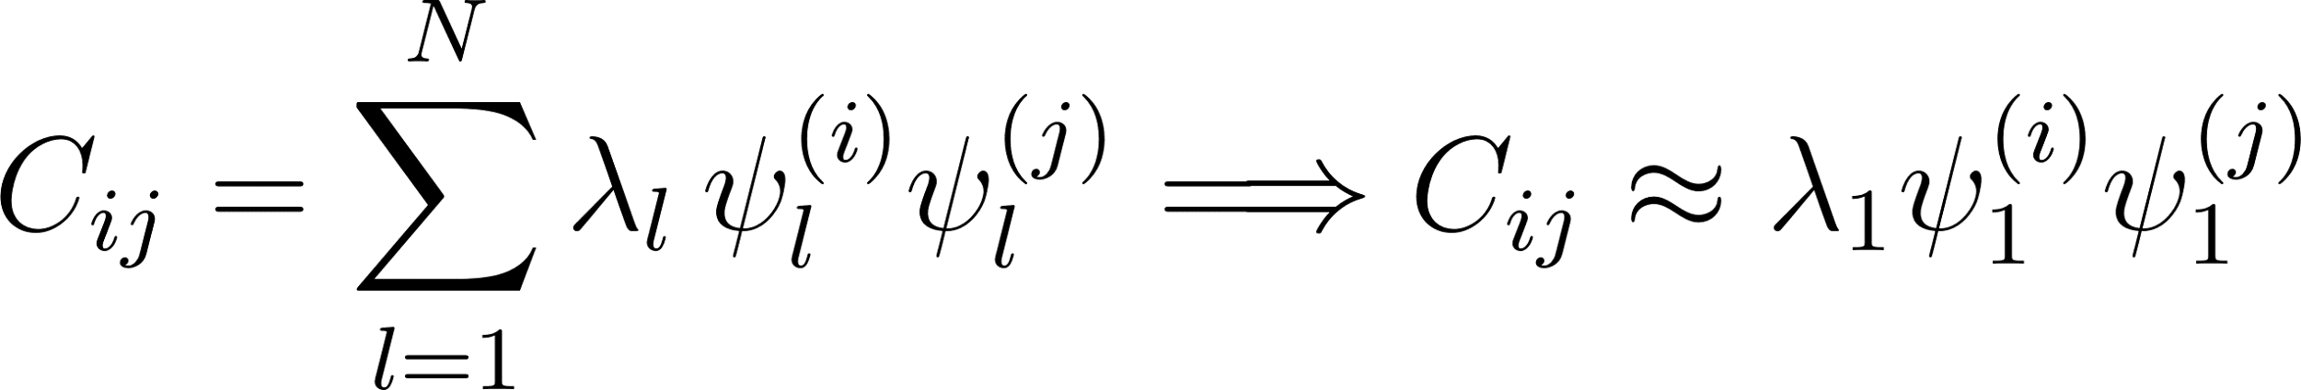
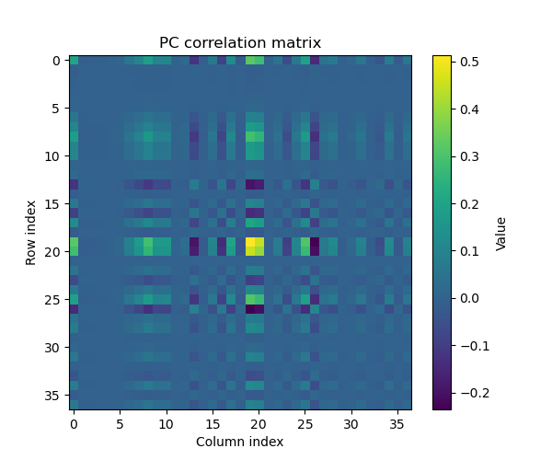
Peyrache A, Benchenane K, Khamassi M, Wiener SI, Battaglia FP. Principal component analysis of ensemble recordings reveals cell assemblies at high temporal resolution. J Comput Neurosci. 2010 Aug;29(1-2):309-325. doi: 10.1007/s10827-009-0154-6. Epub 2009 Jun 16. PMID: 19529888; PMCID: PMC2940043.
Analytical Connectionism 2025

Slide 19
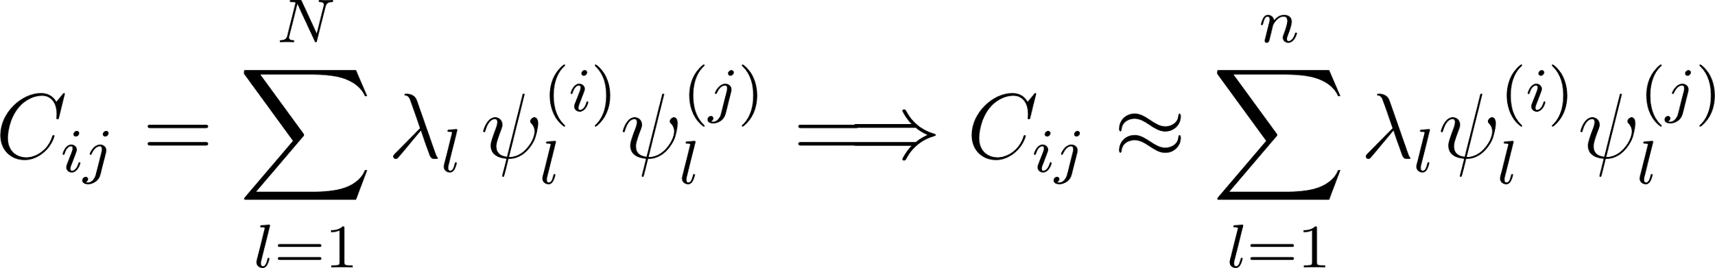
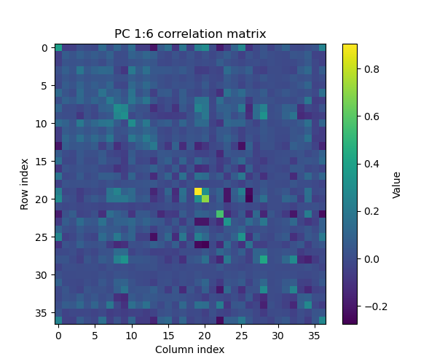
Peyrache A, Benchenane K, Khamassi M, Wiener SI, Battaglia FP. Principal component analysis of ensemble recordings reveals cell assemblies at high temporal resolution. J Comput Neurosci. 2010 Aug;29(1-2):309-325. doi: 10.1007/s10827-009-0154-6. Epub 2009 Jun 16. PMID: 19529888; PMCID: PMC2940043.
Analytical Connectionism 2025

Slide 20
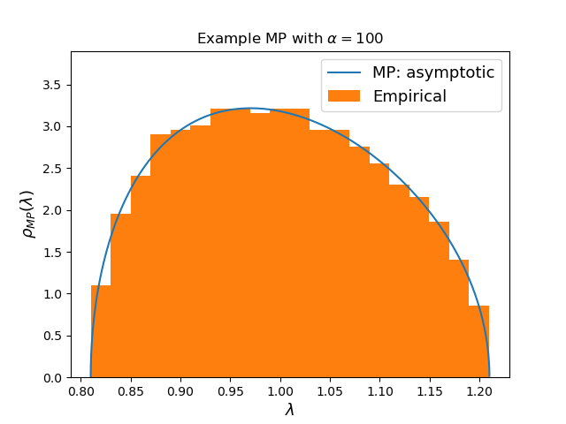
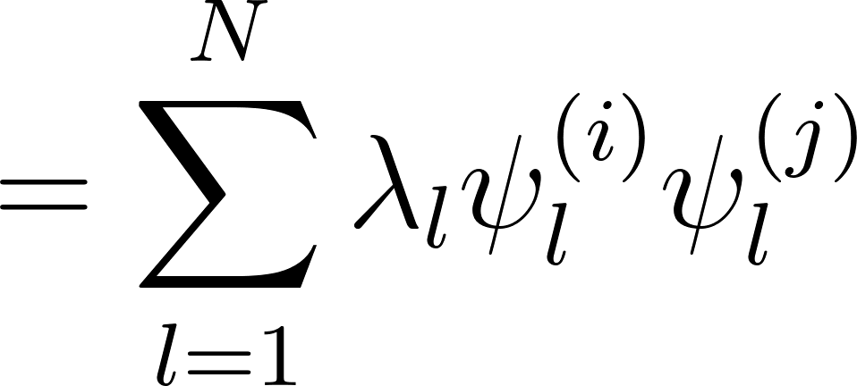
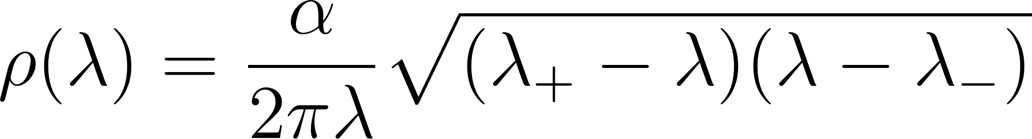
Peyrache A, Benchenane K, Khamassi M, Wiener SI, Battaglia FP. Principal component analysis of ensemble recordings reveals cell assemblies at high temporal resolution. J Comput Neurosci. 2010 Aug;29(1-2):309-325. doi: 10.1007/s10827-009-0154-6. Epub 2009 Jun 16. PMID: 19529888; PMCID: PMC2940043.
Analytical Connectionism 2025
Spectral Decomposition:
Null model: independent activations —> Wishart matrix
—> (asymptotic large matrix) Marchenko-Pastur pdf of eigenvalues (Tutorial Part II):

Slide 21
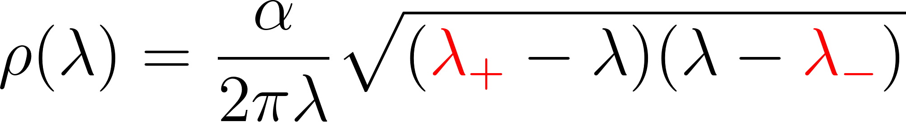
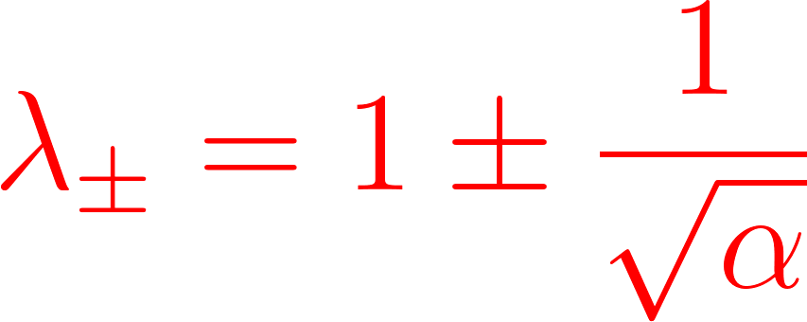
Peyrache A, Benchenane K, Khamassi M, Wiener SI, Battaglia FP. Principal component analysis of ensemble recordings reveals cell assemblies at high temporal resolution. J Comput Neurosci. 2010 Aug;29(1-2):309-325. doi: 10.1007/s10827-009-0154-6. Epub 2009 Jun 16. PMID: 19529888; PMCID: PMC2940043.
Analytical Connectionism 2025
Spectral Decomposition:
Marchenko-Pastur (iid activations):

Slide 22
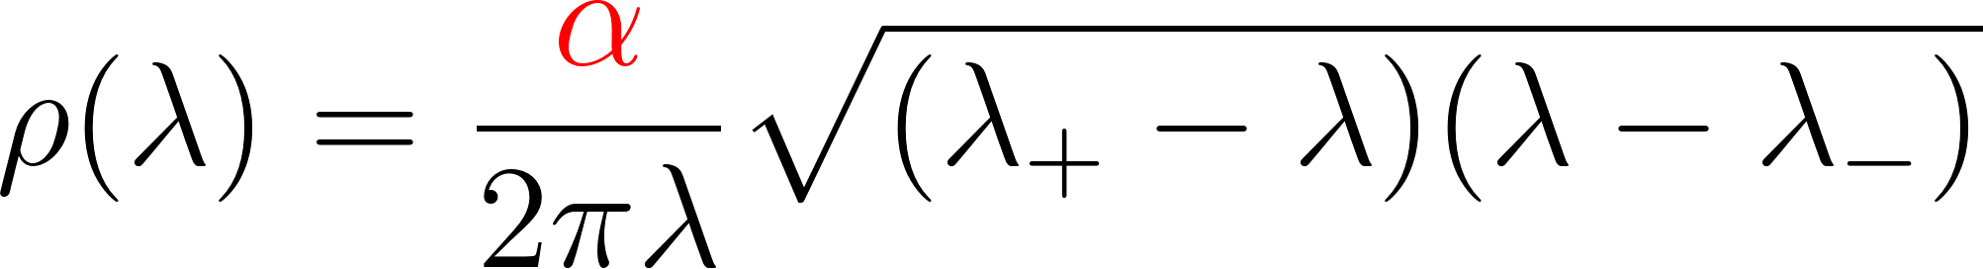
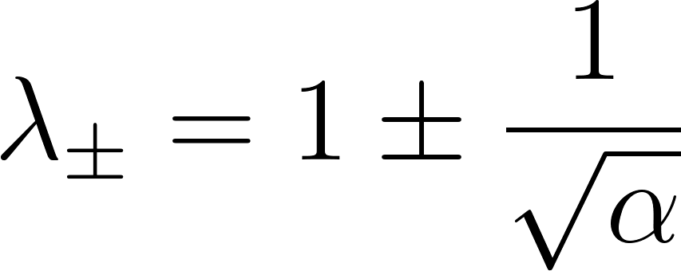
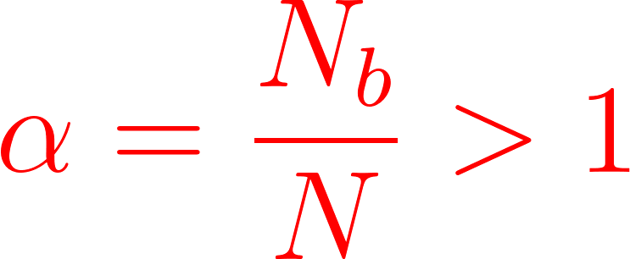
Peyrache A, Benchenane K, Khamassi M, Wiener SI, Battaglia FP. Principal component analysis of ensemble recordings reveals cell assemblies at high temporal resolution. J Comput Neurosci. 2010 Aug;29(1-2):309-325. doi: 10.1007/s10827-009-0154-6. Epub 2009 Jun 16. PMID: 19529888; PMCID: PMC2940043.
Analytical Connectionism 2025
Spectral Decomposition:
Marchenko-Pastur (iid activations):

Slide 23
Peyrache A, Benchenane K, Khamassi M, Wiener SI, Battaglia FP. Principal component analysis of ensemble recordings reveals cell assemblies at high temporal resolution. J Comput Neurosci. 2010 Aug;29(1-2):309-325. doi: 10.1007/s10827-009-0154-6. Epub 2009 Jun 16. PMID: 19529888; PMCID: PMC2940043.
Analytical Connectionism 2025
Replay of activations (intermediate passages: blackboard):

Slide 24
Peyrache A, Benchenane K, Khamassi M, Wiener SI, Battaglia FP. Principal component analysis of ensemble recordings reveals cell assemblies at high temporal resolution. J Comput Neurosci. 2010 Aug;29(1-2):309-325. doi: 10.1007/s10827-009-0154-6. Epub 2009 Jun 16. PMID: 19529888; PMCID: PMC2940043.
Analytical Connectionism 2025
Replay of activations (intermediate passages: blackboard):

Slide 25
Peyrache A, Benchenane K, Khamassi M, Wiener SI, Battaglia FP. Principal component analysis of ensemble recordings reveals cell assemblies at high temporal resolution. J Comput Neurosci. 2010 Aug;29(1-2):309-325. doi: 10.1007/s10827-009-0154-6. Epub 2009 Jun 16. PMID: 19529888; PMCID: PMC2940043.
Analytical Connectionism 2025
Replay of activations (intermediate passages: blackboard):

Slide 26

Peyrache A, Benchenane K, Khamassi M, Wiener SI, Battaglia FP. Principal component analysis of ensemble recordings reveals cell assemblies at high temporal resolution. J Comput Neurosci. 2010 Aug;29(1-2):309-325. doi: 10.1007/s10827-009-0154-6. Epub 2009 Jun 16. PMID: 19529888; PMCID: PMC2940043.
Analytical Connectionism 2025
Replay of activations (intermediate passages: blackboard):
M is a measure of similarity between correlation matrices! Compare with , the pre-task sleep epoch correlation matrix.

Slide 27

Peyrache A, Benchenane K, Khamassi M, Wiener SI, Battaglia FP. Principal component analysis of ensemble recordings reveals cell assemblies at high temporal resolution. J Comput Neurosci. 2010 Aug;29(1-2):309-325. doi: 10.1007/s10827-009-0154-6. Epub 2009 Jun 16. PMID: 19529888; PMCID: PMC2940043.
Analytical Connectionism 2025
Replay of activations (intermediate passages: blackboard): spectral decomposition

Slide 28

Peyrache A, Benchenane K, Khamassi M, Wiener SI, Battaglia FP. Principal component analysis of ensemble recordings reveals cell assemblies at high temporal resolution. J Comput Neurosci. 2010 Aug;29(1-2):309-325. doi: 10.1007/s10827-009-0154-6. Epub 2009 Jun 16. PMID: 19529888; PMCID: PMC2940043.
Analytical Connectionism 2025
Replay of activations (intermediate passages: blackboard): spectral decomposition

Slide 29

Peyrache A, Benchenane K, Khamassi M, Wiener SI, Battaglia FP. Principal component analysis of ensemble recordings reveals cell assemblies at high temporal resolution. J Comput Neurosci. 2010 Aug;29(1-2):309-325. doi: 10.1007/s10827-009-0154-6. Epub 2009 Jun 16. PMID: 19529888; PMCID: PMC2940043.
Analytical Connectionism 2025
Replay of activations (intermediate passages: blackboard): spectral decomposition

Slide 30

Analytical Connectionism 2025
Exercise starts now! Link: https://github.com/FlavioNicoletti/Tutorial_Signal_Retrieval/tree/main/notebooks Recap of useful formula: on the blackboard.
End of Part I of the Tutorial: Thank You for your attention!

