Slide 1

CHIP-SEQ DATA ANALYSIS OF HNFB1
TRANSCRIPTION FACTOR
Università degli Studi di Milano
Bioinformatics for Computational Genomics
Flavio Passante

Slide 2
OVERVIEW
Introduction
Pre-processing
Visualization
Post-processing
Conclusions

Slide 3
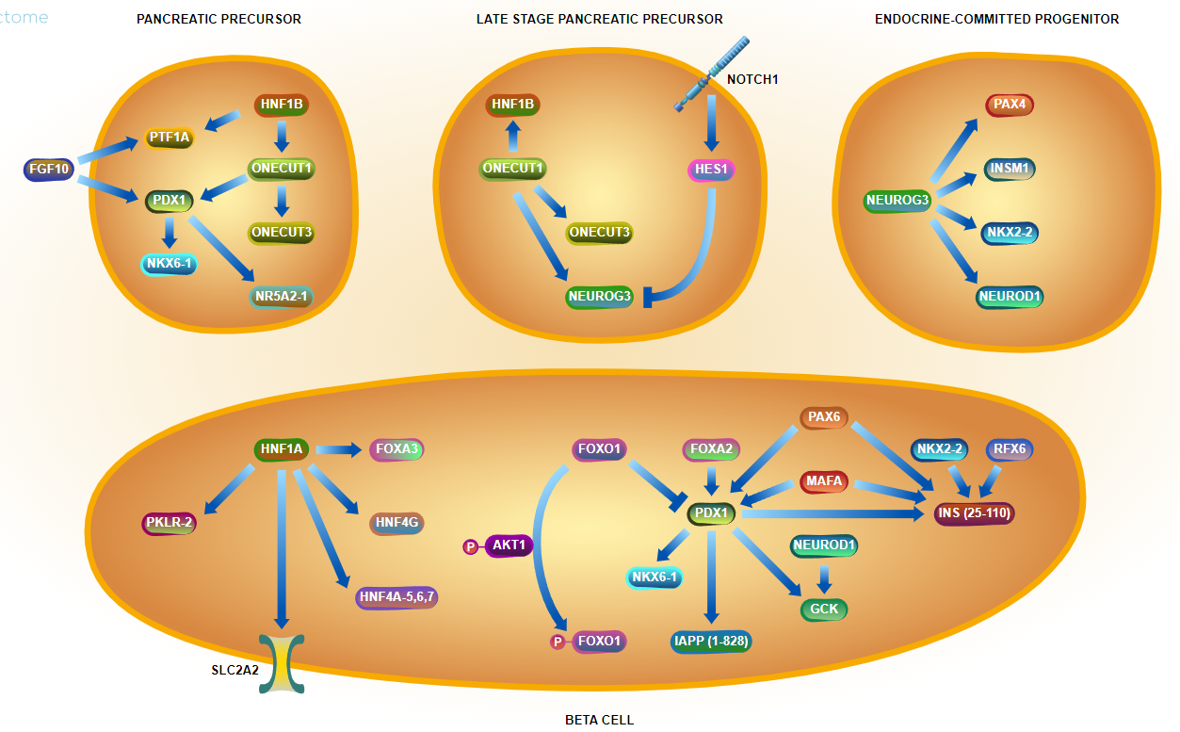
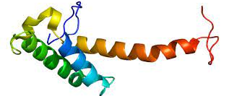
HNF1 HOMEOBOX B
EXPERIMENTAL MODEL
Source: ENCODE encyclopedia
Methods: Chip-Seq
Biosample: Homo sapiens hepg2 genetically modified using crispr
Target: HNF1B
HNF1B encodes hepatocyte nuclear factor 1-beta, a protein of the homeobox helix-turn-helix family. Homeoboxes are DNA sequence found within genes involved in regulation of patterns of anatomical development.
Known also as TCF2, HNF1B it’s a member of homedomain-containing superfamily transcription factors. Early expression of HNF1B is seen in kidney, liver, thymus pancreas and lung. It can act either as a homodimer or as a heterodimer with HNF1A.
The gene has been shown to function in nephron development, and regulates development of the embryonic pancreas.
Mutations in this gene result in renal cysts and diabetes syndrome and noninsulin-dependent diabetes mellitus, and expression of this gene is altered in some types of cancer.

Slide 4
Part 2 – Pre-processing
Sample | Number of mapped reads | % of Mapped reads | Estimated Fragment Size | % of Uniquely mapping reads (Filtered vs Unfiltered) | Redundant Rate
Unfiltered Replicate 1 | ~ 55M (SE100pb) | 95,39% | 180 | 68,21% | 21%
Unfiltered Replicate 2 | ~ 46M (SE100pb) | 95,23% | 167 | 71,25% | 17%
Unfiltered Control | ~39M | 66,08% | - | 58,20% | 15%
Filtered Control | ~23M | 100% | - | - | -
Filtered Replicate 1 (by MACS2) | ~37M (SE100bp) | 100% | 190 | - | 0,00
Filtered Replicate 2 (by MACS2) | ~33M (SE100pb) | 100% | 179 | - | 0,00
This quality control part has been computed with samtools flagstat and macs2 callpeak commands.

Slide 5
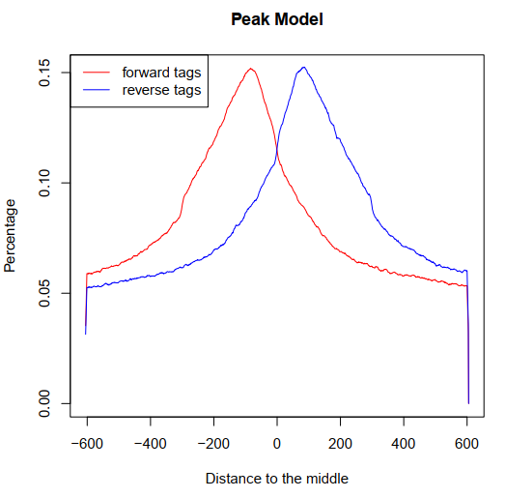
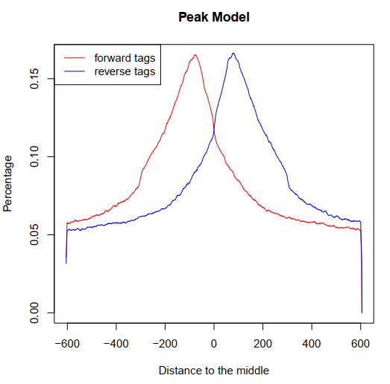
Part 2.1 – Pre-processing
Replicate 1 fragment size estimation plot
Replicate 2 fragment size estimation plot

Slide 6
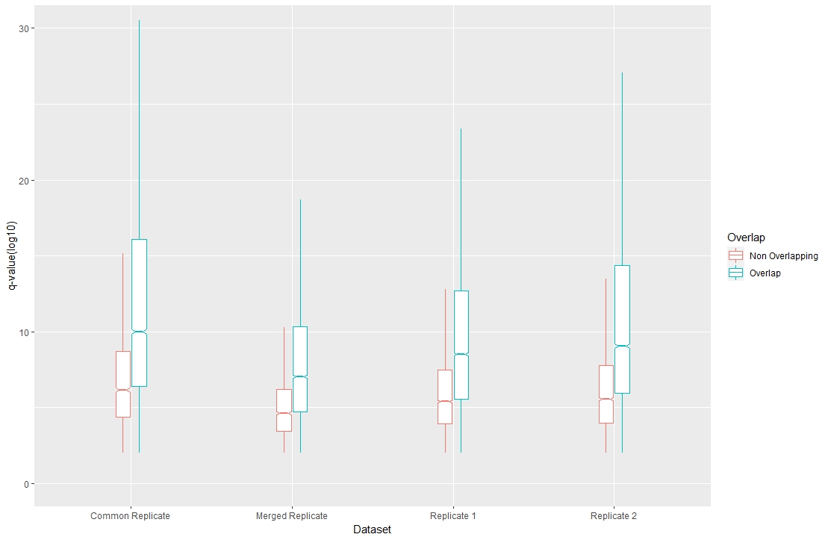
Part 2.2 – Pre-processing
Input Files | Peaks Number | Peaks Number without peaks in blacklist | Peaks in Common with ENCODE | Percentage of Similarity with ENCODE
Rep1 | 17727 | 17183 | 11402 | 66,35%
Rep2 | 12984 | 12919 | 9469 | 73,27%
Merged (Rep1 + Rep) | - | 9863 | 7883 | 79,92%
Common (Rep1 + Rep2) | - | 8821 | 7289 | 82,63%
IDR tresholded peaks | - | 7972 | 6751 | 85,07%
Plot on the left shows the q-value distribution of peaks both overlapping and non-overlapping with those of ENCODE. As it can be seen, non-overlapping peaks have generally lower q-values for each comparison with respect to overlapping one.
Chip-Seq Processing: IDR
Re-running Macs2 with less stringent criteria (q-value = 0.05) and with the IDR treshold of 0.2, a total of 7972 peaks were obtained. Of these, 6782 (percentage of 85.07%) peaks did overlap with ENCODE optimal peaks.

Slide 7
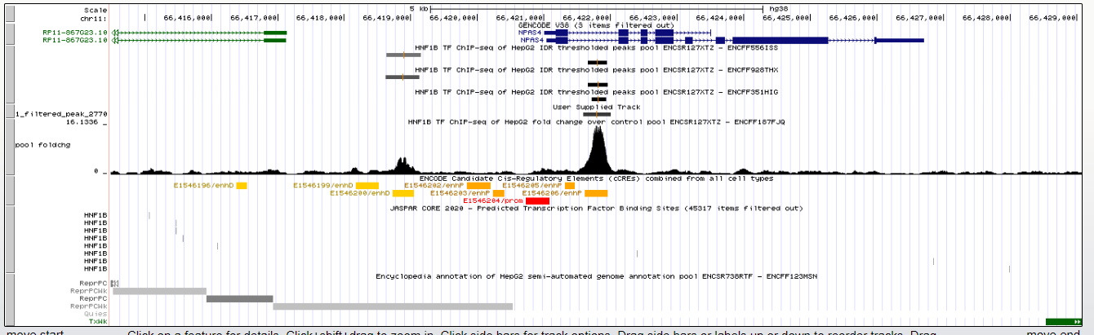
Part 3 – Visualization
Most enriched Peak present in both data and ENCODE.
Promoter
Primal Enhancer
Weak Enhancer

Slide 8
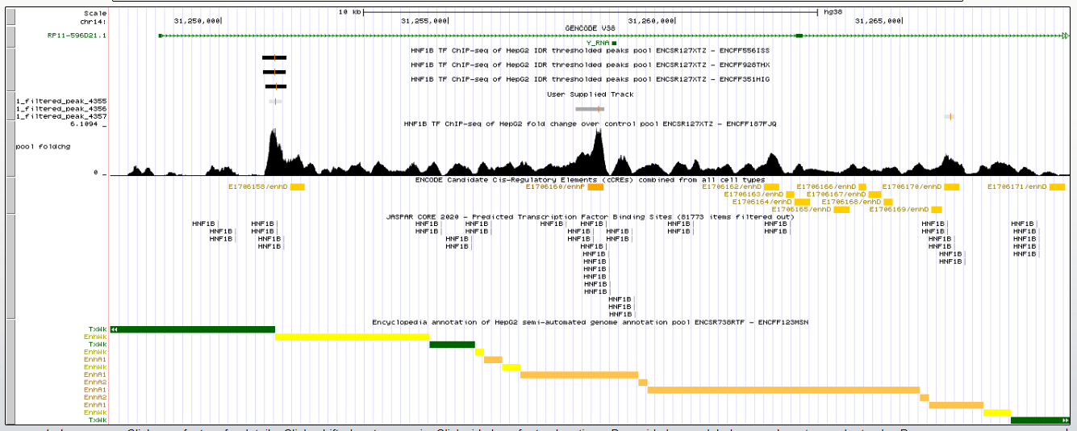
Part 3.1 – Visualization
Most enriched Peak present only in data and not in ENCODE.
Promoter
Primal Enhancer
Weak Enhancer

Slide 9
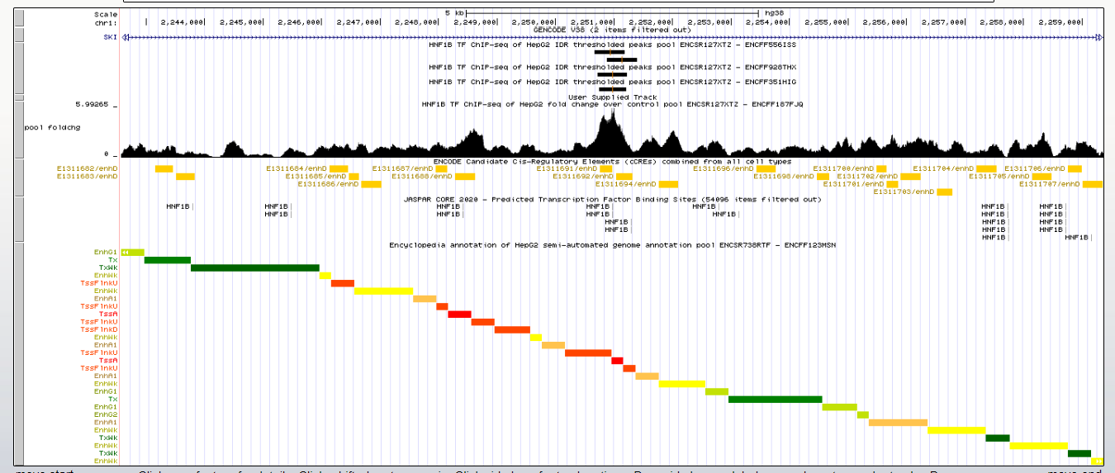
Part 3.2 – Visualization
Most enriched Peak present in ENCODE but not in data.
Promoter
Primal Enhancer
Weak Enhancer

Slide 10
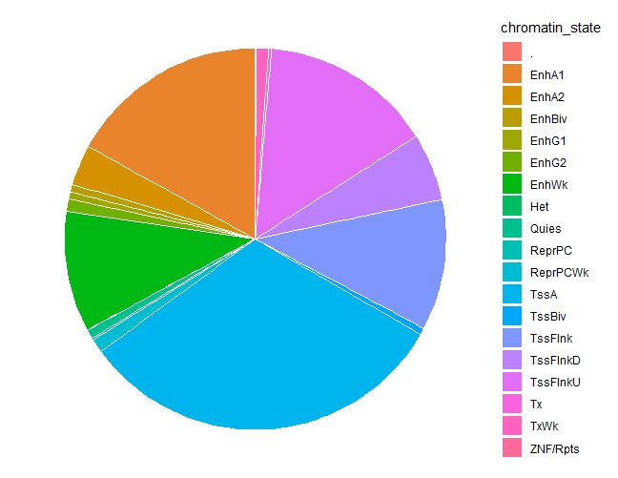
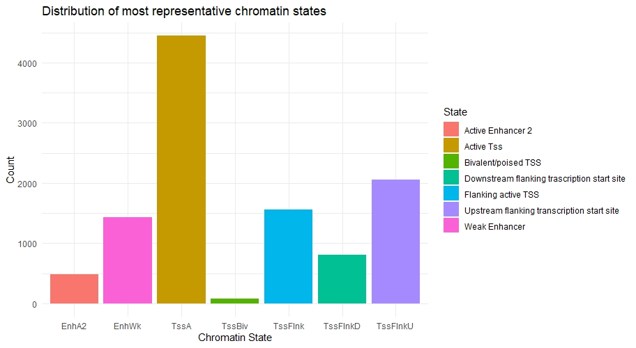
Part 4 – Post-processing
ASSOCIATED CHROMATIN STATES
Pie chart representing all chromatin states associated with each summit via intersection with segmentation annotation.
The figure above depict a barchart showing the distribution of most representative chromatin states associated with my data. It can be seen how the major categories are different TSSs and enhancers promoting transcription.

Slide 11
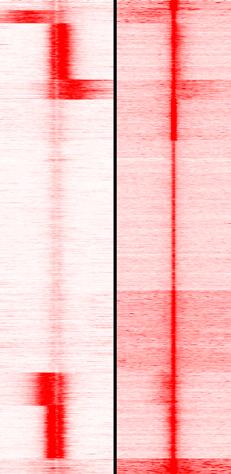
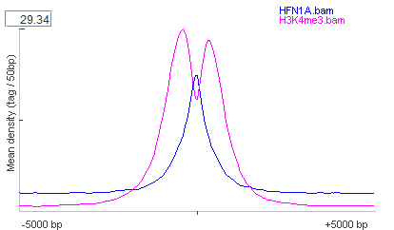
Part 4.1 – Post-processing
In this part of the analysis, seqMiner has been used to plot the distribution of the enrichment of H3K4me3 histone modification for Active TSS state around my data. The same distribution has been computed also for HNF1A transcription factor, since it acts as heterodimer with HNF1B. This combination is also proven by seqMiner results (right heatmap).
H3K4me3
HNF1A

Slide 12
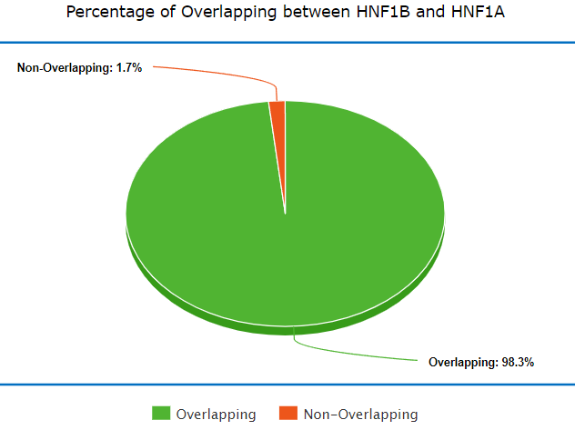
Part 4.2 – Post-processing
SUMMITS OVERLAP WITH ATAC-SEQ RESULTS FOR HEPG2 FROM ENCODE

Slide 13
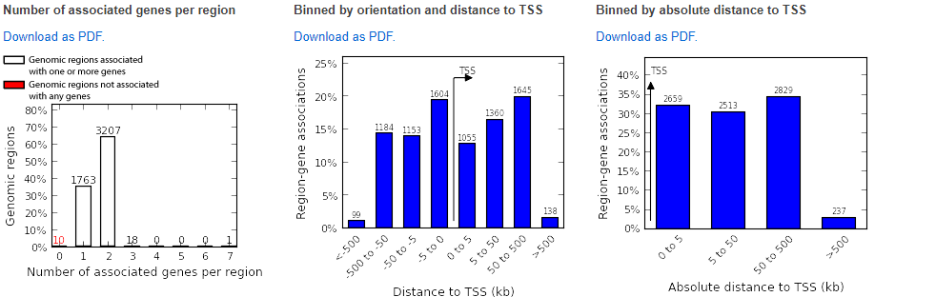
Part 4.3 – Post-Processing - GREAT
Number of Target Genes Promoter bound by HNF1B:
1544
Number of target genes distal regulatory region bound by HNF1B:
2280

Slide 14
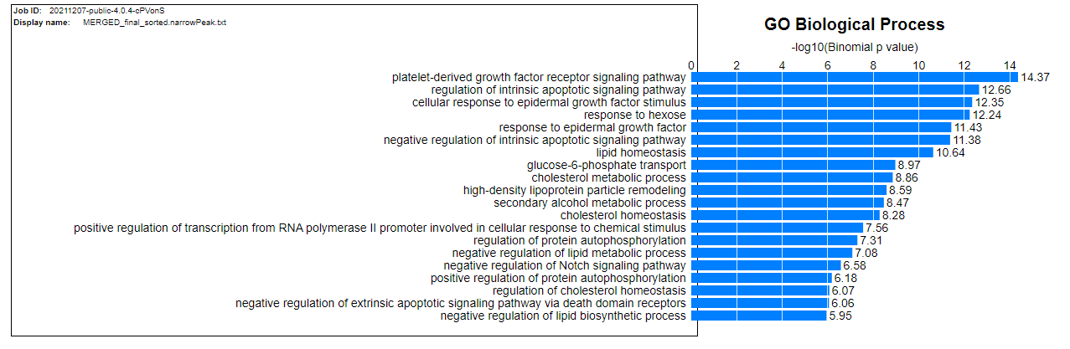
Part 4.4 – Post-processing – GREAT GO functional annotation

