Slide 1
ALV - Reports

Slide 2
ALV:
ALV stands for ABAP List Viewer.
ALV gives us a standard List format and user interface to all our ABAP reports.
ALV is created by a set of standard function modules provided by SAP.
ALV substantially decreases the report development time.
ALV takes care of rendering the list and we can concentrate only on the data retrieval part.

Slide 3
ALV - Simple
DATA: it_spfli TYPE TABLE OF spfli.
SELECT * FROM spfli INTO TABLE it_spfli.
CALL FUNCTION 'REUSE_ALV_GRID_DISPLAY'
EXPORTING
i_structure_name = 'SPFLI'
TABLES
t_outtab = it_spfli.

Slide 4
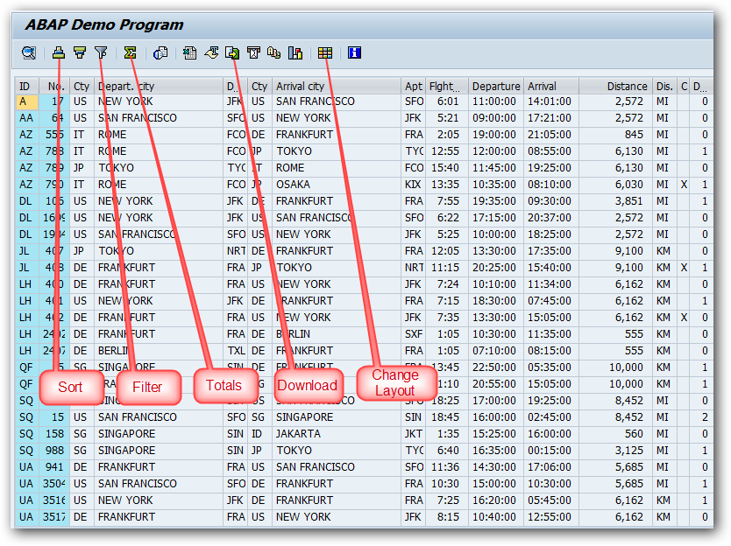

Slide 5
Function modules used to create ALV reports
Some of the function modules used to create ALV reports are listed below.
Function Module | Description
REUSE_ALV_LIST_DISPLAY | Display an ALV list
REUSE_ALV_GRID_DISPLAY | Display an ALV grid
REUSE_ALV_COMMENTARY_WRITE | Output List header information
REUSE_ALV_VARIANT_F4 | Display variant selection dialog box
REUSE_ALV_VARIANT_EXISTENCE | Checks whether a variant exists
REUSE_ALV_FIELDCATALOG_MERGE | Create field catalog from dictionary structure or internal table

Slide 6
An ALV report is created using the standard function modules provided by SAP.
An ALV report can be created using the following steps.
Include SLIS type pool – SLIS type pool contains all the data types required by ALV function modules.
Data retrieval – Code the logic to fetch the data from database table into an Internal Table.
Build Field Catalog – Add the columns into an internal that you want to display in the ALV output list.
Pass the data table and field catalog table to ALV function module

Slide 7
ALV Reports
Create a Simple SAP ALV Report
Field Catalog in SAP ALV
Display Header in ABAP ALV Grid
Display Logo in ABAP ALV Header
Display Subtotal and Total in ABAP ALV Grid
Disable Icons in SAP ALV Toolbar
Currency wise and Quantity wise Totals in SAP ALV
Display Traffic Lights in SAP ALV

Slide 8
Display logo in header:
Use the below steps to display the logo in ABAP ALV header.
First upload the logo that you want to display in ABAP ALV header.
Build the ALV header table.
Pass the TOP-OF-EVENT subroutine name and callback program name to I_CALLBACK_TOP_OF_PAGE and I_CALLBACK_PROGRAM parameters of REUSE_ALV_GRID_DISPLAY function module.
Display the ALV header and logo by passing the ALV header table built in step two and logo that you uploaded in step one to function module ‘REUSE_ALV_COMMENTARY_WRITE’ inside TOP-OF-EVENT subroutine.

Slide 9
Hand In exercise for ALV:
Build a ALV Grid containing: Reuse the components from
Create a Simple SAP ALV Report - SAPHub
Show a Grid with selection screen … paramaters
Display Total and Subtotal for Currency and Quantity
Displaying traffic lights in the grid and using Field catalog.
Display header info and logo picture … picture of the studygroup!

