Slide 1
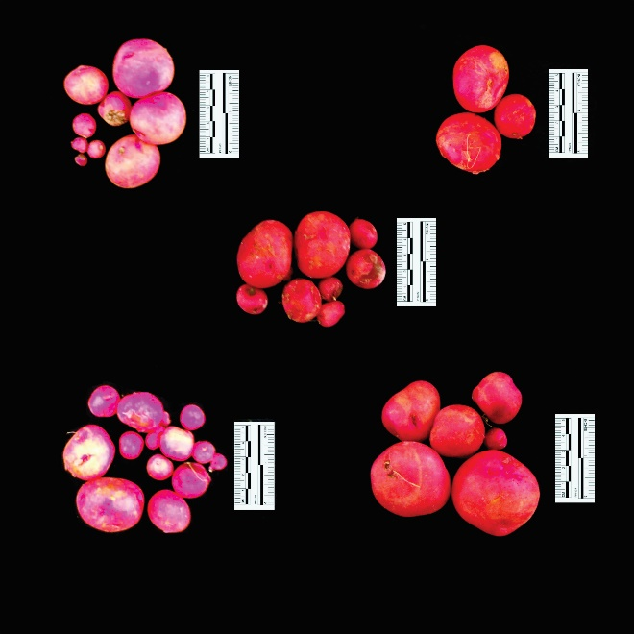
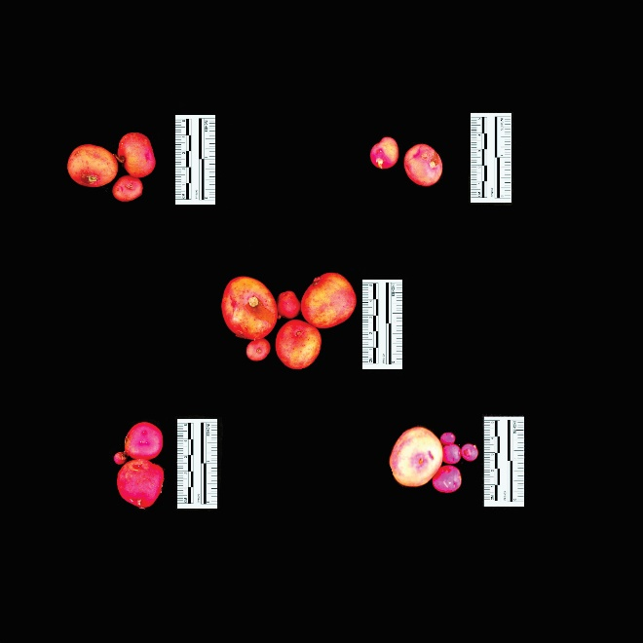
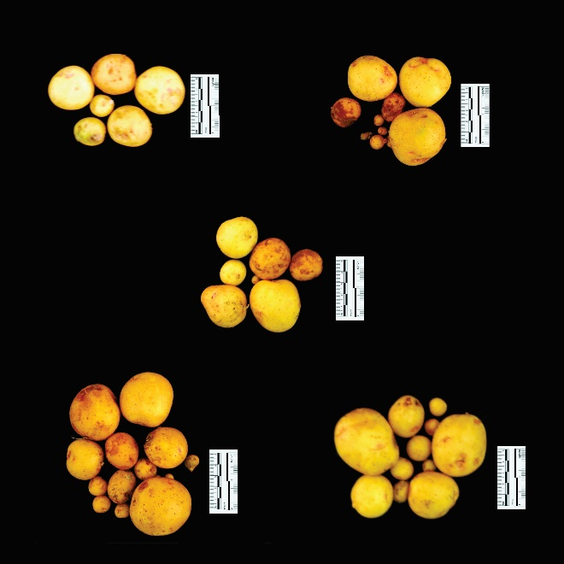
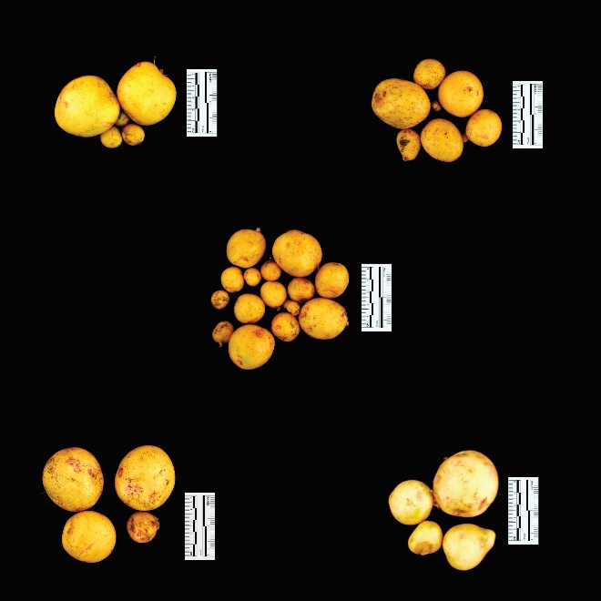
WW
WD
CIP 398203.244
WW
WD
CIP 398190.89
Supplementary Figure 1

Slide 2
Figure 1

Slide 3
Figure 2

Slide 4
Figure 3

Slide 5
Figure 4

Slide 6
Figure 5

