Slide 1

Flavourzilla
Department of Computer Application and Engineering
GLA University, Mathura
Presented by –
Anubhav Nag (181500109)
Kartik Agrawal (181500311)
Tushar Gupta (181500760)
Yash Vardhan Gautam (181500830)

Slide 2
Table of Contents
01
Introduction
04
Technologies Used
02
Problem Statement
05
User Interface Description
03
06
Financial Plan
Objective

Slide 3
Introduction
A Healthy and tasty food is what we all need but unfortunately, everyone does not have the art of making healthy and most important, tasty food.
FLAVOURZILLA will help them by providing a wide range of food recipes of different categories along with videos and required ingredients which will help the user in making delicious and healthy food.
Recipes will be divided into three categories - Meal Timings, Ingredients, and Cuisine. In each category.
The user can find the relevant recipes which will contain an ingredient list, a set of instructions to prepare the food, and a video tutorial that makes understanding easier..
User can manage their profile, rate a recipe, Upload their recipe in the desired category and share their opinion about a recipe which will help in further improvement in recipes.

Slide 4
Problem Statement
We can see a drastic change in an individual's eating habits and taste. Now, people try to do innovations and experiments with raw ingredients.
Everyone wants to have good food in different flavors and tastes but don't know how to prepare it.
Their primary concerns are always about finding the required raw ingredients, their relative quantity, set of instructions to prepare the food.
They have to visit numerous platforms like websites or applications or YouTube which is quite time consuming and hectic.
Many times, people give up their plan of cooking the dish and order it from restaurants because they don't find enough resources which could help them in preparing food.

Slide 5
Objective
The primary objective is to deliver the cooking recipes through an online platform.
It helps to provide recipes from everywhere to anywhere through the internet using this website.
There are numerous cooking websites across the internet which have a wide range of dishes of many categories but there is a limitation of these websites that customers have to search a lot to find a particular dish of their choice, and may not get proper guidance and ingredients to make a perfect dish.
This project focuses on reducing the human effort to find the right dish by making the system more user-friendly by categorizing the whole into many different sections and searching can be done through various factors like ingredients required or by meal timing.

Slide 6
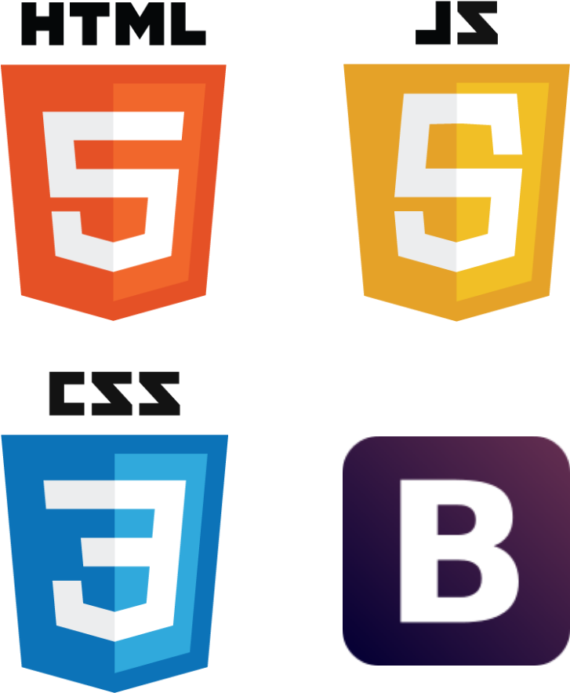

Technologies Used
HTML
CSS
JavaScript
Bootstrap
PHP
MY SQL

Slide 7
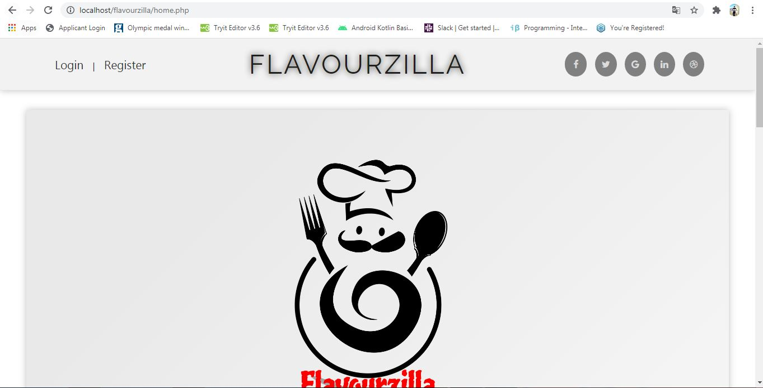
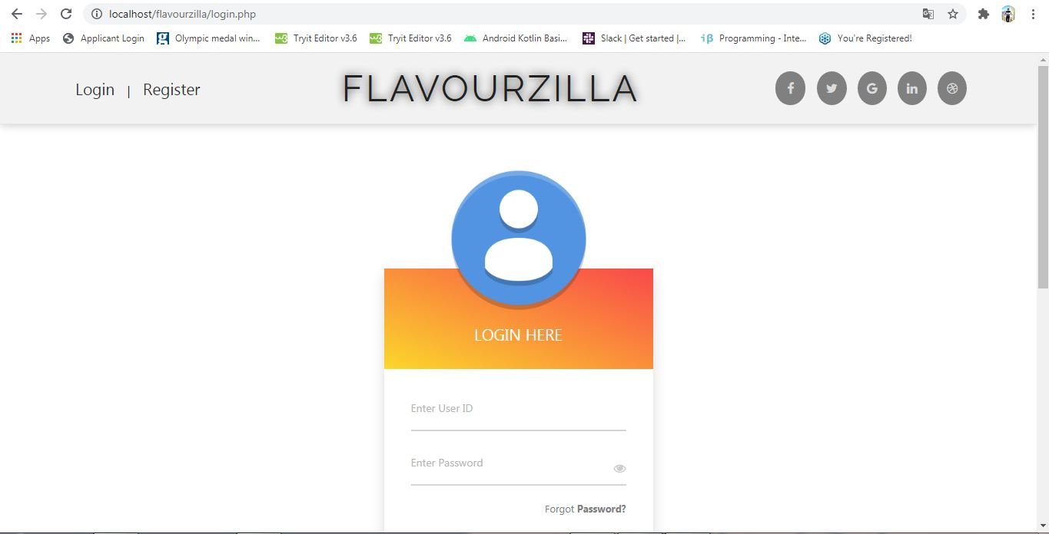
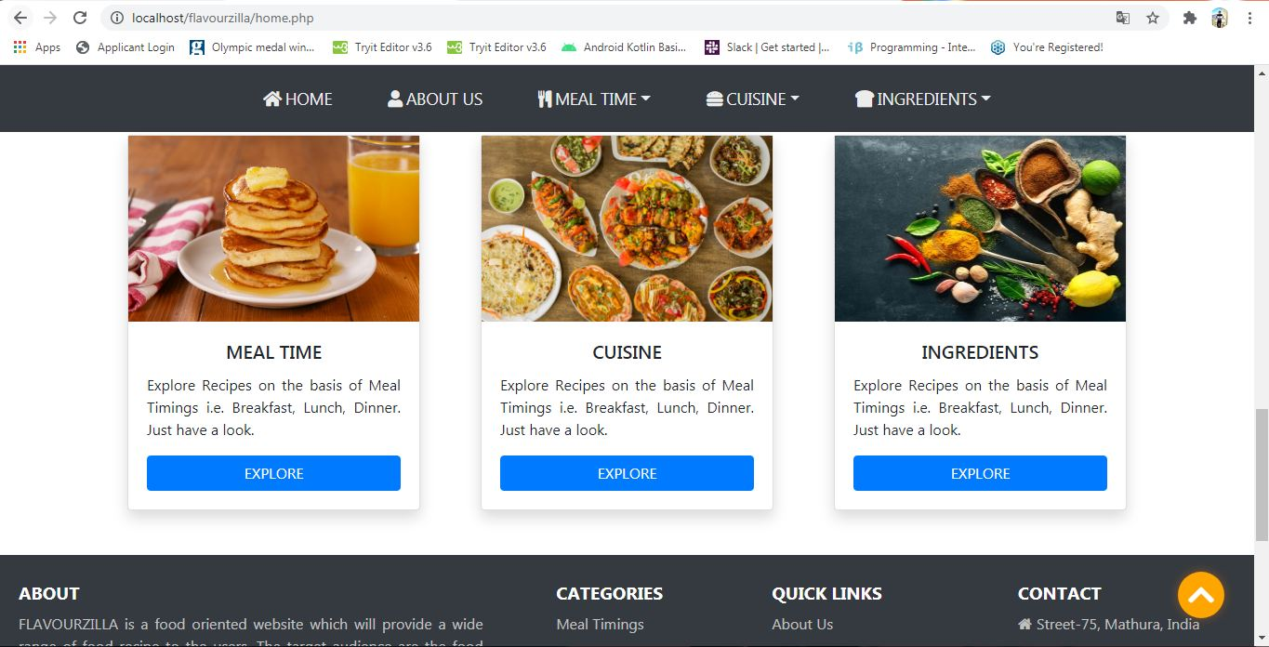
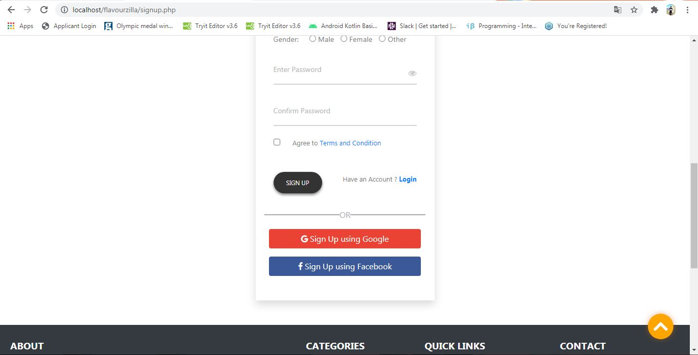
Home Page
Login/Signup Page
User can easily navigate to other pages and get a quick access to newly added recipes
User can easily create their account using email id or he can also login through their social media account

Slide 8
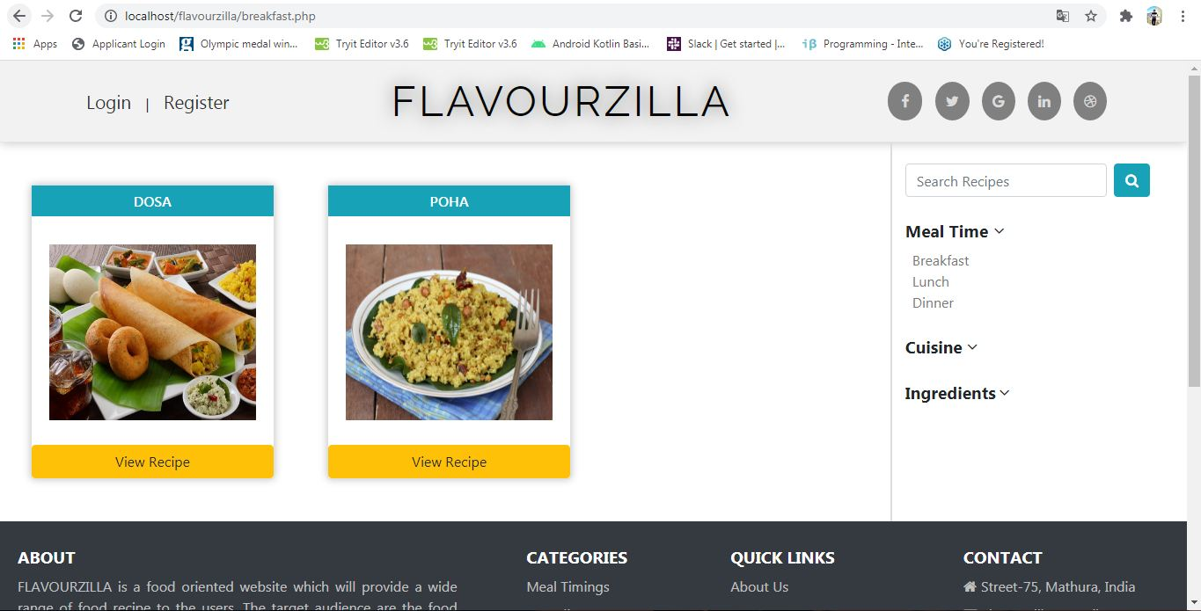
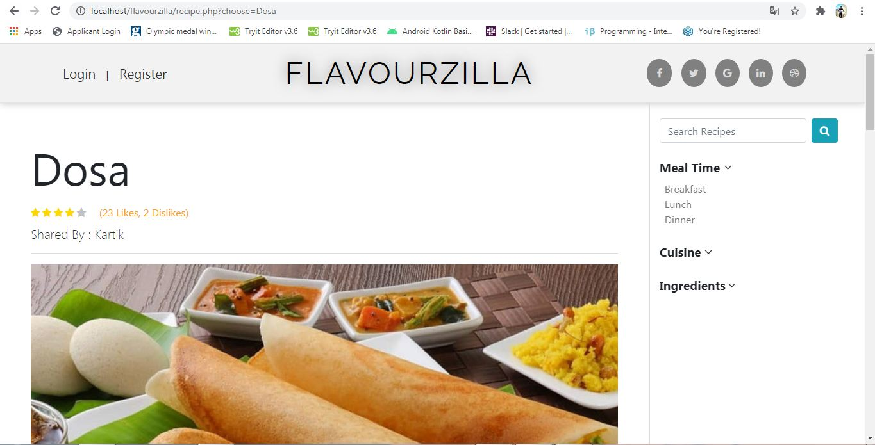
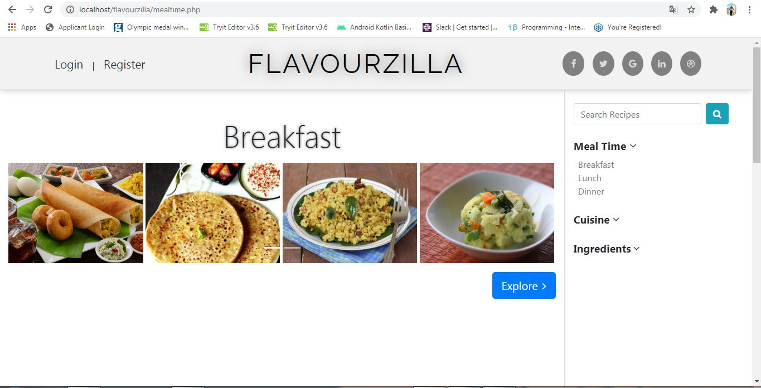
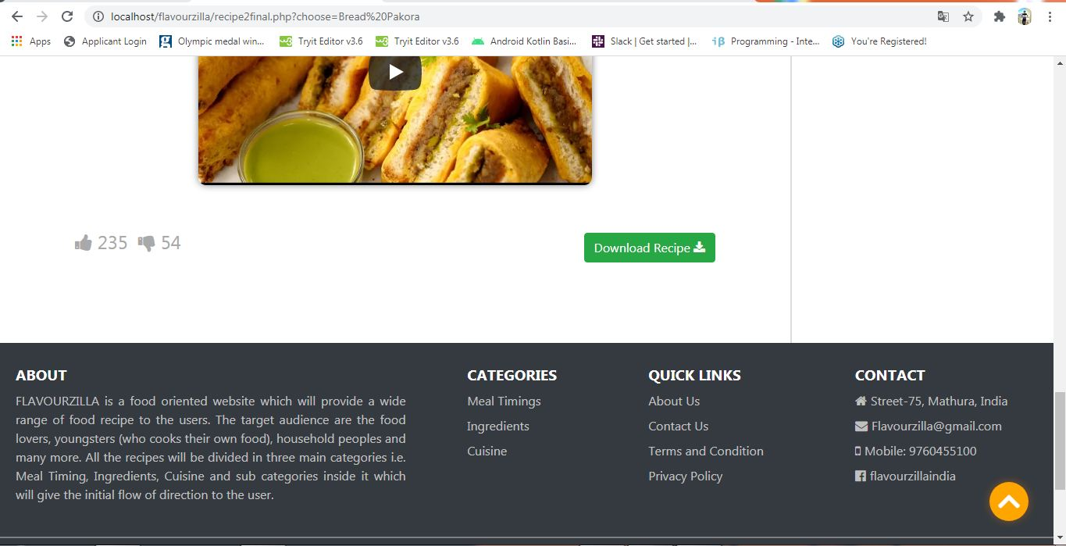
Recipe Categories
Recipe Tutorial
ogin Page
User can select the recipe of their choice from wide range of categories.
User can view the recipe tutorial in text as well as in video format.
He can also download the pdf file.

Slide 9
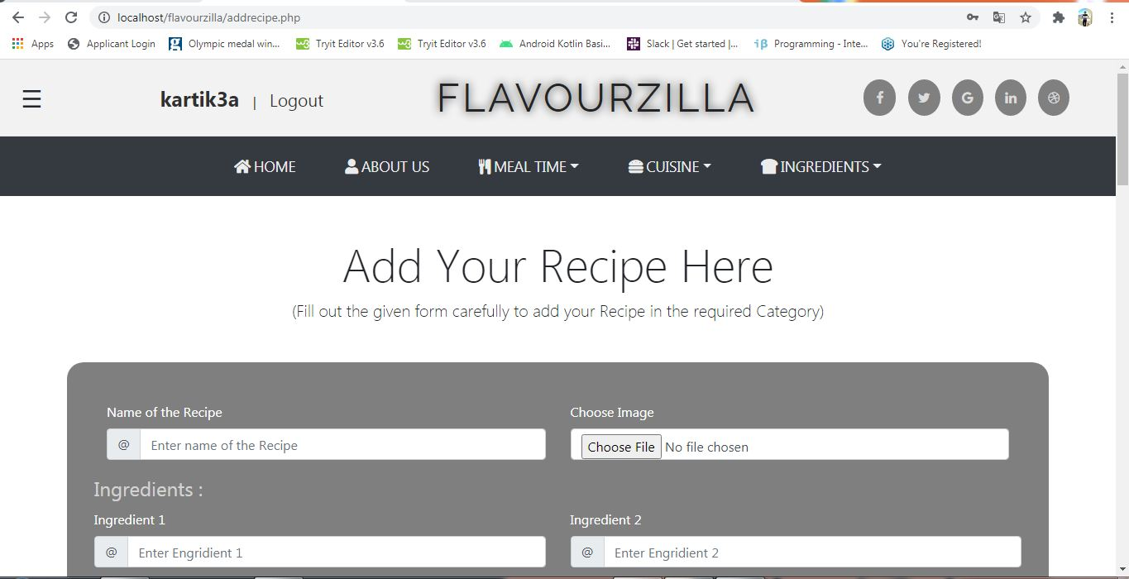
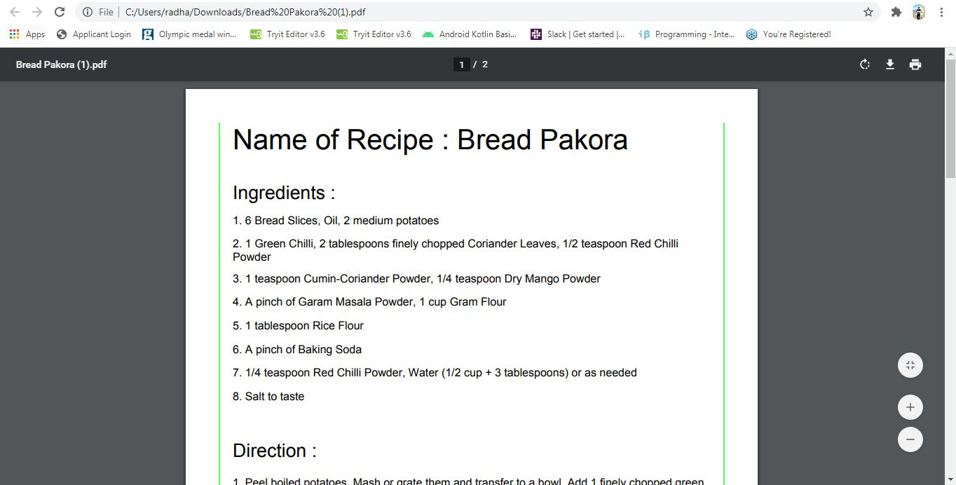
Add Recipe
User can easily add their recipe to the website so that other user also get a chance to explore more and more recipes
Download Recipe PDF
User can download the PDF file of the recipe which can be used in future easily.

Slide 10
Thank You

