Slide 1
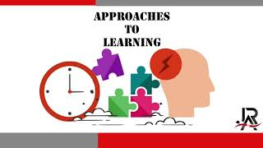

Slide 2
Research Skills
Information literacy (finding and evaluating sources)
Data collection
Ethical use of information
Analyzing and interpreting data
Thinking Skills
Critical thinking
Creative thinking
Transfer of knowledge
Reflection
Problem-solving
ATL (Approaches to learning) Skills
Communication Skills
Exchanging information effectively
Oral, written, and multimedia communication
Listening and understanding perspectives
Self-management Skills
Time management
Organization
Managing state of mind (e.g., mindfulness, perseverance)
Goal setting
Stress management
Social Skills
Collaboration
Building relationships
Working effectively in diverse teams
Conflict resolution

